Slide 1
Adaptive
Office Hours
July 10, 2025

Slide 2
Agenda
FY26 budget - Revenue Reduction Entries in Adaptive
Remaining FY26 Operating Budget Timeline

Slide 3
FY26 Budget – Revenue Reduction
Core Fund Revenue reduction entries have been entered into the FY26 Operating Budget Proposal version in Adaptive.
The total reduction is equal to the required expense reduction, not the actual expense reduction.
  Example: Your unit was directed to reduce expenses by $100,000, but ended up reducing by $102,310. The reduction to your Core Funds Distribution revenue is $100,000, not $102,310.

Slide 4
FY26 Budget – Revenue Reduction
The auto-calculations in Adaptive for merit/unit adjustment have already been included in the total reduction amount.
  Example: Because your unit was able to count $5,000 in expense reduction resulting from the change in unit adjustment/merit towards the $100,000 reduction target, the revenue auto-calc in Adaptive also adjusted your unit’s core fund revenue distribution down by $5,000.
  Core Funds reduction = $100,000
  Exp reduction due to change in unit adj/merit = -$5,000
  Revenue auto-Calc reduction = -$5,000
  Manual reduction remaining = $95,000

Slide 5
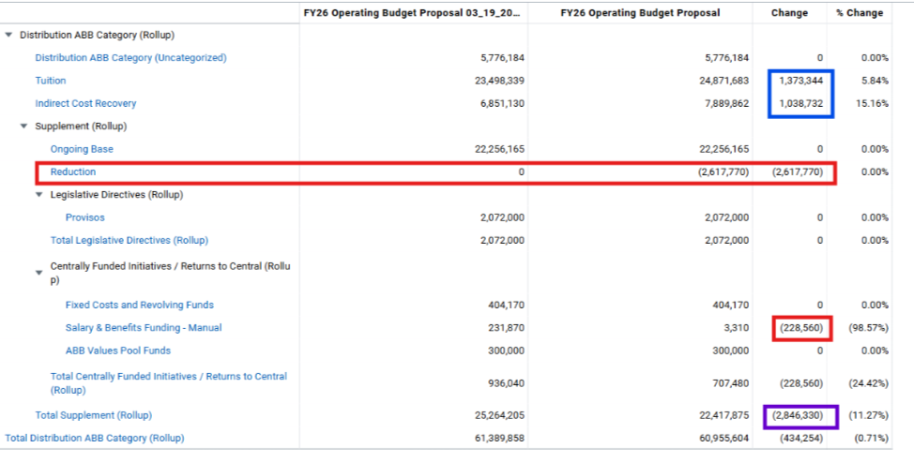
FY26 Budget – Revenue Reduction
Report A1420.6 Version Comparison – Core Funds Revenue Distributions
Tuition rate and ICR changes based on final forecasts from IADS
Net Revenue Reduction = (A) – (B)
Automated Reduction due to S&B assumption changes (B)
Mandated reduction amount (A)

Slide 6
FY26 Budget – Revenue Reduction
Remember to account for other changes in core funds revenue distributions to understand the total in R1320.6.
  Approved Provost Reinvestment Fund (PRF) requests were funded in the final locked version, but were not included at the time of the preliminary lock. Therefore, the total for some units on R1320.6 may not tie to the reduction target.

Slide 7
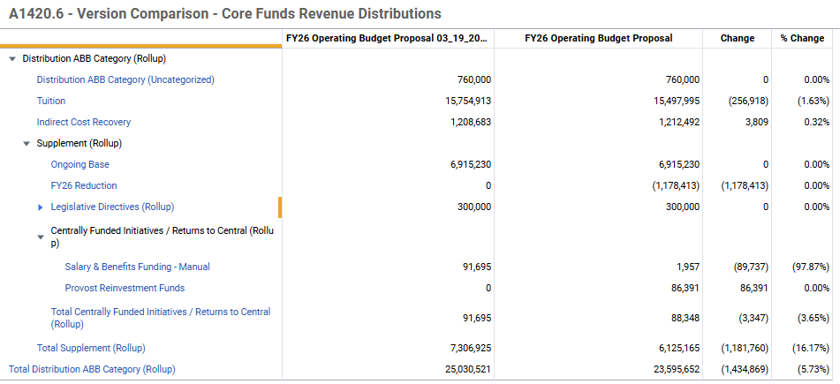
FY26 Budget – Revenue Reduction
Remember to account for other changes in core funds revenue distributions to understand the total in R1320.6.

Slide 8
Remaining FY26 Budget Timeline
Target Date Milestone
Fri, Jul 25 FY26 Operating Budget available in Workday Financials
Thu, Jul 31 Recast open
Thu, Jul 31 Core Funds Distributions processed via Funding Transfer Journal Entries (FTJE) in Workday Financials​
Allocation Reports will be distributed in your unit’s SharePoint folder after posting successfully to Workday.
Beginning Net Position (f/k/a “carryover”) is not an
FTJE processed by Budget, Planning and Operations (BPO)

Slide 9
Questions?

