Slide 1
Adaptive
Office Hours
April 29, 2026

Slide 2
Agenda
PRF Approvals
Terminated/Retired Workers
Historical Pay Rates
Questions?

Slide 3
PRF Approvals
On-cycle PRF Requests have been approved
For non-fixed-cost PRF request:
  BPO is in the process of entering the core fund allocation into Adaptive. Target to complete by early next week.
  We will send out formal announcement via team chat once the entries are completed.
For Fixed Cost PRF request:
  Unit should enter planned expenses using the Program worktag aligned with that fixed cost activity.
  Expense entry in Adaptive should match the PRF request for central funding.

Slide 4
Terminated/Retired Workers
Adaptive automatically transforms worker names in Actuals to NULL if they are retired or terminated
Set up in Adaptive from the start but it can be changed
We would like to change this so terminated/retired worker names come through in Actuals
Are there any downsides to making this change

Slide 5
Historical Pay Rates
We have a solution to the salary and merit increases calculating incorrectly for July/August and Positions losing their Pay Rates
We will load the rate each month into a time span in the Position Roster
Adaptive will use the historical rate to calculate salary as long as the historical rate is loaded
If the period is in the future it will use the regular HRP Full Time Rate or Override Rate.

Slide 6
Historical Pay Rates
Pay attention to the salary
July - November are actual rates stored in the Sheet (Historical Monthly)
After that the Override HRP Rate is used for salary

Slide 7
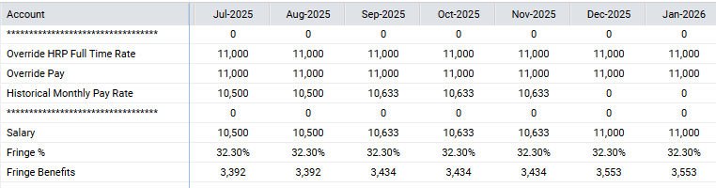

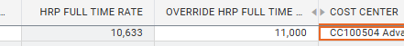
Historical Pay Rates

Slide 8
Questions?

