Slide 1
Adaptive
Office Hours
July 23, 2026

Slide 2
Agenda
Looking ahead to FY28 Budget Development
  No major changes planned (with IBB looming for FY29); keeping the general timeline and materials similar to last year; open to small tweaks that improve the process
Budget Survey Results
Unit Budget Narrative document
  Listening to your feedback! This was mentioned as a challenge by multiple survey responses.
  Discussion – uploading Word docs to shared unit folders vs the MS Form format used last year
Capped at ~30 minutes today (BPO team has a conflict at 10:30am)

Slide 3
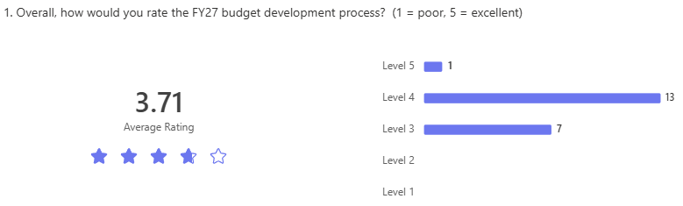
Survey Results – Overall Rating

Slide 4
Survey Results – What Worked?
Dashboards
Reports
Data Stability
Evergreen version
Communication
Office Hours
Teams Chat
BPO team responsiveness

Slide 5
Survey Results – Challenges
Missing Salary Data, missing positions, Hiring Plan, and communication between HR and BPO
Desire for more reports and more detailed reports
MS Forms for narrative was problematic

Slide 6
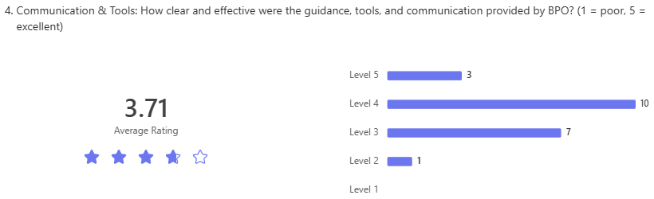
Survey Results – Communication & Tools

Slide 7
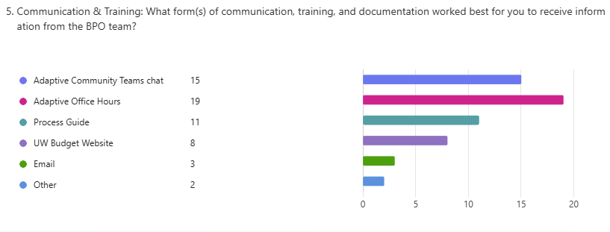
Survey Results – Communication & Tools

Slide 8
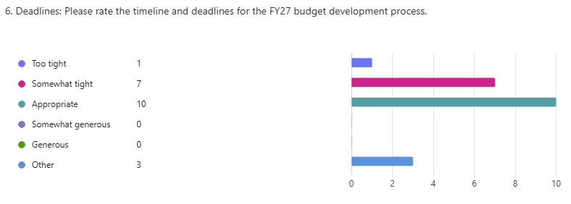
Survey Results – Deadlines

Slide 9
Survey Results – Looking Ahead
Open to Considering summary "cube sheets"
  12 YES responses; 12 Unsure responses; zero NO responses
  BPO team will continue to explore...
What other Improvements do you want to see?
  Continue with office hours and support from BPO team
  Budget Narrative doc – no more MS Forms
  Better ability to paste data into Adaptive
  Job Aids – on how to enter data, when to use opposite sign (+/-)
  Could we start the kick-off earlier?
  Balance sheet / cash flow views

Slide 10
Unit Budget Narrative document
Unit Budget Narrative document
  Listening to your feedback! This was mentioned as a challenge by multiple survey responses.
  Discussion – uploading Word docs to shared unit folders vs the MS Form format used last year

Slide 11
Questions?

