Slide 1
Equipment Capitalization Threshold Change Information Session
June 29, 2016 UW TOWER AUDITORIUM
TOPIC | PRESENTER | CONTACT | MIN
Overview | Erin Fujiwara Assistant Director, Equipment Inventory Office | 206 543-9859 efuji@uw.edu | 5
Equipment Object Codes Changes | Erin Fujiwara Assistant Director, Equipment Inventory Office | 206 543-9859 efuji@uw.edu | 5
Sponsored Projects | Carol Rhodes Acting Co-Director, Office of Sponsored Programs Kirsten Defries Director of Campus Services, Grant and Contract Accounting | 206 543-2139 carhodes@uw.edu 206 543-2597 kirsten5@uw.edu | 5
Ariba Changes | Heather Nicholson Instructional Specialist, Procurement Services and MyFD | 206 685-0377 hlnichol@uw.edu | 5
Q&A Session | Mike Anthony, Management Accounting & Analysis Erin Fujiwara, Equipment Inventory Office Carol Rhodes, Office of Sponsored Programs Kirsten DeFries, Grant and Contract Accounting Heather Nicholson, Procurement Services Robert Bradshaw, Financial Reporting |  | 40

Slide 2
Equipment Threshold Change Overview
June 29, 2016
Erin Fujiwara
Equipment Inventory Office
University of Washington

Slide 3
Equipment Threshold Change
Effective 7/1/2016, UW’s equipment capitalization threshold will increase from $2,000 to $5,000
Equipment over the threshold is
Capitalized,
Depreciated,
Tagged,
Tracked and
Inventoried

Slide 4
Equipment Threshold Change
Considerations for the change:
Anticipated reduction of administrative burden for faculty and staff
Resolves threshold alignment issues between UW, the Federal government and the State of Washington
Inventory process is manual and paper-intensive
Our top 24 research peers have increased their respective thresholds to $5,000
Eliminates the previous inconsistent treatment of recharge/cost center equipment ($5K) with the non-recharge/cost center equipment($2K)

Slide 5
Equipment Threshold Change
Assets in targeted range ($2,000 - $4,999) represent:
Only 13% of the total value of inventory
Over 65% (40,000 count) of items in total inventory
Over 60% (3,300 count) of equipment items purchased in FY 2013 were between the $2,000 and $4,999 range

Slide 6
Equipment Threshold Change
Participants involved in decision making process
Faculty Council on Research
Research Advisory Board
Associate Deans for Research
Post-award Administrative Advisory Group
Office of Research
Office of Sponsored Programs
Office of Planning and Budgeting
Financial Accounting
Research Accounting and Analysis

Slide 7
Equipment Threshold Change
Changes for existing assets under $5,000
Assets with a remaining net book value will remain active and continue to depreciate annually
Mass update of new titles in Oasis
Retirement of items with $0 net book value at the beginning of each fiscal year for the next 5 fiscal years (FY17 – FY22)
Assets will not be included in future physical inventory and federal property reports
Active assets can be viewed in Oasis through ad-hoc reports

Slide 8
Equipment Threshold Change Object Code Changes
June 29, 2016
Erin Fujiwara
Equipment Inventory Office
University of Washington

Slide 9
Equipment Threshold Change Object Code Changes

Slide 10
Equipment Threshold Change Object Code Changes
Equipment Expense Object Codes for State and Non-Grandfathered Award Budgets
Object Code Description
05-40 Non-capitalized Equipment (less than $5,000)
05-41 Non-capitalized Equipment - M&E Tax Exemption ($200 - $4,999)
* These are existing equipment object codes
* Considered non-capital equipment, will be included in the indirect cost calculation and charged F&A

Slide 11
Equipment Threshold Change Object Code Changes
New Equipment Expense Object Codes for Grandfathered Award Budgets
Object Code Description
05-47 Non-capitalized Equipment ($2,000 - $4,999) – Grandfathered Awards
05-48 Non-capitalized Equipment ($2,000 - $4,999) –
M&E Tax Exemption – Grandfathered Awards
* New object codes are available in the Sage budget module
* Will be available to use in Ariba on 7/1/2016 for grandfathered award budgets only
* Considered non-capital equipment, but will be excluded from indirect cost (F&A)
calculation

Slide 12
Equipment Threshold Change Object Code Changes
Starting 7/1/2016, the following Equipment Object Codes will no longer be available
Object Code Description
06-10 Computing Equipment ($2,000 - $4,999)
06-12 Computing Equipment ($2,000 - $4,999) – M&E Tax Exempt
06-14 Computer Cluster ($2,000 - $4,999)
06-16 Computer Cluster ($2,000 - $4,999) – M&E Tax Exempt
06-90 Other Equipment Non-computing ($2,000 - $4,999)
06-92 Other Equipment Non-computing ($2,000 - $4,999) - M&E Tax Exempt

Slide 13
Equipment Threshold Change Sponsored Projects
June 29, 2016
Carol Rhodes and Kirsten DeFries
Office of Sponsored Programs and Grant and Contract Accounting
University of Washington

Slide 14
Equipment Threshold Change Sponsored Projects
Existing $2,000 threshold will apply to the following:
Existing funding
Non-competing renewals
Funding received in response to proposals with eGC-1 approval prior to May 1, 2016 (even if start date is 7/1/16 or later)
Will be referred to as “Grandfathered Awards”

Slide 15
Equipment Threshold Change Sponsored Projects
New $5,000 threshold will apply to the following:
Proposals for new, competing renewal, and supplemental funding with an eGC-1 approval date on or after May 1, 2016.
Budgets submitted with these proposals must categorize items with an acquisition cost of $5,000 or more and a useful life exceeding one year as equipment.
Indirect cost (F&A) must be calculated on all non-capital equipment/supplies with an acquisition cost under $5,000.

Slide 16
Equipment Threshold Change Sponsored Projects
New Equipment Expense Object Codes for Grandfathered Award Budgets
Object Code Description
05-47 Non-capitalized Equipment ($2,000 - $4,999) – Grandfathered Awards
05-48 Non-capitalized Equipment ($2,000 - $4,999) –
M&E Tax Exemption – Grandfathered Awards
* New object codes are available in the Sage budget module
* Will be available to use in Ariba on 7/1/2016 for grandfathered award budgets only
* Considered non-capital equipment, but will be excluded from indirect cost (F&A)
calculation

Slide 17
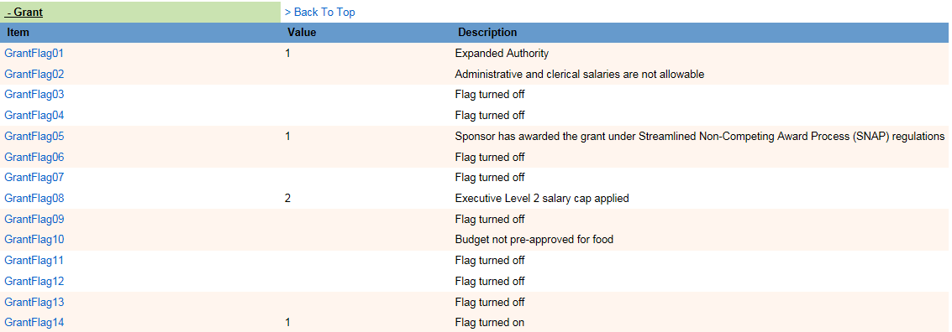
Equipment Threshold Change Sponsored Projects
Identifying Grandfathered Award Budgets
MyFD Budget Profile > Grant Section > Grant Flag 14

Slide 18
Equipment Threshold Change Ariba Changes
June 29, 2016
Heather Nicholson
Procurement Services
University of Washington

Slide 19
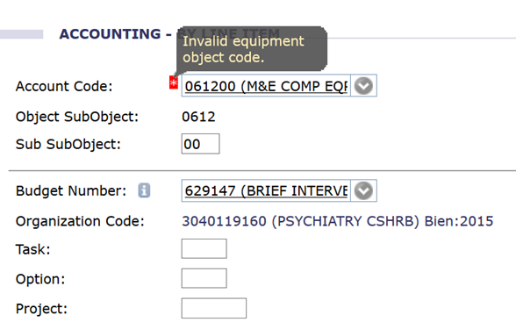
Equipment Threshold Change Ariba Changes
Starting 7/1/2016, the following Equipment Object Codes will no longer be available to use in Ariba.
Object Code Description
06-10 Computing Equipment ($2,000 - $4,999)
06-12 Computing Equipment ($2,000 - $4,999) – M&E Tax Exempt
06-14 Computer Cluster ($2,000 - $4,999)
06-16 Computer Cluster ($2,000 - $4,999) – M&E Tax Exempt
06-90 Other Equipment Non-computing ($2,000 - $4,999)
06-92 Other Equipment Non-computing ($2,000 - $4,999) - M&E Tax Exempt

Slide 20
Equipment Threshold Change Ariba Changes
New $5,000 threshold will apply to:
Purchase orders (BPO and EI)
Non-PO Invoices
eReimbursements
The approval date will determine which threshold will apply.
The $2,000 threshold will apply if fully approved prior to July 1, 2016, with the equipment object code “06”
Anything executed on or after July 1, 2016 will be subject to the new $5,000 threshold.

Slide 21
Equipment Threshold Change Ariba Changes
Purchase Order Approval Clarification
*The $2,000 threshold will apply in cases where a purchase order has been fully executed (EI or BPO number issued) prior to July 1, 2016 regardless of when the equipment is paid for and/or received.
*We recommend submitting requisitions early to ensure the buyers have adequate time to work through any contracting and compliance issues
*Check Ariba to ensure outstanding requisitions and contract requests have been processed
*Requisitions that are not fully executed on July 1, 2016, will be subject to the new $5,000 threshold

Slide 22
Equipment Threshold Change FAQ’s
Frequently asked questions including the initial announcement are available on the EIO’s website:
https://f2.washington.edu/fm/eio/new-equipment-threshold

Slide 23
Equipment Threshold Change Contact Information
Equipment Inventory Office (EIO) – eio@uw.edu
for questions related to equipment management, Oasis changes,
physical inventory, depreciation and purchase of new equipment
Office of Sponsored Programs (OSP) – osp@uw.edu
for questions related to proposals, awards, sponsors, applications and proposals
Grant and Contract Accounting (GCA) – gcahelp@uw.edu
GrantTracker: http://www.washington.edu/research/gca/budget/granttracker.html
for questions related to application of F&A rates and base and grant flag for grandfathered awards
Management Accounting and Analysis (MAA) – mda1213@u.washington.edu
for questions related to F&A rate calculation, direct and indirect cost
Procurement Services – pcshelp@uw.edu
for questions related to purchasing, purchase orders and Ariba
Office of Research Information Services (ORIS) – oris@uw.edu
for questions related to Sage
Financial Reporting (FR) - accountg@uw.edu
For questions related to general accounting and financial reporting

