Slide 1
MRAM | Monthly Research Administration Meeting
January 9, 2025, 9:00 AM – 10:00 AM
Join Webinar: https://washington.zoom.us/j/346891888
Click “CC” to Show Captions in your Zoom Controls
TOPIC | PRESENTER | EMAIL | MIN
Welcome | Kirsten DeFries Research Compliance & Operations | kirsten5@uw.edu | 2
Compliance and Ethics Week Promo | Emily Lemieux Records Management Services | elemieux@uw.edu | 5
Diversity in Clinical Trials | Jason Malone Human Subjects Division | jmmalone@uw.edu | 10
OSP Update | Carol Rhodes Office of Sponsored Programs | carhodes@uw.edu | 10
NIH: Controlled- Access Genomic Data & NIST SP 800-171 | Carol Rhodes Office of Sponsored Programs | carhodes@uw.edu | 10
Research Security Update- Malign Foreign Talent Recruitment Programs Prohibition & Statement | Carol Rhodes Office of Sponsored Programs | carhodes@uw.edu | 10
CORE Update | Laurie Stephan Collaborative On Research Education (CORE) | corehelp@uw.edu | 2
NEXT MEETING
February 13, 2025 9:00 AM - 10:00 AM
Questions about MRAM? email mramques@uw.edu

Slide 2
REMINDER RESOURCES
Award Setup & Modification Requests
What do I do if I received a Notice of Award?
Review Checklist: Award Setup Request Steps for PI/Campus
Read Comments & History before contacting OSP/GCA
Always include relevant attachments
MODs: Review OSP/GCA MOD Checklist and GCA Only MOD Checklist
Tell OSP your ASR/MOD story
Need to change a Grant Name in WD? - Send GCA Only MOD
SAGE Budget Resources and SAGE Awards & Mods Resources
SAGE Office Hours Schedule

Slide 3
Compliance and Ethics Week Promo
MRAM
January 2025
Emily Lemieux
Records Management Services

Slide 4
Compliance and Ethics Week (1 of 2)
Coffee & Compliance: Conversations covering a range of topics with our partner offices
Compliance & Ethics Week Tasks: Tangible steps you can take to up your compliance game in 2025
Partner Offices Links: Review this wealth of information on important topics from across the UW

Slide 5
Compliance and Ethics Week (2 of 2)
2/10 Monday 10am: Live Records Clean-Out
2/11 Tuesday 10am: What's Wrong Here?
2/11 Tuesday 3pm: Digital Accessibility
2/12 Wednesday 10am: What's the deal with UW Medicine Records Management & Information Governance?
2/13 Thursday 10am: Where Research Compliance Supports Ethical Research
2/14 Friday 10am: Vital Records and Business Continuity

Slide 6
UW Diversity in Clinical Trials Initiative: Update
MRAM
January 2025
Jason Malone
Human Subjects Division

Slide 7
Legislation in Brief (SSHB 1745, 2023)
Improve completeness and quality of data concerning diverse demographic groups that is collected, reported and analyzed for clinical trials
Identify barriers to participation for underrepresented demographic groups and employ strategies recognized by FDA to encourage greater participation
Make data concerning demographic groups that is collected, reported, and analyzed for the purposes of clinical trials more available and transparent
Require institutions within WA State to adopt a policy that requires researchers to:
Identify and recruit persons from unrepresented demographic groups
Collaborate with community-based organizations
Use recruitment methods recognized by the FDA
Provide translation & interpreter services for individuals with non-English language preference
Provide culturally specific recruitment materials
Provide option for electronic consent
MRAM – Jason Malone - HSD
Notes:
Recall that in 2023, WA State legislature passed the Diversity in Clinical Trials law to improve participation of underrepresented demographic groups in clinical trials.
Part of the law required that institutions like UW develop a policy that requires researchers to… [REVIEW Slide]

Slide 8
Diversity in Clinical Trials - UW Policy
Announced in the January 7, 2025, HSD e-newsletter
https://www.washington.edu/research/announcements/for-the-record-january-7-2025-dct-guidance-revised-short-form-policy-more/#a1
Diversity Plan and associated guidance available on HSD website
Policy effective date: January 1, 2026
MRAM – Jason Malone - HSD
Notes:
After 1.5 years of development with input from a variety of interested parties across our research community, we have finalized and published our institutional policy including associated guidance.
If you navigate to our newsletter article you can click links to the guidance on our website. There is also a document that summarizes all the feedback we received from the research community and how we addressed that in the final policy.
The effective date of the policy, however, is not until January 1, 2026.

Slide 9
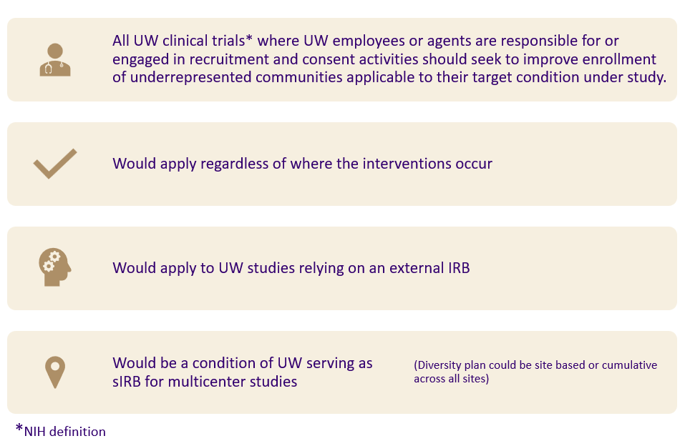
Scope Reminder: UW Policy
MRAM – Jason Malone - HSD
Notes:
A quick refresher on the UW’s policy scope. The UW Diversity in Clinical Trials policy would apply to… [REVIEW Slide]

Slide 10
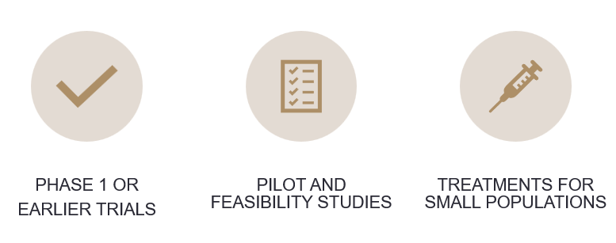
Justified Exclusions
MRAM – Jason Malone - HSD
Notes:
We also carved out types of clinical trials that would generally NOT be subject to the DCT requirements.

Slide 11
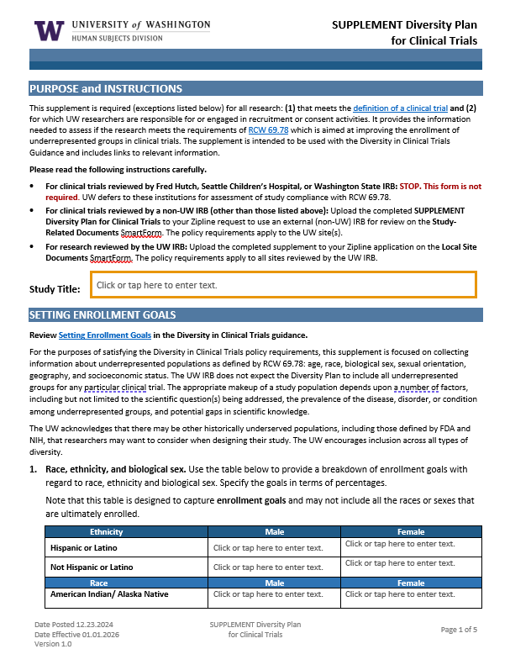
HSD Supplement – Diversity Plan
Establishing Enrollment Goals - age, race, ethnicity, biologic sex, sexual orientation, geographic location (probably zip codes), social economic status (several variables, TBD)
Rationale for current enrollment goals and any exclusions
Strategy for meeting enrollment goals (e.g., study design, recruitment, and retentional plan, reducing barriers to participation
Description of efforts/resources utilized for community engagement that informs recruitment strategy
Plan for tracking enrollment data
MRAM – Jason Malone - HSD
Notes:
So, what will researchers have to do? Starting on January 1, 2026, any researcher who submits a new clinical trial application to HSD (either for UW or external IRB review) will be required to develop a diversity plan.
HSD has developed a new supplement for this. We chose to do a supplement versus incorporate the questions into our IRB Protocol Form because only about 12% of our total research portfolio is comprised of clinical trials that are subject to the DCT requirements.
The plan is modeled after FDA’s proposed diversity action plan, which should make it easier for FDA-regulated studies to utilize a Sponsor’s existing plan.
The diversity plan solicits information in 5 areas… [REVIEW Slide]

Slide 12
Researcher Implications
More staff FTE needed to:
Identify and recruit underrepresented populations
Engaged with targeted communities
Develop culturally specific recruitment materials
Provide e-consent option
Track and report on enrollment metrics
More funding to cover costs associated with:
Translation and interpreter services
Culturally specific recruitment strategies/materials
Reimbursement for participation expenses to reduce barriers (e.g., travel, parking, childcare)
Possible IRB review fees (e.g., commercial IRB review)
MRAM – Jason Malone - HSD
Notes:
In order to implement the DCT requirements, researchers will need more time and money. Some of the specific implications include: [REVIEW Slide]
It is because of these requirements that we have published our policy and guidance a year in advance so that researchers have time to plan and budget for the additional costs.
After 1/1/26, new study submissions for studies subject to the DCT policy will be expect to comply. Insufficient funding will generally not be an acceptable justification for excluding participants from underrepresented communities.

Slide 13
What’s Next? – HSD Timeline
Publication of final diversity plan, policy, and guidance (Jan. 2025)
Pilot pre-award planning* (Jan.-Jun. 2025)
Update other associated HSD forms, policy, and guidance (Jan.-Aug. 2025)
Training and dissemination (Oct.-Dec. 2025
MRAM – Jason Malone - HSD
Notes:
So, what’s next? HSD is planning to do a lot of outreach to message the new requirements to affected researchers.
We have been working with ORIS and OSP to develop a report out of SAGE that will identify new applications for funding that are being submitted for CTs subject to the DCT requirements. We intend to reach out to those researchers directly to educate them about the requirements and offer assistance to a subset of them in piloting the development of an appropriate diversity plan, in coordination with new resources that are being stood up at UW.
Internally we have to update our other existing forms, guidance, and policies to align with the DCT requirements and develop training and guidance for staff and IRB members on how to review the plans.
We also need to work with our commercial IRB partners WCG and Advarra to ensure they have a review process in place.
We will need to have all of these things completed by December of this year so we’re ready to start receiving/reviewing diversity plans next January

Slide 14
Other DCTI Activities
Community Collaboratory – community engagement
UW Libraries/ITHS target population identification service
ITHS Recruitment Support Service
Centralized admin support for translation/interpreter services
Translation support for unfunded/underfunded studies
More e-consent options
Centralized institutional enrollment reporting
MRAM – Jason Malone - HSD
Notes:
Outside of HSD there are several other groups working on establishing additional resources to support researchers. Some of these include… [REVIEW Slide]

Slide 15
Additional Info & Questions
ITHS DCTI Website: https://www.iths.org/dcti/?mkt_tok=MTMxLUFRTy0yMjUAAAGX3ShNtffpAveEMTAg9q_QGVWoot8MtvyPMUoOReG3PUAy32PQ0U6j0Dxf0pfgkICLdRcnOuA7XK6U-SbxvxWK
HSD e-newsletter: https://www.washington.edu/research/manage-your-office-of-research-subscriptions/#hsd-newsletter
Contact HSD: hsdinfo@uw.edu
MRAM – Jason Malone - HSD
Notes:
Outside of HSD there are several other groups working on establishing additional resources to support researchers. Some of these include… [REVIEW Slide]

Slide 16
OSP Update
January 2025 MRAM
Carol Rhodes, Director
Office of Sponsored Programs

Slide 17
OSP Using Workload Status Reports
Priority given to items 60+ days in OSP
60+ numbers look steady ~ things move in and out
Examples: Negotiating with sponsors, Clinical Trials, Waiting on Compliance Approvals (IRB/Export Control/IACUC…etc.)
Items that need campus action: Will be returned with prefixes in front of the comment to categorize the type of change needed
Items on hold OSP: Placed on HOLD with comments for reason(s) on HOLD e.g. waiting on sponsor edits, sponsor signature, etc.
OSP ASR Return Reasons: https://www.washington.edu/research/myresearch-lifecycle/setup/financials/#why-asr-returned

Slide 18
Subaward Escalation Process
Extended through March
OSP and Dean’s offices using subaward escalation process.
Setup Subawards
https://www.washington.edu/research/myresearch-lifecycle/setup/subawards/#first-steps

Slide 19
Staffing Update
Proposals & Awards:
12/09: two temporary Program Coordinators started
12/10: temporary Grant and Contract Analyst started; focus on federal grants & pass-through awards & modifications
1/22 new Grant and Contract Analyst starts
Subawards Four Open Positions:
Two temporary Subaward Administrator positions - interviewing
Backfill of two permanent positions - finalists stage

Slide 20
ASR & MOD Update as of 1/06
ASR/MOD #s (week over week)
Total with OSP: 583
% change from last week: -2.7%
Arrived past week: 85
Approved & assigned to GCA past week: 110
Returned past week: 52
Work in Progress - Days in Status of OSP Assigned / OSP Setup
0-15: 146
16-30: 135
31-60: 110
61+: 192
Volume: https://www.washington.edu/research/osp/about-osp/osp-volume/

Slide 21
Subaward Update as of 1/06
Subaward #s (week over week)
Total with OSP: 933
% change from last week: .2%
In OSP: 602
Assigned: 55
Issued: 276
https://www.washington.edu/research/osp/about-osp/osp-volume/

Slide 22
Resources
OSP ASR Return Reasons
Subaward Escalation
Urgent Requests OSP Requests - ASRs, MODs, Subawards
OSP Volume- ASR, MOD, Subaward
ASR Checklist for PIs & Campus
OSP/GCA Modifications in SAGE - Checklist
Award Changes
Tell OSP your story
Setup Subawards

Slide 23
Questions

Slide 24
NIH: Controlled-Access Genomic Data and
NIST SP 800-171
January 2025 MRAM
Carol Rhodes, Director
Office of Sponsored Programs

Slide 25
Effective 1/25/2025
Projects working with or need access to controlled-access human genomic data will need to comply with NIST SP 800-171 requirements.
NIST SP 800-171 compliance required of :
Approved users of controlled-access human genomic data from NIH controlled-access data repositories. Impacts data access requests to dbGaP.
Developers who test platforms, pipelines, analysis tools, and user interfaces that store, manage, and interact with human genomic data from NIH controlled-access data repositories as well as provide infrastructure development and repository maintenance.
See NIH NOT-OD-24-157 & review NIH security best practices for users of controlled-access data.
Notes:
Not covered - NIST SP 800-53 security requirements

Slide 26
Requesting Access to
Controlled-Access Genomic Data
Researchers must have :
Unit specific IT system or a license to UW’s third-party computing infrastructure compliant with NIST SP 800-171.
An appropriate IT Director identified who has firsthand knowledge of the IT system that will be used.
UW-IT will maintain list
These IT Directors must be consulted by researcher
A System Security Plan (SSP) reflecting assessment complete.
Notes:
dbGap Provides two levels of data, Open or Controlled data.
Requesting datasets from dbGaP includes steps within the eRA Commons as well as within SAGE.

Slide 27
Compliant IT Environments
UW-IT is contracting with a third-party to provide an NIST SP 800-171 compliant environment for UW use. Researchers:
Will be able to access this environment through a license
Can estimate licensing, compute & data capacity costs via resources on UW-IT website.
Three campus units provide their own researchers with unit-specific IT environments that are NIST SP 800-171 compliant, for a fee.
Applied Physics Laboratory
Dept. of Medicine
Center for Studies in Demography & Ecology - UW Data Collaborative (UWDC) and general infrastructure
Notes:
Work with IT director over the unit specific environments to understand cost

Slide 28
IT Director Requirements
Each IT environment must identify and have an IT Director who has firsthand knowledge of the IT system that will be used.
dbGap Controlled Access Genomic Data Requests -
IT Directors must be identified in request
IT Directors must be consulted by researcher before requesting access or naming them on an dbGap Access Request form
UWIT will maintain a list of IT Directors
Stay tuned for more details on process

Slide 29
System Security Plan (SSP)
Includes a variety of required components and reflects an assessment has been completed.
Researchers must have an SSP in place for NIST SP 800-171 compliance.
Stay Tuned for more guidance on SSP implementation.

Slide 30
OSP Review
dbGap Controlled-Access Genomic Data
Summary of OSP requirements:
Researcher routed an NAA eGC1 or Award Modification
Access to a complete Data Access Request in eRA Commons
Appropriate IT Director identified on forms
requires researcher to consult with the IT Director in advance.
Copy of the SSP or IT Director’s acknowledgement that an SSP is in place.
IRB approval (as needed) is provided and corresponds to the study in question.

Slide 31
Proposal Stage Implications
Proposals that anticipate needing access to controlled-access genomic data must be compliant.
Review the Notice of Funding Opportunity for “implementation updates”.
Include anticipated costs in the proposal budget
Can use UW-IT’s estimation resources

Slide 32
Resources
NIH NOT OD 14-124: Genomic Data Sharing Policy
NIH NOT OD 24-157: Implementation Update for Data Management and Access Practices Under the Genomic Data Sharing Policy
NIH NOT OD 25-02: Standard Language for Developer Terms of Access in the Terms and Conditions of Award
NIH Security Best Practices for Users of Controlled-Access Data
NIH Security Best Practice FAQs
NIST SP 800-171: Protecting Controlled Unclassified Information in Nonfederal Systems and Organizations
Stay tuned to MRAM for more resources in the
coming weeks.

Slide 33
Questions

Slide 34
Research Security Updates -
Malign Foreign Talent Recruitment Program Statement
January 2025 MRAM
Carol Rhodes, Director
Office of Sponsored Programs

Slide 35
Reminder: Malign Foreign Talent Recruitment Program Prohibition
MFTRP definition: Programs, positions or activities sponsored by a country of concern that include one or more indicators.
“Covered individual” definition: An individual who (A) contributes in a substantive, meaningful way to the scientific development or execution of an R&D project proposed to be carried out with an . . . award from a Federal research agency; and (B) is designated as a covered individual by the Federal research agency concerned. See Office of Science and Technology Policy (OSTP) Memo.
Prohibition On Participation By University Personnel In Malign Foreign Talent Recruitment Programs
Notes:
(e.g. unauthorized transfer of IP, establishing a lab in a foreign country in violation of the terms and conditions of a federally funded award).

Slide 36
Malign Foreign Talent Recruitment Program (MFTRP)
U.S. Office of Science & Technology Policy (OSTP) requirement:
Individual Certifications
Each covered individual listed in proposals certify they are not a party to a MFTRP … and annually certify for the duration of award.
Institutional Certification
Institutions applying for an award certify that each covered individual who is employed by such institution of higher education or other organization has … complied.
Some agencies have incorporated these requirements into their forms & others are still developing processes.

Slide 37
MFTRP Individual Certification
at the UW
Coming end of Winter Quarter: As part of FIDS disclosure, all designated as Investigator on PI, Personnel & Organizations page of eGC1 must indicate/certify they are not part of a MFTRP.
This would be in addition to certifications/statements made on individual’s Current and Pending Support forms or other sponsor forms.
Stay tuned for more details.
Questions on whether something qualifies as
an MFTRP? Send inquiry to research@uw.edu

Slide 38
Questions

Slide 39
UPDATES
MRAM UPDATE
Laurie Stephan
Associate Director for Learning, ORC

Slide 40
MIGRATION TO TALENT LMS
Self-serve progress tracking​
Transcripts updated more quickly
Zoom webinar within one workday
On-Demand completions immediately
Certificates issued automatically​​
Calendar
Notifications that make sense

Slide 41
2025 WINTER SCHEDULE
Course Registration (https://certificateresearchadmin-uwashington.talentlms.com/plus)
Course | Date | Time
Blueprint of a Proposal | Jan 7 | 9:30 am-12:00 pm
SAGE: Creating and Submitting eGC1s | Jan 14 | 1:00 pm-3:00 pm
SAGE: Creating NIH Proposals in Grant Runner | Jan 21 | 1:00 pm-3:00 pm
Understanding Your New Award | Jan 30 | 9:30 am-11:00 am
Reading the Notice of Award | Feb 2 | 9:30 am-11:00 am
SAGE: Budget | Feb 4 | 1:00 pm-3:00 pm
SAGE Awards | Feb 11 | 1:00 pm-3:30 pm
Award Administration: Fiscal Compliance | Feb 11 | 9:30 am-12:00 pm
Preparing for Audit | Feb 18 | 9:30 am-11:30 am
Navigating the New Frontier of Financial Reporting for Grants Managers | Feb 25 | 9:30 am -11:30 am
SAGE: Budget | Mar 4 | 1:00 pm-3:00 pm
Managing Cost Share at the UW | Mar 4 | 9:30 am-11:30 am
SAGE Awards | Mar 11 | 1:00 pm-3:30 pm

Slide 42
ON-DEMAND COURSES AVAILABLE NOW
1000: Introduction to Research Administration
1002: Introduction to Sponsored Project Budgets
1013: Workshop: Preparing Sponsored Project Budgets
1031: Non-Financial Compliance Basics
1044: Payroll and Non-Payroll Accounting Adjustments on Sponsored Awards
1045: Post Award Food Purchases and Compliance
1046: Timing of Expenditures & Benefit to Award
2000: Direct Billing of F&A Type Costs

