Slide 1
MRAM | Monthly Research Administration Meeting
March 13, 2025, 9:00 AM – 10:30 AM
Join Webinar: https://washington.zoom.us/j/346891888
Click “CC” to Show Captions in your Zoom Controls
TOPIC | PRESENTER | EMAIL | MIN
Welcome | Kirsten DeFries Research Compliance & Operations | kirsten5@uw.edu | 2
•Framework for Nucleic Acid Synthesis Screening •Dual Use Research of Concern (DURC) | Lesley Decker EH&S Biosafety | lldecker@uw.edu | 10
Research Security Updates | Carol Rhodes Office of Sponsored Programs | carhodes@uw.edu | 10
AIDE Initiative | Mandy Morneault Office of Research | vicka@uw.edu | 10
Grant Reporting Update | Mandy Morneault Office of Research Aron Knapp Office of Research Information Services | vicka@uw.edu aronk@uw.edu | 10
Subaward Supplier Invoice Routing | Vince Gonzalez Grant & Contract Accounting | vinceg@uw.edu | 5
Stop Work Order Award Line Special Condition | Vince Gonzalez Grant & Contract Accounting | vinceg@uw.edu | 5
Subaward Update | Amanda Snyder Office of Sponsored Programs | acs229@uw.edu | 5
CORE Update | Laurie Stephan Collaborative On Research Education (CORE) | corehelp@uw.edu | 2
Open Q&A | Presenters |  | 20
NEXT MEETING
April 10, 2025 9:00 AM - 10:00 AM
Questions about MRAM? email mramques@uw.edu

Slide 2
TWO NEW FEDERAL POLICIES IMPACTING BIOLOGICAL RESEARCH EXPECTED MAY 2025
LESLEY DECKER, MS, RBP (ABSA)
EH&S BIOSAFETY MANAGER
MRAM MEETING, MARCH 2025

Slide 3
FRAMEWORK FOR NUCLEIC ACID SYNTHESIS SCREENING

Slide 4
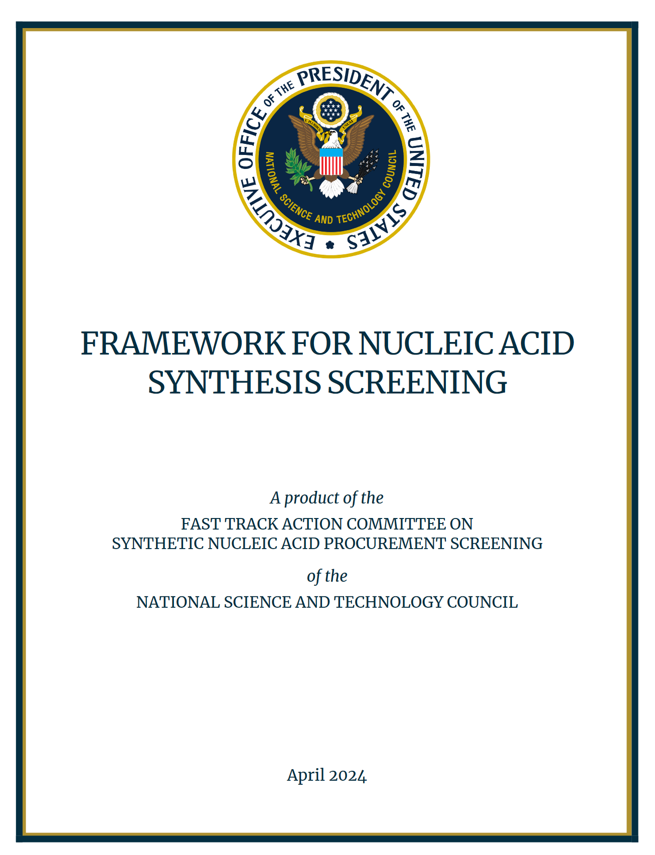
NEW REGULATORY REQUIREMENT
Released in April 2024
Implement by May 2025
Establishes screening processes for purchases of synthetic nucleic acids and synthesis equipment
Minimize potential misuse and ensure biosecurity for life sciences research
Notes:
Issued in response to President Biden’s October 2023 Executive Order on AI and biosecurity
The order directs the reduction of misuse risks related to synthetic nucleic acids.

Slide 5
PURPOSE AND SCOPE (1 of 2)
Providers/manufacturers are recommended to screen purchases of synthetic nucleic acids and synthesis equipment to identify sequences of concern and potential misuse.
Those who receive federal funding are required to purchase only from providers who attest to the required screening framework.
This Photo by Unknown Author is licensed under CC BY-SA-NC

Slide 6
PURPOSE AND SCOPE (2 of 2)
Applies to :
Research involving the procurement of all types of synthetic nucleic acids, including but not limited to:
Single- or double-stranded DNA and RNA
Whole organism genomes containing any synthetic sequences of concern (e.g., whole genomes of federally regulated pathogens such as select agents).
Research involving the procurement of any benchtop equipment capable of synthesizing nucleic acids.
This Photo by Unknown Author is licensed under CC BY-SA-NC

Slide 7
KEY ACTIONS FOR PROVIDERS
Attest to implementing the screening framework and doing due diligence
Screen orders for “sequences of concern” matching or resembling those on regulated pathogen lists, such as select agents or toxins
Verify customers are legitimate
Report suspicious/potentially illegitimate orders to FBI
Maintain records
Ensure robust cybersecurity

Slide 8
UW IMPLEMENTATION PLANS (1 of 2)
EH&S is working with Procurement to create a list of providers or vendors who attest to following the framework.
UW purchases of synthetic nucleic acids and synthesis equipment must be limited to providers on that list.
If UW units synthesize and provide nucleic acid sequences as “core facilities,” they are considered a provider.

Slide 9
U.S. GOVT POLICY FRAMEWORK FOR DUAL USE RESEARCH OF CONCERN (DURC) AND PATHOGENS WITH ENHANCED PANDEMIC POTENTIAL (PEPP)

Slide 10
UPDATED REGULATORY REQUIREMENTS
Released May 2024
Implement in May 2025
Unified oversight for research on biological agents and toxins that, when enhanced, have potential to pose risks to public health, agriculture, food security, economic security, or national security
Supersedes previous DURC and P3CO policies

Slide 11
PURPOSE
To strengthen oversight of life sciences research throughout the research life cycle by:
Defining an expanded scope of agents and toxins subject to oversight
Providing a unified framework to assess for safety, security, and ethical considerations
Delineating roles and responsibilities for PIs, institutions, and federal departments and agencies

Slide 12
TWO CATEGORIES OF RESEARCH (1 of 2)
Category 1: Dual Use Research of Concern (DURC) | Category 2: Pathogen with Enhanced Pandemic Potential (PEPP)
Research that could easily be misused or misapplied to cause harm and pose a significant threat to public health and safety, agriculture, animals, environment, and national security. | Modifying a microorganism to create a “pathogen with enhanced pandemic potential” Capable of uncontrolled spread and severe disease Significant threat to public health, health systems, or national security

Slide 13
TWO CATEGORIES OF RESEARCH (2 of 2)
Category 1: Dual Use Research of Concern (DURC) | Category 2: Pathogen with Enhanced Pandemic Potential (PEPP)
All select agents and toxins in any amount Risk Group 3 or 4 pathogens Pathogens requiring BSL-3 or BSL-4 containment | Any microorganism could be modified into a PEPP Includes genetic modifications and other types of experiments

Slide 14
CATEGORY 1 OR 2 RESEARCH:
Research must fulfill three criteria to qualify as Category 1 or 2 research:
Involves biological agents within the category scope
Specific experimental outcomes or actions are reasonably anticipated
Specific potential effects should those outcomes or actions occur
Note that being an agent within scope only fulfills one criteria.

Slide 15
PROCESS FOR ASSESSMENT
The Principal Investigator (PI) assesses and notifies the funding agency if research may be either Category 1 or 2.
If likely to be funded, the funding agency notifies the Institutional Review Entity (IRE) at PI’s institution
The IRE reviews communicates their assessment back to the funding agency.
The funding agency will confirm the determination.

Slide 16
PROCESS IF CATEGORY 1 OR 2
The IRE and PI work together on a risk-benefit assessment and risk mitigation plan that is then submitted to the funding agency.
The funding agency must approve the risk mitigation plan in order for the experiments to proceed.
Responsible communication of research findings will be emphasized.

Slide 17
CONTINUOUS ASSESSMENT
The PI is responsible to continually assess at all stages of work, not only at proposal or award.
For changes, the PI must initiate an IRE review.
For existing NIH grants as of May 2025, assessments due at the time of Research Performance Progress Report (RPPR).
Include as part of Just-in-Time (JIT) materials submitted on or after May 6, 2025.
https://grants.nih.gov/grants/guide/notice-files/NOT-OD-25-061.html

Slide 18
UW IMPLEMENTATION PLANS (2 of 2)
Maintain Institutional Review Entity (IRE) as a subcommittee of the UW Institutional Biosafety Committee (IBC)
PI self-assessment worksheet
DURC-PEPP application
Updated EH&S trainings to include DURC-PEPP
Updates to Biological Use Authorization (BUA)
Outreach to UW biological research community

Slide 19
EH&S CONTACTS
ZARA LLEWELLYN
Assistant Director for Research Safety
EH&S
zaral@uw.edu
206-221-2676
LESLEY DECKER
Biosafety Manager
EH&S
lldecker@uw.edu
206-221-5524
ehsbio@uw.edu
Two new federal policies impacting research with synthetic nucleic acids and biological agents and toxins expected in May 2025 | EHS

Slide 20
REMINDER RESOURCES
Award Setup & Modification Requests
What do I do if I received a Notice of Award?
Review Checklist: Award Setup Request Steps for PI/Campus
Always include relevant attachments
Read Comments & History before contacting OSP/GCA
MODs: Review OSP/GCA MOD Checklist and GCA Only MOD Checklist
Tell OSP your ASR/MOD story
Need to change a Grant Name in WD? - Send GCA Only MOD
SAGE Budget Resources and SAGE Awards & Mods Resources
Schedule a Teams Appointment for SAGE Support

Slide 21
Research Security Update -
Research Security Update
Carol Rhodes, Director, Office of Sponsored Programs
March 2025 MRAM

Slide 22
Research Security Training
Covered institutions applying for federal funding must implement a research security training program; the UW will provide through an outside vendor (CITI).
Some federal sponsors require institutions certify all covered individuals have taken the training before proposal submission.
The definition of covered individual varies depending on the federal agency.
Covered individuals must complete all four Research Security Training Modules in CITI.
We encourage all covered individuals take this training as soon as possible.

Slide 23
Covered Individual Definition
An individual who (A) contributes in a substantive, meaningful way to the scientific development or execution of an R&D project proposed to be carried out with an . . . award from a Federal research agency; and (B) is designated as a covered individual by the Federal research agency concerned.
See Office of Science and Technology Policy (OSTP) Memo
Notes:
(e.g. unauthorized transfer of IP, establishing a lab in a foreign country in violation of the terms and conditions of a federally funded award).

Slide 24
Research Security Training Completion at the UW
CITI training completion record will be pulled into MyResearch Training Transcript (MRTT)
As of the 3/05/2025 SAGE Release, you will see a link to completion records in MRTT for each individual listed on the PI, Personnel and Organizations page of the eGC1.
Campus units can use the link to check that covered individuals who will be involved in the project have taken the required training.
OSP will confirm in alignment with sponsor policies. This allows OSP to make Institutional Certification.

Slide 25
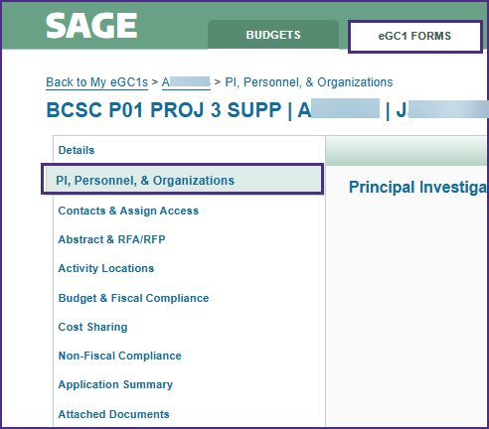
SAGE PI, Personnel, & Organization
Access SAGE eGC1 Forms.
Select an eGC1.
Select the PI, Personnel & Organizations section.

Slide 26
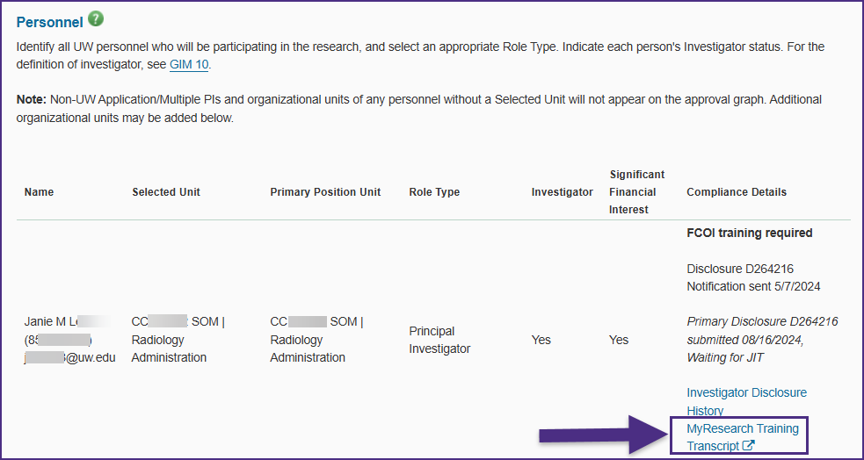
SAGE Links to MyResearch Training Transcript from PI, Personnel, & Organizations

Slide 27
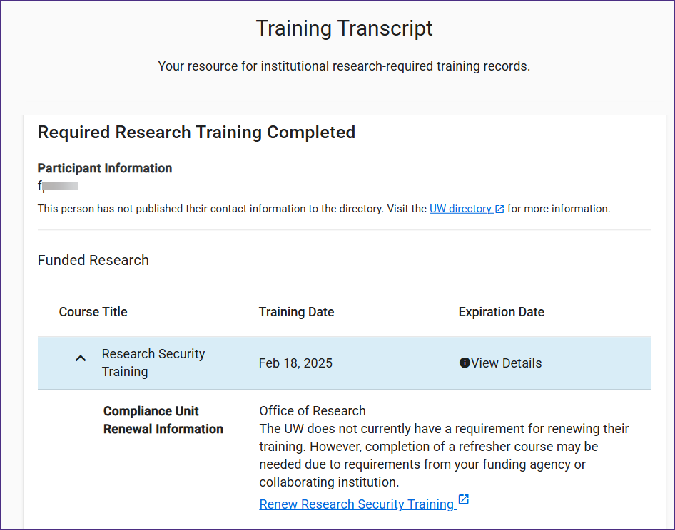
How does this look?
MyResearch Training Transcript

Slide 28
Research Security Training
Questions So Far~
Can you take this training now? Absolutely!
Follow this link to enroll in CITI
Select “LOG IN THROUGH MY ORGANIZATION” and select the UW
Login using your UW NetID
Take all four training modules for credit:
Introduction to Research Security
The Importance of Disclosure
Risk Mitigation and Management
The Importance of International Collaboration
These will appear in My Research Training Transcript as completed
If there are issues, please email researchsecurity@uw.edu

Slide 29
Reminder: Malign Foreign Talent Recruitment Program Prohibition
MFTRP definition: Programs, positions or activities sponsored by a country of concern that include one or more indicators. ​
UW Prohibition On Participation By University Personnel In Malign Foreign Talent Recruitment Programs

Slide 30
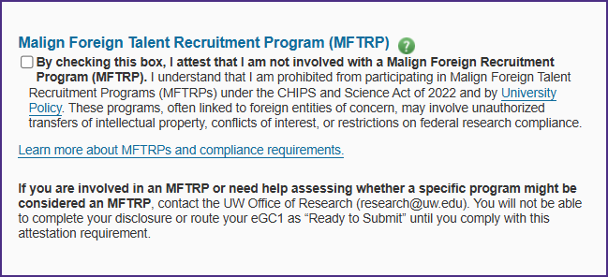
MFTRP Attestation in FIDS
FIDS disclosure completion includes new MFTRP attestation; is required to mark an eGC1 as Ready to Submit.

Slide 31
Other Questions?

Slide 32
Awards Improvement and Development Effort 3/12/2025

Slide 33
What is the AIDE Initiative?
Finance, Planning & Budgeting (FPB)
20-week project to improve grants administration post-WD implementation
Office of Research (OR)
Streamlining award setup
Enhancing reporting capabilities
Increasing efficiency across units
UW Information Technology (UW-IT)
Notes:
Finance, Planning & Budgeting (FPB), the Office of Research (OR), and UW Information Technology (UW-IT) are collaborating on a time-limited project to improve awards management in grants administration.
This initiative focuses on streamlining award setup, enhancing reporting capabilities, and increasing efficiency across units to better support research efforts.

Slide 34
Who Benefits?
UW's Research Enterprise
Office of Sponsored Programs (OSP), Grants Contracts & Accounting (GCA), and Sponsored Programs Finance (SPF)
Principal Investigators and research teams
UW Academy and UW Medicine administrative units
UW collaborators nationally and internationally
Grant sponsors

Slide 35
Areas of Opportunity
Workflow & decision-making
Cross-organization coordination
Technology gaps & new features
Backlogs
Notes:
The project purpose is to streamline workflows to increase efficiency. This is things like building more validations into our systems to support fewer handoffs, returns, and decisions points for campus about what to submit to OSP and GCA.
The project aims to improve alignment across organizations – from systems admin technical teams like UWIT and ORIS to central offices like OSP and GCA to Deans Offices to researchers and their teams.
We will fill the technology gaps by implementing new Workday features and automations alongside enhancements to Sage/Workday integrations.
Finally, we want to address award and sub-award setup, closeout, and reporting issues so that we no longer have backlogs in any of our queues – from the systems admin technical teams to OSP and GCA, and in the campus units getting submissions returned

Slide 36
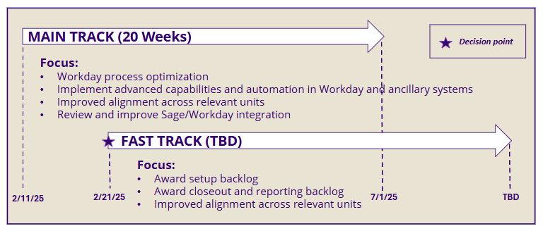
Initiative “track” overview
Notes:
The "main track" of the project is supported by Huron Consulting Group. This track aims to optimize the use of Workday and associated business processes and workflows for targeted post award areas. This Statement of Work is finalized and efforts are underway.
The "main track" includes a functional business review assessment performed by Workday, completed on Tuesday 3/11
The "fast track" will also be supported by Huron. This is where we aim to expedite critical award backlogs. We are eagerly looking toward developing deliverables while aligning with recent developments at the federal level.

Slide 37
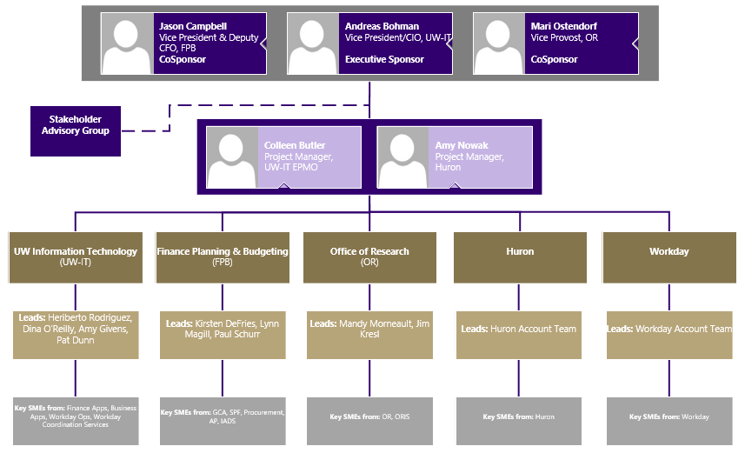
Initiative Team Structure
Notes:
We have representatives from OR, FPB, and UWIT, alongside people from Workday and Huron.
We plan to utilize the existing research community communications infrastructure, including group meetings with research stakeholders like this one, to serve in a stakeholder advisory function. Communications will be two-way, and we will be asking for your feedback on proposed changes along the way. We also hope you can help us obtain feedback from those you represent.

Slide 38
Activities
Initiative kickoff complete
Huron engagement SOW for “main track”
Interviews conducted to identify pain points
Workday Grants Management Functional Review
AIDE webpage published
Notes:
Initiative kickoff was completed in mid-February
Huron engagement scope of work is underway for “main track”
Interviews conducted to identify pain points with FPB/GCA, OR/OSP, ORIS, Procurement, and UW-IT
Started Workday Grants Management Functional Review (six 2-hour sessions completed earlier this week), focusing on Post-Award Workday platform optimization
Published the AIDE webpage

Slide 39
AIDE Resources
Webpage: https://it.uw.edu/initiatives/aide/
Mailman List: aide-initiative@u.washington.edu

Slide 40
OR Strategic Plan
Reporting Needs Intake
OFFICE OF RESEARCH
Notes:
Mandy introduces and aligns to AIDE initiative

Slide 41
We want to know about your reporting needs
Which do you use?
What do you wish you had?
BI Portal Reports
BI Portal Dashboards
Research Key Reports
Workday Reports
Redevelopment of legacy reports & dashboards
New reports & analytics
Other needs
Mandy Morneault
Notes:
Mandy -
- Aron will walk through what's available as a reminder
- I will return to promote a survey for needs assessment

Slide 42
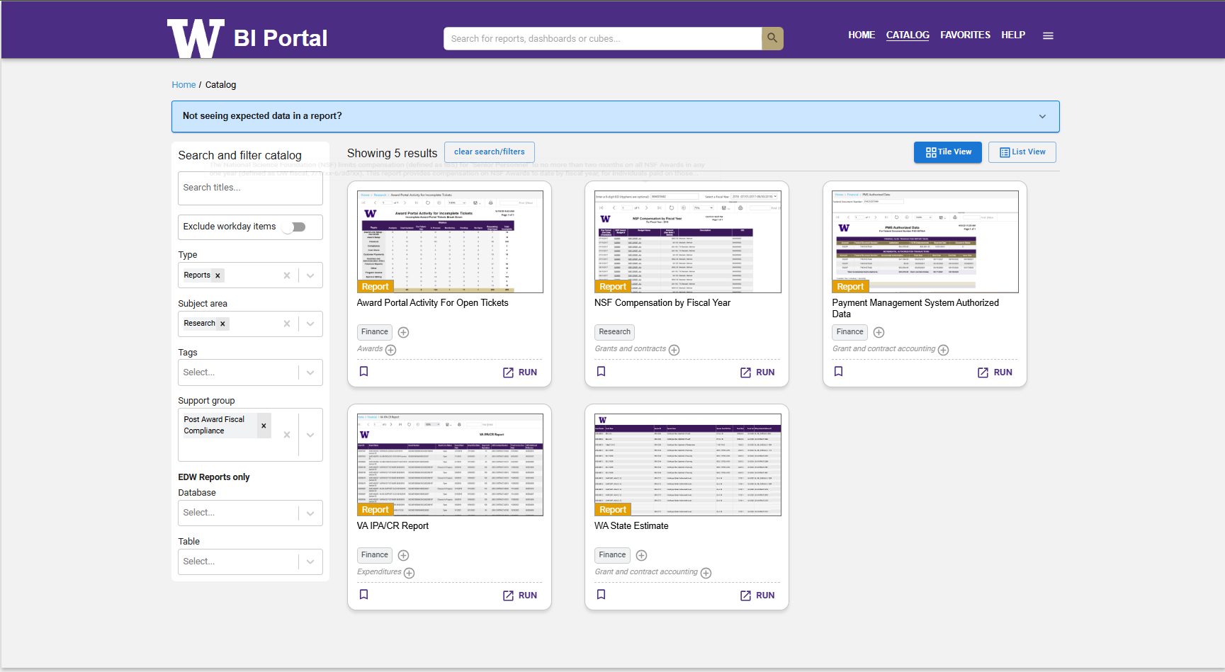
BI Portal Reports
Which do you use?
BI Portal Reports
BI Portal Dashboards
Research Key Reports
Workday Reports
https://biportal.uw.edu/catalog?sa=research
Aron Knapp
Notes:
Aron – review the usability of the BI portal.
Type = Reports
Subject Area = Research

Slide 43
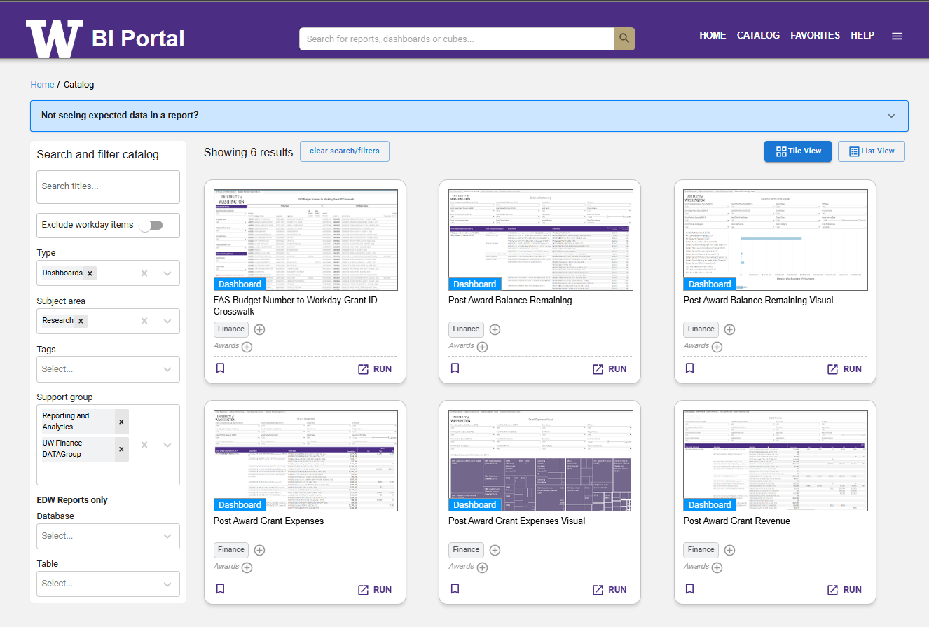
BI Portal Dashboards
Which do you use?
BI Portal Reports
BI Portal Dashboards
Research Key Reports
Workday Reports
https://biportal.uw.edu/catalog?sa=research
Aron Knapp
Notes:
Aron – review Dashboards. and this time show support group

Slide 44
Research Key Reports SharePoint Folder
Which do you use?
BI Portal Reports
BI Portal Dashboards
Research Key Reports
Workday Reports
Unassigned Subaward Requests
Instructions for accessing, downloading and refreshing Excel workbooks in the Key Reports folder
Aron Knapp
Notes:
Aron – Review Reports available at Jim's SharePoint
- unassigned Subawards

Slide 45
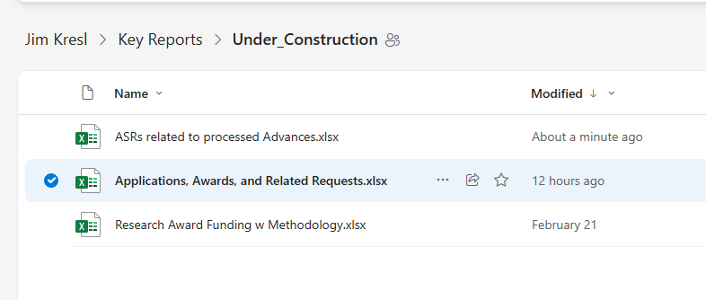
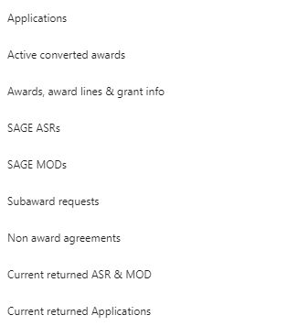
Research Key Reports
Which do you use?
BI Portal Reports
BI Portal Dashboards
Research Key Reports
Workday Reports
Aron Knapp
Notes:
Aron – Review Reports available at Jim's SharePoint
- ASR's related to processed ADVS
- Research Award Funding (w/ Methodology!)
- Applications, Awards and Related Requests

Slide 46
Workday Reports
Which do you use?
BI Portal Reports
BI Portal Dashboards
Research Key Reports
Workday Reports
Mandy Morneault
Notes:
Aron – and here's where I'll turn it back over to Mandy

Slide 47
Tell us
What do you wish you had?
Redevelopment of legacy reports & dashboards
New metrics & reports
Other needs
How do you rank priority for development?
Mandy Morneault
Notes:
Mandy -

Slide 48
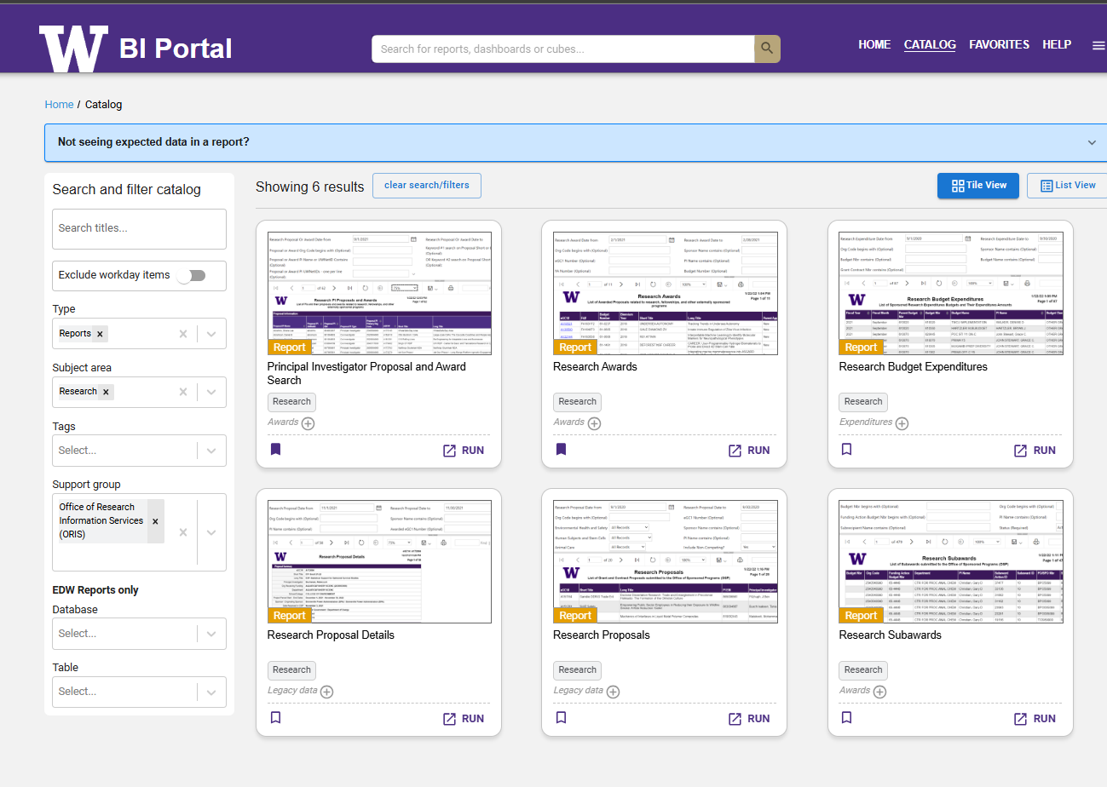
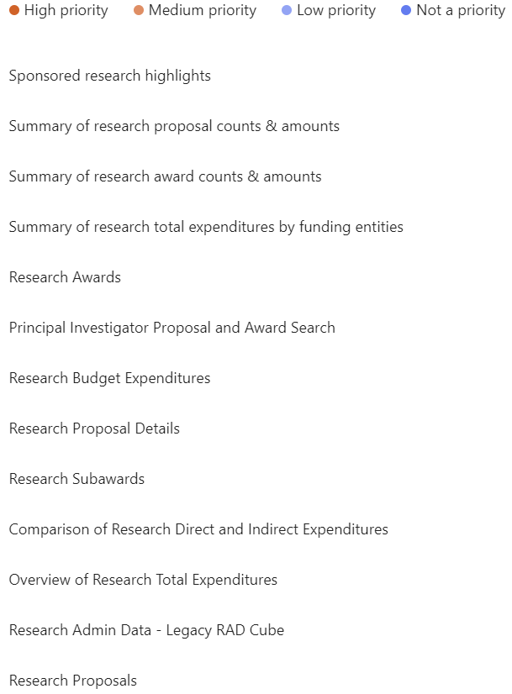
Legacy reporting @ BI Portal
What do you wish you had?
Redevelopment of legacy reports & dashboards
New metrics & reports
Other needs
Mandy Morneault

Slide 49
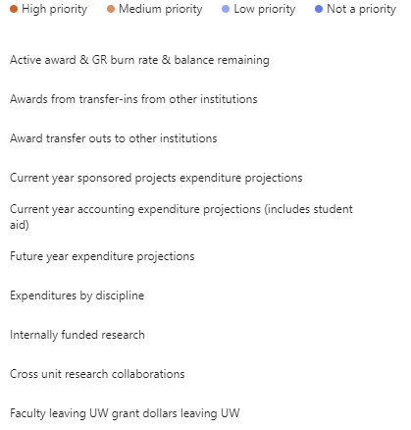
Metrics & reports in development
What do you wish you had?
Redevelopment of legacy reports & dashboards
New metrics & reports
Other needs?
Mandy Morneault

Slide 50
We want to hear from you!
Please send us your reporting usage and needs info by 3/20
https://forms.office.com/Pages/ResponsePage.aspx?id=W9229i_wGkSZoBYqxQYL0nclPm6GAzhPjyaQWAR-VNhUMzZUOE0xRFdWMklUUkZUUlJWSVVZSDFIQi4u
Mandy Morneault

Slide 51
SUBAWARD SUPPLIER INVOICE ROUTING
Vincent Gonzalez, Associate Director
Grant and Contract Accounting
March 2025 MRAM

Slide 52
BACKGROUND (1 of 2)
The previous routing of late subaward supplier invoices within Workday was:
Grant Manager
Grant and Contract Accounting (GCA)
Grant Manager
Principal Investigator
This routing created additional delays in approvals and increased the risk of non-payment

Slide 53
Updated Subaward Supplier Invoice Routing
Effective 2/27/2025, the routing of late subaward supplier invoices within Workday is:
Grant Manager
Principal Investigator
Grant and Contract Accounting (GCA)
This will enable GCA to review and complete the final denial or approval steps and complete the workflow timely

Slide 54
Trends & Reminders
GCA has noticed that ~75% are incorrectly approved by the Grant Manager
If a subaward invoice should post to a continuation grant, it should be denied by the Grant Manager so it does not reach GCA.
This business process only applies when the Final Action Date has passed and/or the award line is in a lifecycle status that does not allow spend
Closed
Closeout in Progress
Canceled
Restricted from Use

Slide 55
RESOURCES (1 of 2)
UW Connect Finance Job Aid Supplier Invoice Business Process for Award Grants

Slide 56
QUESTIONS (1 of 3)
Send award-specific questions to GCA through Award Portal using the topic “Pending Supplier Invoice”
Send other questions to gcahelp@uw.edu

Slide 57
STOP WORK ORDER AWARD LINE SPECIAL CONDITION
Vincent Gonzalez, Associate Director
Grant and Contract Accounting
March 2025 MRAM

Slide 58
BACKGROUND (2 of 2)
New process for stop work orders, resume work orders and Executive Branch directive changes.
The new process is similar to what has been done in the past for government shutdowns.
There are new SAGE Modification Requests subcategories and Workday special conditions to help monitor impacted awards.

Slide 59
PROCESS FOR STOP WORK ORDERS
Change the Award and Award Lines statuses to “Restricted from Use” to prevent spending
GCA will work with the campus unit to post allowable charges to the grant worktag
Add new Workday award line special condition
Pause sponsor invoicing and the submission of financial reports if the sponsor portal is unavailable

Slide 60
NEW AWARD LINE SPECIAL CONDITIONS
Stop Work Order | All Activities - Represents that the stop work order applies to all activities
Stop Work Order | Subject to Sponsor Specifications - Represents a partial stop to activities. Refer to the stop work order for details.

Slide 61
PROCESS FOR RESUME WORK ORDERS
Change the Award and Award Lines statuses to “Open” so spending can resume
Remove stop work order award line special condition
Resume sponsor invoicing and financial reporting if a sponsor portal was previously unavailable
GCA requires a Resume Work Order MOD in order to take these actions.

Slide 62
PROCESS FOR EXECUTIVE BRANCH DIRECTIVE CHANGES
The details of a directive change may differ depending on the topic.
GCA reviews each of these actions to determine the appropriate course of action.
There may be instances where the directive will not require an update in Workday.
Refer to the MOD Comments & History for details.

Slide 63
RESOURCES (2 of 2)
New GCA webpage for Executive Branch Actions
Office of Sponsored Programs Award Changes
Office of Research Guidance on Federal Administration Research Policy
Office of the Provost Federal Policy Updates

Slide 64
QUESTIONS (2 of 3)
Send award-specific questions to GCA through Award Portal using the topic “Other”
Send other questions to gcahelp@uw.edu

Slide 65
Subaward Update
March 2025 MRAM
Amanda Snyder
Office of Sponsored Programs

Slide 66
Reminders
OSP issues subawards only on processed awards
Not on advance spend or during a temporary internal extension
The subrecipient must be registered in both SAGE and Workday before OSP can process.
Must be a supplier AND a subrecipient in Workday
SAGE subrecipient set up is separate process
OSP needs the ASR/MOD number and the GR# in the subaward request
NEW: SAGE fields for this data are live

Slide 67
Volumes & Staffing
Current volumes
Total with OSP: 873
% change from last week: -3.1%
In OSP: 484
Assigned: 92
Issued: 297
Staffing
New administrators are onboarding
Additional part-time help in the meantime

Slide 68
Subaward Escalation & Assurances
Escalation process use extended through June.
OSP and Dean’s offices using subaward escalation process.
During this period of uncertainty, OSP is not issuing assurance letters to subrecipients on federal awards.

Slide 69
General Update
Subawards continue to be processed as usual.
OSP is actively monitoring change orders for outgoing subawards and will consider broad agency announcements in issuing subawards.
These guidelines are applicable to all subawards, whether or not the subrecipient is foreign or domestic.

Slide 70
Subawards &
Stop Work or Suspension Orders
When there is a stop work (SWO) or suspension order for a specific project:
OSP is monitoring for new SWO
OSP will issue suspension letters to active subrecipients & intended subrecipients consistent with the direction of the sponsor.
UW PI & SAGE Subaward Preparer will be copied on the email to the Subrecipient PI and contact.
No subaward request needed in SAGE to suspend a subaward.
Subawards not yet processed will be processed to cover activity up to the stop work date.

Slide 71
Subawards: Change of Scope
If no stop work order, but sponsor agency issued an amendment ceasing activities associated with categories of recent Executive Orders and this impacts the subaward:
Submit request to modify Subaward in SAGE Subawards Module.
Indicate need for a subaward scope and/or budget change.
Include any relevant attachments & information from the sponsor.
Enter the MOD# for the amendment from the Prime Sponsor
E-mail ospsubs@uw.edu to alert OSP of this action

Slide 72
Subawards: Early Terminations
When a federal agency issues an early termination for a project and there are subawards:
OSP monitoring for new Early Terms & will issue suspension letter before the formal amendment to subrecipient
Submit request to modify the Subaward(s) in SAGE Subawards Module
Indicate the new end date
Include any budget changes
Include all relevant attachments & communications with the sponsor
Enter the MOD# for the amendment from the Prime Sponsor
E-mail ospsubs@uw.edu to alert OSP of this action

Slide 73
Questions (3 of 3)
Questions about a specific subaward change order? email: ospsubs@uw.edu

Slide 74
UPDATES
MRAM UPDATE
Laurie Stephan
Associate Director for Learning, ORC

Slide 75
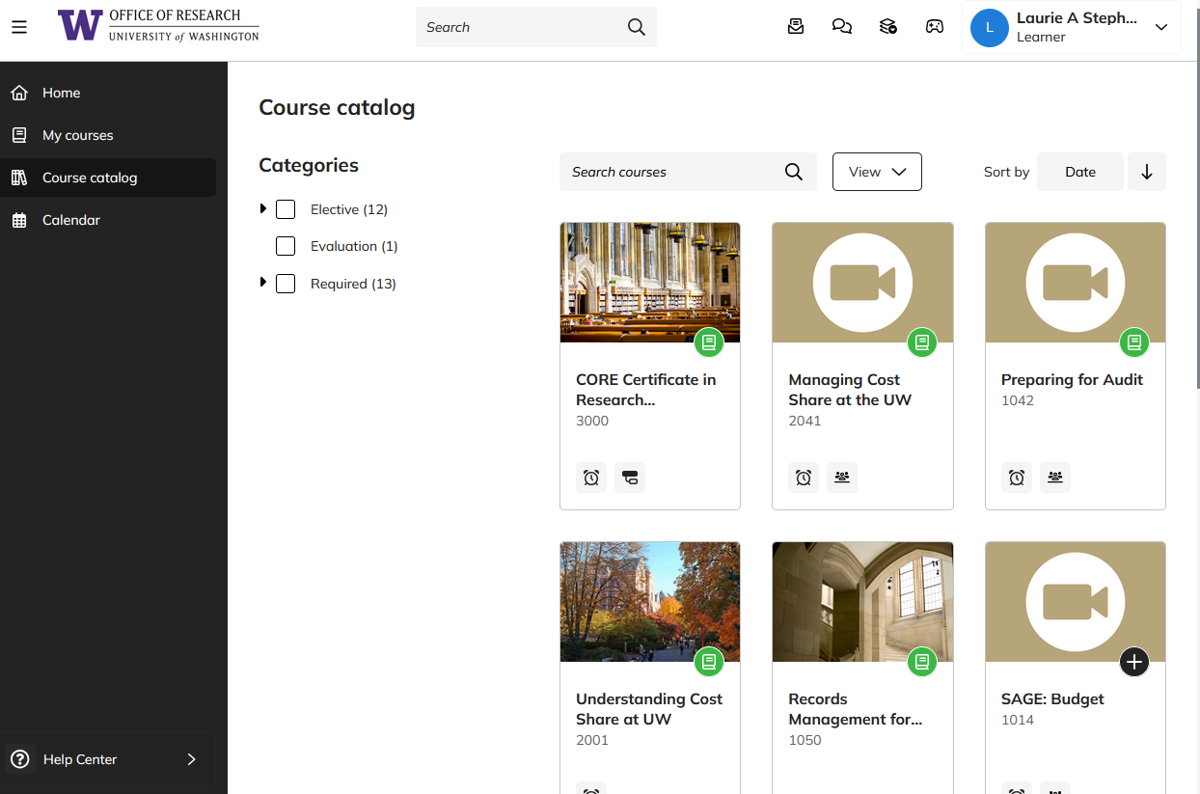
TRACKING CERTIFICATE PROGRESS IN TALENT LMS (1 of 2)
https://certificateresearchadmin-uwashington.talentlms.com/plus/catalog

Slide 76
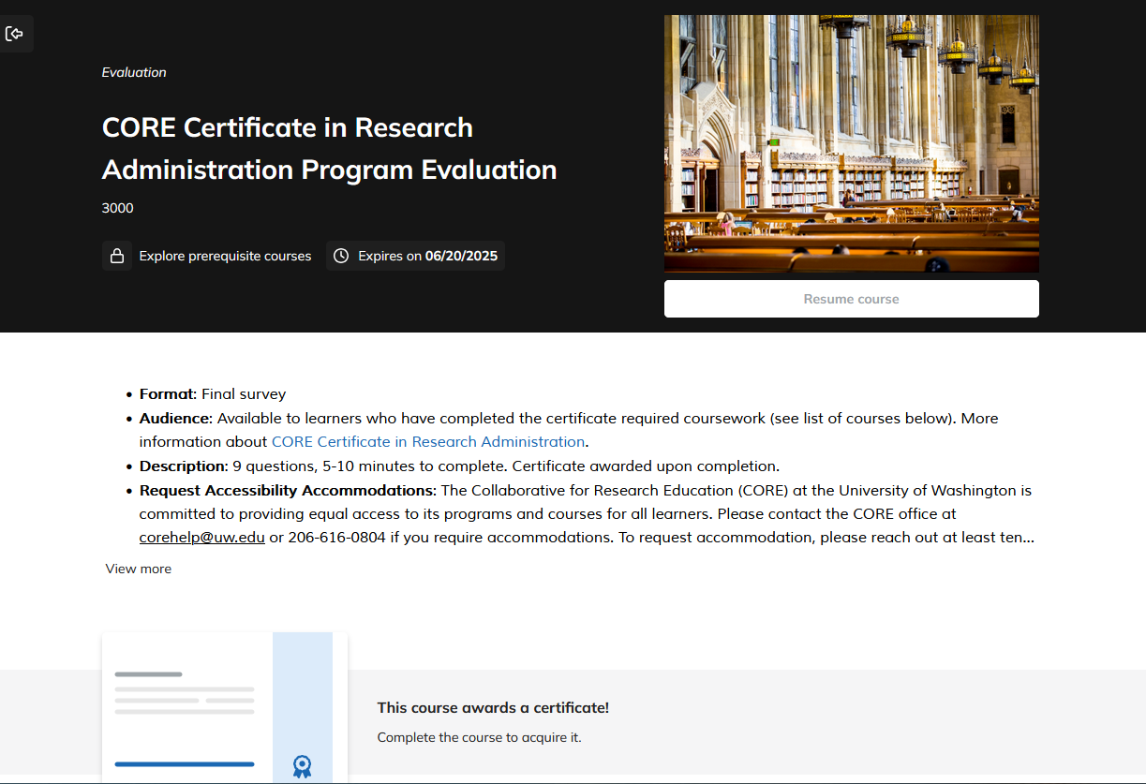
TRACKING CERTIFICATE PROGRESS IN TALENT LMS (2 of 2)
Direct link: https://certificateresearchadmin-uwashington.talentlms.com/plus/catalog/courses/185

Slide 77
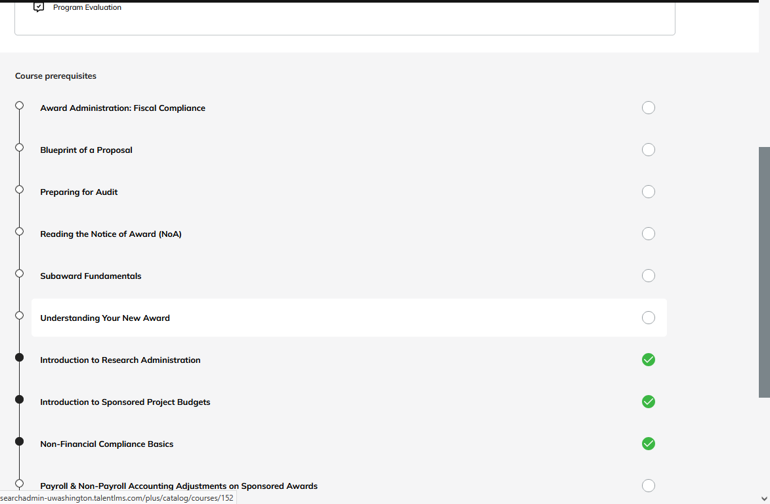
TRACKING CERTIFICATE PROGRESS LMS
Course titles link to courses

Slide 78
2025 SPRING SCHEDULE
Course Registration (https://certificateresearchadmin-uwashington.talentlms.com/plus/catalog)
Course | Date | Time
Blueprint of a Proposal | Mar 27 | 9:30 am-12:00 pm
Managing Cost Share at the UW | Apr 8 | 9:30 am-11:30 am
SAGE: Creating and Submitting eGC1s | Apr 9 | 1:00 pm – 3:00 pm
SAGE: Budget | Apr 15, 23 | 1:00 pm-3:00 pm
SAGE: Creating NIH Proposals in Grant Runner | Apr 29 | 1:00 pm-3:00 pm
Understanding Your New Award | Apr 29 | 9:30 am-11:00 am
Reading the Notice of Award | May 6 | 9:30 am-11:00 am
Award Administration: Fiscal Compliance | May 13 | 9:30 am-12:00 pm
SAGE Awards | May 14, June 11 | 1:00 pm-3:30 pm
New Frontiers of Financial Reporting for Grants Managers | May 15 | 9:30 am -11:30 am
Subaward Fundamentals | May 29 | 1:00 pm-3:30 pm
Compliance Case Studies: FCOI, Export Controls, Research Integrity | June 3 | 9:30 am -11:30 am
Subawards in SAGE | June 5 | 2:00 pm – 3:30 pm
Preparing for Audit | June 10 | 9:30 am-11:30 am
SAGE: Budget | Mar 4 | 1:00 pm-3:00 pm

Slide 79
ON-DEMAND COURSES ALWAYS AVAILABLE
Course Registration (https://certificateresearchadmin-uwashington.talentlms.com/plus/catalog)
1000: Introduction to Research Administration
1002: Introduction to Sponsored Project Budgets
1013: Workshop: Preparing Sponsored Project Budgets
1031: Non-Financial Compliance Basics
1044: Payroll & Non-Payroll Accounting Adjustments on Sponsored Awards
1045: Post Award Food Purchases & Compliance
1046: Timing of Expenditures & Benefit to Award
1050: Records Management for Research Teams: the Basics
2000: Direct Billing of F&A Type Costs
2001: Understanding Cost Share at the UW

Slide 80
Open Q&A Session (20 minutes)

