Slide 1
MRAM | Monthly Research Administration Meeting
                April 10, 2025, 9:00 AM – 10:30 AM
Join Webinar: https://washington.zoom.us/j/346891888
Click “CC” to Show Captions in your Zoom Controls
TOPIC | PRESENTER | EMAIL | MIN
Welcome | Kirsten DeFries Research Compliance & Operations | kirsten5@uw.edu | 2
PAFC Hot Topic: Food, Travel and Late Expenditures | Matt Gardner Post Award Fiscal Compliance | gcafco@uw.edu | 10
GIM 1: Proposal Review and Submission | Carol Rhodes Office of Sponsored Programs | carhodes@uw.edu | 15
New SAGE Resources & Classes | Kim Halstead ORIS | khalstea@uw.edu | 5-10
FY26 Preliminary Fringe Benefit Rates | Colleen Bettis Management Accounting & Analysis | mcbettis@uw.edu | 10
                NEXT MEETING
                May 8, 2025 9:00 AM - 10:00 AM
                Questions about MRAM? email mramques@uw.edu

Slide 2
REMINDER RESOURCES
Award Setup & Modification Requests
What do I do if I received a Notice of Award?
Review Checklist: Award Setup Request Steps for PI/Campus
Always include relevant attachments
Read Comments & History before contacting OSP/GCA
MODs: Review OSP/GCA MOD Checklist and GCA Only MOD Checklist
Tell OSP your ASR/MOD story
Need to change a Grant Name in WD? - Send GCA Only MOD
SAGE Budget Resources and SAGE Awards & Mods Resources
Schedule a Teams Appointment for SAGE Support

Slide 3
COMPLIANCE HOT TOPICS: POTPOURRI
MRAM
April 2025
Matt Gardner
Post Award Fiscal Compliance

Slide 4
Travel on Federal Awards
Reminder: Federal regulations allow for the purchase of the “least expensive unrestricted” (or refundable) ticket
If airfare needs to be purchased for travel on a federal award, and there are concerns with the possibility of a disruption of funding, purchase unrestricted (refundable) tickets
A non-refundable ticket is not an allowable cost on a federal award if the travel does not occur
MRAM – Matt Gardner - PAFC

Slide 5
Travel on Federal Awards - Resources
2 CFR 200.475(e) – Commercial Air Travel
  https://www.ecfr.gov/current/title-2/part-200/subpart-E#p-200.475(e)
PAFC Webpage – Travel on Federal Awards
  https://finance.uw.edu/pafc/spending/specific-cost-items/travel#federal-travel
MRAM – Matt Gardner - PAFC

Slide 6
Food on Sponsored Awards
Food purchased on sponsored awards is a high-risk expenditure with a high burden of proof to show that the expense is necessary for the completion of the Award
If food is necessary, always include the cost and the justification in the proposal budget
  If not included in the proposal, obtain written approval from the sponsor
Meals for team building or recognition are not allowed on sponsored awards
MRAM – Matt Gardner - PAFC

Slide 7
Food on Sponsored Awards –
Best Practices
Document the following:
  Why the food purchase is necessary to achieve the Award objectives
  The number of individuals and the total cost of the food
    The cost per person must be within the per diem rate
  If providing food at a meeting or conference, make sure the vendor provides an itemized receipt identifying food and beverage costs
Use the correct spend category to identify the expenditure as food
Meal costs more than the per diem rate must be covered by non-sponsored funding
Resources: https://finance.uw.edu/pafc/spending/specific-cost-items/food
MRAM – Matt Gardner - PAFC

Slide 8
Equipment purchased in the last 90 days of an Award
Equipment purchases are always high-risk due to the dollar value and potential multiple uses of the item
Auditors will question how the equipment purchase benefited the Award objectives with so little time remaining
Budgetary convenience – or trying to “spend down” remaining funds – is never a valid justification for purchasing equipment
MRAM – Matt Gardner - PAFC
Notes:
NSF auditors will do the math: “Three-year award with a piece of equipment purchased 30 days before the end. 365 days * 3 years = 1,095 days. 30 days left when equipment purchased… 30/1095 = equipment on the award for only 2.7% of the award life but NSF is paying for 100% of the cost.”

Slide 9
Equipment Purchases – Best Practices
Document/justify the need for the equipment – how will the equipment benefit the objectives of this specific award?
Know your sponsor’s policies – some sponsors have specific approval requirements for equipment, others do not
  Example: Under NIH policy, the purchase of a piece of equipment which exceeds $25,000 is considered a change in scope which would require prior written NIH approval
    NIH GPS 8.1.2.5 Change in Scope
MRAM – Matt Gardner - PAFC
Notes:
https://grants.nih.gov/grants/policy/nihgps/HTML5/section_8/8.1.2_prior_approval_requirements.htm#Change4

Slide 10
NIH Salary Cap 2025 Notice
NIH issued notice NOT-OD-25-085 on April 3rd, effective January 1, 2025
  https://grants.nih.gov/grants/guide/notice-files/NOT-OD-25-085.html
Cap is effective in Workday for pay periods beginning on or after 4/1/2025
For pay periods before 4/1/2025, a PAA is required to charge the higher rate
Standard NIH policy states:
  Recipients may rebudget to pay amounts up to the new cap starting with the effective date
  NIH will not provide additional funds to cover the higher cap threshold
MRAM – Matt Gardner - PAFC

Slide 11
NIH Salary Cap - Proposals
For proposals, see OSP’s guidance on documenting salary cap on proposal budgets
  https://www.washington.edu/research/faq/salary-cap-proposal-budgets/
MRAM – Matt Gardner - PAFC

Slide 12
ECC Office Hours (1 of 2)
Focused Topic Office Hour
  Thursday, April 17th 10am to 11am
  Topics:
    ECC Audit functionality
  Info: https://finance.uw.edu/pafc/effort-reporting/ecc-office-hours
The session will be recorded and all materials will be posted on the PAFC Effort Reporting webpage
  Link: https://finance.uw.edu/pafc/session_recordings
MRAM – Matt Gardner - PAFC

Slide 13
ECC Office Hours (2 of 2)
Open Office Hours
Every Friday at 10am to 11am
No set topic; we take all questions relating to ECC/effort reporting, and other post award fiscal compliance topics
https://finance.uw.edu/pafc/effort-reporting/ecc-office-hours
MRAM – Matt Gardner - PAFC

Slide 14
Questions
Post Award Fiscal Compliance (PAFC)
  effortreporting@uw.edu (Effort questions)
  gcafco@uw.edu (All other compliance questions)
  https://finance.uw.edu/pafc/
Matt Gardner
  mgard4@uw.edu
David Parks, Effort Compliance Analyst
  parksd2@uw.edu
MRAM – Matt Gardner – PAFC

Slide 15
GIM 1: Proposal Review and Submission
April 10, 2025
Carol Rhodes, Director
Office of Sponsored Programs

Slide 16
GIM 1: Review and Submission Requirements for Proposals
GIM 1 is UW’s policy for proposal review and submission roles and responsibilities.
OSP authority for GIM ~ from Executive Order 34.
Companion to GIM 19, UW’s internal deadline policy
  Also needs updates
Several factors require us to revisit roles and responsibilities related to proposals.

Slide 17
Update Factors:
Evolving Sponsor Requirements
Increased regulatory requirements at time of proposal submission for federal grants:
  Research security
  Data privacy
Federal sponsors expanding Other Transaction Authority (OTA)
  More stringent terms we often have to agree to at submission.
Federal contracts
  Requires detailed information as well as certifications at time of proposal.
Private and nonprofit sponsors: Upfront terms and conditions at time of proposal that bind the UW.

Slide 18
Update Factors:
Enhanced System Validation Tools
Better Data
Sponsor system validations have improved & often validate formatting, page length, missing attachments:
  Research.gov
  Grants.gov
SAGE Budget pulls UW specific data ~ helps build accurate budgets which can be used in filling out sponsor budget detail:
  F&A rates
  Fringe benefit rates
  Institutional Base Salary (IBS)
Grantrunner: SAGE NIH System to System tool. Pulls accurate institutional business information and SF424 forms for NIH applications
SFI disclosure & training records integrate with SAGE

Slide 19
Institutional Review
Areas Remaining the Same
Institutional Review, carried out by OSP:
University is eligible
University business data are correct
Facilities and Administrative (F&A) costs calculated according to GIM 13
Cost share review
All proposed subrecipients satisfy the UW’s documentation requirements in GIM 7

Slide 20
Institutional Review
Changes or More Emphasis:
Required compliance areas or additional steps are addressed, such as:
  IT security environment meet sponsor requirements
  Malign Foreign Talent Recruitment Program statement
  Research Security training completion
Review terms and conditions at proposal stage that obligate the University, such as:
  Upfront Intellectual Property terms
  Promise to indemnify sponsor, even for its use of proposal materials
  Other nonstandard terms

Slide 21
PI & Campus Unit Responsibilities
People & Entities
What is in GIM 1 now/staying the same:
Personnel Eligibility - includes Principal Investigator
No Conflict of Commitment
Reasonableness of the commitment of faculty and staff effort
Debarment, suspension, or ineligibility status of key personnel is checked
Qualifications of personnel, including subrecipient(s)
What’s Changing
Accurate portrayal of entities participating (subrecipients versus vendors)

Slide 22
PI & Campus Unit Responsibilities
Programmatic Areas
What is in GIM 1 now/staying the same:
Proposed Programmatic Components
Grantsmanship, including strategy, persuasiveness, and significance
Scientific and technical merit
Academic value of the research activity
Scope of Work meets sponsor and proposal guidelines
What’s Changing
Technical Instructions unique to specific opportunity are met (required attachments, components, sections)

Slide 23
PI & Campus Unit Responsibilities
Budget
What is in GIM 1 now/staying the same:
Any F&A waiver is approved by department official (e.g., Chair) before submission to OSP
Budget line items comply with UW requirements
  IBS is accurate
  UW rates used according to UW policy (F&A, fringe benefit)
Requested amounts for effort proposed are not requested or paid for off another sponsored program
What’s Changing
Total amount requested is within sponsor limits
Sponsor specific budgetary requirements

Slide 24
PI & Campus Unit Responsibilities
Facilities, Location, IT Requirements
What is in GIM 1 now/staying the same:
Facilities and resources listed are available for use
Facility improvements/renovation required are approved
Correct location information is listed, and commensurate F&A rate used
All information, data, equipment, materials proposed for use (UW or third party) are available
What’s Changing
Specific data privacy and security requirements can be met by unit, including technical, administrative, or organization measures required by sponsor.

Slide 25
Related GIM 1 Presentations Timeline
2024 MRAM Special Topics
6/2024: eGC1 Project Types: federal contracts and Other Transaction Agreements
  FAQ: How do I know what project type to select on an eGC1 & why is it important?
  FAQ: Why should I route an eGC1 for Contracts & Other Transactions to OSP ASAP?
9/2024: Research Security overall
  Research Security at the UW
  Federal Research Security Videos
12/2024: Disposition of Intellectual Property in Sponsored Programs
12/2024: Research Security training

Slide 26
Related GIM 1 Presentation Timeline
11/2024: Administrative Advisory Group
1/08/2025: Research Administration Process Improvement Team (RAPIT)
1/09/2025: Research Security, NIH Controlled Access Genomic Data Security
1/10/2025: Research Advisory Board (RAB)
3/05/2025: RAPIT Update to Deans Level Admins
4/10/2025: MRAM GIM 1 Updates
  Draft available for campus preview by end of day with survey for campus feedback
Jan-April 2025 OSP workgroups:
  Reviewed policy language & definitions

Slide 27
Coming up
DRAFT “For Comment” publication after today’s MRAM
Survey for campus input & feedback
Links to draft & feedback survey will be available from GIM 1, OSP Homepage, and Office of Research Announcements
Additional proposal preparation guidance, definitions, & resources under development
Implementation targeted for: Late Spring 2025

Slide 28
Questions (1 of 2)

Slide 29

SAGE RESOURCES &
SPRING 2025 CLASSES
Kim Halstead
Office of Research Information Services (ORIS)
April 10, 2025

Slide 30

SAGE Spring Classes
Classes are filling up – register now!
  SAGE: Creating and Submitting eGC1s
    Thursday, 5/29, 10 am - 12 pm
  SAGE: Budget
    Tuesday, 4/15, 1 - 3 pm
  SAGE: Creating NIH Proposals in Grant Runner
    Tuesday, 4/29, 1 - 3 pm
  SAGE Awards & Modifications
    Wednesday, 5/14, 1 - 3:30 pm
  Subawards in SAGE
    Thursday, 6/5, 2 - 3:30 pm

Slide 31
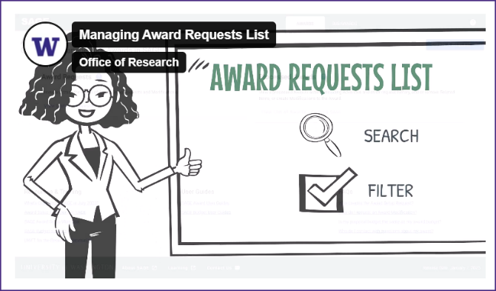
New SAGE Resources (1 of 2)
Managing Your SAGE Award
Requests List (Video)
Notes:
This video is a great resource for learning how to search through and filter your tasklist.

Slide 32
New SAGE Resources (2 of 2)
SAGE Subawards Highlights & Updates (Job Aid Link)
In March, updates were made to the subaward module in SAGE to require associating a subaward request/MOD with both:
  a Workday Finance Grant/Award Line
  an existing ASR or MOD

Slide 33
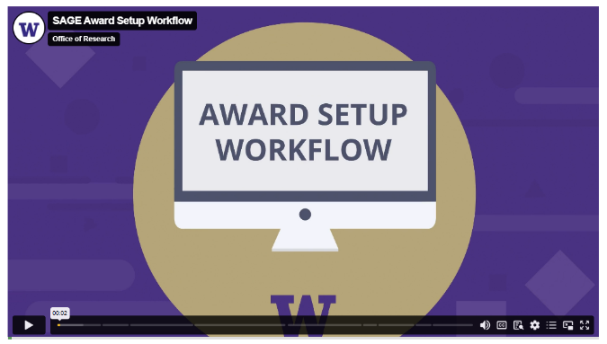
Updated SAGE Resources
SAGE Award Setup Workflow (Video)

Slide 34
Reminder:
Award Budget Resources
Simplified Award Budgets
  SAGE Award Budget: Quick Tips for Simplifying Your Award Budget
  How to Create a Categorical Totals Budget
  How to Create an Unallocated Totals Budget
Notes:
SAGE award budgets can often be less detailed than proposal budgets. To see if these simplified budgets are right for your award, review our simplified award budget job aid series.
We are also updating our SAGE user guides quite frequently.

Slide 35
Where do I find SAGE
resources? (1 of 3)
All SAGE Budget Resources
All SAGE Awards & Modifications Resources
We update and link to resources on the SAGE landing page, CORE catalog, UW Connect Finance, send out announcements to the SAGE user list, and communicate here at MRAM.

Slide 36
Where do I find SAGE
resources? (2 of 3)
If you’re in the system and see a question mark or hyperlink, they
link out to guidance for that section (job aid, user guides, website guidance).

Slide 37
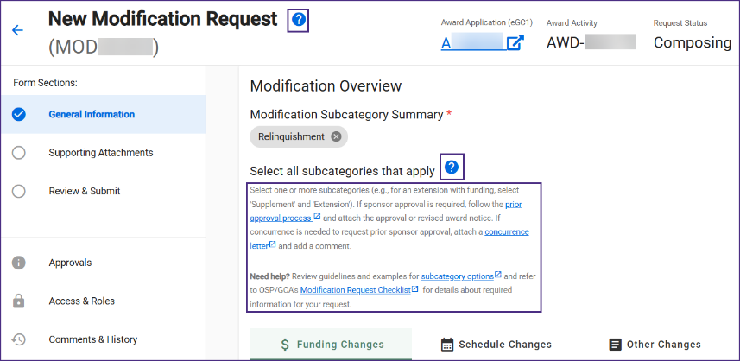
Where do I find SAGE
resources? (3 of 3)

Slide 38
Teams Appointments for SAGE Support
Reminder: Schedule a live consultation with a SAGE Support agent, Tuesday - Thursday.
  SAGE Budget Appointments
  General SAGE Help Appointments
SAGE Contact Information
“How do I adjust the F&A rate to get my award amounts to match my NoA?”
“Help! Why am I getting this eGC1 error?”
“Can you help me simplify my proposal budget for my award budget?”

Slide 39
Questions?

Slide 40
FY26 Benefit Load Rate
Proposal Development
MRAM
April 2025
Colleen Bettis
Management Accounting and Analysis

Slide 41
FY26 BLR Rate Overview
Uniform Guidance
  Federal Requirements
  Overview of Calculation
University of Washington Rates
  Current Environment
  FY26 Significant Impacts/Mitigation Efforts
  Next Steps
Questions

Slide 42
Uniform Guidance
eCFR :: 2 CFR 200.431 -- Compensation—fringe benefits.
§ 200.431 Compensation—fringe benefits.
(a) General. Fringe benefits are allowances and services employers provide to their employees as compensation in addition to regular salaries and wages. Fringe benefits include, but are not limited to, the costs of leave, employee insurance, pensions, and unemployment benefits. Except as provided elsewhere in these principles, the costs of fringe benefits are allowable provided that the benefits are reasonable and are required by law, an organization-employee agreement, or an established policy of the recipient or subrecipient.

Slide 43
Uniform Guidance (cont.)
Required to direct charge to Federal Awards
Negotiated annually
Based on actuals from prior closed FY and projections for the upcoming FY
  Alternates odd/even years
    (FY23 actuals used in FY25 calculation)
    (FY24 actuals used in FY26 calculation)

Slide 44
Rate Calculation Components
Actual Benefit Costs (FY24)
Workers Comp, Unemployment, Health Plans, SS, Medicare, Separation Leave, UPASS, PFML, etc..
Projected increases/decreases in benefit costs (FY26)
Over/Under Recovery True Up
(FY24 projected – FY24 actuals)
Actual S&W FY24
Projected FY26 S&W

Slide 45
University of Washington FY26 Rates
Significant Impacts
  High Number of Rate Categories
  Healthcare Costs
    12 – 15% increase proposed
    GAIP significant increases
  Hourly Over Recovery
    Changes in FLSA wage thresholds
    Higher growth in hourly wage base than projected
Compliant Strategies implemented to lessen YOY variance
  Split O/U recoveries over two years
  Averaged Projects when allowable

Slide 46
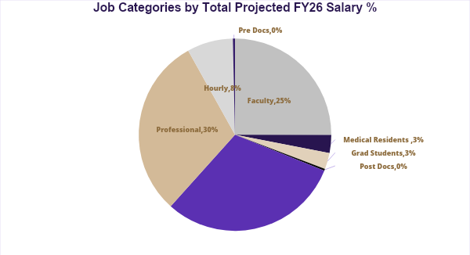
UW Rates – Job Categories

Slide 47
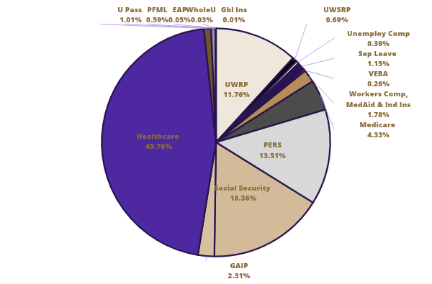
UW FY26 Projected Cost Breakdown (%)

Slide 48
FY26 BLR Preliminary Rates modeling PEBB proposed rates
 | FY24 submitted | FY25 submitted | FY26 preliminary PEBB @$1315 | FY26 preliminary PEBB @$1347
Faculty | 22.6 | 24.9 | 27.5 | 27.7
Medical Residents | 28.5 | 29.3 | 31.2 | 31.7
Grad Students | 18.2 | 18.7 | 29.2 | n/c *GAIP
Post Doc Trainees | 16.3 | 18.7 | 25.4 | 25.8
Classified | 38.1 | 34.4 | 37.5 | 37.9
Pro Staff | 30.0 | 30.3 | 32.0 | 32.4
Hourly | 21.2 | 23.0 | 15.0 | 15.2
Pre Doc Trainees | 25.2 | 22.5 | 29.4 | n/c *GAIP

Slide 49
Next Steps
Analyzing Strategic Options to Mitigate Wide Variances YOY
  Leveraging WD capability
  Discussion with Peer Institutions
  Model Options

Slide 50
Questions? (2 of 2)
fahelp@uw.edu

