Slide 1
MRAM | Monthly Research Administration Meeting
April 11, 2024, 9:00 AM – 10:00 AM Join Webinar: https://washington.zoom.us/j/346891888 Click “CC” to Show Captions in your Zoom Controls
TOPIC | PRESENTER | EMAIL | MIN
Welcome | Kirsten DeFries Research Compliance & Operations | kirsten5@uw.edu | 2
Federal Updates: NSF Proposals and Awards Policy and Procedures Guide (PAPPG) | Ari Santander and Tim Mhyre Office of Sponsored Programs | filimus@uw.edu tmhyre@uw.edu | 10
GCA Update | Juan Lepez Grant & Contract Accounting | kabah12@uw.edu | 15
Subawards - Foundational Steps & OSP Updates | Amanda Snyder Office of Sponsored Programs | acs229@uw.edu | 10
CORE Update | Laurie Stephan Collaborative On Research Education (CORE) | corehelp@uw.edu | 5
NEXT MEETING May 9, 2024 9:00 AM - 10:00 AM Questions about MRAM? email mramques@uw.edu

Slide 2
REMINDERS:
Award Setup & Modification Requests
Read Comments & History before you contact OSP/GCA
MODs: Include links to SAGE Budget Snapshot URLs
How to Make a SAGE Budget Snapshot
Change SAGE Budget Worksheet name from “Primary Worksheet” to something meaningful before submitting
Job Aid: Difference Between Award Budget and Sponsor Award
Need to change a Grant Name in WD?
Send GCA Only MOD
Weekly SAGE Office Hours: Schedule
New reporting tools: PI Dashboard, Grant Planning & Forecasting, Post Award Dashboard
Tips for Success: Award Setup & Modifications Requests in SAGE

Slide 3
Federal Updates:
NSF - Proposal & Award Policies and Procedures Guide
Effective May 2024
Tim Mhyre & Ari Santander, OSP Managers
2024 MRAM
Office of Sponsored Programs

Slide 4
NSF - Proposal and Award Policy & Procedure Guide (PAPPG) May 20, 2024
2024 - Summary of Changes - effective May 20,2024
For applications submitted or due on or after May 20, 2024
PAPPG 2024: Proposal Prep Instructions
Notes:
Tim

Slide 5
Common Disclosure Forms
Biographical Sketch & Current and Pending or Other Support
NSF will require these common forms for the Biographical Sketch & Current and Pending (Other) Support
Use the National Science & Technology (NSTC) reference tool Pre- and Post-award Disclosures for guidance on:
Types of activities to report
Where to report them
When updates are required
Activities that are not required to be reported
We expect other agencies to adopt these forms.
Notes:
Tim
NIH adopting in 2025
NSTC tool is on the same page as the common forms

Slide 6
Common Disclosure Forms
Biographical Sketch & Current and Pending or Other Support
Biographical Sketch:
Required for all senior/key personnel
Must be created in SciENcv
Must certify that the individual is not a party to a malign foreign talent recruitment program
No page limitation
Synergistic Activities:
Removed from the Biographical Sketch
Uploaded separately in Research.gov for each individual
One-page limit, up to five distinct examples
Current and Pending (Other) Support:
Must be created in SciENcv
Must certify that the individual is not a party to a malign foreign talent recruitment program
Notes:
Tim

Slide 7
Malign Foreign Talent Recruitment Program - Prohibition
Individuals who are current parties to these programs are ineligible to serve as senior/key person on NSF proposals/awards
Each senior/key person must certify prior to proposal submission via Biographical Sketch, Current & Pending (Other) Support
Each PI and Co-PI on an NSF award must certify annually
New Term & Condition will add this as a post-award requirement
Organizations must certify upon submission of proposal
Malign Foreign Talent Recruitment Program - review for more detailed definition
Notes:
Ari

Slide 8
Malign Foreign Talent Recruitment Program Examples
Particularly important when dealing with countries of concern, for example:
People’s Republic of China (includes Hong Kong & Macau), Russian Federation, Democratic People’s Republic of Korea, Islamic Republic of Iran…
And where at least one of these 9 characteristics apply. Two of those characteristics include:
Requires investigators to engage in unauthorized transfer of intellectual property
Inability to terminate activities under the program
Malign Foreign Talent Recruitment Program - review for more details on characteristics
Notes:
Ari

Slide 9
Other Changes:
Mentoring Plan & Individual Development Plans for Post Docs & Grad Students
Mentoring Plan required for postdoctoral scholars and graduate students
Maximum one page
Combined plan
Must be included for all grad students and postdocs regardless of where they reside
Individual Development Plan required for grad students and postdocs
For grad students/postdocs with one person month or greater of NSF support
Each must have individual plan, updated annually
PI or co-PI will certify annually in Research.gov as part of progress report
New T&C will add this as a post-award requirement
Notes:
Ari

Slide 10
Other Changes: Proposal Submission Time, Foreign Organization Justification & Foreign Post Award Financial Disclosure
Proposal submission deadline is 5:00 PM UW’s time (Pacific time)
Not PI’s or Co-PI’s local time
Requirements for foreign organization justification in proposals
Post Award Foreign Financial Disclosure - handled institutionally by central office
Notes:
Ari

Slide 11
Other Changes:
Proposals that may Impact Tribal Nations
New Cover Sheet checkbox “Potential Impacts on Tribal Nations”
Must provide one of the following at proposal stage
Written request to Tribal Nation with activities that require review/approval
Written confirmation from the Tribal Nation that review/approval are not required
Written approval from the Tribal Nation

Slide 12
Other Changes: New Definition of Scientific Integrity
“Scientific integrity is the adherence to professional practices, ethical behavior, and the principles of honesty and objectivity when conducting, managing, using the results of, and communicating about science and scientific activities. Inclusivity, transparency, and protection from inappropriate influence are hallmarks of scientific integrity.”
Notes:
Ari

Slide 13
Resources
NSF 2024 PAPPG On-Demand Webinar (3.12.24)
NSF - Summary of 2024 PAPPG Changes
PAPPG 2024: Proposal Prep Instructions
Common Disclosure Forms and NSTC Tool for Pre-award & Post-Award Disclosures
Characteristics of Malign Foreign Talent Recruitment Program
Biographical Sketches
Synergistic Activities
Current and Pending Support
Notes:
Ari

Slide 14
GCA UPDATE
MRAM
April 11, 2024
Juan Lepez, Director
Grant & Contract Accounting

Slide 15
AGENDA
Process Changes
Updates on Known Issues
New Grant Reports
Web Updates
Reminders
MRAM - Juan Lepez- Grant & Contract Accounting

Slide 16
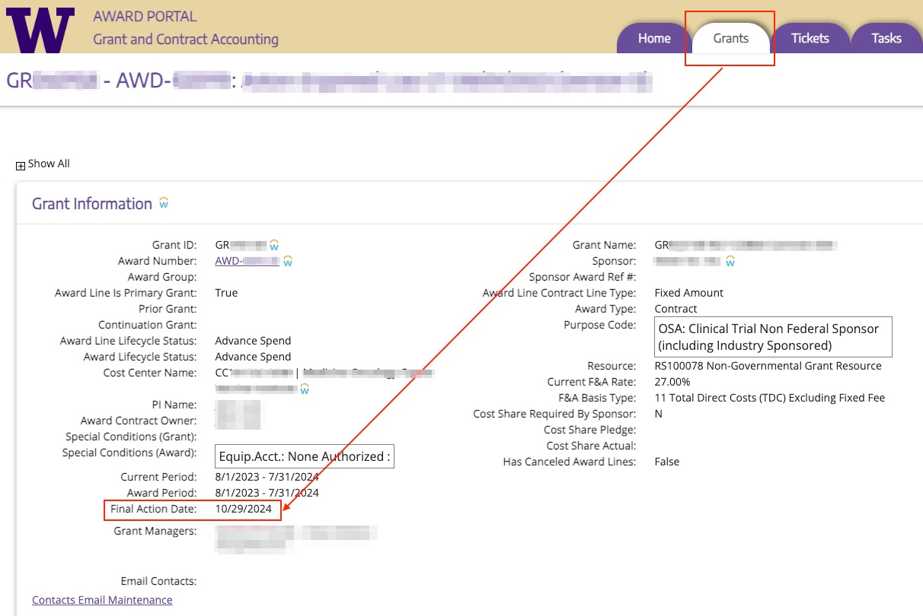
PROCESS CHANGES
New automated Workday lifecycle status change
Expired to Closeout in Progress
Started Monday April 8, 2024
Occurs Mondays
after Final Action Date
Reduces manual entry
for GCA and likelihood of
unallowable charges
posting
MRAM - Juan Lepez- Grant & Contract Accounting

Slide 17
PROCESS CHANGES
New Pending Adjustment Workday lifecycle status
Will exclude award line from automated status change from Expired to Closeout in Progress
Campus will need to send Award Portal ticket to request new status
Include reason to keep award line open
May need to include sponsor approval
Information about the automated status change and new status are available on GCA Closing Your Award webpage
MRAM - Juan Lepez- Grant & Contract Accounting

Slide 18
PROCESS CHANGES
Requesting changes to Workday Awards
SAGE GCA Only MOD with SAGE Budget
If request includes new award line
SAGE GCA Only MOD with no SAGE Budget
May require attaching new forms (e.g. rebudgeting)
Allows campus to include approvers if needed
Better workflow for requests to be sent directly to GCA Award Setup Team
Provides more accurate workload picture for GCA
MRAM - Juan Lepez- Grant & Contract Accounting

Slide 19
PROCESS CHANGES
Requesting Changes to Workday Awards
New forms include:
Rebudgeting within one award line
Rebudgeting between multiple award lines
Changes to a non-primary award line (e.g. Cost Center)
Forms and additional guidance will be available on GCA Modifications webpage by April 30
MRAM - Juan Lepez- Grant & Contract Accounting

Slide 20
KNOWN ISSUES UPDATES
Company issues in Workday
Issues can happen when GCA changes Award Line Cost Center from UW1861 to/from SOM. Examples of issues we’ve come across include:
Posting expenses
Letter of credit drawdowns and cash application
Generating sponsor invoices
MRAM - Juan Lepez- Grant & Contract Accounting

Slide 21
KNOWN ISSUES UPDATES
Company issues in Workday
Award line cost center, grant cost center, and award line company must all match
Critical that these are set up correctly from the beginning
Cost centers should likely not be listed under the two companies (UW1861 & SOM)
GCA still researching and working with Financial Application Management team to document impacts and create process documentation
MRAM - Juan Lepez- Grant & Contract Accounting

Slide 22
KNOWN ISSUES UPDATES
Issue - PAAs were posting in Closeout in Progress
Update - This has been corrected in Workday. PAAs can no longer post to an award line in Closeout in Progress status
Visit the GCA Known Issues webpage for updates on other issues
MRAM - Juan Lepez- Grant & Contract Accounting

Slide 23
NEW REPORTS
Award Reconciliation Plan Workday Report (R1536)
Compares plan amounts to award line amounts
Useful for carryover, rebudgeting funds between award lines
Job aid is currently in progress
Actual vs. Calculated F&A Report (BI Portal)
Purpose: compares actual F&A expenses to calculated F&A
Usage: during monthly grant reconciliation, during closeout
Using the Calculate vs. Actual Indirect Cost Report (UW Connect job aid)
MRAM - Juan Lepez- Grant & Contract Accounting

Slide 24
WEB UPDATES
Refreshed Final Action Date webpage
Updated to Workday terminology
Added a Roles and Responsibilities section
Added examples of FAD calculations
No change to how the FAD is calculated
MRAM - Juan Lepez- Grant & Contract Accounting

Slide 25
REMINDERS
Recent increase in direct communications with GCA staff
Please contact GCA through Award Portal or gcahelp@uw.edu
Helps our teams focus on completing workload
MRAM - Juan Lepez- Grant & Contract Accounting
Notes:
.

Slide 26
RESOURCES
Closing Your Award
Workday Award Line Lifecycle Statuses
MRAM - Juan Lepez- Grant & Contract Accounting

Slide 27
QUESTIONS
Questions can be sent to gcahelp@uw.edu
MRAM - Juan Lepez- Grant & Contract Accounting

Slide 28
Subawards -
Foundational Steps &
OSP Updates
Amanda Snyder, OSP Associate Director
April 11, 2024 MRAM
Office of Sponsored Programs

Slide 29
Prime Award from sponsor available in Workday?
Award Line (GR#) for Subaward in Workday?
Is Subrecipient a Supplier in Workday?
Are they also a Subrecipient in Workday?
Begin Subaward Request in SAGE
SAGE Status = “Composing”
OSP requests Supplier Contract & Purchase Order
OSP Review & Negotiation
OSP Issues Subaward to Subrecipient
OSP Administrator Assigned
Submit Subaward Request in SAGE
SAGE Status = “Issued”
SAGE Status = “OSP Assigned”
SAGE Status = “IN OSP”
Procurement Creates Supplier Contract & Purchase Order in Workday
Campus Reviews & Approves PO
Subaward Signed & Activated in SAGE
Award Line Activated in Workday
Subrecipient Invoicing
SAGE Status = “Active”
WORKDAY Status changes from ”Pending Subaward" to "Open"
Campus
Invoice Approval & Subrecipient Paid
Central Offices: OSP, Procurement, GCA
Subrecipient

Slide 30
Setting the Foundation - Before sending subaward request in SAGE
Prime Award from sponsor available in Workday?
Award Line (GR#) for Subaward in Workday?
Are they also a Subrecipient in Workday?
Is Subrecipient a Supplier in Workday?
Campus
Central Offices: OSP, Procurement, GCA
Subrecipient

Slide 31
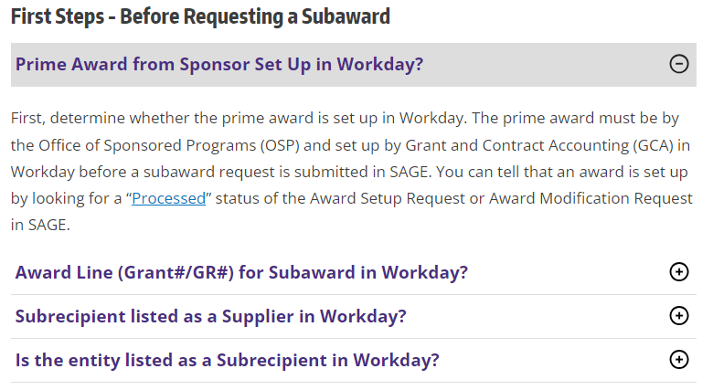
Research Website Resources
Two short videos walking through subaward process
Outgoing Subawards - First Steps - VIDEO
Next Steps to Establish and Set Up an Outgoing Subaward - VIDEO
Expandable web content for process steps

Slide 32
Subawards - OSP Updates
Extremely high volumes
Number of Subaward Actions in OSP is currently hovering around 850
CY23 Q1 - Between 175 and 244 items fully executed per month
Many escalation requests for items to be prioritized
Almost every item in OSP is urgent
Please note: We are not able to provide estimates of how long it will take review or issue items due to volumes and escalation requests.

Slide 33
Subawards - What is OSP doing?
Resources
2 Subaward Administrator Positions open
3 OSP staff from other teams working on subawards
Assoc. Director focusing on supporting subaward team
Working with the Office of Research on additional solutions
Priority is still being given to non-US, non-profit, and small business subrecipients
Request other IHE use their version of Advance Awards
Assurance emails to subrecipients when we are not in a position to prioritize their actions
Trying to assign items with the end date of the action taken into consideration, along with when the item arrived in OSP.

Slide 34
Resources
Research Website - Setup - Subawards
Outgoing Subawards - First Steps - VIDEO
Next Steps to Establish and Set Up an Outgoing Subaward - VIDEO
Subaward FAQ - Updated Nov 2023
OSP Volumes: Awards, Modifications, and Subawards
Urgent OSP Requests

Slide 35
UPDATES AND NEW LEARNING RESOURCES
MRAM UPDATE
Laurie Stephan, Associate Director for Learning
Office of Research Central

Slide 36
CORE UPDATES
Introduction to Research Administration on-demand course open
New Course: Navigating the New Frontier of Financial Reporting for Grants Managers, May 30, 9:30AM–12:00PM
Interfacing with Workday
AWD Information in Workday
Grant Budget vs Actuals R1234
Running the report
Reviewing Journal Lines
Filters
Budgeting Monitoring
Exporting Data
Visualizing Data with WD Tables
Encumbrances

Slide 37
CHECK OUT A NEW VIDEO
NEW!
Purchase Order Lifecycle R1514 demonstration at the April UW Finance Reporting Webinar. Timestamp: 10:19-21:00
Erik Sheker, Office of Research, provides real world examples of how to use this report to identify and troubleshoot issues with your POs in Workday
Award Structures in Workday—Vince Gonzalez, GCA, provides a tour of the information that lives at the Award level in Workday
Non-SNAP (HRSA) Award
SNAP (NIH) Award
Multi-year Fixed Amount Award
Multi-year Milestone Award

Slide 38
WORKDAY FINANCE FOR THE RESEARCH COMMUNITY LEARNING RESOURCES
Vice Provost for Research started outreach with research community to assess Workday Finance and transition training needs in January 2024
March 2024 Office of Research Central launched survey through MRAM to rank most needed learning resources
129 responses to survey

Slide 39
SURVEY RESULTS

Slide 40
SURVEY RESULTS

Slide 41
SURVEY RESPONSES RANKED
WORKDAY FINANCE FOR THE RESEARCH COMMUNITY TRAINING TOPICS | Score
Navigating Financial Reporting for Grants Managers | 96%
Top Ten Workday Reports for Grants Managers | 93%
Guide to Subaward Budget Setup, Invoicing & Modifications | 89%
Grant Manager completion of a GCA only MOD with GCA review for integration with Workday | 85%
Grant Manager completion of an ASR with GCA review for integration with Workday | 83%
ECC for the Grants Manager | 78%
Payroll Accounting Adjustments (with and without Salary Cap) & Worktag Adjustments | 77%
Supplier & External Customer Invoices (creating & receiving) | 66%
Create Requisition PO or BPO | 64%
Workday Reports for RPPRs | 60%
Allocate Costs to Multiple Cost Centers on Single Transaction | 58%
Transfer Awards for Incoming Faculty | 50%

Slide 42
WORK IN PROGRESS REVIEW SESSIONS
GOAL: gather feedback from the MRAM Community as the primary audience for resources developed in response to the survey
WHEN: Weekly on Fridays, April 26 to June 7
HOW LONG: 45 minutes in duration
WHAT: A short preview of the material with an opportunity for structured feedback
UNABLE TO JOIN? Sessions will be recorded and available for feedback via a Microsoft form through the following week

