Slide 1
MRAM | Monthly Research Administration Meeting
June 12, 2025, 9:00 AM – 10:00 AM
Join Webinar: https://washington.zoom.us/j/346891888
Click “CC” to Show Captions in your Zoom Controls
TOPIC | PRESENTER | EMAIL | MIN
Welcome | Matt Gardner Post Award Fiscal Compliance | gcafco@uw.edu | 2
PAFC Hot Topic: Cost Share, NRSA Stipend Levels & Travel Compliance | Matt Gardner Post Award Fiscal Compliance | gcafco@uw.edu | 10
NSF Updates | Carol Rhodes Office of Sponsored Programs | osp@uw.edu | 5-10
GIM 1 Publication, Training, and Guidance Updates | Carol Rhodes Office of Sponsored Programs | osp@uw.edu | 10-15
DOGE Draw Requests | Lori Hobson Controller’s Office | gcaloc@uw.edu | 10
CORE Update | Laurie Stephan Collaborative On Research Education (CORE) | corehelp@uw.edu | 5
NEXT MEETING
July 10, 2025 9:00 AM - 10:00 AM
Questions about MRAM? email mramques@uw.edu

Slide 2
REMINDER RESOURCES
Award Setup & Modification Requests
What do I do if I received a Notice of Award?
Review Checklist: Award Setup Request Steps for PI/Campus
Always include relevant attachments
Read Comments & History before contacting OSP/GCA
MODs: Review OSP/GCA MOD Checklist and GCA Only MOD Checklist
Tell OSP your ASR/MOD story
Need to change a Grant Name in WD? - Send GCA Only MOD
SAGE Budget Resources and SAGE Awards & Mods Resources
Schedule a Teams Appointment for SAGE Support

Slide 3
COMPLIANCE HOT TOPICS: COST SHARE; NRSA STIPEND LEVELS; TRAVEL
MRAM
June 2025
Matt Gardner
Post Award Fiscal Compliance

Slide 4
Cost Share Report in Workday (1 of 2)
Report Title: “R1205 Cost Share”
Report can display all cost share by Award, Grant, Cost Center, Cost Center Hierarchy, PI, or Sponsor
Data elements:
Award
Grant
Award Line
Award Start Date
Award End Date
Cost Share Type
Commitment Amount
Contribution Amount
MRAM – Matt Gardner – PAFC

Slide 5
Cost Share Report in Workday (2 of 2)
MRAM – Matt Gardner – PAFC

Slide 6
NRSA Stipend Levels for Federal FY 2025
NIH issued NOT-OD-25-105 on May 16th
New stipends levels for fellows, predocs, and postdocs on NRSA Fellowships and Training Grants
Effective for all NRSA awards made on or after October 1, 2024
Retroactive adjustments or supplementation of stipends for an award made prior to October 1, 2024, are not permitted

Slide 7
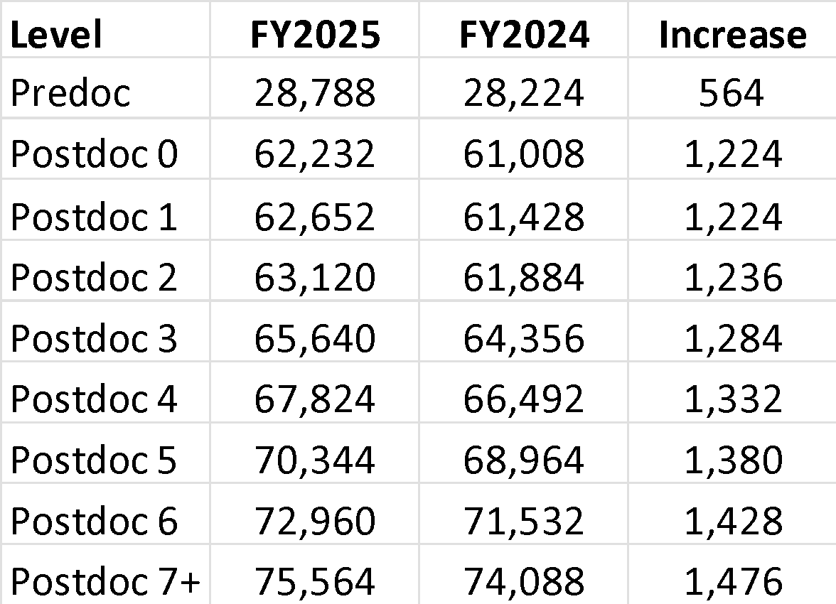
NRSA Stipend Levels for FY 2025 – New Levels
Stipends increased for all career levels for federal FY 2025
Institutional Allowance and Training Related Expenses remain the same

Slide 8
NRSA Stipend Level Notices
FY 2024: NOT-OD-24-104
Effective for awards made on or after Oct. 1, 2023
https://grants.nih.gov/grants/guide/notice-files/NOT-OD-24-104.html
FY 2025: NOT-OD-25-105
Effective for awards made on or after Oct. 1, 2024
https://grants.nih.gov/grants/guide/notice-files/NOT-OD-25-105.html

Slide 9
NRSA Stipend Levels – Scenario A
Training Grant award dates: 7/1/2025 – 6/30/2026
Award was issued during federal FY 2025
Stipend levels determined by NOT-OD-25-105
The most recently issued stipend levels apply to trainees appointed to this budget period as the award was issued after to Oct. 1, 2024

Slide 10
NRSA Stipend Levels – Scenario B
Training Grant award dates: 9/1/2024 – 8/31/2025
Award was issued during federal FY 2024
Stipend levels determined by NOT-OD-24-104
The recently issued stipend levels will not apply to trainees appointed to this budget period as the award was issued prior to Oct. 1, 2024.

Slide 11
Awards issued on or after October 1, 2024
If an award was issued on or after October 1, 2024 (FY2025) but before the new stipend levels were released…
NIH will revise the award to adjust the funding to the new levels
Appointments to institutional training grants must be amended to reflect the FY 2025 levels after the award is adjusted by NIH

Slide 12
Travel on Sponsored Awards: Reminders
Sponsors typically require recipients to follow their institution’s travel policies
In these instances, travel charged to the award must comply with UW Travel policies
UW Travel: https://finance.uw.edu/travel/
This would include any policies regarding reimbursements, receipts, and authorizations
Federal regulations state specific requirements for:
Class of air travel (least expensive accommodation)
Type of airfare ticket (unrestricted is allowable)
Compliance with the Fly America Act (use of U.S. flag carrier)
MRAM – Matt Gardner – PAFC

Slide 13
ECC Focused Topic Office Hour
Thursday, June 26th, 10am to 11am
Topics:
New IBS definition and how/when to use the Salary Allocations Calculator tool
Info: https://finance.uw.edu/pafc/effort-reporting/ecc-office-hours
The session will be recorded and all materials will be posted on the PAFC Effort Reporting webpage
Link: https://finance.uw.edu/pafc/session_recordings
MRAM – Matt Gardner - PAFC

Slide 14
Questions
Post Award Fiscal Compliance (PAFC)
effortreporting@uw.edu (Effort questions)
gcafco@uw.edu (All other compliance questions)
https://finance.uw.edu/pafc/
Matt Gardner
mgard4@uw.edu
David Parks, Effort Compliance Analyst
parksd2@uw.edu
MRAM – Matt Gardner – PAFC

Slide 15
NSF: Updates
June 2025 MRAM
Carol Rhodes, Director
Office of Sponsored Programs

Slide 16
Updates to NSF Award Terms & Conditions
NSF’s recently updated Award Terms & Conditions.
Safe and Inclusive Working Environments for Off-Campus or Off-Site Research renamed to Safe and Harassment-free Working Environments for Off-Campus or Off-Site Research.
May not operate any programs that advance or promote DEI, or discriminatory equity ideology in violation of Federal anti-discrimination laws.
Do not engage in discriminatory prohibited boycott activity.

Slide 17
Updates to NSF Award Terms & Conditions - Indirect Costs
Imposes a 15% indirect cost rate cap
This is currently challenged in court
NSF has stayed (paused) implementation
Hearing for case is 6/13/2025 (summary judgment) but will be several days before we hear resulting decision.
In meantime, UW will submit at our regular negotiated rates.
UW will not be processing NSF awards during this time.
Notes:
NSF may unilaterally implement a 15% Indirect Cost Rate, regardless of whether there is already a negotiated indirect cost rate in place.
NSF may notify recipients via email or other written communication.
Additionally, no rates greater than 15% MTDC, will be allowed for the entire life of the award. This includes the award period prior to notification of the application of this term.
Charging excess indirect costs to an NSF award or using incorrect rate will be disallowed.
This term and condition will supersede any previously submitted and/or approved budget.

Slide 18
Malign Foreign Talent Recruitment (MFTRP) Certification Requirement - as of 6/07/2025
All named PIs & Co-PIs on NSF awards made after 5/20/2024 must annually certify they are not party to a MFTRP.
Only PIs and Co-PIs required to certify at this time
Impacted PIs & Co-PIs prompted to complete MFTRP certification after signing into Research.gov
Those with more than one active award are only required to certify once, annually.
PIs and Co-PIs can view completed MFTRP certifications under Academic / Professional Information section of their profile.
NSF plans to expand requirement for all senior/key personnel roles as well as provide organizations with access to the annual certifications.
NSF Proposal and Award Policies and Procedures Guide (PAPPG) Chapter II.D.1.e(ii)

Slide 19
Questions (1 of 2)

Slide 20
GIM 1 Publication, Training, and Guidance Updates
June 2025 MRAM
Carol Rhodes, Director
Office of Sponsored Programs

Slide 21
Feedback
Institutional Review, PI/Campus Review
General - OSP Review
Will OSP verify changes requested on an eGC1 were sufficient or just move the application along?
When OSP provides technical instruction review, it should be consistent and/or clearly communicated on each eGC1.
Get rid of “Recommended changes” all OSP changes should be required changes.
OSP review should be consistent throughout OSP.
Aspects of Proposals Review by PI and Campus Units, including Department, Schools & Colleges
Review levels not clear between PI vs. Unit Reviewers, Deans level reviews
How to ensure PI visibility of complete applications from RTS=No to an RTS=Yes proposal applications.

Slide 22
Feedback
Changes, Roles & Responsibilities, Additional Comments
Training Needs
More access & training required on campus
Enormous responsibility on PI, they need training on proposal submission
Provide more guidance on what MUST be reviewed at campus level to help realign review practices with policies
Additional Comments
Enhance SAGE contacts to include pre-award & post award contacts

Slide 23
Training and Resource Updates
Office of Research Website
Quick Guide to Proposal Preparation
Companion to Blueprint of a Proposal and the Quick Guide for Proposal Submission
Targeted for mid July
Future video explainer & checklist envisioned
Solicitation Terms to Watch for
Instructions & list of terms requiring increased PI & institutional scrutiny
July 1 release targeted
Glossary Updates
Administrative Elements, Technical Instructions, Programmatic Elements of a Proposal, Business Data, and more….

Slide 24
Training and Resource Updates
Courses & Events
What should a campus & PI approved eGC1 look like?
Demo and Q&A session with experts from OSP & ORIS
July 17, session will be recorded
Grants Management for Investigators
Revisions to both the Refresher & In-Person courses
On-demand & in person in the Fall
CORE: SAGE: Creating & Submitting an eGC1
Updated & bonus summer session scheduled end of July
7/30/2025
CORE: Blueprint of a Proposal
Revised & Updated
9/29/2025

Slide 25
Training and Resource Updates
NEW On-Demand
CORE: Reading the Funding Opportunity
Video Explainer
Includes sample exercise for NIH & industry funded opportunities, with more samples envisioned
Targeted for early July
CORE: Funding Mechanisms at the UW
Nano video mini-series
Why is it important to know the sponsor funding mechanism?
Identifying federal sponsor funding mechanisms
Identifying non-federal sponsor funding mechanisms
Targeted by end of July
CORE: SAGE eGC1 On-Demand Resources
On-demand resources planned for summer & fall

Slide 26
Training and Resource Updates
FAQs
NEW FAQs
NEW: Should I route an eGC1 marked NO to the Ready to Submit question?
NEW, 7/01/2025: What does a campus & PI approved eGC1 mean to OSP?
NEW 7/01/2025: What resources are available to help me learn how to prepare a proposal at the UW?
New Late Summer: What do I need to attach to an eGC1 for a proposal to an external sponsor?
Existing FAQs
UPDATED: Is my eGC1 Ready to Submit?
What are some Proposal Reminders to help streamline submission?
How do I know what project type to select on an eGC1 and why is it important?
Why should I route an eGC1 for Contracts & Other Transactions to OSP ASAP?

Slide 27
Questions (2 of 2)
See information shared at April MRAM on revisions to GIM 1.

Slide 28
DOGE Requests
MRAM
June 12, 2025
Lori Hobson
Controller’s Office

Slide 29
LOC Draws
Draw Requests
Uploaded as a file
Multiple awards are included in each file
Justification is by Workday Object Class
MRAM – Lori Hobson – Controller’s Office

Slide 30
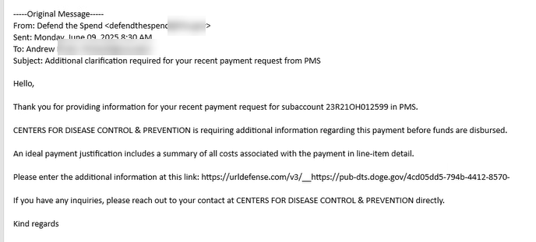
DOGE Requests (1 of 1)
Requests for additional information
Email is received by person submitting the draw
Includes link to form to provide requested information
MRAM – Lori Hobson – Controller’s Office

Slide 31
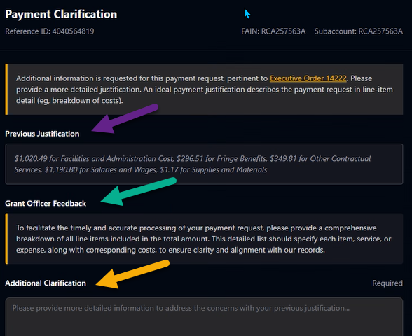
DOGE Requests – Sample Form
MRAM – Lori Hobson – Controller’s Office

Slide 32
DOGE Requests – How you can help
Respond to requests as soon as possible
Provide a detailed response that we can use as written
Address specific transactions included in attachment
Use definitive language
Do not include screenshots
If you receive requests for multiple awards, please reply to each email. Do not combine responses in one email.

Slide 33
DOGE Requests – Sample Responses

Slide 34
DOGE Requests – Questions
Send questions to gcaloc@uw.edu

Slide 35
UPDATES
MRAM UPDATE
Laurie Stephan, Associate Director for Learning, ORC

Slide 36
Community of Practice for Research Administrators (CoPRA)
PURPOSE
A tri-campus community of practice led by and for practitioners of research administration at the UW who share a passion for their work and believe they can learn to do it better through regular interactions with members of their community.
STAY IN TOUCH
Teams channel
Informational website
In-Person Meetings, first one:
June 18, 11:00 am – 12:00 pm, Miller 320, Zoom

Slide 37
Community Need Survey Results (1 of 2)
TOPIC | HIGH Priority | Medium Priority | Low Priority | Not a Priority | Highest Priority Score
Proposals | 33% | 27% | 15% | 15% | 60%
Award Setup | 34% | 31% | 19% | 6% | 65%
Award Modifications | 45% | 37% | 13% | 5% | 82%
Closeout | 40% | 38% | 13% | 9% | 78%
Subawards | 44% | 36% | 16% | 4% | 80%
Financial Reporting (Workday and BI Portal) | 62% | 30% | 4% | 4% | 92%
Sponsor Reporting (Progress and Final Reports) | 31% | 38% | 24% | 7% | 69%

Slide 38
Community Need Survey Results (2 of 2)
TOPIC | COMMENTS
Workday Reports (20) | Finding the right financial reports to be able to confidently and quickly provide budget updates, monitoring, and spend-down forecasting… so many different ways to view the data, differences in parameters
Finding Current Information (16) | Finding the best, most recent, most helpful guidance and tools/processes given the enormous amount of information that has accumulated in a variety of places on UW web pages. Many days I feel like my questions all start with “Where do I find…”
Clarity Around Processes | SAGE MODS, Proposals, Subawards, Cost Share, Travel, PAAs, FAB Budgets
Support through Change (14) | There is so much going on, constant change.
Budget Management (8) | Best practices for tracking/monitoring grant budgets that includes pre- and post-W/D expenses, budget projections.
Supporting PIs (7) | Workday reports, policies, proposals
Tasks Management (7) | Tracking all of the little tiny tasks that have to happen at once
Notes:
Workday reports June 18. Finding current information AIDE. Clarity around processes SAGE MODs first, Support through Change—CoPRA develops to give us community to support us, and CoPRA might be able to get into one of its goals of matching mentors to mentees.

Slide 39
CoPRA June 18 Meeting Goal & Structure
The goal is for the community to begin to develop a shared body of knowledge around how to get the information grant managers need from Workday. We strongly encourage community members to bring questions and practices to the table.
Community members will share key reports and search parameters for getting answers to specific questions
Screen sharing for anyone who wants to demonstrate either their question or their answer
Open dialog will be encouraged with mics in the room and via Zoom for all to hear
Best practices, tips and caveats will be documented and shared via the Teams channel after the meeting (the meeting will not be recorded)
Do you have a particularly sticky wicket you’d like the community to consider? Feel free to post on CoPRA Teams channel or email Chelsea (cmusick@uw.edu), Stephanie (sln56@uw.edu), or CORE help (corehelp@uw.edu) and we will tackle it live!

