Slide 1
MRAM | Monthly Research Administration Meeting
                July 10, 2025, 9:00 AM – 10:00 AM
Join Webinar: https://washington.zoom.us/j/346891888
Click “CC” to Show Captions in your Zoom Controls
TOPIC | PRESENTER | EMAIL | MIN
Welcome | Kirsten DeFries Research Compliance & Operations | kirsten5@uw.edu | 2
HSD Updated Data Security Requirement | Jason Malone Human Subjects Division | jmmalone@uw.edu | 10
Research Administration Data (RAD) - new reports | Aron Knapp Office of Research Information Services (ORIS) | aronk@uw.edu | 10
AIDE - Update on Workstreams | Mandy Morneault Office of Research | vicka@uw.edu | 5
CORE Update | Laurie Stephan Collaborative On Research Education (CORE) | corehelp@uw.edu | 5
                NEXT MEETING
                August 14, 2025 9:00 AM - 10:00 AM
                Questions about MRAM? email mramques@uw.edu

Slide 2
REMINDER RESOURCES
Award Setup & Modification Requests
What do I do if I received a Notice of Award?
Review Checklist: Award Setup Request Steps for PI/Campus
Always include relevant attachments
Read Comments & History before contacting OSP/GCA
MODs: Review OSP/GCA MOD Checklist and GCA Only MOD Checklist
Tell OSP your ASR/MOD story
Need to change a Grant Name in WD? - Send GCA Only MOD
SAGE Budget Resources and SAGE Awards & Mods Resources
Schedule a Teams Appointment for SAGE Support

Slide 3
UPDATED HSD GUIDANCE: DATA SECURITY PROTECTIONS
JULY 10, 2025
MRAM
JASON MALONE, HSD DIRECTOR

Slide 4
THE GUIDANCE (SLIDE 1 OF 2)
Describes the types of data security protections that the UW IRB expects researchers to provide for human participants data, according to the possibility and type of harm to participants associated with a breach of the data.
Applies only to studies where the UW is the IRB of record, including non-UW institutions relying on the UW IRB for review.
  Currently does not apply to studies relying on an external IRB
Notes:
- The guidance itself is not new.
- These data security requirements have been around since 2016 but have not been updated significantly in the intervening 9 years.
- It currently only applies to studies where the UW is the reviewing IRB, including non-UW sites relying on the UW for IRB review.

Slide 5
THE GUIDANCE (SLIDE 2 OF 2)
What’s new?
  Risk Levels have been revised and reduced from five (5) to four (4)
  Security requirements for each level have been updated to reflect current best practices
  New device configuration guidance, sample policies templates, and online training tutorial available
What’s the same?
  Researchers may still request an exception from specific requirements
  Researchers may select more than one data classification level for different types of research data
  Researchers are still expected that all data in the same system should be maintained at the highest risk level for any of the data
  Many of the required protections are already part of UW IT-supported servers and networks and would not require any additional work or resources from researchers.
Notes:
- Over the past 6 months has worked with UW Medicine Compliance, UW Medicine Information Security, UW-IT Information Security, other SMEs and researchers to bring the guidance up to current data protection standards.
[REVIEW Slide Content]

Slide 6
Data Security Risk Levels 1 and 2
OLD
NEW
 | Level 1: Very low risk of harm if disclosed
Description | These data have little or no sensitivity. Disclosure of these data would have very little or no risk of physical, psychological, social, economic, legal, or educational advancement harm to the subjects.
Examples | De-identified, anonymous, or publicly available data Data for which subjects have consented to allow public access (e.g., a museum archive) Opinions of individuals about non-sensitive issues, or performance on non-sensitive tasks
 | Level 1: Suitable for Public Disclosure
Description | Information suitable for publication, public sharing, or open access. Applies to both existing data (retrospective use) and prospectively collected data.
Examples | Data from lawful and trusted public sources (e.g., census data, court records) Data for which participants have consented to allow public access (e.g., a museum archive, NIH public access repositories)
 | Level 2: Little risk of harm to individuals if disclosed
Description | These data have relatively little risk of harm except possible short-term embarrassment or psychological discomfort if the data were disclosed. Disclosure of this information would not reasonably place individuals at risk of criminal or civil liability or be damaging to their financial standing, insurability, employability, educational advancement, or reputation.
Examples | Performance of individuals on benign tasks (e.g., online games and puzzles) Individual opinions on innocuous topics (e.g., perceived nutritional values of different foods, product brand preferences)
 | Level 2: Some risk of minor harm to individuals if disclosed
Description | These data have relatively little sensitivity except possibly short-term embarrassment or psychological discomfort if the data were disclosed.
Examples | Performance of individuals on non-sensitive tasks in a competitive situation Genetic information about individuals’ metabolism of medical drugs such as statins
Notes:
Some bigger changes were made here to better align with general data security risk levels here at UW and other peer institutions
Previously Level 1 included low risk research (e.g., opinion survey studies, performance of non-sensitive tasks). These have now been moved up to Level 2
Level 1 is limited to information that would be acceptable if it were publicly disclosed.
Result of this is that more low-risk research will now qualify for the application of the data security standards required under level 2

Slide 7
Data Security Risk Level 3
OLD
NEW
 | Level 3: Could cause risk of material harm to individuals if disclosed.
Description | These data could result in harm that can have genuine impact, but the magnitude and/or duration are generally not serious, long-lasting, and/or irreversible.
Examples | Non-sensitive Personal Health Information
 | Level 3: Risk of material harm to individuals if disclosed
Description | These data could result in harm that has a genuine impact, but the magnitude and/or duration are generally not serious, long-lasting, and/or irreversible. Disclosure of these data could cause some financial or social harm, civil liability, reputational harm, or impact to educational advancement. However, disclosure of these data would not cause criminal liability, loss of insurability or employability, severe financial or social harm.
Examples | Non-stigmatized personal health information (e.g., lab results that don’t indicate a clear diagnosis such as Vitamin D levels, visibly obvious conditions such as broken arm, wearing corrective lens) Student course performance information
Notes:
There were fewer changes to Risk level 3 but more details were provided to assist researchers in identifying what type of data fits into this category.

Slide 8
Data Security Risk Levels 4 and 5
OLD
NEW
 | Level 4: Would likely cause serious harm to individuals if disclosed
Description | These data could result in serious harm.
Examples | Sensitive Personal Health Information, such as the history of cancer or other significant conditions which could (for example) affect employability or insurability
 | Level 5: Extremely sensitive; could cause severe harm to individuals if disclosed
Description | These data could result in serious and long-lasting harm.
Examples | Information about subjects’ illegal behavior Very sensitive Personal Health Information, such as the diagnosis of HIV/AIDS in some cultures or a diagnosis of leprosy
 | Level 4: Risk of serious and/or long-lasting harm to individuals if disclosed
Description | These data could result in serious and/or long-lasting harm. Disclosure of these data could cause criminal liability, loss of insurability or employability, severe financial or social harm.
Examples | Personal health information such as mental health, alcohol and substance abuse, HIV status, STIs, cancer, reproductive healthcare Individually identifiable financial account information Information about illegal behavior (e.g., use of illegal substances, underage use of legal substances) Information about immigration status
Notes:
Levels 4 and 5 have been combined in our updated guidance because we have found it difficult to separate the two and the data security requirements are essentially the same. Any study working with level 5 data would now be considered level 4 under the revised guidance

Slide 9
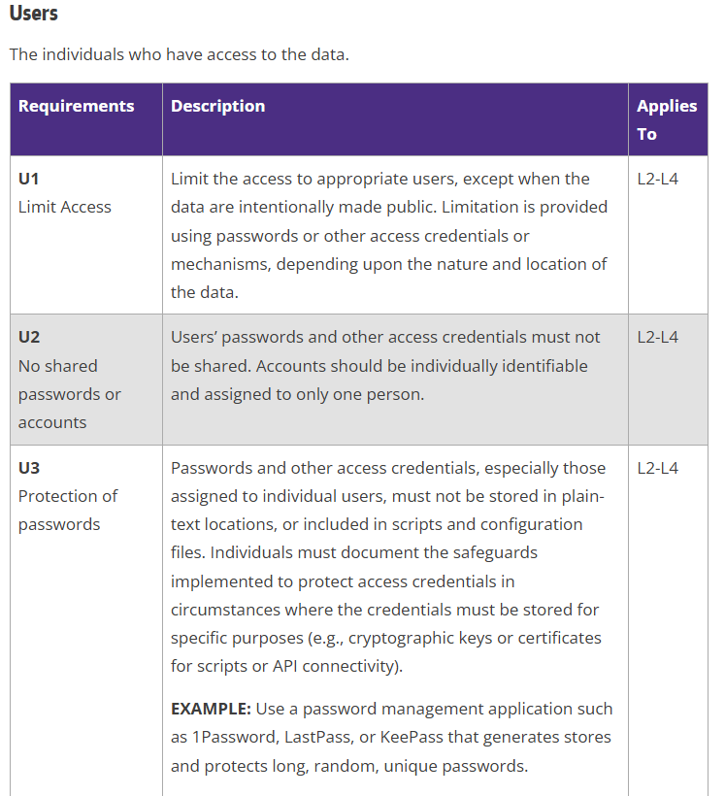
DATA PROTECTION REQUIREMENTS
Six categories:
  Users
  Devices
  Servers/Services
  Paper/Non-digital Records
  Data Transmission
  Vendors
Notes:
There six categories of data protection requirements and within each are specific requirements along with what risk levels those requirements apply to.
This is not new but the content for many of the requirements has been updated or enhanced.
We’ve also attempted to provide more details for clarity and links to helpful references and other institutional guidance. Some of these changes were made in response to feedback we’ve received from researchers when we’ve conducted PAVE audits.

Slide 10
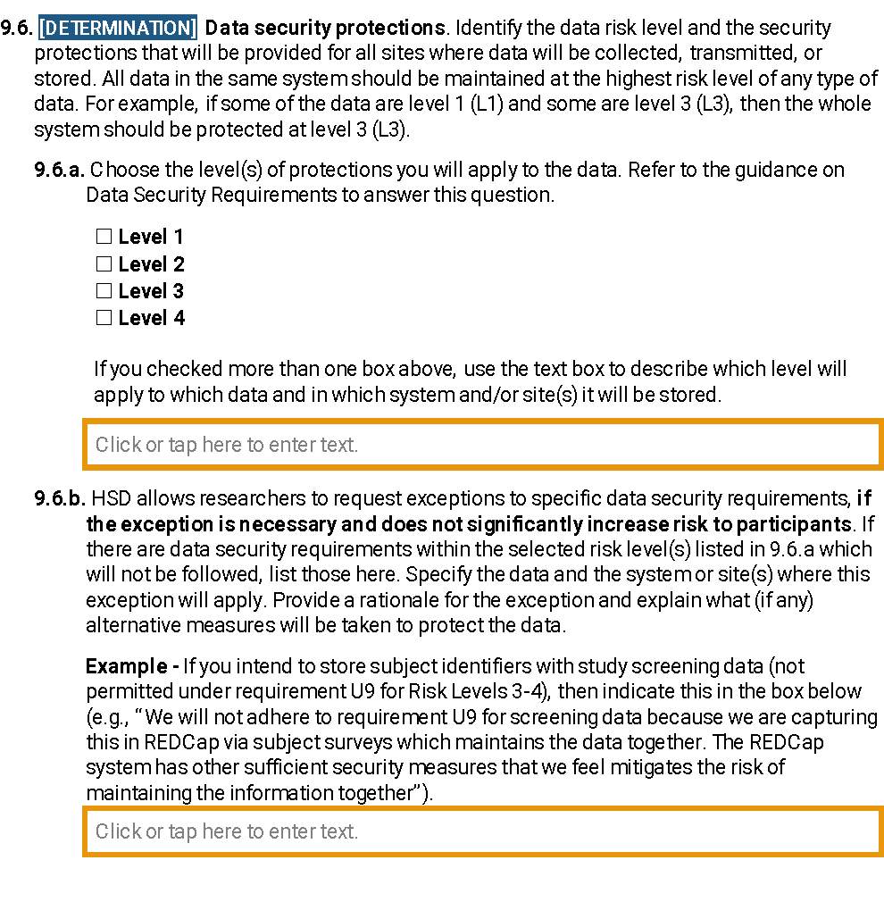
Revised IRB Protocol Question
Notes:
We have updated our IRB protocol form to reflect the changes in risk levels.
Researchers can check more than one risk level and then describe in more detail what level will apply to which types of data and in which systems that data will be stored [CLICK for Fly-in and CLICK AGAIN for Fly-away]
As noted before, researchers can request exceptions to specific requirements for a given risk level [CLICK for Fly-in]

Slide 11
IMPLEMENTATION
New Studies
  New requirements effective July 1, 2025
Existing Studies
  Researchers must apply updated protections by January 1, 2026
  Researchers are expected to assess if the data security risk level(s) has changed and if yes, submit a study modification
  HSD review staff assess if security level has changed for studies that submit for Continuing Review and if yes ask researcher to submit a study modification
Notes:
For new studies approved after July 1st, the updated data security protection requirements are in effect.
We’re giving existing studies more time to assess their data security protections and make any updates [REVIEW Slide]

Slide 12
OTHER RESOURCES
Online Tutorial Data Security Protections (https://www.washington.edu/research/hsd/training/hsd-tutorials-and-videos/#datasecurity)
WORKSHEET Device Configuration (https://www.washington.edu/research/forms-and-templates/worksheet-device-configuration/)
Template Policies
  Confidentiality and Security Training (https://www.washington.edu/research/forms-and-templates/template-confidentiality-training/)
  Device Management and Monitoring (https://www.washington.edu/research/forms-and-templates/template-device-mgmt-policy/)
  Research Data Access Control (https://www.washington.edu/research/forms-and-templates/template-data-access-policy/)
Notes:
As mentioned earlier, we’ve developed a number of new resources to make compliance with these data security requirements easier including:
New online tutorial for researchers that explains the purpose of these requirements, the risk levels, and the associated data security requirements
A new worksheet that walks through how to appropriately configure devices for proper security. This is especially useful for researchers, particularly student researchers who may be using personal devices not supported by a department IT
Some of the security requirements include having specific policies that address how research staff are training on data security, how devices are managed and tracked, and how access to study data is controlled. We have now created sample templates for researchers who may not have department policies that address this and need to generate their own.

Slide 13


QUESTIONS?

Slide 14

NEW RAD GROUP REPORTS
Aron Knapp
Office of Research Information Services (ORIS)
July 9, 2025

Slide 15
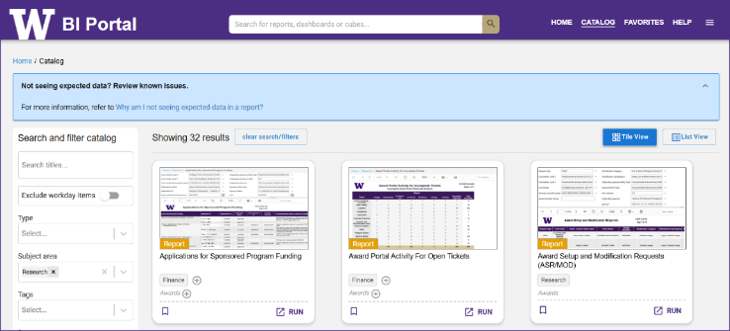
Research Reports @ the BI Portal
BI Portal Overview
https://biportal.uw.edu/home
Requires an active UW NetID + password
Requires EDW access rights
  Instructions at Request Permission & Access Data
Subject area = Research

Slide 16
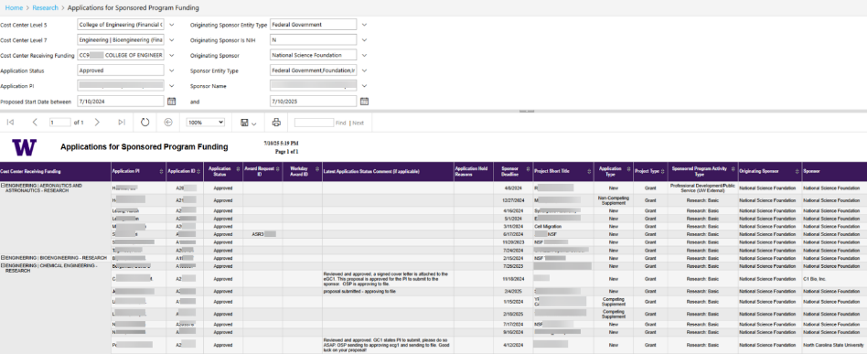
Research Reports @ the BI Portal
Applications for Sponsored Program Funding (1 of 2)
Shows historical and active applications
Filter by Cost Center Hierarchies, Cost Center, Status, PI, Sponsor and more
Example: CoE, Approved Applications to the NSF for year ahead, an NSF ‘pipeline’.

Slide 17
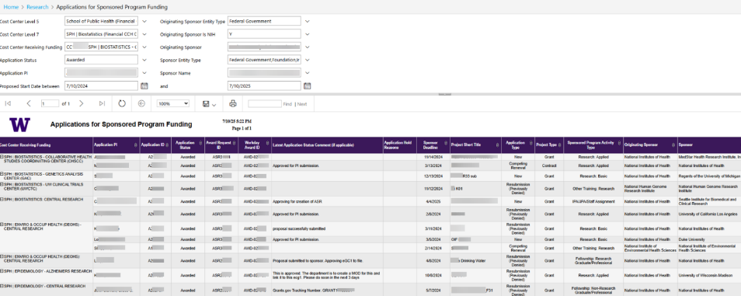
Research Reports @ the BI Portal
Applications for Sponsored Program Funding
(2 of 2)
Example #2: SPH, Awarded Applications to the NIH since WD go-live through a year from today. Help connect pre- and post-award with key identifiers.

Slide 18
Research Reports @ the BI Portal
Applications for Sponsored Program Funding
Report Link

Slide 19
Research Reports @ the BI Portal
Subawards
SAGE subaward requests received by the Office of Sponsored Programs (OSP) from FY2024 - present.
Track the status of subaward requests, prioritize which subawards to escalate, and analyze subaward trends

Slide 20
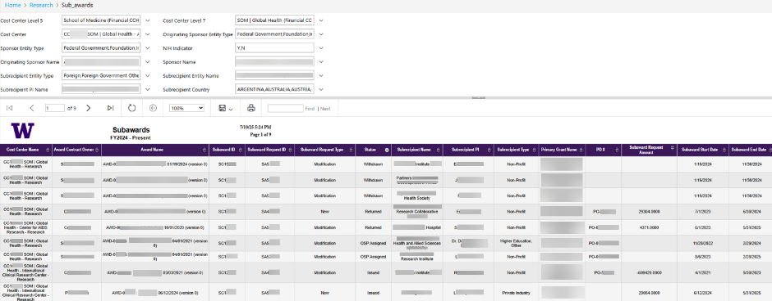
Research Reports @ the BI Portal
Subawards (1 of 2)
Example #3: GH, Subawards in process. Thrulines from SAGE to WD.

Slide 21
Research Reports @ the BI Portal
Subawards (2 of 2)
Report Link

Slide 22
ORIS RAD Group Reports
Overview
ORIS RAD Group Reports (SharePoint Link)
Notes:
the reports under construction vs the reports on there way or already at the BI portal.

Slide 23
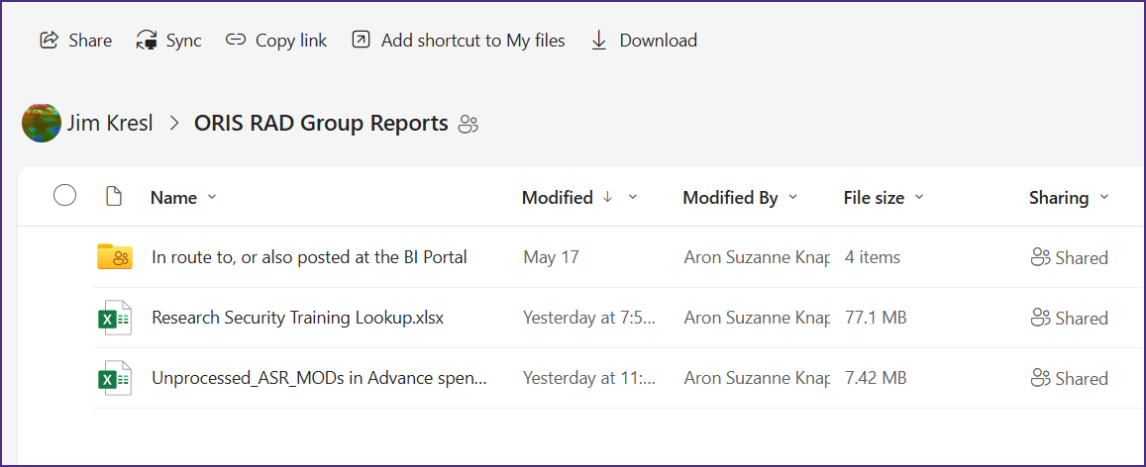
ORIS RAD Group Reports
The newest
Research Security Training Lookup
Unprocessed ASRs and MODs in Advance Spend

Slide 24
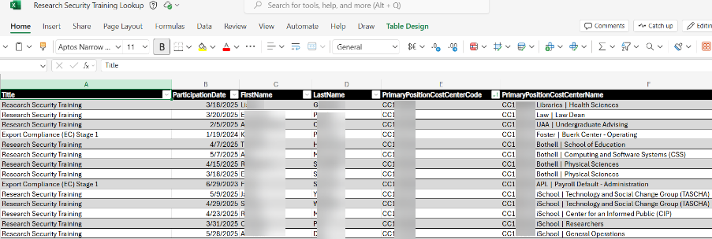
ORIS RAD Group Reports
Research Security Tracking
Research Security Tracking
  support your research teams in meeting research compliance
Notes:
Tracking

Slide 25
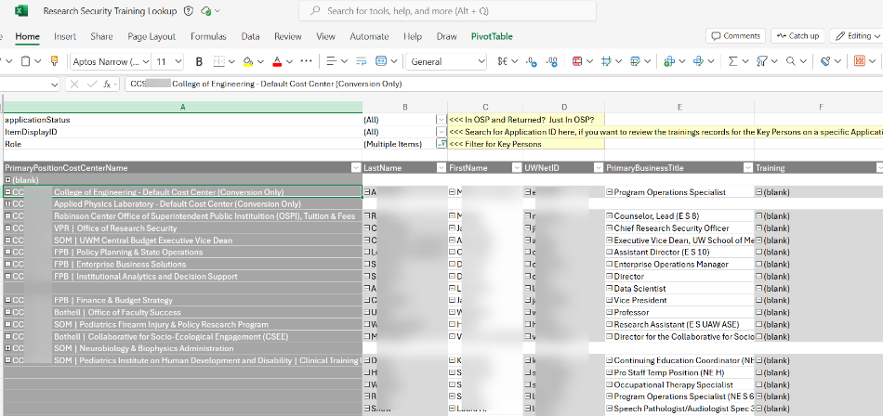
ORIS RAD Group Reports
Research Security Lookup
Research Security lookup by Application ID
  support your research teams in meeting research compliance
Notes:
Tracking

Slide 26
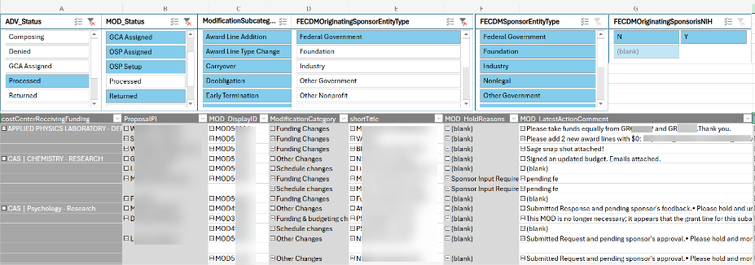
ORIS RAD Group Reports
Unprocessed ASR/MODs in ADV Spend
Identify the Award Setup and Modification Requests related to Awards in Advance spend.
Notes:
Tracking

Slide 27
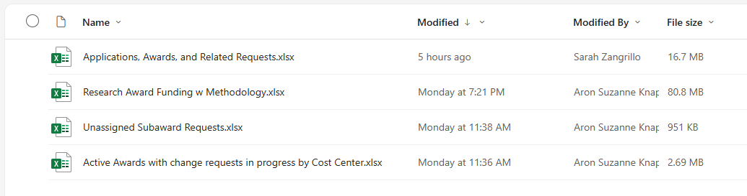
ORIS RAD Group Reports
Refresher
ORIS RAD Group Reports (SharePoint Link)
Notes:
each of these are either already at , or are on their way to the BI portal

Slide 28
ORIS RAD Group Reports
What’s Coming Next
Sponsored Program Award Reports!
AIDE Priorities
  Awards w/ SAGE requests in progress
  AwardView
Longitudinal Counts and Amounts (pre and post WD)
Active Awards by CCH/CC/PI
Closeout: Awards/Grants that have ended more than 120 days ago NOT in closed status
Awards by Discipline
Awards with Non-fiscal compliance elements
Top 10 awardees

Slide 29
ORIS RAD Group Reports
Resources
Research Administration Data questions: grantrpt@uw.edu
  Will go to ORIS’ RAD Group
Technical BI Portal questions, including how to connect: help@uw.edu
  Put “EDW Question” in subject line
  Will go to UWIT’s BI portal team

Slide 30
Questions?

Slide 31
Awards Improvement and Development Effort
Update 7/10/2025
Notes:
I’m here with a bimonthly update on the Awards Improvement and Development Effort—AIDE.
AIDE is a collaboration between Finance, Planning & Budgeting, the Office of Research, and UW-IT to improve grants administration and awards management.

Slide 32
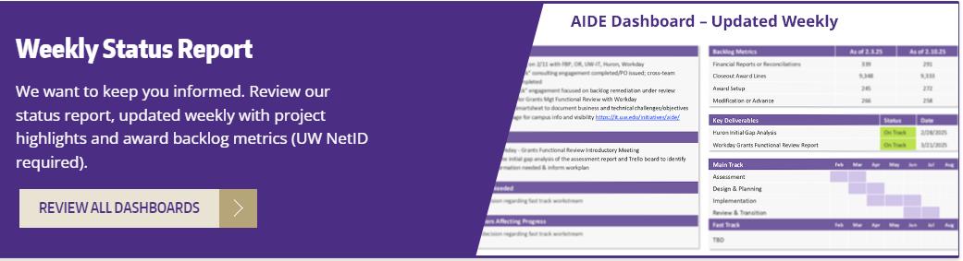
Website enhancements (1 of 2)
Webpage: https://it.uw.edu/initiatives/aide/
Notes:
Since May, we’ve enhanced the AIDE webpage.
The AIDE Status Report dashboard is updated weekly. It includes a 6-page report with recent accomplishments, key deliverables, upcoming goals, and metrics on OSP and GCA workstreams.

Slide 33
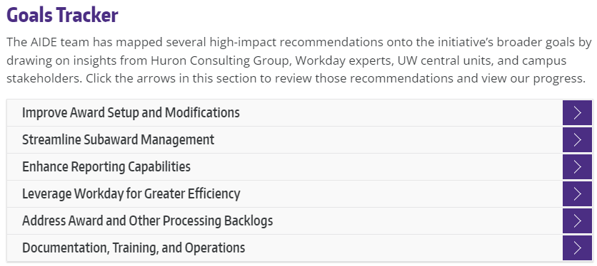
Website enhancements (2 of 2)
Webpage: https://it.uw.edu/initiatives/aide/
Notes:
We’ve also mapped recommendations to AIDE’s broader goals, drawing on input from campus, central units, Huron, and Workday experts.
You can now explore these recommendations and their implementation status directly in the Goals Tracker section of the webpage.

Slide 34
Delivered! Streamlining Enhancements
Award Setup Request Validations
Updated Compliance Questions
SAGE-to-Workday Enhancements
Maintenance Fixes & Documentation Updates
  SAGE flags errors pre-submission
  eGC1 updated for federal compliance
  Improved grant tagging, faster processing
  Streamlined guidance, smoother user experience
August Pipeline: SAGE MODs-Workday Integrations
Notes:
One of the UW central units, the Office of Research Information Services (ORIS), has recently released improvements aligned with AIDE’s goals
Award Setup Request Validations: New SAGE features now flag common errors before submission, reducing rework and processing delays.
Updated Compliance Questions: In response to upcoming federal requirements, eGC1 now includes updated guidance for biohazards, select agents, SCUBA diving, and hazardous chemicals.
SAGE-to-Workday Enhancements: Integration improvements ensure accurate grant resource tagging and object code mapping for more efficient award processing.
Maintenance Fixes & Documentation Updates: Behind-the-scenes improvements and clearer guidance further reduce friction for campus users.
And in August, we’re expecting the release of SAGE Mods–Workday integrations.

Slide 35
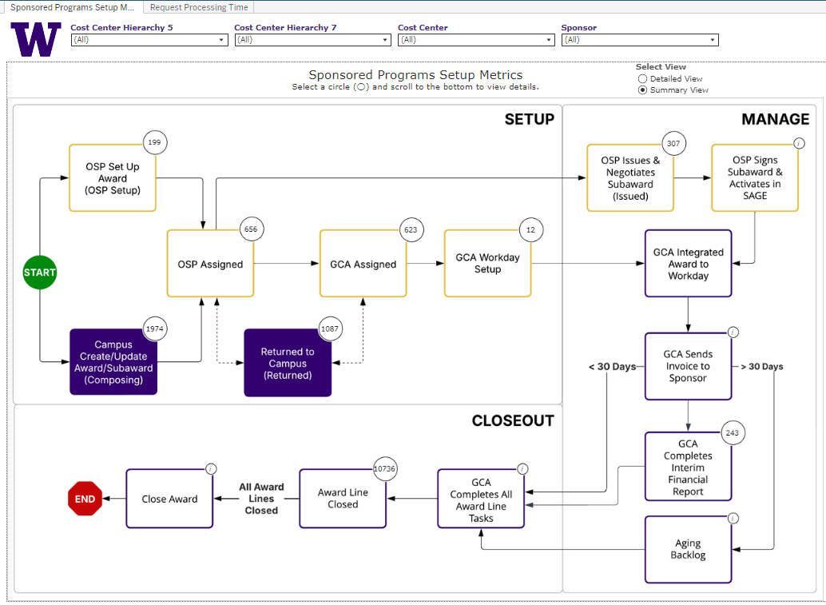
Delivered! Sponsored Programs Metrics Dashboard (1 of 2)
Summary view
Notes:
We’ve launched a new Sponsored Programs Setup Metrics Dashboard, developed with FPB’s DATAGroup.
It provides visibility into the full award lifecycle—helping you track progress, anticipate timelines, and plan resources.
Search for ‘SponsoredProgramsSetup’ in the BI Portal to access it.
There are two different views – here, a less-detailed summary view.
https://bitools.uw.edu/#/views/SponsoredProgramsSetup/SponsoredProgramsSetupMetrics?:iid=1

Slide 36
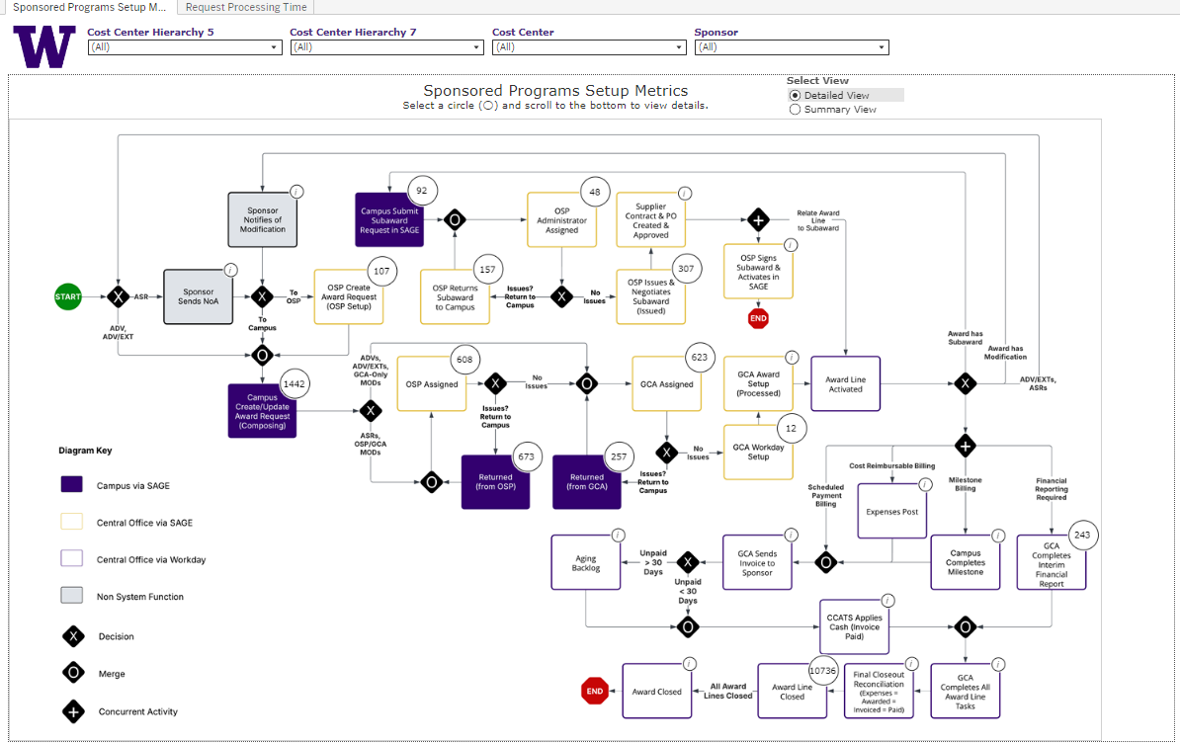
Delivered! Sponsored Programs Metrics Dashboard (2 of 2)
Detailed view
Notes:
There’s also a detailed view that shows the full process flow. This helps pinpoint where an award is in the pipeline.

Slide 37
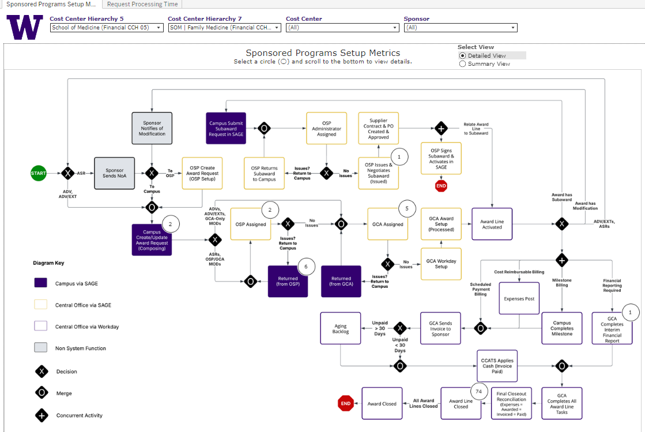
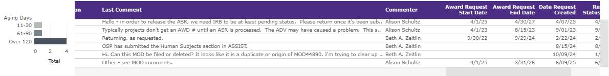
An Updated User Interface
Search for your cost center
Find submission status
For returns, see return comments
Notes:
You can filter by cost center to see where your submissions are.
For example, here I’ve filtered for Family Medicine and can see six items returned by OSP.
The table includes comments, so you can quickly understand the reason for return.

Slide 38
SMEs for User Testing
SME Participation
Purpose of SME Engagement
  35 representatives from 13 schools/colleges/campuses
  Selected based on interest, expertise and availability
  Representing diverse research administration perspectives
  Informs user experience testing and feedback
  Provides insight into specific workstreams
  Shapes practical, campus-informed solutions
Notes:
We’ve invited each school, college, and campus to identify subject matter experts for user testing.
So far, we’ve received 35 names from 13 units—representing a strong cross-section of our research community.
These SMEs will help us test usability, flag issues, and shape improvements based on real campus experience.
We’ll continue expanding engagement as the initiative progresses.

Slide 39

UPDATES
MRAM UPDATE
Laurie Stephan, Associate Director for Learning, ORC

Slide 40
Community of Practice for Research Administrators (CoPRA)
PURPOSE
A tri-campus community of practice led by and for practitioners of research administration at the UW who share a passion for their work and believe they can learn to do it better through regular interactions with members of their community.
STAY IN TOUCH
Teams channel
Informational website
Office hours for collaborative problem solving. Bring your questions!
  July 31, 11:00 am – 12:00 pm (Zoom only)

Slide 41
New Resources
Proposal Development
  New video and exercises on Reading the Notice of Funding Opportunity (NOFO)
  Proposal Preparation Quick Guide
Video Demos on Financial Tools
PI Dashboard in Workday
Post Award Dashboard in Tableau
Workday Navigation Tips

