Slide 1
MRAM | Monthly Research Administration Meeting
                August 14, 2025, 9:00 AM – 10:30 AM
Join Webinar: https://washington.zoom.us/j/346891888
Click “CC” to Show Captions in your Zoom Controls
TOPIC | PRESENTER | EMAIL | MIN
Welcome | Kirsten DeFries Research Compliance & Operations | kirsten5@uw.edu | 2
PAFC Hot Topic: NIH Child Care | Matt Gardner Post Award Fiscal Compliance | gcafco@uw.edu | 10
Diversity in Clinical Trials Initiative | Jason Malone Human Subjects Division | jmmalone@uw.edu | 10
NIH No-Cost Extensions | Mike Snow Office of Sponsored Programs | osp@uw.edu | 3-5
ATF eGC1s | Mike Snow & Elizabeth Walker -Tilley Office of Sponsored Programs | osp@uw.edu | 15
Subawards Update | Josy Combs Office of Sponsored Programs | ospsubs@uw.edu | 10
SAGE Update | Judy Chung Office of Research Information Services | sagehelp@uw.edu | 10
GCA Update and Staffing | Vince Gonzalez Grant & Contract Accounting | vinceg@uw.edu | 5
Extending Subaward Award Lines | Vince Gonzalez Grant & Contract Accounting | vinceg@uw.edu | 5
CORE Update | Laurie Stephan Collaborative On Research Education (CORE) | corehelp@uw.edu | 2
                NEXT MEETING
                September 11, 2025 9:00 AM - 10:00 AM

Slide 2
COMPLIANCE HOT TOPIC: NIH CHILDCARE COSTS
MRAM
August 2025
Matt Gardner
Post Award Fiscal Compliance

Slide 3
MRAM – Matt Gardner – PAFC
NIH NRSA Childcare Costs –
New process for Training Grants
NIH Notice: NOT-OD-25-100
https://grants.nih.gov/grants/guide/notice-files/NOT-OD-25-100.html
Latest notice applies only to Institutional Training Grants; does not apply to Fellowships
“…NIH will provide the annual childcare costs (currently $3,000) for 25% of the full-time predoctoral or postdoctoral NRSA training appointment slots at the time each new, renewal or continuation award is made.”
If more than 25% of the appointments have eligible childcare costs, recipients may request an administrative supplement.

Slide 4
NIH NRSA Childcare Costs - Example
At the time of renewal, an award has four (4) full-time appointment slots
NIH will automatically provide funding for one (1) training slot ($3,000)
If more than one trainee has eligible childcare costs, recipient may request an administrative supplement
MRAM – Matt Gardner – PAFC

Slide 5
NIH NRSA Childcare Costs - Reminders
Childcare costs remain restricted for purpose – they may only be used for childcare costs
Recipients are not permitted to rebudget unused childcare costs into any other budget category
Unused funds must be reported as an unobligated balance on the SF425 financial report
MRAM – Matt Gardner – PAFC

Slide 6
NIH NRSA Childcare Costs –
Key change with the new notice
You will now see awarded childcare costs on Training Grants regardless of whether the costs were requested.
These costs are restricted; recipients may not use them for any other purpose.
If none of the trainees are eligible for reimbursement of childcare costs, awarded funds will remain unspent.
MRAM – Matt Gardner – PAFC

Slide 7
NIH NRSA Childcare Costs – Resources (1 of 2)
NOT-OD-25-100
https://grants.nih.gov/grants/guide/notice-files/NOT-OD-25-100.html
NOT-OD-24-116
https://grants.nih.gov/grants/guide/notice-files/NOT-OD-24-116.html
NIH FAQ – Childcare Costs
https://grants.nih.gov/faqs#/funding_programs_childcare_costs.htm?anchor=56502
MRAM – Matt Gardner – PAFC

Slide 8
NIH NRSA Childcare Costs – Resources (2 of 2)
PAFC:
https://finance.uw.edu/pafc/award-management/nih-childcare-allowance
GCA:
https://finance.uw.edu/gca/award-lifecycle/sponsor-specific-information/nih-childcare-allowance
MRAM – Matt Gardner – PAFC

Slide 9
Non-sponsored Funding Sources (1 of 2)
Non-sponsored funding sources may be used to cover costs which cannot be covered by sponsored award funds – such as cost share, salary cap, or deficits/unallowable costs.
Could be in the form of gift funding, indirect cost recovery (“ICR”) funding, etc.
MRAM – Matt Gardner – PAFC

Slide 10
Non-sponsored Funding Sources (2 of 2)
Non-sponsored funding can have limitations or restrictions on use. These could include:
  Restrictions on the types of costs or activities which could be supported with the funding
    Donor intent
    Legislative intent
  A limitation on the time frame for use
Reminder: It is the responsibility of the department to be aware of any restrictions or limitations on the use of these funds to cover specific costs.
MRAM – Matt Gardner – PAFC

Slide 11
Questions
Post Award Fiscal Compliance (PAFC)
  effortreporting@uw.edu (Effort questions)
  gcafco@uw.edu (All other compliance questions)
  https://finance.uw.edu/pafc/
Matt Gardner
  mgard4@uw.edu
David Parks, Effort Compliance Analyst
  parksd2@uw.edu
MRAM – Matt Gardner – PAFC

Slide 12
UW Diversity in Clinical Trials Initiative: Update
MRAM
August 14, 2025
Jason Malone
Human Subjects Division
Notes:
I want to review with you all today the Diversity in Clinical Trials Initiative, whose implementation date is coming up on January 1st.
I’ll go over the policy requirements, exceptions, and then would like to talk about some of the resources being stood up for researchers to support compliance.

Slide 13
Legislation in Brief (SSHB 1745, 2023)
Improve completeness and quality of data concerning diverse demographic groups that is collected, reported and analyzed for clinical trials
Identify barriers to participation for underrepresented demographic groups and employ strategies recognized by FDA to encourage greater participation
Make data concerning demographic groups that is collected, reported, and analyzed for the purposes of clinical trials more available and transparent
Require institutions within WA State to adopt a policy that requires researchers to:
  Identify and recruit persons from underrepresented demographic groups
  Collaborate with community-based organizations
  Use recruitment methods recognized by the FDA
  Provide translation & interpreter services for individuals with non-English language preference
  Provide culturally specific recruitment materials
  Provide option for electronic consent
Notes:
Recall that in 2023, the WA State legislature passed the Diversity in Clinical Trials law to improve participation of underrepresented demographic groups in clinical trials.
Part of the law required that institutions like UW develop a policy that requires researchers to… [REVIEW Slide]

Slide 14
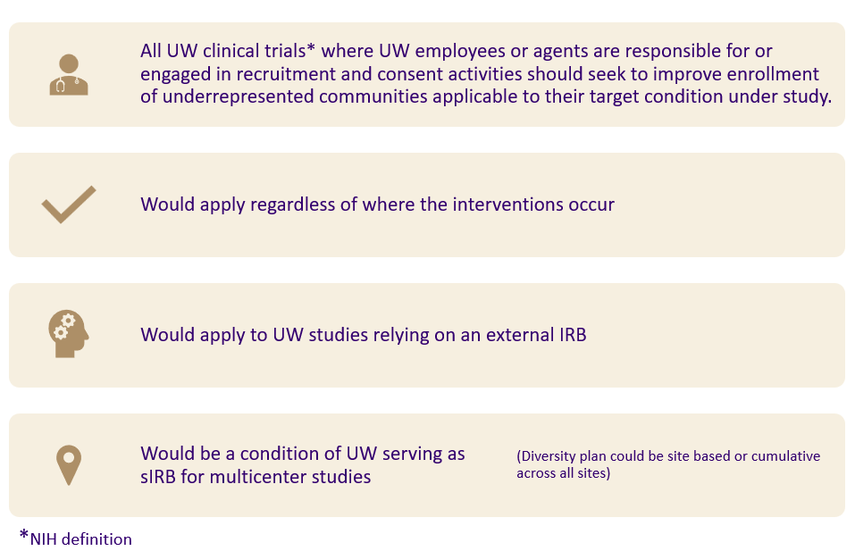
UW Policy Scope (1 of 2)
Notes:
Our institutional policy is broader that the state law, applying to all types of UW clinical trials, not just drug/device studies, so behavioral or surgical interventional trials are included.
It applies to clinical trials where UW employees or agents are responsible for or engaged in recruitment and consent activities. If the UW is only engaged for example, as a data coordinating site and is not responsible for recruitment and consent, the policy does not apply.
It would apply regardless of where the research is occurring (e.g., WA state, international) and would apply for studies relying on an external IRB and for non-UW sites relying on the UW IRB for review.

Slide 15
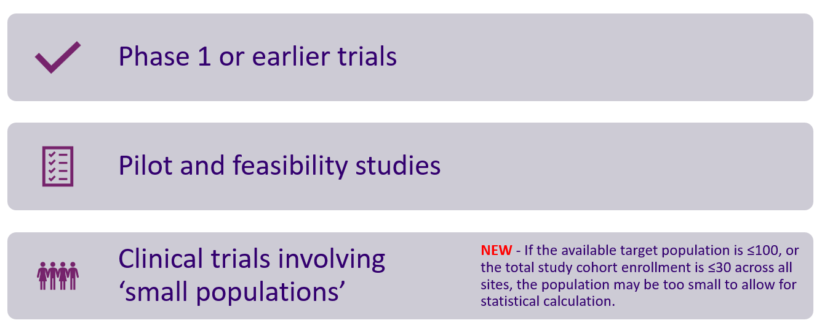
UW Policy Scope (2 of 2)
Notes:
There are some exceptions to the policy including [REVIEW Slide]
Note that we have recently provided additional clarification to the exception regarding ‘small populations’. [CLICK for Fly-in]
If the available target population is ≤100, or the total study cohort enrollment is ≤30 across all sites, the population may be too small to allow for statistical calculation.
Some examples of studies that may not have an available population greater than 100 individuals might include studies involving rare diseases or unique and limited populations (e.g., a study involving astronauts).
For multi-site research, the cohort enrollment includes all sites so if the local UW site is only enrolling 10 participants but there are 25 other study sites each enrolling 10 people, the cohort for the study overall is 250 and therefore the study is subject to the DCT requirements. The UW site would be expected to develop a reasonable diversity plan for their targeted 10 participants.

Slide 16
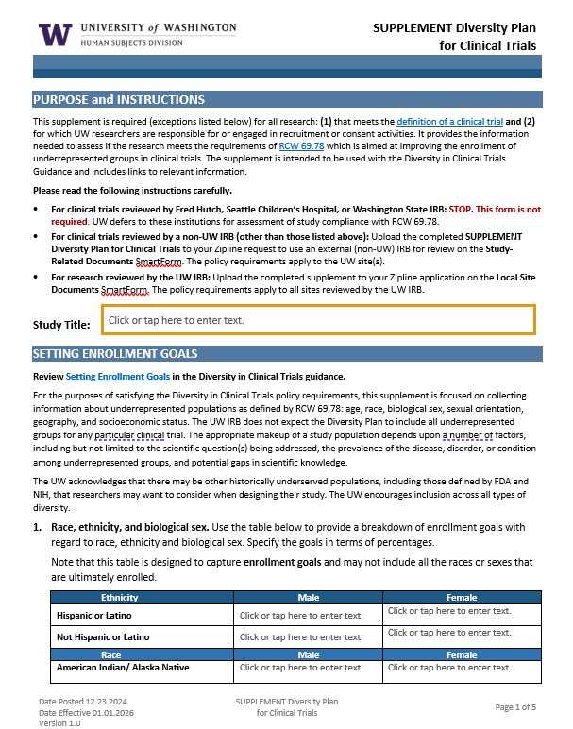
HSD Supplement – Diversity Plan
Establishing Enrollment Goals - age, race, ethnicity, biologic sex, sexual orientation, geographic location (probably zip codes), social economic status (several variables, TBD)
Rationale for current enrollment goals and any exclusions
Strategy for meeting enrollment goals (e.g., study design, recruitment, and retentional plan, reducing barriers to participation
Description of efforts/resources utilized for community engagement that informs recruitment strategy
Plan for tracking enrollment data
Notes:
HSD has developed a diversity supplement that researchers will submit as part of their application to HSD (either for UW or external IRB review).
The diversity plan solicits information in 5 areas… [REVIEW Slide]

Slide 17
UW Policy - Translation & Interpretation
When 5% or more of the target population speaks a primary language other than English:
  The study must have translations of any written materials to be read by participants (e.g., consent forms, recruitment materials, surveys) available at the outset of the research.
  There must be resources in place to support their inclusion for the duration of the study.
When less than 5% of the target population speaks a primary language other than English:
  There must be a plan in place to support their enrollment and participation in the research when they are encountered.
Notes:
I want to call out the policy requirements regarding enrollment of individuals with a non-English language preference.
[REVIEW Slide]

Slide 18
Implications for Researchers
More staff FTE needed to:
  Identify and recruit underrepresented populations
  Engaged with targeted communities
  Develop culturally specific recruitment materials
  Provide e-consent option
  Track and report on enrollment metrics
More funding to cover costs associated with:
  Translation and interpreter services
  Culturally specific recruitment strategies/materials
  Reimbursement for participation expenses to reduce barriers (e.g., travel, parking, childcare)
  Possible IRB review fees (e.g., commercial IRB review)
Notes:
To implement the DCT requirements, researchers will need more time and money. Some of the specific implications include: [REVIEW Slide]
It is because of these requirements that we have published our policy and guidance a year in advance (this past January) so that researchers have time to plan and budget for the additional costs.
After January 1, 2026, new study submissions for clinical trials subject to the DCT policy will be expected to comply. Insufficient funding will generally not be an acceptable justification for excluding participants from underrepresented communities.

Slide 19
Resources
Notes:
I next want to talk about some of the resources being stood up to help researchers comply with the DCT requirements.

Slide 20

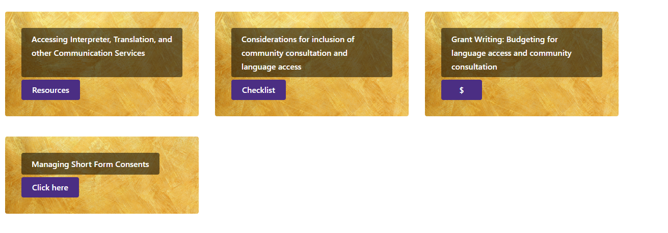
Support Services – Translation & Interpretation
UW Medicine Language Access & Cultural Advocacy
  Provides access to translation and interpretation in the UW clinic space
  Expanding access outside of the clinic space to support this policy
  Provides guidance on budgeting and community consultation needs.
Clinical Trials Language Access Resources (requires UW NetID)
Notes:
UW Med Language Access and Cultural Advocacy office has established relationships with translation and interpreter services companies that researchers can now access.
Researcher wouldn’t need to identify and separately contract with companies. Instead, they can submit an email request for services, receive a quote and then be invoiced directly. Translations can happen in a matter of days for some languages.
You can also obtain quotes to help in preparing budget estimates for grants, contracts, or other funding proposals.
All of these services are available now for use by any UW researcher.
NOTE – Translation services provided in association with a clinical visit do not incur additional research charges but research only visits do.
Also, the Office of Healthcare Equity is working with UWLACA to establish a process by which unfunded or underfunded studies can access free translation and interpreter services. More information on this will be published in our newsletter when it goes live.

Slide 21
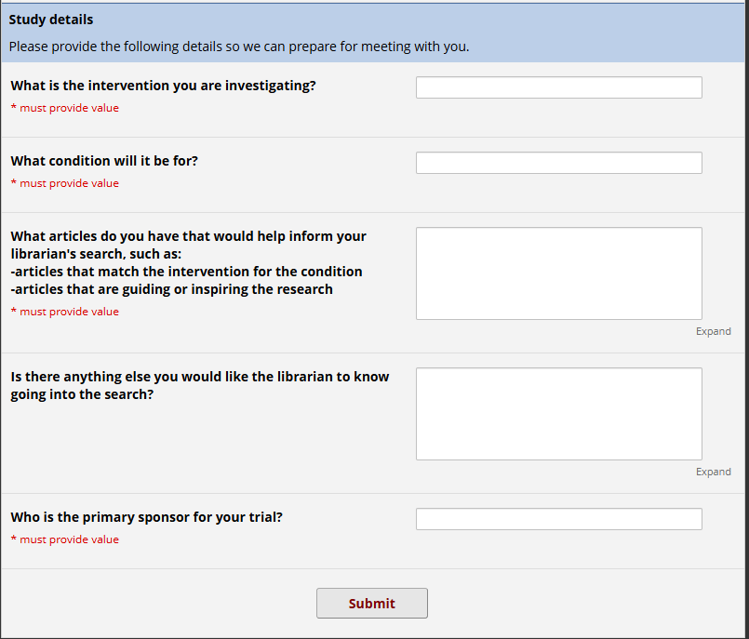
Support Services – Health Sciences Research Library
Open to UW Researchers
(no charge)
Identifying demographics
  PubMed
  ClinicalTrials.gov registry
DCTI-specific REDCap intake and query*
Notes:
Health Sciences Library offers a lit search review service to help researchers obtain information to identify underrepresented communities within their target population and intervention.
This is a free resource open to all UW researchers now.

Slide 22
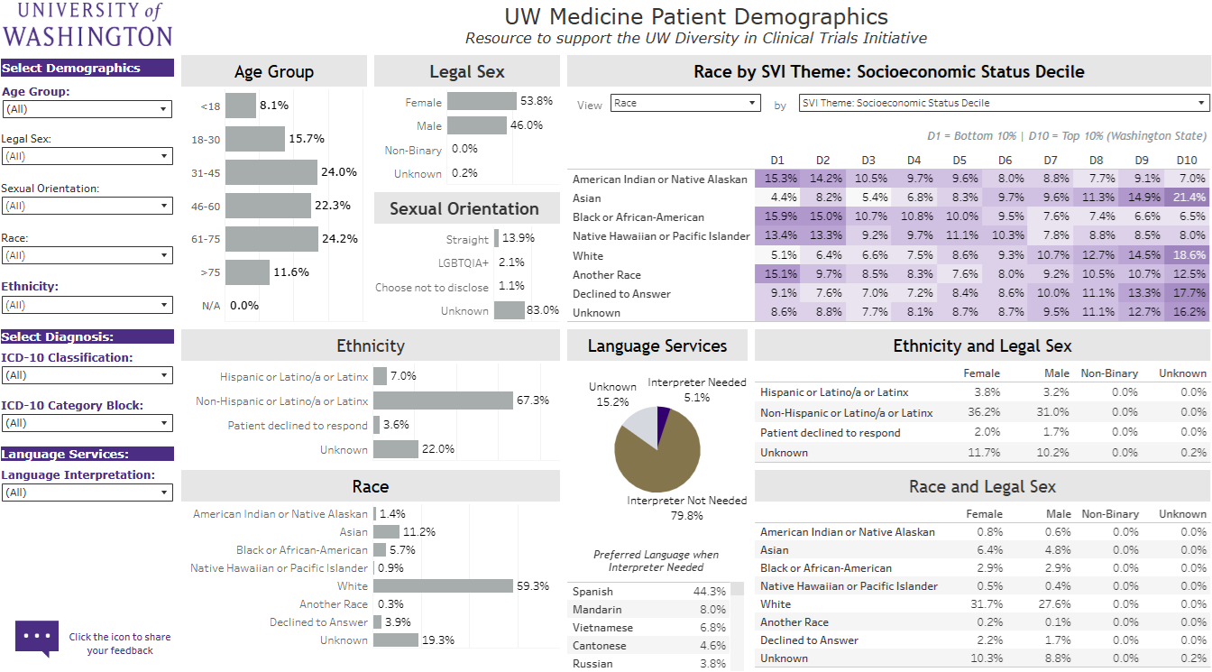
Support Services – Clinical Trial Dashboard
Available in Fall 2025
(no charge)
UW's first aggregated data set from Epic & OnCore
Access via UW BI Portal (UW NetID required)
Allows filtering by
  Demographics
  ICD-10 codes
  Interpretation needed (Y/N)
  Area Deprivation Index
  Social Vulnerability Index
Notes:
Another service that will help investigators identify their target population is the Clinical Trial Dashboard.
This tool pulls from data in Epic and Oncore to give breakdowns of available populations within the data set that align with the different underrepresented communities identified in the WA State law.
Data can be filtered down by ICD-10 codes to look at race/ethnicity, sex, age, etc.
This tool should be available this fall and will be free to use.

Slide 23
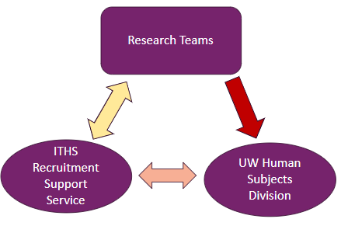
Recruitment Support Service
Open to WWAMI Researchers
(no charge)
Consultations to help with recruitment and retention planning
  meeting representation goals & breaking down barriers
  outreach strategies
  culturally sensitive recruitment materials
  budget & logistics
Consultants
  UW
  SCH
  Office of Healthcare Equity representation
  UW Human Subjects Division
Notes:
The ITHS has established a recruitment support service to provide consultations to researchers on developing appropriate recruitment and retention strategies, including helping with designing culturally sensitive recruitment materials and budgeting and planning.
It draws from a pool of expertise across different offices, include representatives from HSD to ensure the plan developed will meet the policy requirements.
This service is live now and open to researchers across WWAMI region at no cost.

Slide 24
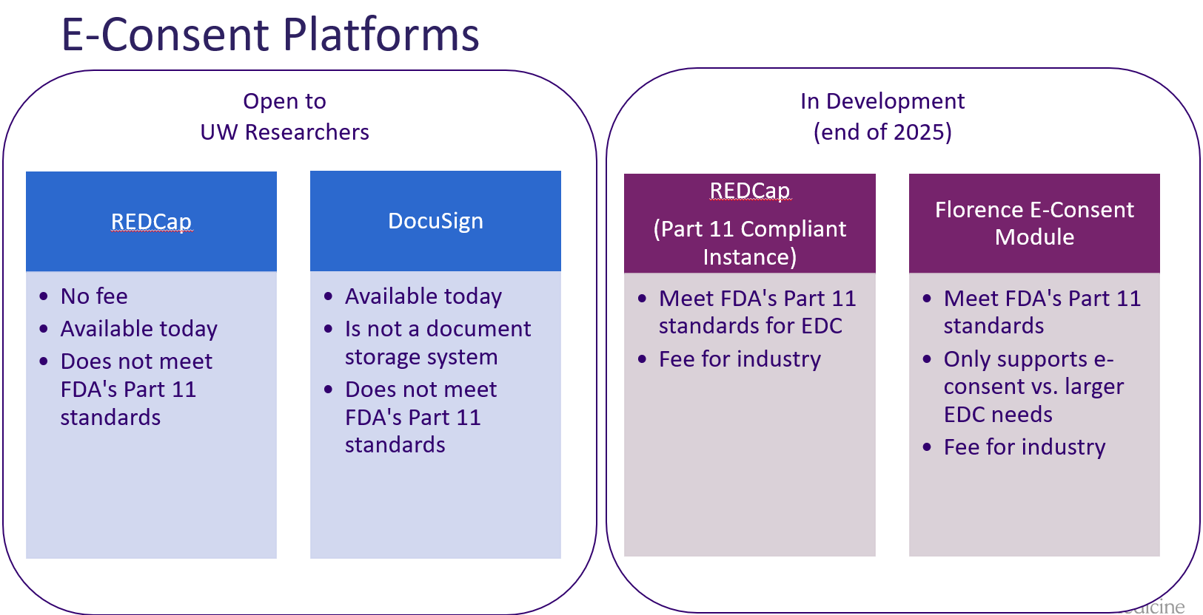
Support Services: E-consent Platforms
Notes:
Recall that the DCT law requires that e-consent be offered as an option to participants.
The UW has available free e-consent resources now with REDCap and DocuSign.
For FDA-regulated studies, we don’t currently have any part 11 compliant e-tool. Two systems are being added to address this:
A part 11 compliant REDCap instance that will also support EDC
Florence e-consent module
Both should be available by the end of this calendar year. Costs are still being determined for use of the part 11 REDCap instance but the Florence e-consent module will be free for all studies except industry-sponsored trials.
Look for more information about these in future hsd newsletters.

Slide 25
Resources & Guidance
Human Subjects Division
  Diversity in Clinical Trials Guidance
  Diversity Plan for Clinical Trials Supplement
  hsdinfo@uw.edu
Office of Health Equity & Community Engagement
  Community-Centered Research Resources
ITHS Recruitment Support Service
  Recruitment Support Service
  recruitmentsupport@uw.edu
UW Medicine Language Access & Cultural Advocacy
  Clinical Trials Language Access Resources
DCTI Website
  ITHS DCTI Home Page
Notes:
Finally, I’ve listed here links to available resources about these services and other information about the DCTI.

Slide 26

QUESTIONS
Send questions to hsdinfo@uw.edu
Notes:
Feel free to send any questions you have about the DCTI to hsdinfo@uw.edu.

Slide 27
NIH No-Cost Extensions
Mike Snow, Proposals and Award Manager
Office of Sponsored Programs

Slide 28
UPDATE
NOT-OD-25-142: eRA Commons option for grantee-approved first no-cost extensions (NCE) re-enabled
MODs for first NCE requests no longer require additional documentation (progress update, budget, justification)
OSP will review existing MODs to process as first NCE if available
Please continue submitting extension MODs timely with the extension form attached

Slide 29
Questions

Slide 30
After-the-Fact & Non-Award Agreement eGC1s
August 2025 MRAM
Elizabeth Walker-Tilley, Contracts Team Manager
Mike Snow, Proposals and Awards Team Manager
Office of Sponsored Programs

Slide 31
Proposal eGC1 vs. After-the-Fact eGC1s: What’s the difference? Proposals
UW Executive Order 34 - Proposals and preliminary discussions that might become a proposal should be submitted to OSP, “preferably in advance.”
OSP review is required by UW policy, even if sponsor might not insist on institutional official sign-off or submission in sponsor system.
  An informal discussion can result in proposal eGC1s.
Proposals to external sponsors must follow guidelines in GIM 1 and GIM 19.
When do you need an eGC1?
Notes:
Mike

Slide 32
Proposal eGC1 vs. After-the-Fact eGC1s More context - Proposals
Formal: Sponsor issues a Request for Proposal (RFP), PI prepares and OSP submits a proposal to a competitive review process with a deadline.
Informal: Conceptual discussions with a sponsor can result in development of a project, may require:
PI developing proposal material (scope of work, budget, etc.).
PI sending them details on how the project will be accomplished.
Create a Proposal eGC1 and route for review and approvals.
Notes:
Mike - both of the informal types are still proposals

Slide 33
Proposal eGC1 vs. After-the-Fact eGC1s After-the-Fact (ATF)
Sponsor has already decided they will sponsor research at the UW.
  Sponsor decision may result from an informal discussion if sponsor has no formal application process.
  Sponsor confirms they want to move forward with the project.
Scope of Work is already established or the activity of the new agreement supports an existing or potential UW sponsored program.
Sponsor requests to issue UW Sponsored Research Agreement template or has provided DRAFT agreement.
GIM 19 deadlines do not apply.
Requesting a UW Approved Sponsored Research Agreement Template
Notes:
Mike
ATF eGC1s are used to document when a sponsor and UW PI have determined to establish sponsored program activity that:
Lacks a proposal eGC1, or
Needs a supporting agreement for an existing UW sponsored program, or
Requires discussion with the sponsor prior to submitting a proposal such as confidentiality/non-disclosure agreements and teaming agreements.
Although not a proposal, an ATF eGC1 still requires the same campus unit approval and institutional review.
There are two types of ATFs, ATF’s with funding and ATFs without funding (non-award agreements).

Slide 34
Types of ATF eGC1s
ATF with funding
Complete eGC1 as usual attach the agreement, and select ATF
Requires budget & budget justification, we highly recommend using SAGE Budget
ATF without funding aka Non-Award Agreement
See Agreement Types for examples
NAA eGC1 instructions
Note: Staff assignments also use an ATF eGC1.
eGC1s for After-the-Fact Awards and Non-Award Agreements
Notes:
Mike

Slide 35
Proposal vs. ATFs:
Best Practices
Does the PI need an itemized budget to share with a potential funder? Likely a proposal.
  Route an eGC1 prior to proposing a budget to the sponsor.
Requesting sponsorship? Likely a proposal.
Always include sponsor communication to clarify what is being requested.
UW prefers to use our UW Sponsored Research Agreement template.
If sponsor sends a draft agreement but project was not handled as a proposal, route ATF eGC1 as soon as possible to allow OSP to negotiate.
Do not route an ATF to get around the eGC1 proposal review process. It won’t save time.
OSP will need to return the eGC1 & it will take longer.
Notes:
Mike

Slide 36
OSP ATF eGC1 Review
Is it a proposal or actually an ATF?
Is it complete and does it have all required elements?
Is it a non-award agreement (NAA) or is there funding?
Is there a request to issue UW Sponsored Research Agreement template or is an editable DRAFT agreement attached?
OSP approves complete ATF eGC1s and creates the next SAGE item to conduct a full agreement review.
Approval of an ATF eGC1 does not imply OSP’s approval or acceptance of the agreement.
Notes:
Elizabeth

Slide 37
Incomplete ATF eGC1s
Will be returned & include request for missing information.
Examples:
No agreement documents attached
Missing or insufficient scope of work
Missing related budget
Answers to non-fiscal compliance questions not reflecting the nature of the activity, including things like Animal Subjects or Human Subjects etc.
Notes:
Elizabeth

Slide 38
Complete ATF in SAGE - Next Steps
Award Setup Request & Non-Award Agreement
Next SAGE item is where agreement review, negotiation, and eventually execution of the agreement, takes place.
ATFs with funding
Become an Award Setup Request (ASR)
OSP will create the ASR, but must send to campus for completion (SAGE Budget, etc.)
ATFs without funding
Become an NAA in SAGE
OSP/Campus communications during processing are via email
  Attachments visible to campus on the original ATF eGC1
Agreement Types
Notes:
Elizabeth

Slide 39
Key Reminders:
eGC1 Details Page
Start and End Dates: Period of performance, or Start Date “today” & End Date for later.
Sponsor Deadline: System required field
OSP disregards this field for ATFs
If sponsor does have a deadline for award acceptance, include explanation in Additional Information (eGC1 Certify Route section).
Sponsor Details: OSP requires this field to be completed, including contact information for agreement negotiation.
Notes:
Elizabeth
System required fields on the Details page include: Full Application Title, Short Title, Start and End Dates, Application Type, Project Type, Sponsored Program Activity (SPA) Type, and Sponsor fields.

Slide 40
Key Reminders:
eGC1 Abstract
Describing the purpose and goals in detail can help prevent delays.
Provide as much detail as possible: goals, objectives, deliverables, summary of expected outcomes and purpose of the agreement.
Notes:
Elizabeth

Slide 41
Key Reminders:
eGC1 Compliance Questions
OSP review of the eGC1 prior to approval focuses on correctly identifying compliance issues reflected in the project scope.
Responses to compliance questions also informs our compliance partners what type of review as well as the level of review required.
Full review of each compliance component to assess needed approvals will follow, in conjunction with agreement review.
Inaccurate or incomplete information on compliance questions for ATF eGC1s will create confusion, which causes rework and delay in the review process.

Slide 42
Key Reminders:
eGC1 Attachments & Additional Information
Attach editable version of the DRAFT agreement, or request UW Sponsored Research Agreement Template.
ATF with funding needs Budget & Budget Justification.
We recommend using SAGE Budget
Complete Additional Information in Certify & Route section, with:
Explanations, special requirements, and contextual information in as much detail as possible that you think might help reviewers understand.
Information on any sponsor required deadlines.
Notes:
Elizabeth

Slide 43
Resources
UW’s Executive Order 34
eGC1s for After-the-Fact Awards and Non-Award Agreements
Non-Award Agreement Instructions
Agreement Types
When do you need an eGC1?
Note:
Further updates on ATF processes are under way!
We’ll return to MRAM soon.

Slide 44
Questions

Slide 45
Subawards Update
August 14 MRAM
Josy Combs, Subawards Team Manager
Office of Sponsored Programs

Slide 46
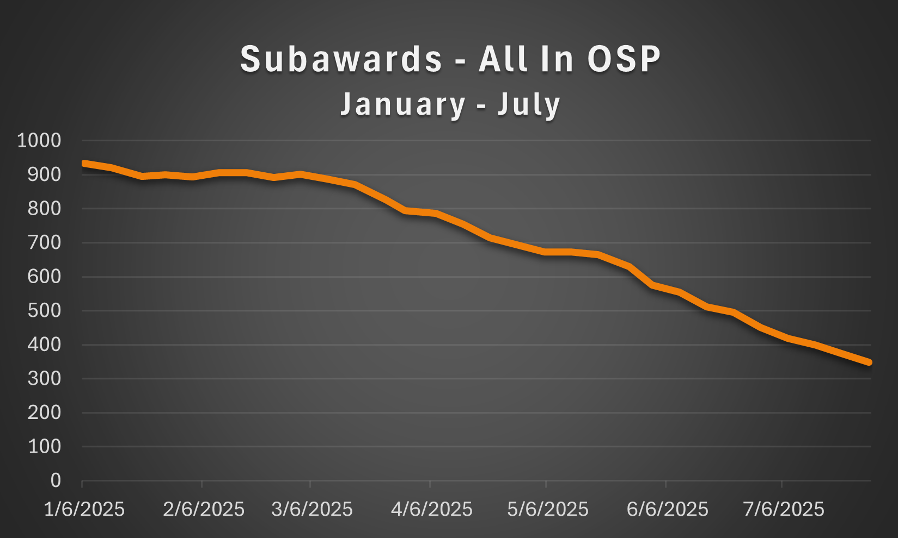
Recent Volumes
OSP Volumes

Slide 47
Subaward Action Reminders
Review all subaward requests before submitting to OSP.
  Budget Period should be one year
  Required documents uploaded and correct
  Include additional details in the Special Instructions box
Have a large volume (10+) of subaward requests under the same award? email ospsubs@uw.edu with details.
Common Errors
Subaward budget is provided as a lump sum within the total project budget. Instead of a detailed budget.
Including a link to SAGE budget rather than attaching the document.
Review First Steps and Next Steps to confirm the subaward request is complete.

Slide 48
New Subaward Escalation Request form
OSP Subawards Team assigns subaward actions (SAs) by the date the SA last arrived in OSP.
Some situations may require you to the request item be escalated for priority assignment.
Reasons to request escalation of an SA, Subrecipient is or has:
Foreign entity in a low to middle income country
Small non-profit organization or a sole proprietorship, domestic or foreign
Other unique circumstances outside the UW’s control that warrant prioritizing
Note, the assurance request form has been disabled.
Escalating Subawards

Slide 49
Before Requesting Escalation
Confirm the subaward request is complete.
SA must have a SAGE state of “In OSP”.
Associated ASR or MOD in SAGE must be fully processed.
Required form fields:
Subaward (SC) #
Subaward Action (SA) #
Subrecipient Name
Associated ASR# or MOD#
Confirm the ASR or MOD is fully processed (Open status in Workday)
UW Award (AWD) #
Workday Grant (GR) #
Cost Center
Reason SA needs to be escalated
OSP will review these requests and make assignments once per week, typically on Tuesdays and may deny or return requests.
Escalating Subawards

Slide 50
Resources
OSP Volumes
Subaward Requests: First Steps and Next Steps
Escalating Subawards

Slide 51
Questions

Slide 52

SAGE UPDATE
Judy Chung
Office of Research Information Services (ORIS)
August 14, 2025

Slide 53
Context for SAGE Migration
The SAGE Suite moved to new AWS cloud architecture at end of June.
This involved…
  Upgrading versions of various components
  A learning curve around new technologies
  Managing issues with older code on top of newer infrastructure
A stabilization period after a migration is typical
  Ours has been more impactful and challenging than we anticipated

Slide 54
Progress on SAGE Stabilization: Trends
July:
  3-week period of extreme fluctuation and instability
  Configuration changes & incremental releases made
August:
  Reduction in help desk calls & errors in our logs
  Performance improvements in key areas, but there’s still more to do
  Expanded monitoring tools for early alerts, leading to quicker action

Slide 55
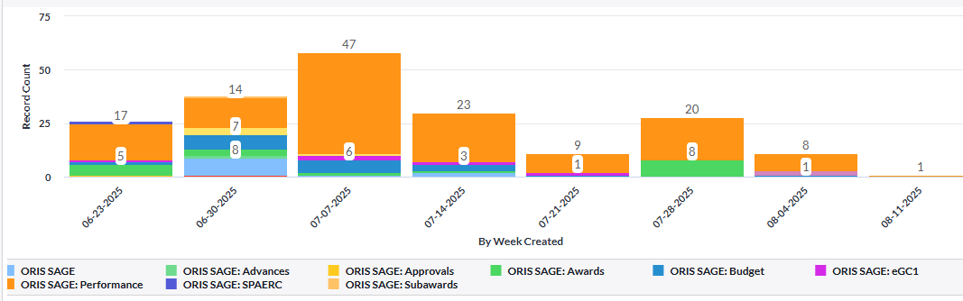
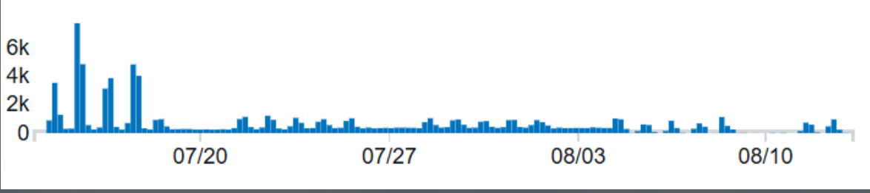
Progress on SAGE Stabilization: Data
SAGE help desk incident reports by week
Error log trends by week

Slide 56


Areas of Focus: Overall
Overall System Uptime
Fine-tuned memory and CPU allocations
Addressed errors leading to peak slowness & outages
Expanded monitoring tools
In Progress:
Continued monitoring & prioritizing of problematic areas and emerging issues with performance and system stability

Slide 57
Areas of Focus: SAGE Budget
SAGE Budget Performance
Resolved worksheet settings saving delays
Increased speed of other cost entry saving
Improved processing times for recalculation of totals
(more to come!)
Grant Runner: Decreased navigation & load times when budget is connected
In Progress:
Additional work on recalculating processing times
  Personnel & other cost entry; F&A changes
More Grant Runner performance improvements

Slide 58
Areas of Focus: Awards
Awards Section Performance
Reduced status change delays for ASRs & MODs
Reduced general navigation slowness on requests
In Progress:
Speeding up load time for large awards
  ADV (renewal) and MODs
Fixing the award list not updating regularly for new personnel entry

Slide 59
Where to Get Updates on SAGE
SAGE Health – webpage coming soon!
  Will share what is known of system issues or outages
Regular MRAM Report Outs
  Will keep in touch on progress and planned work
Email Following Impactful Releases
  MRAM and SAGE mailing list recipients (excludes PIs unless intentionally subscribed)
    Subscribe to SAGE News

Slide 60
How To Keep In Touch with ORIS
We thank you for your partnership and patience as we continue to update, refactor, and fully stabilize the SAGE Suite.
Please do continue to make sagehelp@uw.edu aware of issues, especially if you observe prolonged slow performance for more than 5-10 minutes.
Reporting issues allows us to act more quickly to resolve them!

Slide 61
GCA UPDATE & STAFFING
Vincent Gonzalez
Associate Director
Grant & Contract Accounting
August 2025 MRAM

Slide 62
TOPICS
Backlog Status Update
Staffing & Priorities
Friendly Reminder: Contacting GCA

Slide 63
BACKLOG STATUS UPDATE
As of Monday, August 11th, 2025:
Award Setup: 144 backlog items
  ADVs (25), ASRs (64), MODs (55) not processed within 5 business days
Invoicing: No specific backlog metrics to share, but unbilled lists are reviewed to ensure timely invoicing
Reporting: 186 backlog reports
  Pending DOGE Requests, Fabrication Award Lines, Reinstated Awards
Closing: 10,303 backlog award lines
  Award lines unclosed more than 120 days after their end date

Slide 64
STAFFING & PRIORITIES
GCA has seen turnover across most workgroups
We are recruiting additional team members largely using Fixed Duration Appointments, which require training in GCA processes
Our Priorities remain:
  Timely processing of Award Setup items (ADVs, ASRs, and MODs)
  Minimizing backlogs across all GCA Teams
  Addressing high risk items related to invoicing, reporting, and closeout actions

Slide 65
FRIENDLY REMINDER: CONTACTING GCA
The GCA Grant Analysts monitor the gcahelp@uw.edu inbox, initial award portal tickets, and phone calls
They have a turnaround time of 5 business days
To ensure efficient processing, avoid duplication, and prevent delays, please:
Send your inquiry only once to the GCA Grant Analyst Team
Avoid follow-up emails within the 5-business-day window

Slide 66
RESOURCES
GCA Workload Metrics week-over-week are available on the GCA homepage

Slide 67
QUESTIONS
Contact GCA for assistance by creating a ticket in
Award Portal or email gcahelp@uw.edu

Slide 68
EXTENDING SUBAWARD AWARD LINES
Vincent Gonzalez, Associate Director
Grant and Contract Accounting
August 2025 MRAM

Slide 69
BACKGROUND
Prior Process: GCA originally provided guidance instructing campus customers to send requests for subaward award line extensions via Award Portal
New Process: GCA has revised the approach. All award modifications will be processed in SAGE to:
  Have a single intake and processing method
  Ensure an audit trail within SAGE

Slide 70
SAGE PROCESSES – EXTENSIONS
If a sponsor approved extension (OSP/GCA MOD) is received:
  Consider if one (or multiple) subaward award lines should be extended
  Update your SAGE Budget worksheet(s) to reflect the extended end date

Slide 71
SAGE PROCESSES – EXTENSIONS (CONT)
If a sponsor approved extension (OSP/GCA MOD) has already been processed but one (or multiple) subaward award lines were not extended:
  Submit a GCA-only MOD
  Update your SAGE Budget worksheet(s) to reflect the extended end date
  Provide a SAGE Budget Snapshot link

Slide 72
RECOMMENDATIONS & IMPACT
Identify which subaward lines require an extension
Plan these extensions in advance and document within SAGE Budget
Early planning reduces processing time for subaward amendments

Slide 73
RESOURCES
See Subaward Extensions section in the July 2025 GCA Newsletter

Slide 74
QUESTIONS
Send award-specific questions to GCA through Award Portal using the topic “Award Setup”
Send other questions to gcahelp@uw.edu

Slide 75

UPDATES
MRAM UPDATE
Laurie Stephan, Associate Director for Learning, ORC

Slide 76
Community of Practice for Research Administrators (CoPRA)
PURPOSE
A tri-campus community of practice led by and for practitioners of research administration at the UW who share a passion for their work and believe they can learn to do it better through regular interactions with members of their community.
STAY IN TOUCH
Teams channel
Informational website
Office hours for collaborative problem solving. Bring your questions!
  September 4, 11:00 am – 12:00 pm (Zoom only)

Slide 77
Fall Schedule
Register for Autumn CORE Courses
Course # | Course | Start | End | Date
1001 | Blueprint of a Proposal | 1:00 PM | 3:30 PM | 9/30/2025
2041 | Managing Cost Share at the UW | 9:30 AM | 11:30 AM | 10/7/2025
1011 | SAGE: Creating and Submitting eGC1s | 1:00 PM | 3:00 PM | 10/8/2025
1014 | SAGE: Budget | 2:00 PM | 4:00 PM | 10/15/2025
1095 | Navigating the New Frontier of Financial Reporting for Grants Managers | 9:30 AM | 11:30 AM | 10/16/2025
1012 | SAGE: Creating NIH Proposals in Grant Runner | 2:30 PM | 4:30 PM | 10/22/2025
1011 | SAGE: Creating and Submitting eGC1s | 1:00 PM | 3:00 PM | 10/28/2025
1030 | Understanding Your New Award | 9:30 AM | 11:00 AM | 10/28/2025
1039 | Reading the Notice of Award | 9:30 AM | 11:00 AM | 11/4/2025
2031 | Case Studies in Compliance: Humans, Animals and Substances | 2:00 PM | 4:00 PM | 11/4/2025
1015 | SAGE Awards & Modifications | 1:00 PM | 3:30 PM | 11/5/2025
1040 | Award Administration: Fiscal Compliance | 1:00 PM | 3:30 PM | 11/13/2025
1042 | Preparing for Audit | 9:30 AM | 11:30 AM | 12/2/2025
1032 | Subaward Fundamentals | 9:30 AM | 12:00 PM | 12/4/2025
1033 | Subawards in SAGE | 2:00 PM | 3:30 PM | 12/11/2025

