Slide 1
MRAM | Monthly Research Administration Meeting
                September 11, 2025, 9:00 AM – 10:00 AM
Join Webinar: https://washington.zoom.us/j/346891888
Click “CC” to Show Captions in your Zoom Controls
TOPIC | PRESENTER | EMAIL | MIN
Welcome | Kirsten DeFries Research Compliance & Operations | kirsten5@uw.edu | 2
PAFC Hot Topic | Matt Gardner Post Award Fiscal Compliance | gcafco@uw.edu | 10
Fringe Benefit Expenditures: 8/1 to 8/15/2025 Payroll Period | Vincent Gonzalez Grant & Contract Accounting | gcahelp@uw.edu | 5
New Approach Methodologies | Aubrey Schoenleben Office of Animal Warfare | aubreys@uw.edu | 10
SAGE Update | Judy Chung Office of Research Information Services | sagehelp@uw.edu | 10
AIDE Initiative: Update | Mandy Morneault Office of Research | vicka@uw.edu | 5
MRAM Website Updates | Amanda Snyder Office of Sponsored Programs | osp@uw.edu | 2
CORE Update | Laurie Stephan Collaborative On Research Education (CORE) | corehelp@uw.edu | 2
                NEXT MEETING
                October 9, 2025 9:00 AM - 10:00 AM
                Questions about MRAM? email mramques@uw.edu

Slide 2
COMPLIANCE HOT TOPICS: PRE-WORKDAY EXPENSE TRANSFERS; CLOSEOUT
MRAM
September 2025
Matt Gardner
Post Award Fiscal Compliance

Slide 3
Pre-Workday Expense Transfers: Overview
Process developed at Workday Go Live to facilitate moving expenses charged pre-Workday to and from sponsored awards in Workday
Applicable to costs charged prior to July 1, 2023 (Workday Go Live) in the old financial system (FAS)
MRAM – Matt Gardner – PAFC

Slide 4
Pre-Workday Expense Transfers:
Policy Change
Effective October 1, 2025
The Pre-Workday Expense Transfer process will be retired and unavailable for use
After September 30, 2025, it is no longer permissible to move costs to a sponsored award which were charged prior to July 1, 2023
If unallowable or unallocable expenses were charged to a sponsored award prior to July 1, 2023, please contact Grant & Contract Accounting guidance on removing those costs from the award
MRAM – Matt Gardner – PAFC

Slide 5
Accounting Adjustment Reminders
Accounting adjustments on sponsored awards should be completed in a timely manner
Any adjustment which occurs more than 120 days after the original transaction date must include an explanation/reason for the delay
See GIM 15 for UW policy on accounting adjustments
GIM 15 - Accounting Adjustments on Sponsored Awards
MRAM – Matt Gardner – PAFC

Slide 6
Closeout: Resolving deficits (1 of 2)
A deficit occurs when costs which otherwise meet the four cost principles exceed the amount obligated by the sponsor
Deficits can be resolved via two methods:
  A lump sum deficit journal, or
  An accounting adjustment to moves the individual expense(s)
Please see the GCA webpage for information on the sponsored award deficit process
  https://finance.uw.edu/gca/award-lifecycle/closing-your-award/deficit-process-sponsored-program-awards
MRAM – Matt Gardner – PAFC

Slide 7
Closeout: Resolving deficits (2 of 2)
All costs charged to a sponsored award must meet the four cost principles:
  Reasonable
  Allocable
  Allowable
  Consistently treated
Costs which don’t meet the four cost principles must be removed from the applicable grant worktag via an accounting adjustment
If the award is in deficit, and there are costs which do not meet the cost principles, use of a lump sum deficit journal is not appropriate to remove the unallowable costs; an accounting adjustment is required
MRAM – Matt Gardner – PAFC

Slide 8
Closeout: Why does the method of removal matter?
A lump sum deficit journal is processed under a single generic spend category; it does not move the specific transaction off the award
Example: $5,000 in unallowable salary is charged to an award, which puts the award into a $5,000 deficit
If a lump sum journal is processed to remove the $5,000 in deficit, the unallowable salary transaction remains on the award
  This will impact the Effort Statement in ECC
In this example, the unallowable salary must be removed via a payroll accounting adjustment to ensure an accurate Effort Statement in ECC
MRAM – Matt Gardner – PAFC

Slide 9
Effort “Focused Topic” Office Hour
Date: Thursday, September 25th
Time: 10:00am – 11:00am
Topics:
  Closeout and Deficits
  Manual FEC Process
Info: https://finance.uw.edu/pafc/effort-reporting/ecc-office-hours
The session will be recorded and all materials will be posted on the PAFC Effort Reporting webpage
  Link: https://finance.uw.edu/pafc/session_recordings
MRAM – Matt Gardner – PAFC

Slide 10
Questions
Post Award Fiscal Compliance (PAFC)
  effortreporting@uw.edu (Effort questions)
  gcafco@uw.edu (All other compliance questions)
  https://finance.uw.edu/pafc/
Matt Gardner
  mgard4@uw.edu
David Parks, Effort
  parksd2@uw.edu
MRAM – Matt Gardner – PAFC

Slide 11
FRINGE BENEFIT EXPENDITURES
8/1 - 8/15/2025 PAYROLL PERIOD
Vincent Gonzalez
Associate Director
Grant & Contract Accounting
September 2025 MRAM

Slide 12
BACKGROUND
There was a fringe benefit expenditure posting issue related to the 8/1 – 8/15/2025 payroll period
Approximately 1/6 of the fringe benefit expenditures posted within Workday before the task aborted/failed
The remaining 5/6 of fringe benefit expenditures did not post to Workday

Slide 13
CURRENT STATE OF SOLUTION
Manual Journals Posted: We have posted manual journals to accrue fringe benefits to ensure accounts across the UW accurately reflect fringe benefit expenditures
Temporary Fix: This manual journal is a temporary measure while we coordinate with Workday on a full technical fix

Slide 14
MANUAL JOURNAL ELEMENTS
The manual journals will have a few key elements:
Accounting Date: 8/31/2025
Journal: JE-XXXXXXXXX - SOM School of Medicine - 08/31/2025 - Accrue Fringe Benefit Correction for 8/15/2025 PPE
Journal Source: Manual Journal
Line Memo: Accrue Fringe Benefit Correction for 8/15/2025 PPE
The transaction will list the appropriate Fringe Benefit Ledger, Object Class, & Spend Category

Slide 15
PENDING ITEMS
Workday Fix Task: We’re coordinating with Workday to deliver a technical fix, which is expected in October
Restricting 8/1 to 8/15/2025 Payroll Accounting Adjustments (PAAs): Given the impact of completing PAAs prior to implementation of the benefit fix task, we are restricting PAAs related to this period.
  We’re still coordinating with Payroll on this piece
Reversal of Manual Journal: Once the fix task is fully tested and in place, we will reverse the manual journal

Slide 16
Questions
Any questions?
Notes:
Add Vince’s example here.

Slide 17
New Approach Methodologies
MRAM
September 2025
Aubrey Schoenleben, PhD, CPIA
Office of Animal Welfare (OAW)

Slide 18

What are NAMs?
NAMs = tools and strategies that support innovation, improve translational science, and reduce reliance on animals.​
MRAM – Aubrey Schoenleben – OAW

Slide 19
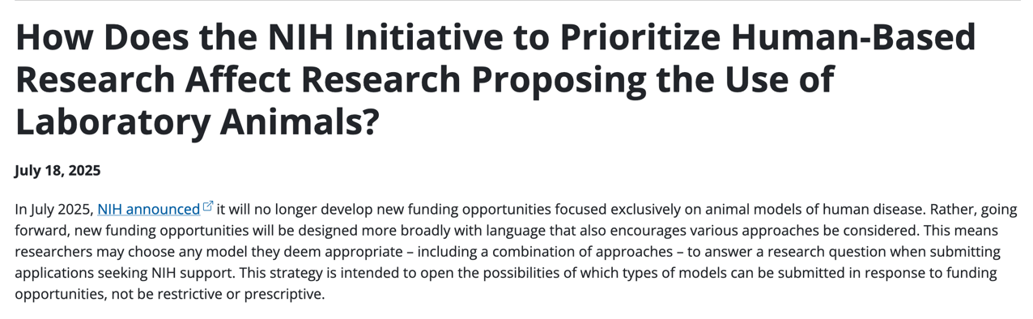
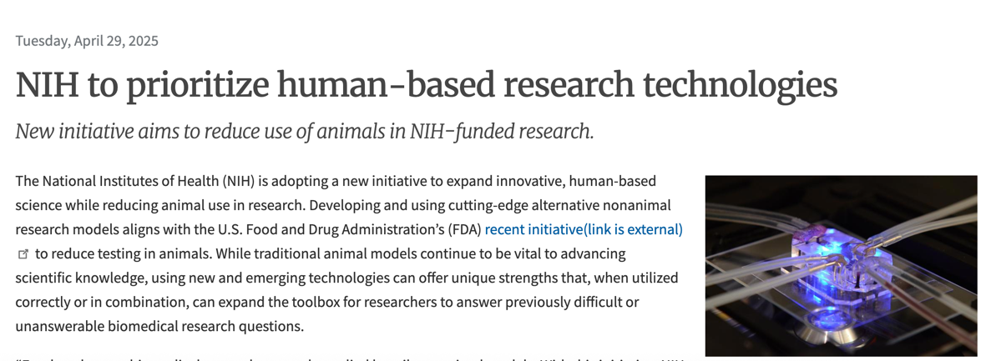

What’s all the buzz about?
Notes:
Increasing emphasis from funding agencies (NIH, FDA, EPA) on NAMs adoption.
Role in compliance and accreditation (AAALAC, OLAW expectations, institutional policy).
Opportunities to support faculty success (grant competitiveness, publication impact).
Resource planning implications (infrastructure, training, collaborations).

Slide 20
What’s Changing?
The scope of the NOFO, not the requirement for each individual grant.
New language reflects a broader, more inclusive framework encouraging innovation across the 3Rs
Creation of NIH Standardized Organoid Modeling (SOM) Center – press release expected soon.
UW Resources
Dedicated website
Proposal support/funding opportunities
Reach out at aco3rs@uw.edu
https://www.washington.edu/aco3rs/nams/
MRAM – Aubrey Schoenleben – OAW

Slide 21
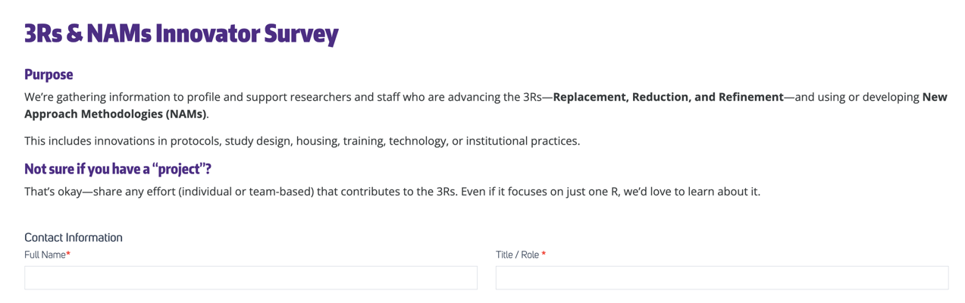
3Rs & NAMs Innovator Survey
Goal: Gain a better understanding of the current landscape at UW – what work is already happening in this space, where is support needed.
Please share within your networks!
https://sites.uw.edu/oawrss/3rs-nams-innovator-survey/
MRAM – Aubrey Schoenleben – OAW

Slide 22
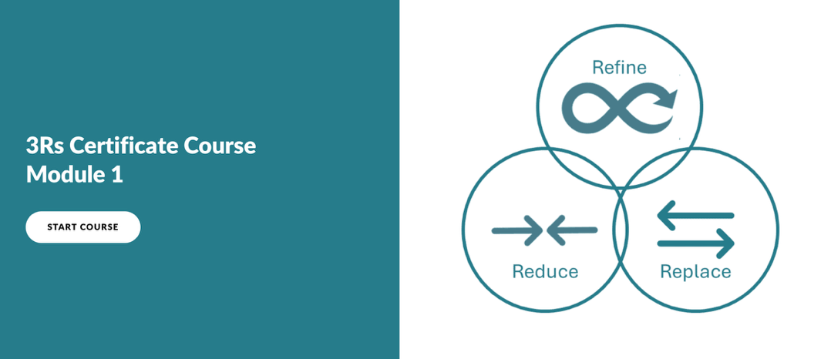

3Rs Certificate Course
Self-paced course to elevate understanding and application of the 3Rs
Available to all UW faculty, staff, and students.
https://www.washington.edu/aco3rs/3rs/citi-courses/
MRAM – Aubrey Schoenleben - OAW

Slide 23
Thank you!
Questions?
Aubrey Schoenleben
Office of Animal Welfare
aubreys@uw.edu

Slide 24

SAGE UPDATE
Judy Chung & Kim Halstead
Office of Research Information Services (ORIS)
September 11, 2025

Slide 25
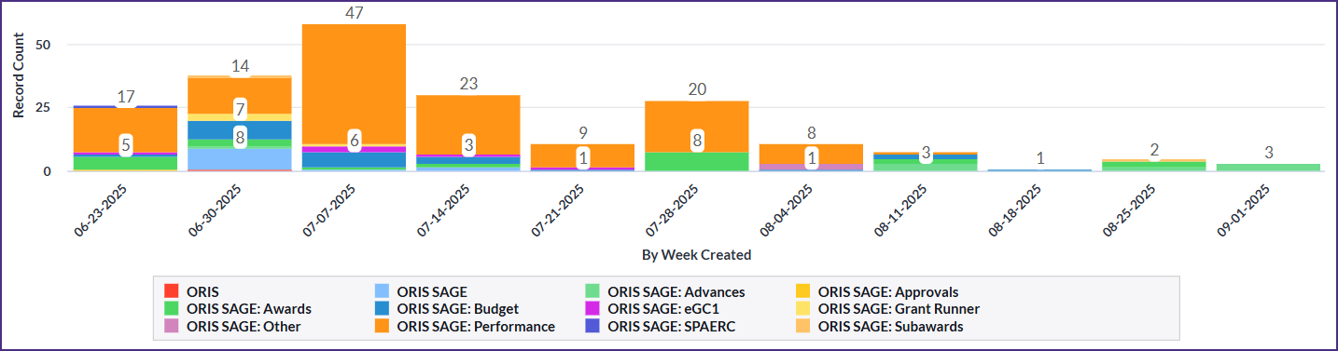
Progress on SAGE Stabilization: Data
SAGE help desk incident reports by week
Continued positive trends for stability
Current issue: ADVs with SFI reviews can get stuck in routing
  Updating them daily as we see them, until issue resolved

Slide 26


Areas of Focus: Overall
Overall System Uptime
Fine-tuned memory and CPU allocations
Addressed errors leading to peak slowness & outages
Expanded monitoring tools
In Progress:
Evaluating slowness observed on Monday ~ 4:30 pm

Slide 27
Areas of Focus: SAGE Budget
SAGE Budget Performance
Resolved worksheet settings saving delays
Increased speed of other cost entry saving
Improved processing times for recalculation of totals
(more to come!)
In Progress:
Improve calculation of totals for faster saving
Testing soon: Prototyping a manual calculation option for budget totals

Slide 28
Areas of Focus: Awards
Awards Section Performance
Reduced status change delays for ASRs & MODs
Reduced general navigation slowness on requests
New! Improved speed of navigation
for MODs with large awards (biggest gains)
for ASRs and ADVs
New! Fixed Award Requests List missing items for new contacts
In Progress (Award-related Issues):
Advances with missing award preparer routing issues
Advances with SFI not updating with review status
Misc remaining errors with routing and status changes

Slide 29
Areas of Focus: Misc Other
Misc Other Performance:
Grant Runner:
Improved navigation & load times when budget is connected
New! Additional performance improvements released 9/9
eGC1:
New! Improve speed of disclosure notifications on eGC1

Slide 30

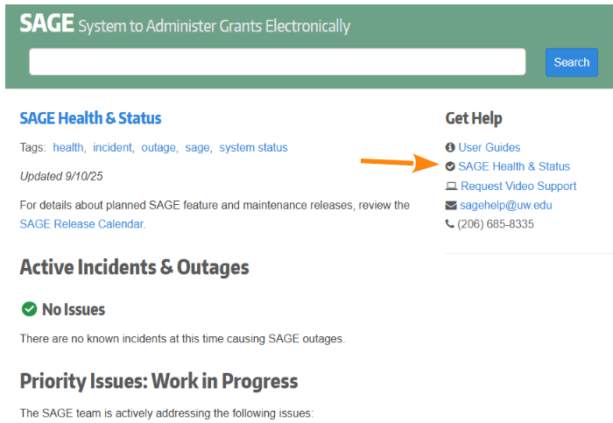
SAGE Health & Status Webpage
SAGE Health & Status
  Currently linked in the sidebar of the SAGE login page
Good place to check first if you’re having issues with SAGE and view work in progress

Slide 31

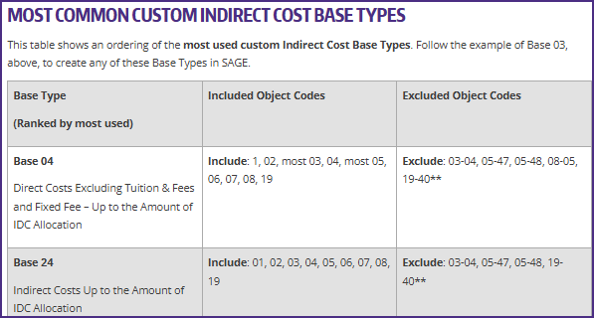
How to Make a Custom Base Type in SAGE Budget
  Added crosswalks for base types and object codes for both preset and custom SAGE base types.
Reminder:
New & Updated Resources (1 of 2)

Slide 32
Reminder:
New & Updated Resources (2 of 2)
(New) SAGE eGC1 Resources Collection:
  Bookmark this collection of eGC1 resources for easy reference.
  Also linked on the SAGE login page sidebar
(Revised) Subawards Quick Guide:
  This reference covers the essential elements of the outgoing subaward process and modifications.

Slide 33

Reminder: Fall SAGE Classes
SAGE: Creating and Submitting eGC1s
  Wednesday, 10/08, 1 – 3 p.m. PT
SAGE: Budget
  Wednesday, 10/15, 2 – 4 p.m.
  Tuesday, 10/28, 1 – 3 p.m.
SAGE: Creating NIH Proposals in Grant Runner
  Wednesday, 10/22, 2:30 – 4:30 p.m.
SAGE: Awards & Modifications
  Wednesday, 11/05, 1 – 3 p.m.

Slide 34
AIDE Update
Awards Improvement & Development Effort
9/11/2025

Slide 35

Transition
AIDE Executive Sponsors
Governance Committees and other Institutional Advisory Groups
A
AIDE Leads
Business Lead: Mandy Morneault
Program Managers: Dina O’Reilly, Colleen Butler
Systems Lead: Heriberto Rodriguez
Awards & Mods Setup
Subawards
Workday Enhancements
Sponsor Invoicing
Reporting
Communication & Training
UW Workstream Leads
UW Workstream Leads
UW Workstream Lead
UW Workstream Lead
UW Workstream Leads
UW Workstream Leads
Carol Rhodes, Vince Gonzalez
Amanda Snyder, Kirsten DeFries
Holly Roser
Kirsten DeFries
Danel Phelps, Rick Fenger
Colleen Butler, Mandy Morneault

Slide 36
Campus Engagement Focus
Awards & Mods Setup
Subawards
Reporting
Roadmap items
Roadmap items
Roadmap items
34
10
10
Research Administration Process Improvement Team (RAPIT)

Slide 37

Training & Instructional Documentation User Experience Testing
Goal: Evidence-based, user-centered training & instructions
Examine user instruction journey:
Find instructions
Complete tasks
Pain points
RAPIT members to recommend participants

Slide 38
Questions?

Slide 39
MRAM Web Update
September 2025

Slide 40
MRAM Website Moves October 15
Current MRAM webpages will be redirected to a new MRAM website by 10/15.
While the look and feel of the new MRAM webpages may shift a little, you should still be able to find everything you need.
Questions?
email: mramques@uw.edu

Slide 41
Questions

Slide 42

UPDATES
MRAM UPDATE
Laurie Stephan, Associate Director for Learning, ORC

Slide 43
Community of Practice for Research Administrators (CoPRA)
PURPOSE
A tri-campus community of practice led by and for practitioners of research administration at the UW who share a passion for their work and believe they can learn to do it better through regular interactions with members of their community.
STAY IN TOUCH
Teams channel
Informational website
Bi-monthly live sessions for collaborative problem solving. Bring your questions!
  Next live session: October 16, 1 pm
  CoPRA Convos are included on the OR home page. Scroll down to find the Trumba calendar

Slide 44
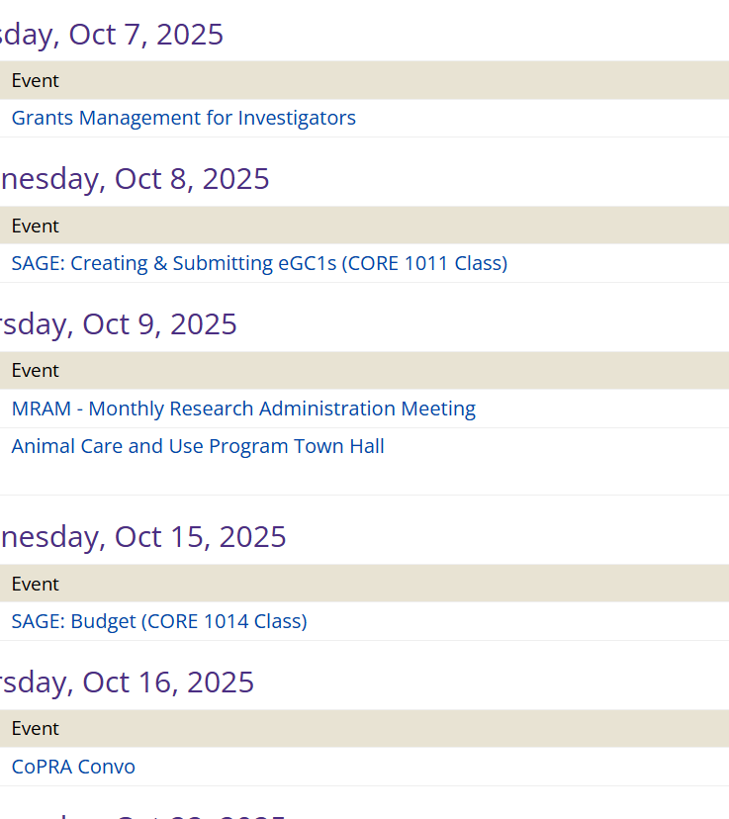
Office of Research Trumba Calendar
Includes MRAM, CORE classes, CoPRA Convos and much more
Grants Management for Investigators training, October 7, 1-3 pm

Slide 45
Fall Schedule
Register for Autumn CORE Courses
Course # | Course | Start | End | Date
1001 | Blueprint of a Proposal | 1:00 PM | 3:30 PM | 9/30/2025
2041 | Managing Cost Share at the UW | 9:30 AM | 11:30 AM | 10/7/2025
1011 | SAGE: Creating and Submitting eGC1s | 1:00 PM | 3:00 PM | 10/8/2025
1014 | SAGE: Budget | 2:00 PM | 4:00 PM | 10/15/2025
1095 | Navigating the New Frontier of Financial Reporting for Grants Managers | 9:30 AM | 11:30 AM | 10/16/2025
1012 | SAGE: Creating NIH Proposals in Grant Runner | 2:30 PM | 4:30 PM | 10/22/2025
1011 | SAGE: Creating and Submitting eGC1s | 1:00 PM | 3:00 PM | 10/28/2025
1030 | Understanding Your New Award | 9:30 AM | 11:00 AM | 10/28/2025
1039 | Reading the Notice of Award | 9:30 AM | 11:00 AM | 11/4/2025
2031 | Case Studies in Compliance: Humans, Animals and Substances | 2:00 PM | 4:00 PM | 11/4/2025
1015 | SAGE Awards & Modifications | 1:00 PM | 3:30 PM | 11/5/2025
1040 | Award Administration: Fiscal Compliance | 1:00 PM | 3:30 PM | 11/13/2025
1042 | Preparing for Audit | 9:30 AM | 11:30 AM | 12/2/2025
1032 | Subaward Fundamentals | 9:30 AM | 12:00 PM | 12/4/2025
1033 | Subawards in SAGE | 2:00 PM | 3:30 PM | 12/11/2025

Slide 46
New Resources
Proposal Development
  New video and exercises on Reading the Notice of Funding Opportunity (NOFO)
  Proposal Preparation Quick Guide
Video Demos on Financial Tools
PI Dashboard in Workday
Post Award Dashboard in Tableau
Workday Navigation Tips

