Slide 1
NATIONAL BIOSAFETY
MONTH 2024
Esther Pellham
EH&S Biosafety officer
October 2024
Notes:
Welcome to biosafety month everyone!
Each year for biosafety month we highlight our role in the university and a topic in biosafety.
Presentation by Esther Pellham

Slide 2
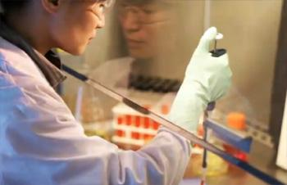
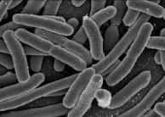
WHAT IS BIOSAFETY?
Framework for containment of biohazards
Includes safe practices, safety equipment, facilities and training
Protects the worker, community and environment
Protects the research product
Notes:
Biosafety is the safe handling of biohazards. Quickly define biohazard.
The purpose of biosafety is to protect the worker community and environment, by extension the safe work practices protect the product and improve research quality.

Slide 3
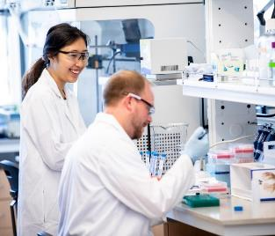
ABOUT EH&S BIOSAFETY FY24
533 principal investigators (PIs) with 655 active Biological Use Authorizations (BUAs)
353 BUAs reviewed
302 biosafety lab inspections (by PI)
450 rooms
Online trainings completed:
Biosafety: 2,597
Bloodborne pathogens (BBP): 5,321
Notes:
>600 active BUAs and >500 Pis
About 350 BUAs, 300 lab inspections include 450 rooms
BBP training includes both research and non-research. (Does not include UW Medicine)

Slide 4
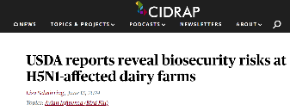
BIOSAFETY AND BIOSECURITY IN 2024
Notes:
Mention biosafety and biosecurity are in the news, emerging diseases and new outbreaks (High path). Increasing regulations and oversight for biological research – NIH Guidelines update for gene drive research, new issues from the white house on purchasing synthetic nucleic acids, and new Dual Use Research of Concern (DURC) framework on the horizon.

Slide 5
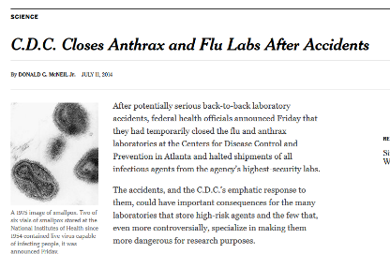
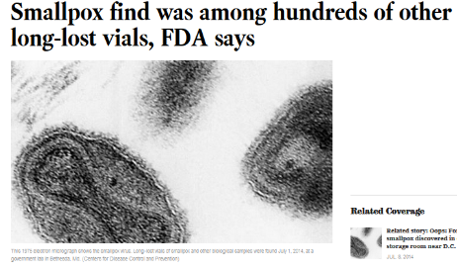
NATIONAL BIOSAFETY MONTH
Started in 2014 by the NIH Office of Science Policy
Time to focus attention to biosafety practices, policies, procedures and inventory
Notes:
About a decade ago there were several incidents in the news that highlighted gaps in biosafety programs. The FDA found smallpox vials in a cold room that were unaccounted for.
The CDC failed to inactivate anthrax samples that were sent out to labs that did not have the ability to handle them appropriately.
In response the white house ordered all federally funded labs to stop work and review inventories and procedures. From these incidents biosafety month was born.

Slide 6
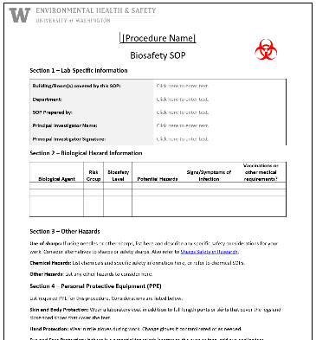
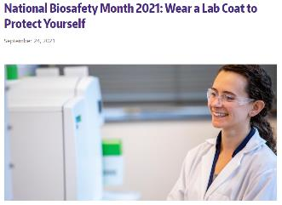
NATIONAL BIOSAFETY MONTH AT UW
Notes:
We have had numerous topics featured in our biosafety month from its start in 2014 including substituting hazards with safer alternatives, biological inventories, sharps safety, exposure response, and wearing appropriate PPE.

Slide 7
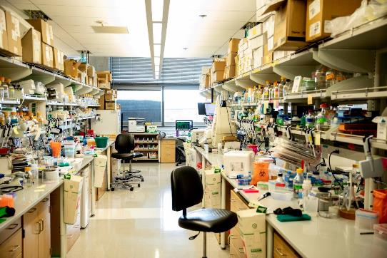
2024 BIOSAFETY MONTH AT UW:
SPA DAY OR “SELF CARE” FOR YOUR LAB
Deep clean your lab:
Reduce chances for contamination
Fosters a healthy workplace
Less potential for lab accidents
Reduces visual fatigue and stimulates creativity!
Notes:
This year EH&S decided to focus on laboratory cleanliness and giving your workspace a “spa day”. This focus on cleaning/decluttering your lab space has several advantages including: reducing contamination from unwanted mold or bacteria that could contaminate experiments and contribute to unhealthy conditions for lab personnel, removes hazards that could lead to lab accidents and incidents, and cleaning up your work space can stimulate creativity by reducing distraction, promoting a sense of calm, and while you are cleaning, it can give your brain the freedom to think creatively.
Cluttered vs dirty, not the same thing. A working lab will have clutter, but need to limit where and how much.

Slide 8
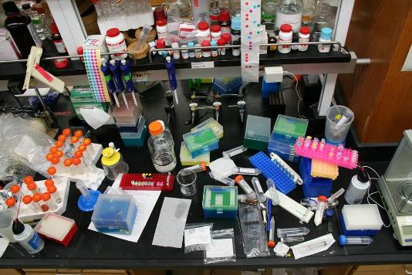
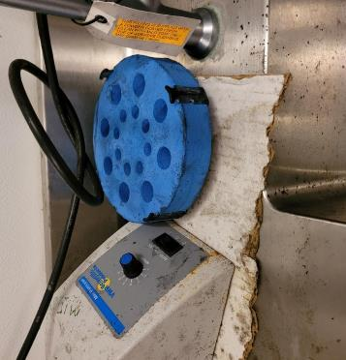
Notes:
Looking at the workbench on the left, it is difficult to know where to start and where samples or reagents are when your lab bench looks like the one pictured above. Some dirty work spaces can be a health hazard. The picture on the right is mold growing on equipment, and cardboard in a cold room at UW. The labs sharing this space were tasked with removing and decontaminating all items, and no more cardboard in the cold room.
Cluttered vs dirty, not the same thing. A working lab will have clutter, but need to limit where and how much.

Slide 9
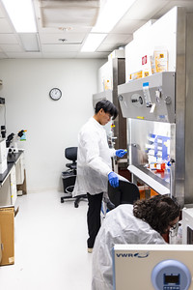
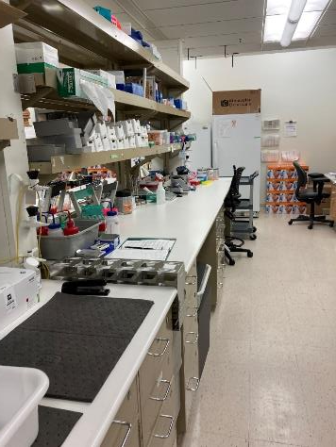
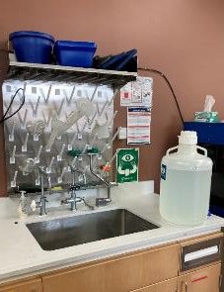
Notes:
When your lab space is tidy, and neat, there is less chances of contamination, healthy working conditions, and safety equipment and signs are more obvious like in the picture in the center. There is room to work on the lab benches on the right.

Slide 10
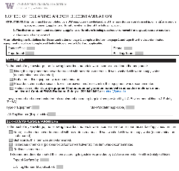
2024 BIOSAFETY MONTH AT UW:
SPA DAY OR “SELF CARE” FOR YOUR LAB
Dispose of expired or unneeded reagents, supplies, and equipment
Remove excess cardboard
Choose appropriate disinfectant for biological agent
UW Surplus website has list of items they cannot accept
Clean up paper documents too
Notes:
Scheduling a lab spa day can highlight some tasks that may not have been addressed for months or years. Working with expired reagents can affect results. Cardboard can encourage mold growth. If you are sending items to surplus, consult the website for items they will and won’t accept. Always decontaminate items before sending them to surplus. Paper documents take up space and get lost. Can they be archived, shredded or converted to electronic records?
Point out example of dirty item sent to surplus.

Slide 11
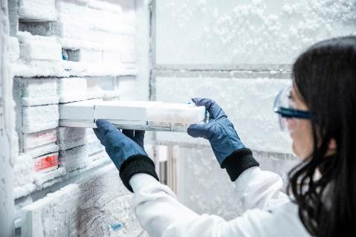
2024 BIOSAFETY MONTH AT UW:
SPA DAY OR “SELF CARE” FOR YOUR LAB
Clean freezers and refrigerators:
Use trays and absorbent materials to collect water
Sharp instruments cause damage; use a spray bottle of warm water or a blunt scraper to remove ice
Keep or toss? Update inventory and dispose of appropriately
Use fresh bleach solution to decontaminate surface
Notes:
Cleaning out freezers and refrigerators, frees up space, allows the equipment to work more efficiently (removes ice build-up), and allows research to continue without the costly purchase of new equipment. Follow these steps to properly clean out freezers and fridges.

Slide 12
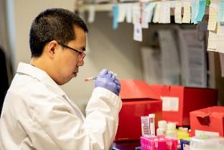
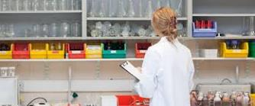
MAINTAIN YOUR CLEAN AND TIDY LAB
“Maintenance phase”
Schedule weekly/monthly/quarterly routine cleaning or lab chores
Keep items off the floor
Store supplies in plastic containers instead of cardboard
Check expiration dates
Remove waste and/or schedule waste pick-ups promptly
Replace and launder lab coats on a routine basis and if contaminated
Notes:
Now that your lab has gotten a refresh, maintaining all that hard work can be made easy with weekly/monthly/quarterly schedule of routing cleaning or lab chores. Things to consider, schedule BSC cleanings, water bath and incubators, schedule inventory of chemicals and other reagents, to prevent mold growth, store items in plastic storage boxes, and don’t let waste pile up in the lab.

Slide 13
BIOSAFETY MONTH OUTREACH
Email to principal investigators and lab managers with BUAs
News post featured on the EH&S website/newsletter
Featured on the Office of Research webpage
Presentations at U-WIDE Health and Safety Committee, MRAM, and IBC meeting

Slide 14
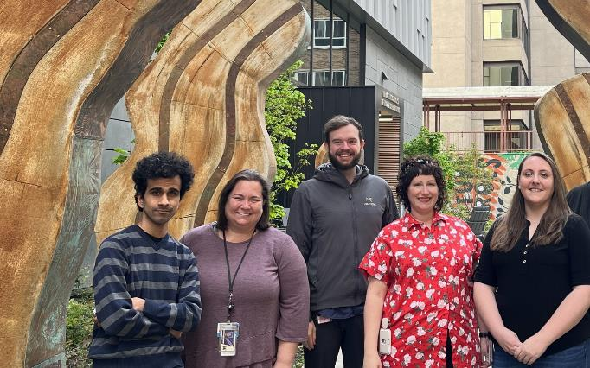
HAPPY BIOSAFETY MONTH!
Questions?
ehsbio@uw.edu
Thanks to the biosafety team!
Notes:
Please contact Biosafety any time for questions or information, you don’t need to wait to biosafety month”.

