Slide 1
TWO NEW FEDERAL POLICIES IMPACTING BIOLOGICAL RESEARCH EXPECTED MAY 2025
LESLEY DECKER, MS, RBP (ABSA)
EH&S BIOSAFETY MANAGER
MRAM MEETING, MARCH 2025

Slide 2
FRAMEWORK FOR NUCLEIC ACID SYNTHESIS SCREENING

Slide 3
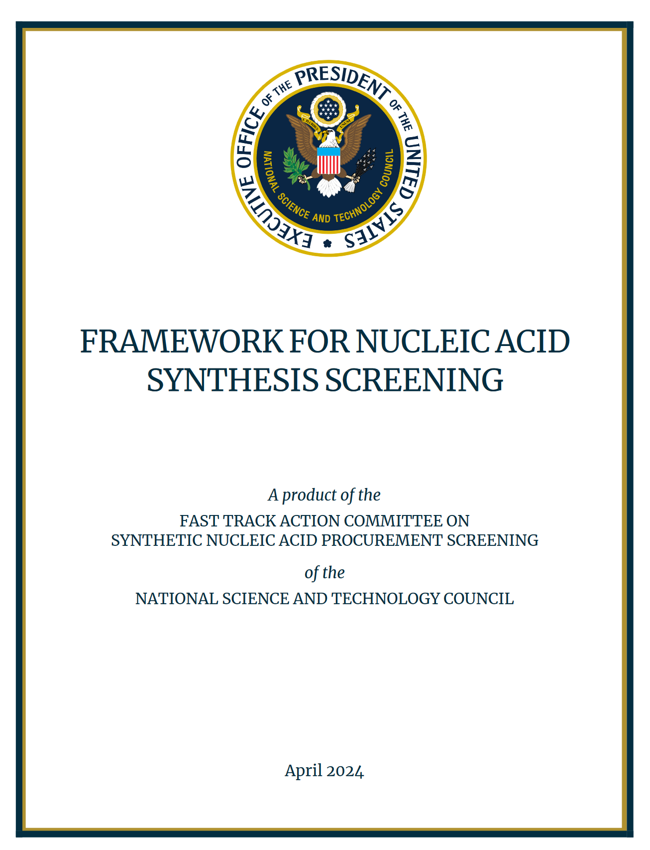
NEW REGULATORY REQUIREMENT
Released in April 2024
Implement by May 2025
Establishes screening processes for purchases of synthetic nucleic acids and synthesis equipment
Minimize potential misuse and ensure biosecurity for life sciences research
Notes:
Issued in response to President Biden’s October 2023 Executive Order on AI and biosecurity
The order directs the reduction of misuse risks related to synthetic nucleic acids.

Slide 4
PURPOSE AND SCOPE (1 of 2)
Providers/manufacturers are recommended to screen purchases of synthetic nucleic acids and synthesis equipment to identify sequences of concern and potential misuse.
Those who receive federal funding are required to purchase only from providers who attest to the required screening framework.
This Photo by Unknown Author is licensed under CC BY-SA-NC

Slide 5
PURPOSE AND SCOPE (2 of 2)
Applies to :
Research involving the procurement of all types of synthetic nucleic acids, including but not limited to:
Single- or double-stranded DNA and RNA
Whole organism genomes containing any synthetic sequences of concern (e.g., whole genomes of federally regulated pathogens such as select agents).
Research involving the procurement of any benchtop equipment capable of synthesizing nucleic acids.
This Photo by Unknown Author is licensed under CC BY-SA-NC

Slide 6
KEY ACTIONS FOR PROVIDERS
Attest to implementing the screening framework and doing due diligence
Screen orders for “sequences of concern” matching or resembling those on regulated pathogen lists, such as select agents or toxins
Verify customers are legitimate
Report suspicious/potentially illegitimate orders to FBI
Maintain records
Ensure robust cybersecurity

Slide 7
UW IMPLEMENTATION PLANS (1 of 2)
EH&S is working with Procurement to create a list of providers or vendors who attest to following the framework.
UW purchases of synthetic nucleic acids and synthesis equipment must be limited to providers on that list.
If UW units synthesize and provide nucleic acid sequences as “core facilities,” they are considered a provider.

Slide 8
U.S. GOVT POLICY FRAMEWORK FOR DUAL USE RESEARCH OF CONCERN (DURC) AND PATHOGENS WITH ENHANCED PANDEMIC POTENTIAL (PEPP)

Slide 9
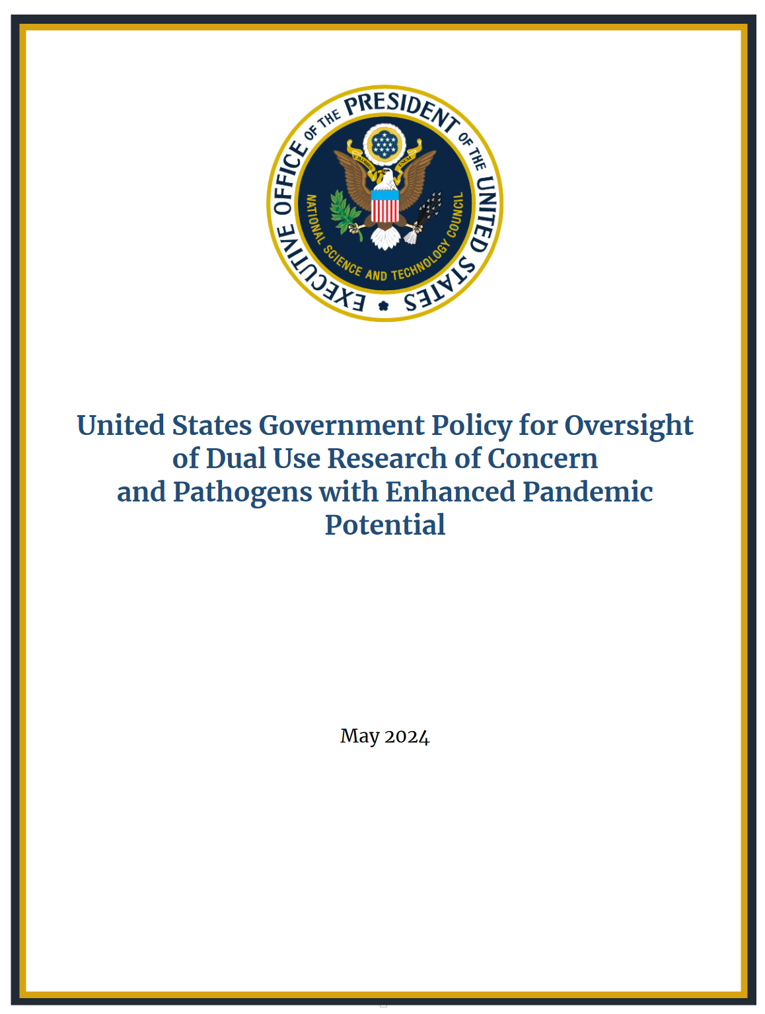
UPDATED REGULATORY REQUIREMENTS
Released May 2024
Implement in May 2025
Unified oversight for research on biological agents and toxins that, when enhanced, have potential to pose risks to public health, agriculture, food security, economic security, or national security
Supersedes previous DURC and P3CO policies

Slide 10
PURPOSE
To strengthen oversight of life sciences research throughout the research life cycle by:
Defining an expanded scope of agents and toxins subject to oversight
Providing a unified framework to assess for safety, security, and ethical considerations
Delineating roles and responsibilities for PIs, institutions, and federal departments and agencies

Slide 11
TWO CATEGORIES OF RESEARCH (1 of 2)
Category 1: Dual Use Research of Concern (DURC) | Category 2: Pathogen with Enhanced Pandemic Potential (PEPP)
Research that could easily be misused or misapplied to cause harm and pose a significant threat to public health and safety, agriculture, animals, environment, and national security. | Modifying a microorganism to create a “pathogen with enhanced pandemic potential” Capable of uncontrolled spread and severe disease Significant threat to public health, health systems, or national security

Slide 12
TWO CATEGORIES OF RESEARCH (2 of 2)
Category 1: Dual Use Research of Concern (DURC) | Category 2: Pathogen with Enhanced Pandemic Potential (PEPP)
All select agents and toxins in any amount Risk Group 3 or 4 pathogens Pathogens requiring BSL-3 or BSL-4 containment | Any microorganism could be modified into a PEPP Includes genetic modifications and other types of experiments

Slide 13
CATEGORY 1 OR 2 RESEARCH:
Research must fulfill three criteria to qualify as Category 1 or 2 research:
Involves biological agents within the category scope
Specific experimental outcomes or actions are reasonably anticipated
Specific potential effects should those outcomes or actions occur
Note that being an agent within scope only fulfills one criteria.

Slide 14
PROCESS FOR ASSESSMENT
The Principal Investigator (PI) assesses and notifies the funding agency if research may be either Category 1 or 2.
If likely to be funded, the funding agency notifies the Institutional Review Entity (IRE) at PI’s institution
The IRE reviews communicates their assessment back to the funding agency.
The funding agency will confirm the determination.

Slide 15
PROCESS IF CATEGORY 1 OR 2
The IRE and PI work together on a risk-benefit assessment and risk mitigation plan that is then submitted to the funding agency.
The funding agency must approve the risk mitigation plan in order for the experiments to proceed.
Responsible communication of research findings will be emphasized.

Slide 16
CONTINUOUS ASSESSMENT
The PI is responsible to continually assess at all stages of work, not only at proposal or award.
For changes, the PI must initiate an IRE review.
For existing NIH grants as of May 2025, assessments due at the time of Research Performance Progress Report (RPPR).
Include as part of Just-in-Time (JIT) materials submitted on or after May 6, 2025.
https://grants.nih.gov/grants/guide/notice-files/NOT-OD-25-061.html

Slide 17
UW IMPLEMENTATION PLANS (2 of 2)
Maintain Institutional Review Entity (IRE) as a subcommittee of the UW Institutional Biosafety Committee (IBC)
PI self-assessment worksheet
DURC-PEPP application
Updated EH&S trainings to include DURC-PEPP
Updates to Biological Use Authorization (BUA)
Outreach to UW biological research community

Slide 18
EH&S CONTACTS
ZARA LLEWELLYN
Assistant Director for Research Safety
EH&S
zaral@uw.edu
206-221-2676
LESLEY DECKER
Biosafety Manager
EH&S
lldecker@uw.edu
206-221-5524
ehsbio@uw.edu
Two new federal policies impacting research with synthetic nucleic acids and biological agents and toxins expected in May 2025 | EHS

