Slide 1
UPDATED HSD GUIDANCE: DATA SECURITY PROTECTIONS
JULY 10, 2025
MRAM
JASON MALONE, HSD DIRECTOR

Slide 2
THE GUIDANCE (SLIDE 1 OF 2)
Describes the types of data security protections that the UW IRB expects researchers to provide for human participants data, according to the possibility and type of harm to participants associated with a breach of the data.
Applies only to studies where the UW is the IRB of record, including non-UW institutions relying on the UW IRB for review.
Currently does not apply to studies relying on an external IRB
Notes:
- The guidance itself is not new.
- These data security requirements have been around since 2016 but have not been updated significantly in the intervening 9 years.
- It currently only applies to studies where the UW is the reviewing IRB, including non-UW sites relying on the UW for IRB review.

Slide 3
THE GUIDANCE (SLIDE 2 OF 2)
What’s new?
Risk Levels have been revised and reduced from five (5) to four (4)
Security requirements for each level have been updated to reflect current best practices
New device configuration guidance, sample policies templates, and online training tutorial available
What’s the same?
Researchers may still request an exception from specific requirements
Researchers may select more than one data classification level for different types of research data
Researchers are still expected that all data in the same system should be maintained at the highest risk level for any of the data
Many of the required protections are already part of UW IT-supported servers and networks and would not require any additional work or resources from researchers.
Notes:
- Over the past 6 months has worked with UW Medicine Compliance, UW Medicine Information Security, UW-IT Information Security, other SMEs and researchers to bring the guidance up to current data protection standards.
[REVIEW Slide Content]

Slide 4
Data Security Risk Levels 1 and 2
OLD
NEW
 | Level 1: Very low risk of harm if disclosed
Description | These data have little or no sensitivity. Disclosure of these data would have very little or no risk of physical, psychological, social, economic, legal, or educational advancement harm to the subjects.
Examples | De-identified, anonymous, or publicly available data Data for which subjects have consented to allow public access (e.g., a museum archive) Opinions of individuals about non-sensitive issues, or performance on non-sensitive tasks
 | Level 1: Suitable for Public Disclosure
Description | Information suitable for publication, public sharing, or open access. Applies to both existing data (retrospective use) and prospectively collected data.
Examples | Data from lawful and trusted public sources (e.g., census data, court records) Data for which participants have consented to allow public access (e.g., a museum archive, NIH public access repositories)
 | Level 2: Little risk of harm to individuals if disclosed
Description | These data have relatively little risk of harm except possible short-term embarrassment or psychological discomfort if the data were disclosed. Disclosure of this information would not reasonably place individuals at risk of criminal or civil liability or be damaging to their financial standing, insurability, employability, educational advancement, or reputation.
Examples | Performance of individuals on benign tasks (e.g., online games and puzzles) Individual opinions on innocuous topics (e.g., perceived nutritional values of different foods, product brand preferences)
 | Level 2: Some risk of minor harm to individuals if disclosed
Description | These data have relatively little sensitivity except possibly short-term embarrassment or psychological discomfort if the data were disclosed.
Examples | Performance of individuals on non-sensitive tasks in a competitive situation Genetic information about individuals’ metabolism of medical drugs such as statins
Notes:
Some bigger changes were made here to better align with general data security risk levels here at UW and other peer institutions
Previously Level 1 included low risk research (e.g., opinion survey studies, performance of non-sensitive tasks). These have now been moved up to Level 2
Level 1 is limited to information that would be acceptable if it were publicly disclosed.
Result of this is that more low-risk research will now qualify for the application of the data security standards required under level 2

Slide 5
Data Security Risk Level 3
OLD
NEW
 | Level 3: Could cause risk of material harm to individuals if disclosed.
Description | These data could result in harm that can have genuine impact, but the magnitude and/or duration are generally not serious, long-lasting, and/or irreversible.
Examples | Non-sensitive Personal Health Information
 | Level 3: Risk of material harm to individuals if disclosed
Description | These data could result in harm that has a genuine impact, but the magnitude and/or duration are generally not serious, long-lasting, and/or irreversible. Disclosure of these data could cause some financial or social harm, civil liability, reputational harm, or impact to educational advancement. However, disclosure of these data would not cause criminal liability, loss of insurability or employability, severe financial or social harm.
Examples | Non-stigmatized personal health information (e.g., lab results that don’t indicate a clear diagnosis such as Vitamin D levels, visibly obvious conditions such as broken arm, wearing corrective lens) Student course performance information
Notes:
There were fewer changes to Risk level 3 but more details were provided to assist researchers in identifying what type of data fits into this category.

Slide 6
Data Security Risk Levels 4 and 5
OLD
NEW
 | Level 4: Would likely cause serious harm to individuals if disclosed
Description | These data could result in serious harm.
Examples | Sensitive Personal Health Information, such as the history of cancer or other significant conditions which could (for example) affect employability or insurability
 | Level 5: Extremely sensitive; could cause severe harm to individuals if disclosed
Description | These data could result in serious and long-lasting harm.
Examples | Information about subjects’ illegal behavior Very sensitive Personal Health Information, such as the diagnosis of HIV/AIDS in some cultures or a diagnosis of leprosy
 | Level 4: Risk of serious and/or long-lasting harm to individuals if disclosed
Description | These data could result in serious and/or long-lasting harm. Disclosure of these data could cause criminal liability, loss of insurability or employability, severe financial or social harm.
Examples | Personal health information such as mental health, alcohol and substance abuse, HIV status, STIs, cancer, reproductive healthcare Individually identifiable financial account information Information about illegal behavior (e.g., use of illegal substances, underage use of legal substances) Information about immigration status
Notes:
Levels 4 and 5 have been combined in our updated guidance because we have found it difficult to separate the two and the data security requirements are essentially the same. Any study working with level 5 data would now be considered level 4 under the revised guidance

Slide 7
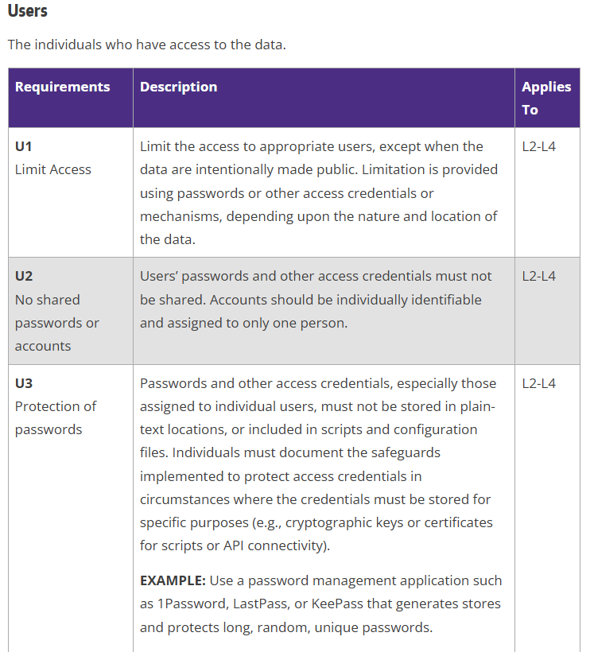
DATA PROTECTION REQUIREMENTS
Six categories:
Users
Devices
Servers/Services
Paper/Non-digital Records
Data Transmission
Vendors
Notes:
There six categories of data protection requirements and within each are specific requirements along with what risk levels those requirements apply to.
This is not new but the content for many of the requirements has been updated or enhanced.
We’ve also attempted to provide more details for clarity and links to helpful references and other institutional guidance. Some of these changes were made in response to feedback we’ve received from researchers when we’ve conducted PAVE audits.

Slide 8
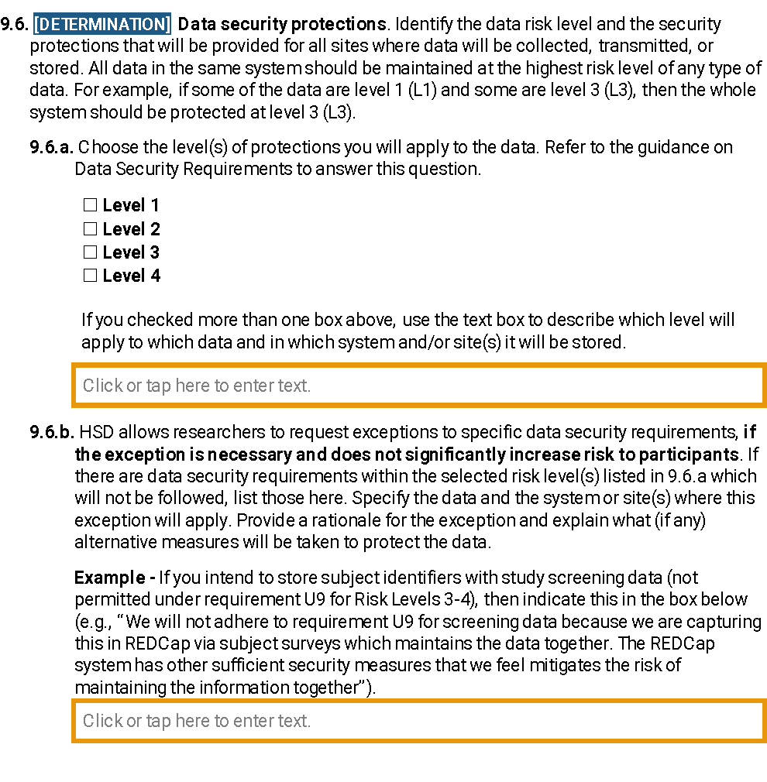
Revised IRB Protocol Question
Notes:
We have updated our IRB protocol form to reflect the changes in risk levels.
Researchers can check more than one risk level and then describe in more detail what level will apply to which types of data and in which systems that data will be stored [CLICK for Fly-in and CLICK AGAIN for Fly-away]
As noted before, researchers can request exceptions to specific requirements for a given risk level [CLICK for Fly-in]

Slide 9
IMPLEMENTATION
New Studies
New requirements effective July 1, 2025
Existing Studies
Researchers must apply updated protections by January 1, 2026
Researchers are expected to assess if the data security risk level(s) has changed and if yes, submit a study modification
HSD review staff assess if security level has changed for studies that submit for Continuing Review and if yes ask researcher to submit a study modification
Notes:
For new studies approved after July 1st, the updated data security protection requirements are in effect.
We’re giving existing studies more time to assess their data security protections and make any updates [REVIEW Slide]

Slide 10
OTHER RESOURCES
Online Tutorial Data Security Protections (https://www.washington.edu/research/hsd/training/hsd-tutorials-and-videos/#datasecurity)
WORKSHEET Device Configuration (https://www.washington.edu/research/forms-and-templates/worksheet-device-configuration/)
Template Policies
Confidentiality and Security Training (https://www.washington.edu/research/forms-and-templates/template-confidentiality-training/)
Device Management and Monitoring (https://www.washington.edu/research/forms-and-templates/template-device-mgmt-policy/)
Research Data Access Control (https://www.washington.edu/research/forms-and-templates/template-data-access-policy/)
Notes:
As mentioned earlier, we’ve developed a number of new resources to make compliance with these data security requirements easier including:
New online tutorial for researchers that explains the purpose of these requirements, the risk levels, and the associated data security requirements
A new worksheet that walks through how to appropriately configure devices for proper security. This is especially useful for researchers, particularly student researchers who may be using personal devices not supported by a department IT
Some of the security requirements include having specific policies that address how research staff are training on data security, how devices are managed and tracked, and how access to study data is controlled. We have now created sample templates for researchers who may not have department policies that address this and need to generate their own.

Slide 11
QUESTIONS?

