Slide 1
COMPLIANCE HOT TOPICS: COST SHARE; NRSA STIPEND LEVELS; TRAVEL
MRAM
June 2025
Matt Gardner
Post Award Fiscal Compliance

Slide 2
Cost Share Report in Workday (1 of 2)
Report Title: “R1205 Cost Share”
Report can display all cost share by Award, Grant, Cost Center, Cost Center Hierarchy, PI, or Sponsor
Data elements:
Award
Grant
Award Line
Award Start Date
Award End Date
Cost Share Type
Commitment Amount
Contribution Amount
MRAM – Matt Gardner – PAFC

Slide 3
Cost Share Report in Workday (2 of 2)
MRAM – Matt Gardner – PAFC

Slide 4
NRSA Stipend Levels for Federal FY 2025
NIH issued NOT-OD-25-105 on May 16th
New stipends levels for fellows, predocs, and postdocs on NRSA Fellowships and Training Grants
Effective for all NRSA awards made on or after October 1, 2024
Retroactive adjustments or supplementation of stipends for an award made prior to October 1, 2024, are not permitted

Slide 5
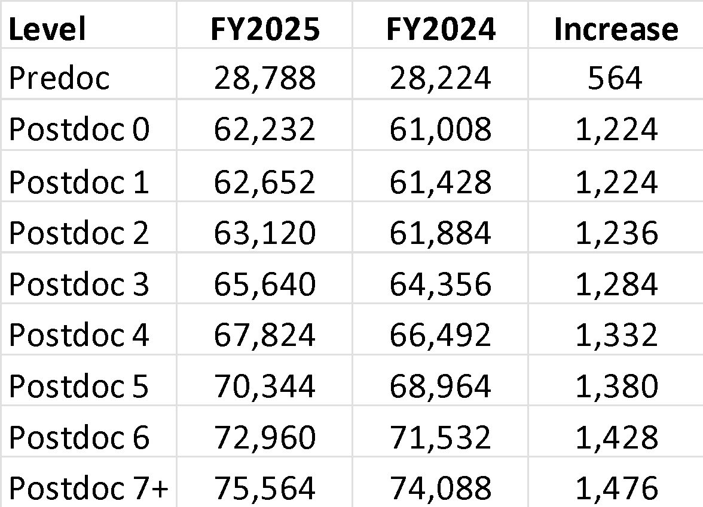
NRSA Stipend Levels for FY 2025 – New Levels
Stipends increased for all career levels for federal FY 2025
Institutional Allowance and Training Related Expenses remain the same

Slide 6
NRSA Stipend Level Notices
FY 2024: NOT-OD-24-104
Effective for awards made on or after Oct. 1, 2023
https://grants.nih.gov/grants/guide/notice-files/NOT-OD-24-104.html
FY 2025: NOT-OD-25-105
Effective for awards made on or after Oct. 1, 2024
https://grants.nih.gov/grants/guide/notice-files/NOT-OD-25-105.html

Slide 7
NRSA Stipend Levels – Scenario A
Training Grant award dates: 7/1/2025 – 6/30/2026
Award was issued during federal FY 2025
Stipend levels determined by NOT-OD-25-105
The most recently issued stipend levels apply to trainees appointed to this budget period as the award was issued after to Oct. 1, 2024

Slide 8
NRSA Stipend Levels – Scenario B
Training Grant award dates: 9/1/2024 – 8/31/2025
Award was issued during federal FY 2024
Stipend levels determined by NOT-OD-24-104
The recently issued stipend levels will not apply to trainees appointed to this budget period as the award was issued prior to Oct. 1, 2024.

Slide 9
Awards issued on or after October 1, 2024
If an award was issued on or after October 1, 2024 (FY2025) but before the new stipend levels were released…
NIH will revise the award to adjust the funding to the new levels
Appointments to institutional training grants must be amended to reflect the FY 2025 levels after the award is adjusted by NIH

Slide 10
Travel on Sponsored Awards: Reminders
Sponsors typically require recipients to follow their institution’s travel policies
In these instances, travel charged to the award must comply with UW Travel policies
UW Travel: https://finance.uw.edu/travel/
This would include any policies regarding reimbursements, receipts, and authorizations
Federal regulations state specific requirements for:
Class of air travel (least expensive accommodation)
Type of airfare ticket (unrestricted is allowable)
Compliance with the Fly America Act (use of U.S. flag carrier)
MRAM – Matt Gardner – PAFC

Slide 11
ECC Focused Topic Office Hour
Thursday, June 26th, 10am to 11am
Topics:
New IBS definition and how/when to use the Salary Allocations Calculator tool
Info: https://finance.uw.edu/pafc/effort-reporting/ecc-office-hours
The session will be recorded and all materials will be posted on the PAFC Effort Reporting webpage
Link: https://finance.uw.edu/pafc/session_recordings
MRAM – Matt Gardner - PAFC

Slide 12
Questions
Post Award Fiscal Compliance (PAFC)
effortreporting@uw.edu (Effort questions)
gcafco@uw.edu (All other compliance questions)
https://finance.uw.edu/pafc/
Matt Gardner
mgard4@uw.edu
David Parks, Effort Compliance Analyst
parksd2@uw.edu
MRAM – Matt Gardner – PAFC

