Slide 1
UW Diversity in Clinical Trials Initiative: Update
MRAM
January 2025
Jason Malone
Human Subjects Division

Slide 2
Legislation in Brief (SSHB 1745, 2023)
Improve completeness and quality of data concerning diverse demographic groups that is collected, reported and analyzed for clinical trials
Identify barriers to participation for underrepresented demographic groups and employ strategies recognized by FDA to encourage greater participation
Make data concerning demographic groups that is collected, reported, and analyzed for the purposes of clinical trials more available and transparent
Require institutions within WA State to adopt a policy that requires researchers to:
Identify and recruit persons from unrepresented demographic groups
Collaborate with community-based organizations
Use recruitment methods recognized by the FDA
Provide translation & interpreter services for individuals with non-English language preference
Provide culturally specific recruitment materials
Provide option for electronic consent
MRAM – Jason Malone - HSD
Notes:
Recall that in 2023, WA State legislature passed the Diversity in Clinical Trials law to improve participation of underrepresented demographic groups in clinical trials.
Part of the law required that institutions like UW develop a policy that requires researchers to… [REVIEW Slide]

Slide 3
Diversity in Clinical Trials - UW Policy
Announced in the January 7, 2025, HSD e-newsletter
https://www.washington.edu/research/announcements/for-the-record-january-7-2025-dct-guidance-revised-short-form-policy-more/#a1
Diversity Plan and associated guidance available on HSD website
Policy effective date: January 1, 2026
MRAM – Jason Malone - HSD
Notes:
After 1.5 years of development with input from a variety of interested parties across our research community, we have finalized and published our institutional policy including associated guidance.
If you navigate to our newsletter article you can click links to the guidance on our website. There is also a document that summarizes all the feedback we received from the research community and how we addressed that in the final policy.
The effective date of the policy, however, is not until January 1, 2026.

Slide 4
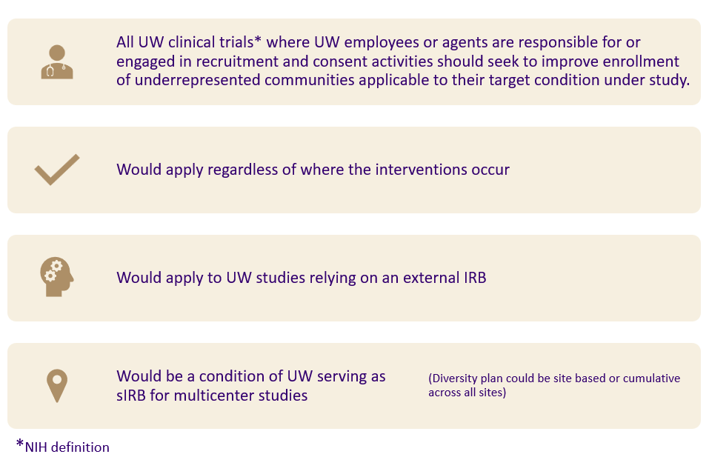
Scope Reminder: UW Policy
MRAM – Jason Malone - HSD
Notes:
A quick refresher on the UW’s policy scope. The UW Diversity in Clinical Trials policy would apply to… [REVIEW Slide]

Slide 5
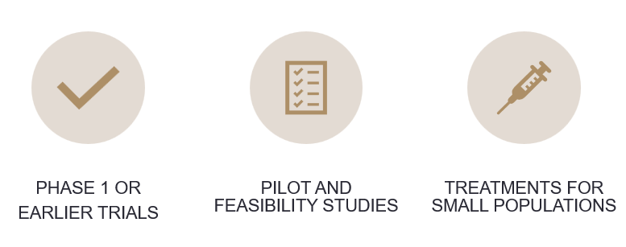
Justified Exclusions
MRAM – Jason Malone - HSD
Notes:
We also carved out types of clinical trials that would generally NOT be subject to the DCT requirements.

Slide 6
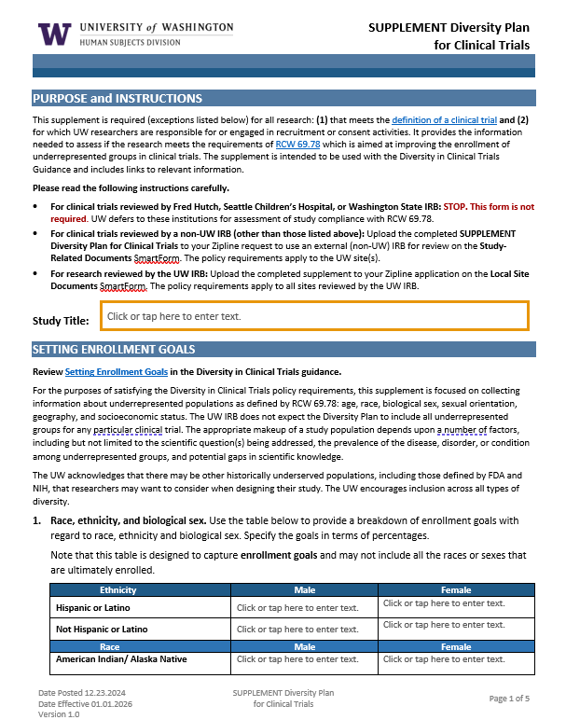
HSD Supplement – Diversity Plan
Establishing Enrollment Goals - age, race, ethnicity, biologic sex, sexual orientation, geographic location (probably zip codes), social economic status (several variables, TBD)
Rationale for current enrollment goals and any exclusions
Strategy for meeting enrollment goals (e.g., study design, recruitment, and retentional plan, reducing barriers to participation
Description of efforts/resources utilized for community engagement that informs recruitment strategy
Plan for tracking enrollment data
MRAM – Jason Malone - HSD
Notes:
So, what will researchers have to do? Starting on January 1, 2026, any researcher who submits a new clinical trial application to HSD (either for UW or external IRB review) will be required to develop a diversity plan.
HSD has developed a new supplement for this. We chose to do a supplement versus incorporate the questions into our IRB Protocol Form because only about 12% of our total research portfolio is comprised of clinical trials that are subject to the DCT requirements.
The plan is modeled after FDA’s proposed diversity action plan, which should make it easier for FDA-regulated studies to utilize a Sponsor’s existing plan.
The diversity plan solicits information in 5 areas… [REVIEW Slide]

Slide 7
Researcher Implications
More staff FTE needed to:
Identify and recruit underrepresented populations
Engaged with targeted communities
Develop culturally specific recruitment materials
Provide e-consent option
Track and report on enrollment metrics
More funding to cover costs associated with:
Translation and interpreter services
Culturally specific recruitment strategies/materials
Reimbursement for participation expenses to reduce barriers (e.g., travel, parking, childcare)
Possible IRB review fees (e.g., commercial IRB review)
MRAM – Jason Malone - HSD
Notes:
In order to implement the DCT requirements, researchers will need more time and money. Some of the specific implications include: [REVIEW Slide]
It is because of these requirements that we have published our policy and guidance a year in advance so that researchers have time to plan and budget for the additional costs.
After 1/1/26, new study submissions for studies subject to the DCT policy will be expect to comply. Insufficient funding will generally not be an acceptable justification for excluding participants from underrepresented communities.

Slide 8
What’s Next? – HSD Timeline
Publication of final diversity plan, policy, and guidance (Jan. 2025)
Pilot pre-award planning* (Jan.-Jun. 2025)
Update other associated HSD forms, policy, and guidance (Jan.-Aug. 2025)
Training and dissemination (Oct.-Dec. 2025
MRAM – Jason Malone - HSD
Notes:
So, what’s next? HSD is planning to do a lot of outreach to message the new requirements to affected researchers.
We have been working with ORIS and OSP to develop a report out of SAGE that will identify new applications for funding that are being submitted for CTs subject to the DCT requirements. We intend to reach out to those researchers directly to educate them about the requirements and offer assistance to a subset of them in piloting the development of an appropriate diversity plan, in coordination with new resources that are being stood up at UW.
Internally we have to update our other existing forms, guidance, and policies to align with the DCT requirements and develop training and guidance for staff and IRB members on how to review the plans.
We also need to work with our commercial IRB partners WCG and Advarra to ensure they have a review process in place.
We will need to have all of these things completed by December of this year so we’re ready to start receiving/reviewing diversity plans next January

Slide 9
Other DCTI Activities
Community Collaboratory – community engagement
UW Libraries/ITHS target population identification service
ITHS Recruitment Support Service
Centralized admin support for translation/interpreter services
Translation support for unfunded/underfunded studies
More e-consent options
Centralized institutional enrollment reporting
MRAM – Jason Malone - HSD
Notes:
Outside of HSD there are several other groups working on establishing additional resources to support researchers. Some of these include… [REVIEW Slide]

Slide 10
Additional Info & Questions
ITHS DCTI Website: https://www.iths.org/dcti/?mkt_tok=MTMxLUFRTy0yMjUAAAGX3ShNtffpAveEMTAg9q_QGVWoot8MtvyPMUoOReG3PUAy32PQ0U6j0Dxf0pfgkICLdRcnOuA7XK6U-SbxvxWK
HSD e-newsletter: https://www.washington.edu/research/manage-your-office-of-research-subscriptions/#hsd-newsletter
Contact HSD: hsdinfo@uw.edu
MRAM – Jason Malone - HSD
Notes:
Outside of HSD there are several other groups working on establishing additional resources to support researchers. Some of these include… [REVIEW Slide]

