Slide 1
UW Diversity in Clinical Trials Initiative: Update
MRAM
August 14, 2025
Jason Malone
Human Subjects Division
Notes:
I want to review with you all today the Diversity in Clinical Trials Initiative, whose implementation date is coming up on January 1st.
I’ll go over the policy requirements, exceptions, and then would like to talk about some of the resources being stood up for researchers to support compliance.

Slide 2
Legislation in Brief (SSHB 1745, 2023)
Improve completeness and quality of data concerning diverse demographic groups that is collected, reported and analyzed for clinical trials
Identify barriers to participation for underrepresented demographic groups and employ strategies recognized by FDA to encourage greater participation
Make data concerning demographic groups that is collected, reported, and analyzed for the purposes of clinical trials more available and transparent
Require institutions within WA State to adopt a policy that requires researchers to:
  Identify and recruit persons from underrepresented demographic groups
  Collaborate with community-based organizations
  Use recruitment methods recognized by the FDA
  Provide translation & interpreter services for individuals with non-English language preference
  Provide culturally specific recruitment materials
  Provide option for electronic consent
Notes:
Recall that in 2023, the WA State legislature passed the Diversity in Clinical Trials law to improve participation of underrepresented demographic groups in clinical trials.
Part of the law required that institutions like UW develop a policy that requires researchers to… [REVIEW Slide]

Slide 3
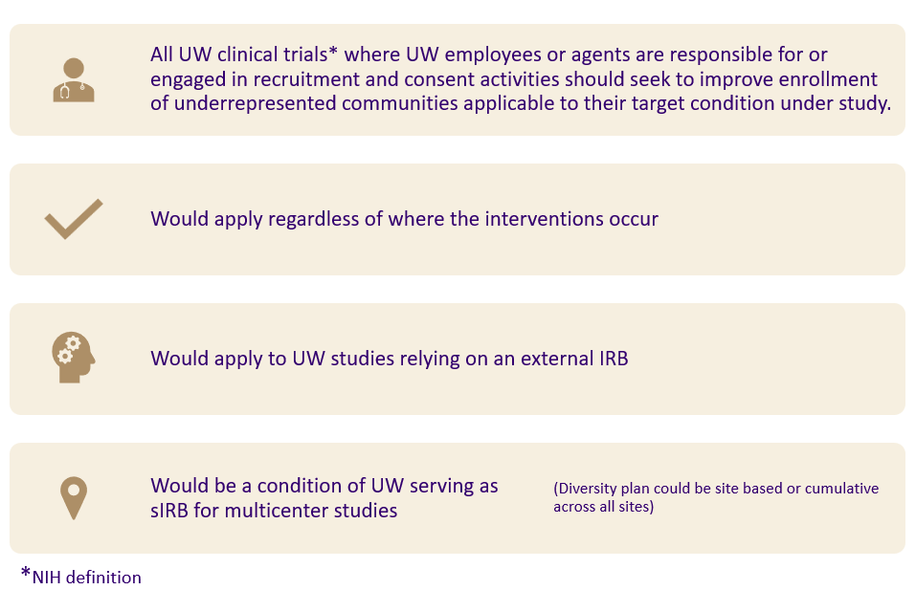
UW Policy Scope (1 of 2)
Notes:
Our institutional policy is broader that the state law, applying to all types of UW clinical trials, not just drug/device studies, so behavioral or surgical interventional trials are included.
It applies to clinical trials where UW employees or agents are responsible for or engaged in recruitment and consent activities. If the UW is only engaged for example, as a data coordinating site and is not responsible for recruitment and consent, the policy does not apply.
It would apply regardless of where the research is occurring (e.g., WA state, international) and would apply for studies relying on an external IRB and for non-UW sites relying on the UW IRB for review.

Slide 4
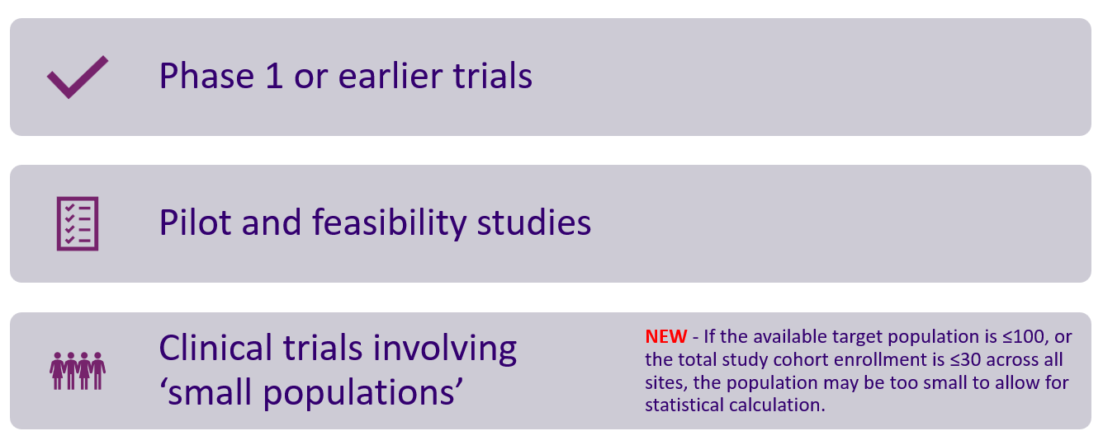
UW Policy Scope (2 of 2)
Notes:
There are some exceptions to the policy including [REVIEW Slide]
Note that we have recently provided additional clarification to the exception regarding ‘small populations’. [CLICK for Fly-in]
If the available target population is ≤100, or the total study cohort enrollment is ≤30 across all sites, the population may be too small to allow for statistical calculation.
Some examples of studies that may not have an available population greater than 100 individuals might include studies involving rare diseases or unique and limited populations (e.g., a study involving astronauts).
For multi-site research, the cohort enrollment includes all sites so if the local UW site is only enrolling 10 participants but there are 25 other study sites each enrolling 10 people, the cohort for the study overall is 250 and therefore the study is subject to the DCT requirements. The UW site would be expected to develop a reasonable diversity plan for their targeted 10 participants.

Slide 5
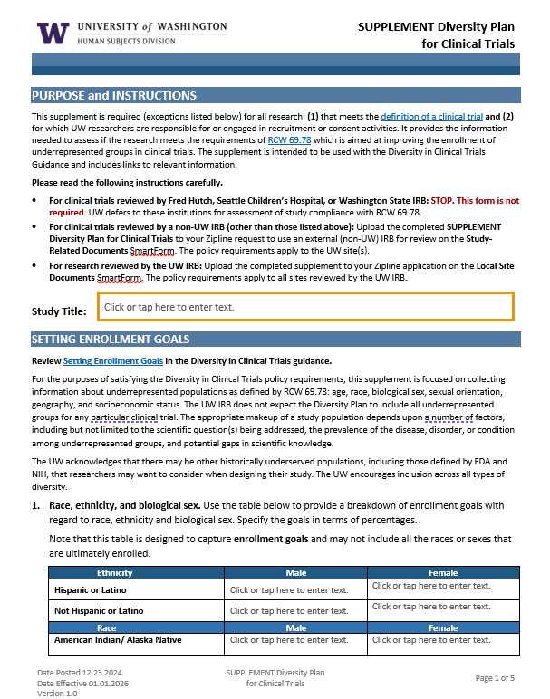
HSD Supplement – Diversity Plan
Establishing Enrollment Goals - age, race, ethnicity, biologic sex, sexual orientation, geographic location (probably zip codes), social economic status (several variables, TBD)
Rationale for current enrollment goals and any exclusions
Strategy for meeting enrollment goals (e.g., study design, recruitment, and retentional plan, reducing barriers to participation
Description of efforts/resources utilized for community engagement that informs recruitment strategy
Plan for tracking enrollment data
Notes:
HSD has developed a diversity supplement that researchers will submit as part of their application to HSD (either for UW or external IRB review).
The diversity plan solicits information in 5 areas… [REVIEW Slide]

Slide 6
UW Policy - Translation & Interpretation
When 5% or more of the target population speaks a primary language other than English:
  The study must have translations of any written materials to be read by participants (e.g., consent forms, recruitment materials, surveys) available at the outset of the research.
  There must be resources in place to support their inclusion for the duration of the study.
When less than 5% of the target population speaks a primary language other than English:
  There must be a plan in place to support their enrollment and participation in the research when they are encountered.
Notes:
I want to call out the policy requirements regarding enrollment of individuals with a non-English language preference.
[REVIEW Slide]

Slide 7
Implications for Researchers
More staff FTE needed to:
  Identify and recruit underrepresented populations
  Engaged with targeted communities
  Develop culturally specific recruitment materials
  Provide e-consent option
  Track and report on enrollment metrics
More funding to cover costs associated with:
  Translation and interpreter services
  Culturally specific recruitment strategies/materials
  Reimbursement for participation expenses to reduce barriers (e.g., travel, parking, childcare)
  Possible IRB review fees (e.g., commercial IRB review)
Notes:
To implement the DCT requirements, researchers will need more time and money. Some of the specific implications include: [REVIEW Slide]
It is because of these requirements that we have published our policy and guidance a year in advance (this past January) so that researchers have time to plan and budget for the additional costs.
After January 1, 2026, new study submissions for clinical trials subject to the DCT policy will be expected to comply. Insufficient funding will generally not be an acceptable justification for excluding participants from underrepresented communities.

Slide 8
Resources
Notes:
I next want to talk about some of the resources being stood up to help researchers comply with the DCT requirements.

Slide 9

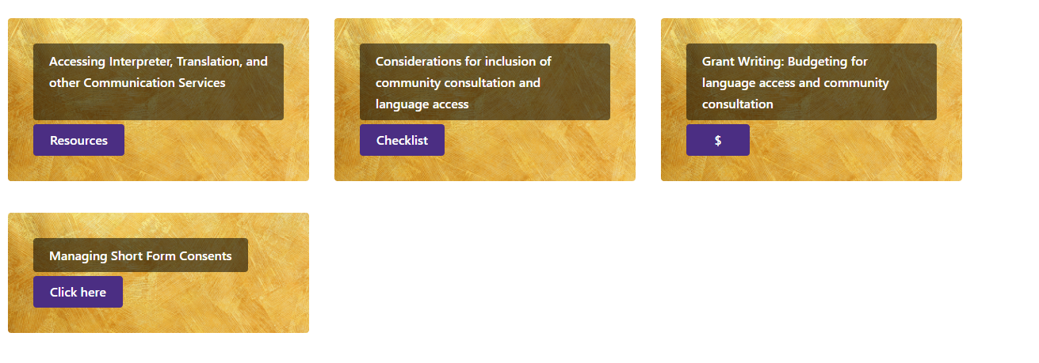
Support Services – Translation & Interpretation
UW Medicine Language Access & Cultural Advocacy
  Provides access to translation and interpretation in the UW clinic space
  Expanding access outside of the clinic space to support this policy
  Provides guidance on budgeting and community consultation needs.
Clinical Trials Language Access Resources (requires UW NetID)
Notes:
UW Med Language Access and Cultural Advocacy office has established relationships with translation and interpreter services companies that researchers can now access.
Researcher wouldn’t need to identify and separately contract with companies. Instead, they can submit an email request for services, receive a quote and then be invoiced directly. Translations can happen in a matter of days for some languages.
You can also obtain quotes to help in preparing budget estimates for grants, contracts, or other funding proposals.
All of these services are available now for use by any UW researcher.
NOTE – Translation services provided in association with a clinical visit do not incur additional research charges but research only visits do.
Also, the Office of Healthcare Equity is working with UWLACA to establish a process by which unfunded or underfunded studies can access free translation and interpreter services. More information on this will be published in our newsletter when it goes live.

Slide 10
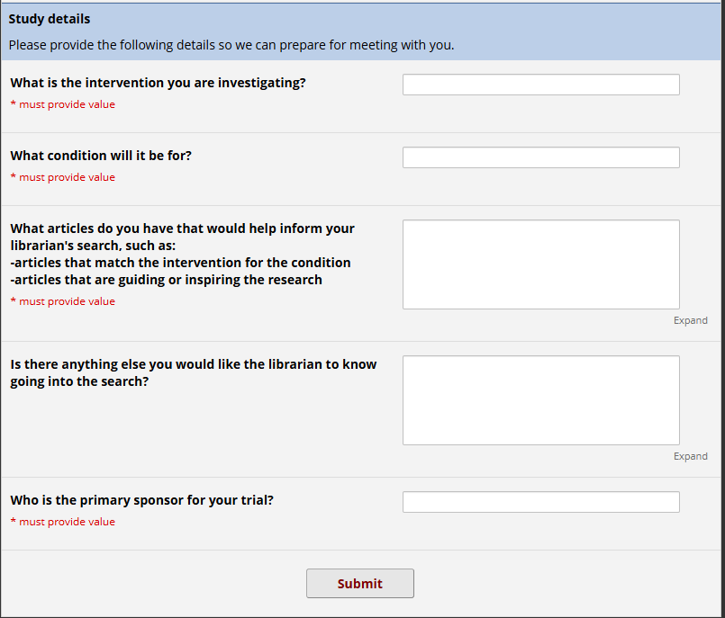
Support Services – Health Sciences Research Library
Open to UW Researchers
(no charge)
Identifying demographics
  PubMed
  ClinicalTrials.gov registry
DCTI-specific REDCap intake and query*
Notes:
Health Sciences Library offers a lit search review service to help researchers obtain information to identify underrepresented communities within their target population and intervention.
This is a free resource open to all UW researchers now.

Slide 11
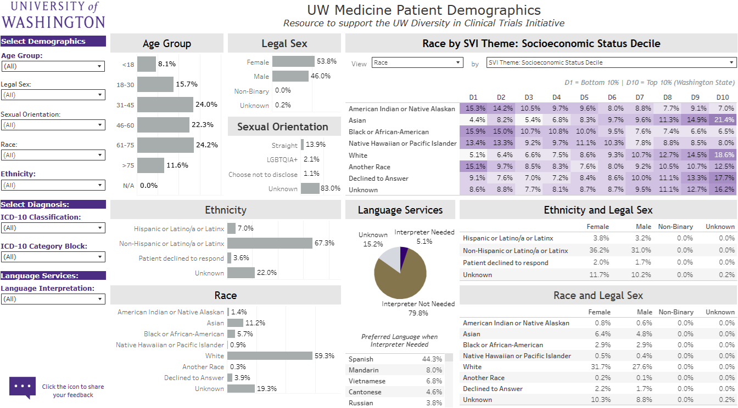
Support Services – Clinical Trial Dashboard
Available in Fall 2025
(no charge)
UW's first aggregated data set from Epic & OnCore
Access via UW BI Portal (UW NetID required)
Allows filtering by
  Demographics
  ICD-10 codes
  Interpretation needed (Y/N)
  Area Deprivation Index
  Social Vulnerability Index
Notes:
Another service that will help investigators identify their target population is the Clinical Trial Dashboard.
This tool pulls from data in Epic and Oncore to give breakdowns of available populations within the data set that align with the different underrepresented communities identified in the WA State law.
Data can be filtered down by ICD-10 codes to look at race/ethnicity, sex, age, etc.
This tool should be available this fall and will be free to use.

Slide 12
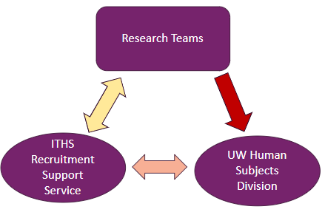
Recruitment Support Service
Open to WWAMI Researchers
(no charge)
Consultations to help with recruitment and retention planning
  meeting representation goals & breaking down barriers
  outreach strategies
  culturally sensitive recruitment materials
  budget & logistics
Consultants
  UW
  SCH
  Office of Healthcare Equity representation
  UW Human Subjects Division
Notes:
The ITHS has established a recruitment support service to provide consultations to researchers on developing appropriate recruitment and retention strategies, including helping with designing culturally sensitive recruitment materials and budgeting and planning.
It draws from a pool of expertise across different offices, include representatives from HSD to ensure the plan developed will meet the policy requirements.
This service is live now and open to researchers across WWAMI region at no cost.

Slide 13
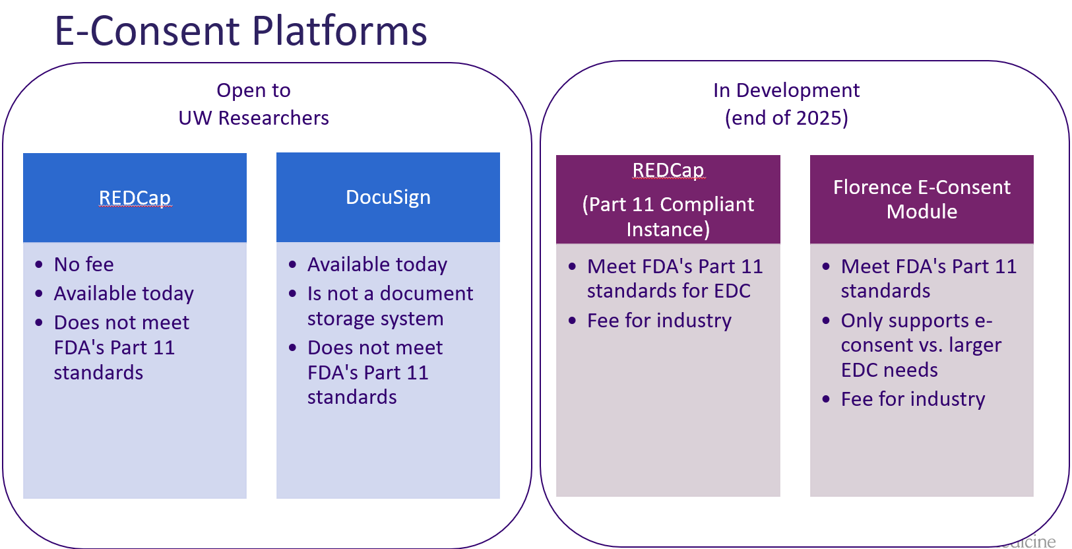
Support Services: E-consent Platforms
Notes:
Recall that the DCT law requires that e-consent be offered as an option to participants.
The UW has available free e-consent resources now with REDCap and DocuSign.
For FDA-regulated studies, we don’t currently have any part 11 compliant e-tool. Two systems are being added to address this:
A part 11 compliant REDCap instance that will also support EDC
Florence e-consent module
Both should be available by the end of this calendar year. Costs are still being determined for use of the part 11 REDCap instance but the Florence e-consent module will be free for all studies except industry-sponsored trials.
Look for more information about these in future hsd newsletters.

Slide 14
Resources & Guidance
Human Subjects Division
  Diversity in Clinical Trials Guidance
  Diversity Plan for Clinical Trials Supplement
  hsdinfo@uw.edu
Office of Health Equity & Community Engagement
  Community-Centered Research Resources
ITHS Recruitment Support Service
  Recruitment Support Service
  recruitmentsupport@uw.edu
UW Medicine Language Access & Cultural Advocacy
  Clinical Trials Language Access Resources
DCTI Website
  ITHS DCTI Home Page
Notes:
Finally, I’ve listed here links to available resources about these services and other information about the DCTI.

Slide 15

QUESTIONS
Send questions to hsdinfo@uw.edu
Notes:
Feel free to send any questions you have about the DCTI to hsdinfo@uw.edu.

