Slide 1
New NIH SNAP SAGE Budget Requirement
MRAM
October 10, 2024
Juan Lepez, Director
Grant & Contract Accounting

Slide 2
NIH SNAP AWARD SETUP IN WORKDAY
GCA, OSP, and ORIS met with campus stakeholders and discussed the pain points related to the administration of NIH SNAP Awards
Based on this feedback, we have changed how SAGE Budgets are constructed and how the periods are selected on an Award Setup Request (ASR)
MRAM – Juan Lepez – Grant & Contract Accounting

Slide 3
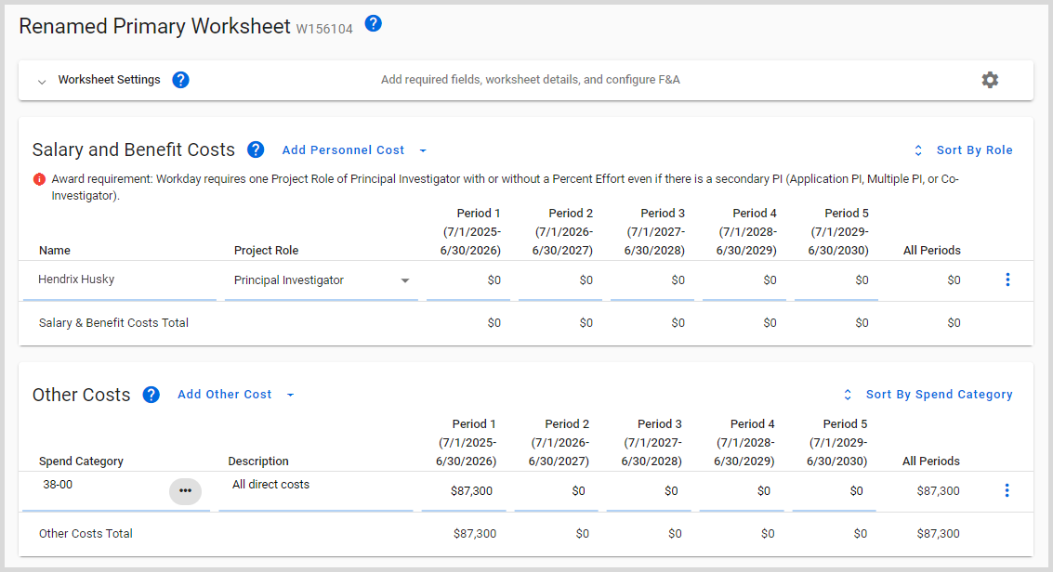
NEW SAGE BUDGET REQUIREMENT
Setup award budget for all periods of the award in SAGE Budget with:
Funded amounts included for the authorized periods
$0 amounts for future periods
MRAM – Juan Lepez – Grant & Contract Accounting

Slide 4
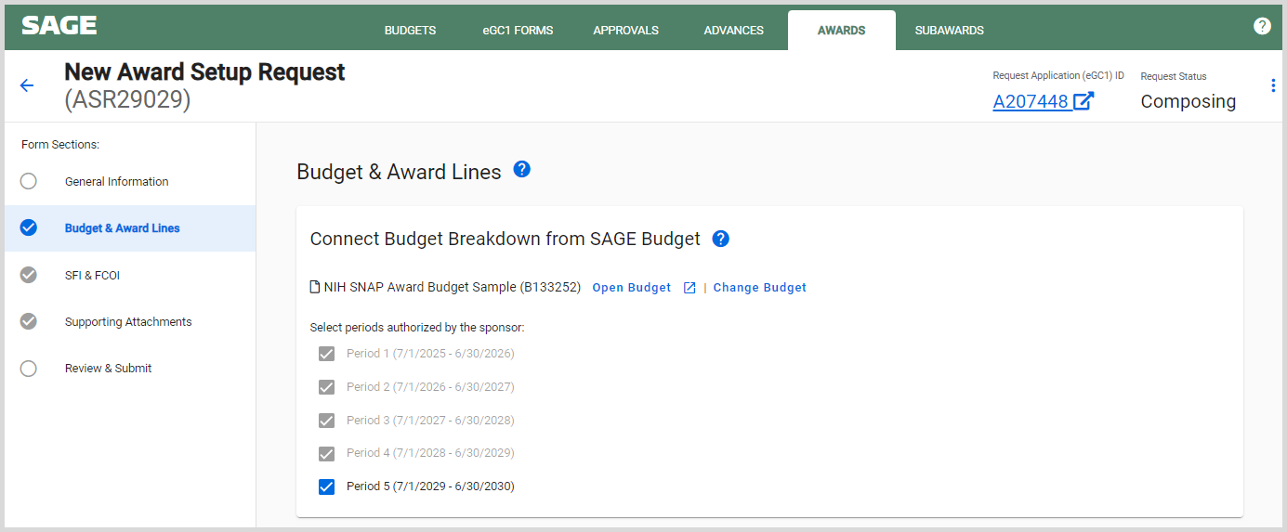
NEW SAGE BUDGET REQUIREMENT
Select all budget periods on the Award Setup Request (ASR)
MRAM – Juan Lepez – Grant & Contract Accounting

Slide 5
BENEFITS
Time savings for both campus and central offices:
Temporary Internal Extensions will no longer be required for NIH SNAP awards
Increased autonomy for campus to adjust costing allocations
Results in a seamless ASR integration process between SAGE and Workday
Future MODs will largely be supplements related to funded budget periods
MRAM – Juan Lepez – Grant & Contract Accounting

Slide 6
TIMING OF PROCESS CHANGE
For in-flight ASRs routed to GCA during the month of October, GCA will manually update Workday to reflect this new setup process
Effective 11/01/2024, GCA will return ASRs that do not follow the latest NIH SNAP SAGE Budget guidance
MRAM – Juan Lepez – Grant & Contract Accounting

Slide 7
Updated Guidance
NIH SNAP: A Detailed Guide for Completing the ASR in SAGE
NIH SNAP: Quick Tips
NIH SNAP: Award Budget
MRAM – Juan Lepez – Grant & Contract Accounting

Slide 8
Supplier Invoices in Draft Status
Reminder – Review WD inbox notification and only approve if appropriate and once AP ticket has been submitted
Supplier Invoice Business Process for Award Grants
MRAM – Juan Lepez – Grant & Contract Accounting

Slide 9
QUESTIONS
Questions can be sent to gcahelp@uw.edu
MRAM – Juan Lepez – Grant & Contract Accounting

