Slide 1
NEW RAD GROUP REPORTS
Aron Knapp
Office of Research Information Services (ORIS)
July 9, 2025

Slide 2
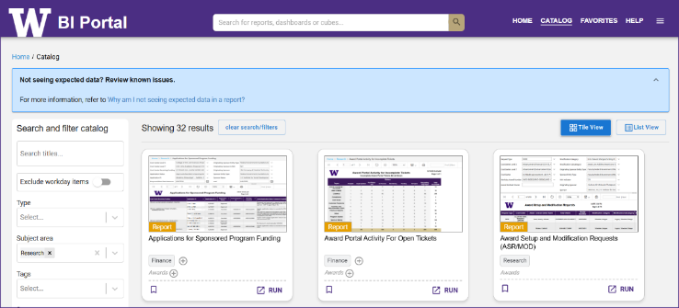
Research Reports @ the BI Portal
BI Portal Overview
https://biportal.uw.edu/home
Requires an active UW NetID + password
Requires EDW access rights
Instructions at Request Permission & Access Data
Subject area = Research

Slide 3
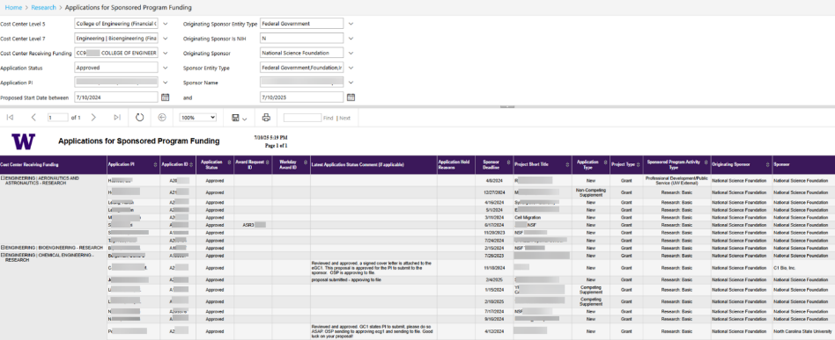
Research Reports @ the BI Portal
Applications for Sponsored Program Funding (1 of 2)
Shows historical and active applications
Filter by Cost Center Hierarchies, Cost Center, Status, PI, Sponsor and more
Example: CoE, Approved Applications to the NSF for year ahead, an NSF ‘pipeline’.

Slide 4
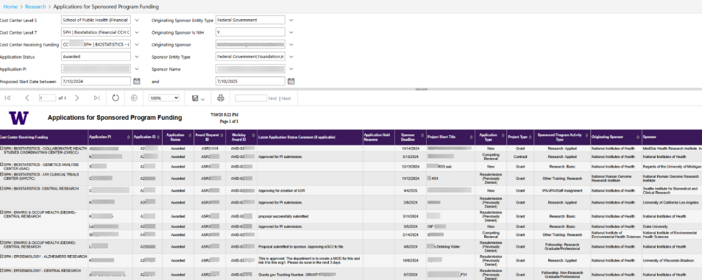
Research Reports @ the BI Portal
Applications for Sponsored Program Funding (2 of 2)
Example #2: SPH, Awarded Applications to the NIH since WD go-live through a year from today. Help connect pre- and post-award with key identifiers.

Slide 5
Research Reports @ the BI Portal
Applications for Sponsored Program Funding
Report Link

Slide 6
Research Reports @ the BI Portal
Subawards
SAGE subaward requests received by the Office of Sponsored Programs (OSP) from FY2024 - present.
Track the status of subaward requests, prioritize which subawards to escalate, and analyze subaward trends

Slide 7
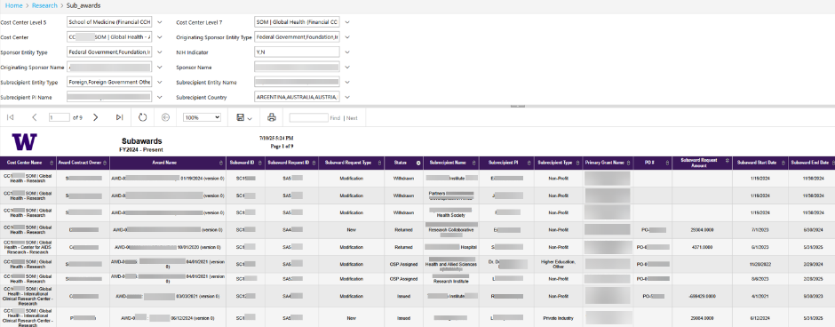
Research Reports @ the BI Portal
Subawards (1 of 2)
Example #3: GH, Subawards in process. Thrulines from SAGE to WD.

Slide 8
Research Reports @ the BI Portal
Subawards (2 of 2)
Report Link

Slide 9
ORIS RAD Group Reports
Overview
ORIS RAD Group Reports (SharePoint Link)
Notes:
the reports under construction vs the reports on there way or already at the BI portal.

Slide 10
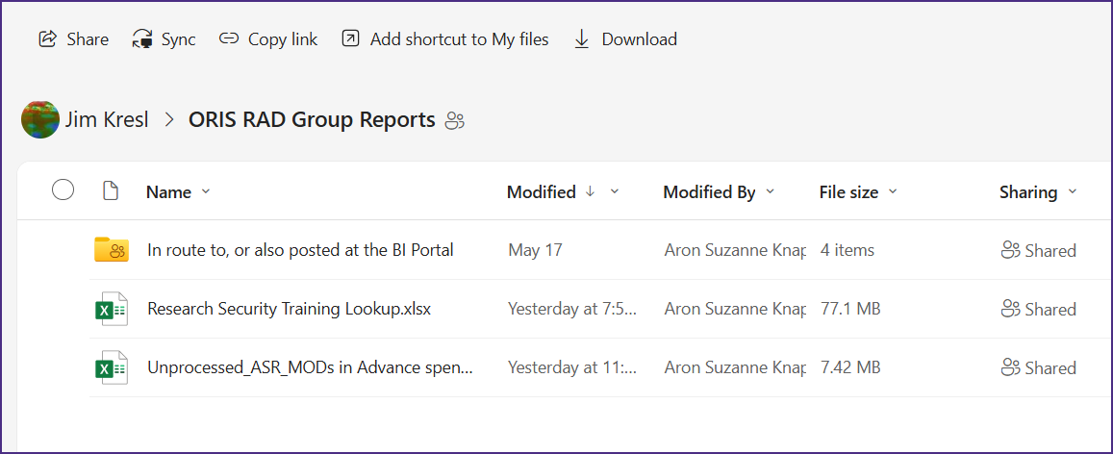
ORIS RAD Group Reports
The newest
Research Security Training Lookup
Unprocessed ASRs and MODs in Advance Spend

Slide 11
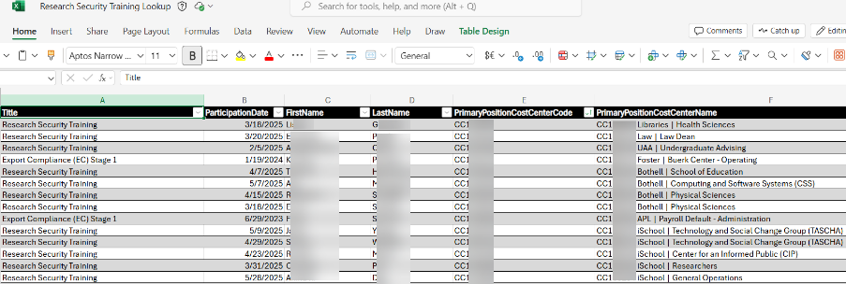
ORIS RAD Group Reports
Research Security Tracking
Research Security Tracking
support your research teams in meeting research compliance
Notes:
Tracking

Slide 12
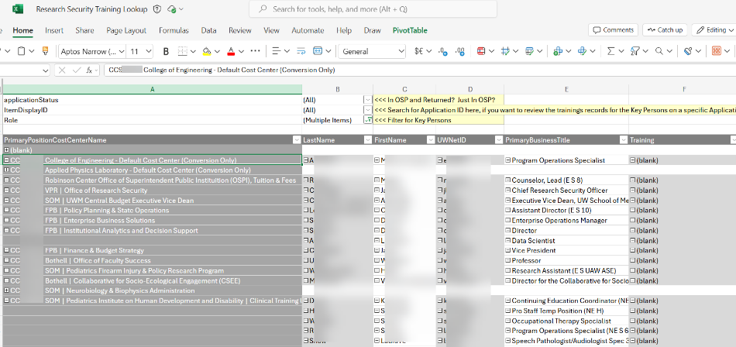
ORIS RAD Group Reports
Research Security Lookup
Research Security lookup by Application ID
support your research teams in meeting research compliance
Notes:
Tracking

Slide 13
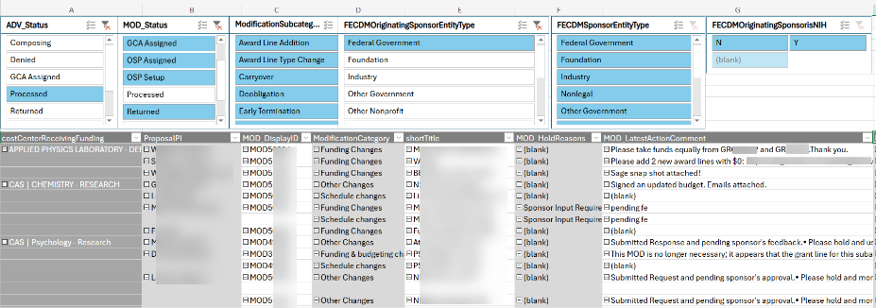
ORIS RAD Group Reports
Unprocessed ASR/MODs in ADV Spend
Identify the Award Setup and Modification Requests related to Awards in Advance spend.
Notes:
Tracking

Slide 14
ORIS RAD Group Reports
Refresher
ORIS RAD Group Reports (SharePoint Link)
Notes:
each of these are either already at , or are on their way to the BI portal

Slide 15
ORIS RAD Group Reports
What’s Coming Next
Sponsored Program Award Reports!
AIDE Priorities
Awards w/ SAGE requests in progress
AwardView
Longitudinal Counts and Amounts (pre and post WD)
Active Awards by CCH/CC/PI
Closeout: Awards/Grants that have ended more than 120 days ago NOT in closed status
Awards by Discipline
Awards with Non-fiscal compliance elements
Top 10 awardees

Slide 16
ORIS RAD Group Reports
Resources
Research Administration Data questions: grantrpt@uw.edu
Will go to ORIS’ RAD Group
Technical BI Portal questions, including how to connect: help@uw.edu
Put “EDW Question” in subject line
Will go to UWIT’s BI portal team

Slide 17
Questions?

