Slide 1
Research Security Update -
Research Security Update
Carol Rhodes, Director, Office of Sponsored Programs
March 2025 MRAM

Slide 2
Research Security Training
Covered institutions applying for federal funding must implement a research security training program; the UW will provide through an outside vendor (CITI).
Some federal sponsors require institutions certify all covered individuals have taken the training before proposal submission.
The definition of covered individual varies depending on the federal agency.
Covered individuals must complete all four Research Security Training Modules in CITI.
We encourage all covered individuals take this training as soon as possible.

Slide 3
Covered Individual Definition
An individual who (A) contributes in a substantive, meaningful way to the scientific development or execution of an R&D project proposed to be carried out with an . . . award from a Federal research agency; and (B) is designated as a covered individual by the Federal research agency concerned.
See Office of Science and Technology Policy (OSTP) Memo
Notes:
(e.g. unauthorized transfer of IP, establishing a lab in a foreign country in violation of the terms and conditions of a federally funded award).

Slide 4
Research Security Training Completion at the UW
CITI training completion record will be pulled into MyResearch Training Transcript (MRTT)
As of the 3/05/2025 SAGE Release, you will see a link to completion records in MRTT for each individual listed on the PI, Personnel and Organizations page of the eGC1.
Campus units can use the link to check that covered individuals who will be involved in the project have taken the required training.
OSP will confirm in alignment with sponsor policies. This allows OSP to make Institutional Certification.

Slide 5
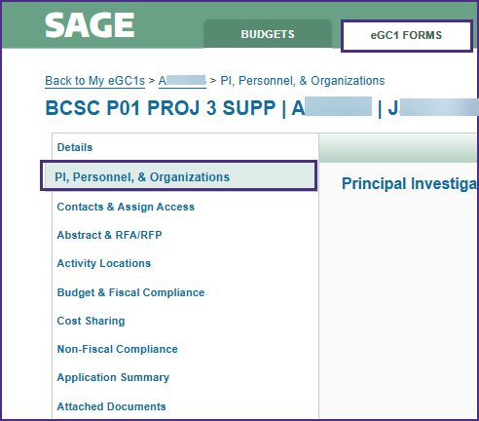
SAGE PI, Personnel, & Organization
Access SAGE eGC1 Forms.
Select an eGC1.
Select the PI, Personnel & Organizations section.

Slide 6
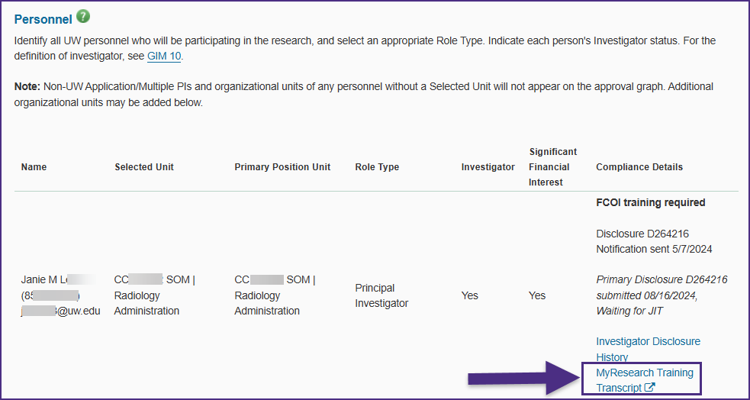
SAGE Links to MyResearch Training Transcript from PI, Personnel, & Organizations

Slide 7
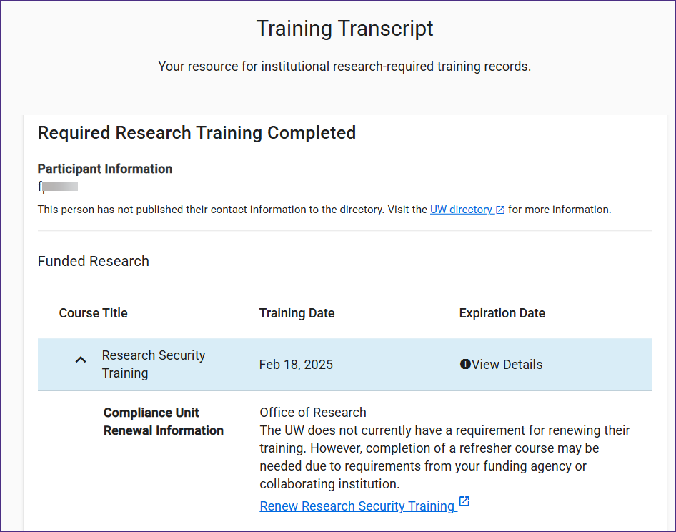
How does this look?
MyResearch Training Transcript

Slide 8
Research Security Training
Questions So Far~
Can you take this training now? Absolutely!
Follow this link to enroll in CITI
Select “LOG IN THROUGH MY ORGANIZATION” and select the UW
Login using your UW NetID
Take all four training modules for credit:
Introduction to Research Security
The Importance of Disclosure
Risk Mitigation and Management
The Importance of International Collaboration
These will appear in My Research Training Transcript as completed
If there are issues, please email researchsecurity@uw.edu

Slide 9
Reminder: Malign Foreign Talent Recruitment Program Prohibition
MFTRP definition: Programs, positions or activities sponsored by a country of concern that include one or more indicators. ​
UW Prohibition On Participation By University Personnel In Malign Foreign Talent Recruitment Programs

Slide 10
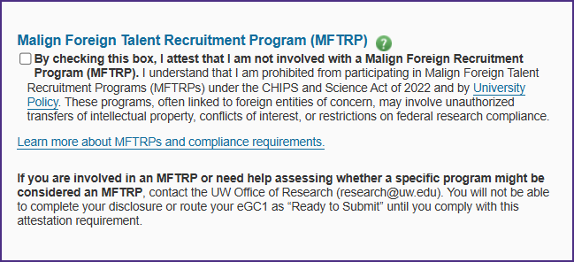
MFTRP Attestation in FIDS
FIDS disclosure completion includes new MFTRP attestation; is required to mark an eGC1 as Ready to Submit.

Slide 11
Other Questions?

