Slide 1
Awards Improvement and Development Effort 3/12/2025

Slide 2
What is the AIDE Initiative?
Finance, Planning & Budgeting (FPB)
20-week project to improve grants administration post-WD implementation
Office of Research (OR)
Streamlining award setup
Enhancing reporting capabilities
Increasing efficiency across units
UW Information Technology (UW-IT)
Notes:
Finance, Planning & Budgeting (FPB), the Office of Research (OR), and UW Information Technology (UW-IT) are collaborating on a time-limited project to improve awards management in grants administration.
This initiative focuses on streamlining award setup, enhancing reporting capabilities, and increasing efficiency across units to better support research efforts.

Slide 3
Who Benefits?
UW's Research Enterprise
Office of Sponsored Programs (OSP), Grants Contracts & Accounting (GCA), and Sponsored Programs Finance (SPF)
Principal Investigators and research teams
UW Academy and UW Medicine administrative units
UW collaborators nationally and internationally
Grant sponsors

Slide 4
Areas of Opportunity
Workflow & decision-making
Cross-organization coordination
Technology gaps & new features
Backlogs
Notes:
The project purpose is to streamline workflows to increase efficiency. This is things like building more validations into our systems to support fewer handoffs, returns, and decisions points for campus about what to submit to OSP and GCA.
The project aims to improve alignment across organizations – from systems admin technical teams like UWIT and ORIS to central offices like OSP and GCA to Deans Offices to researchers and their teams.
We will fill the technology gaps by implementing new Workday features and automations alongside enhancements to Sage/Workday integrations.
Finally, we want to address award and sub-award setup, closeout, and reporting issues so that we no longer have backlogs in any of our queues – from the systems admin technical teams to OSP and GCA, and in the campus units getting submissions returned

Slide 5
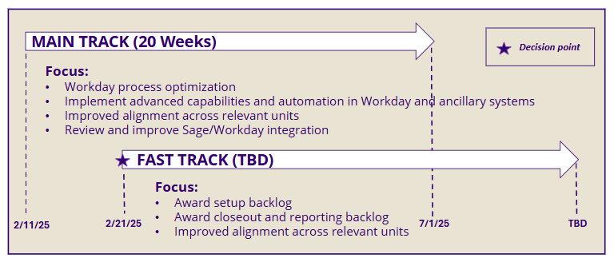
Initiative “track” overview
Notes:
The "main track" of the project is supported by Huron Consulting Group. This track aims to optimize the use of Workday and associated business processes and workflows for targeted post award areas. This Statement of Work is finalized and efforts are underway.
The "main track" includes a functional business review assessment performed by Workday, completed on Tuesday 3/11
The "fast track" will also be supported by Huron. This is where we aim to expedite critical award backlogs. We are eagerly looking toward developing deliverables while aligning with recent developments at the federal level.

Slide 6
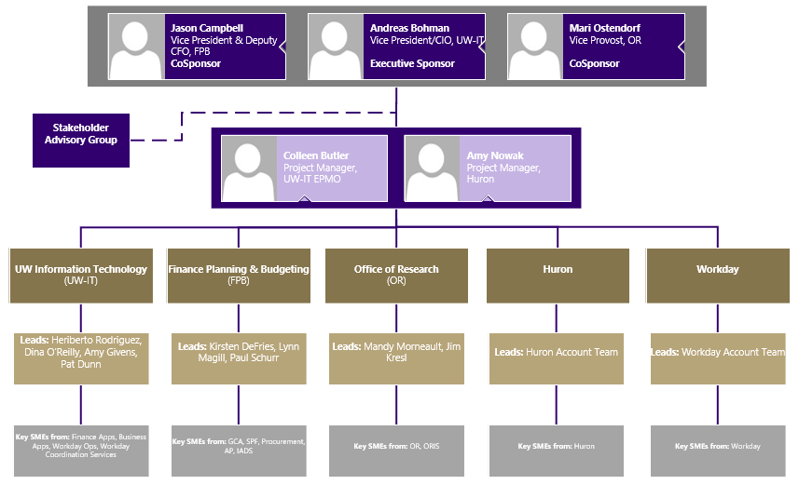
Initiative Team Structure
Notes:
We have representatives from OR, FPB, and UWIT, alongside people from Workday and Huron.
We plan to utilize the existing research community communications infrastructure, including group meetings with research stakeholders like this one, to serve in a stakeholder advisory function. Communications will be two-way, and we will be asking for your feedback on proposed changes along the way. We also hope you can help us obtain feedback from those you represent.

Slide 7
Activities
Initiative kickoff complete
Huron engagement SOW for “main track”
Interviews conducted to identify pain points
Workday Grants Management Functional Review
AIDE webpage published
Notes:
Initiative kickoff was completed in mid-February
Huron engagement scope of work is underway for “main track”
Interviews conducted to identify pain points with FPB/GCA, OR/OSP, ORIS, Procurement, and UW-IT
Started Workday Grants Management Functional Review (six 2-hour sessions completed earlier this week), focusing on Post-Award Workday platform optimization
Published the AIDE webpage

Slide 8
AIDE Resources
Webpage: https://it.uw.edu/initiatives/aide/
Mailman List: aide-initiative@u.washington.edu

