Slide 1
Awards Improvement and Development Effort Update 7/10/2025
Notes:
I’m here with a bimonthly update on the Awards Improvement and Development Effort—AIDE. AIDE is a collaboration between Finance, Planning & Budgeting, the Office of Research, and UW-IT to improve grants administration and awards management.

Slide 2
Website enhancements (1 of 2)
Webpage: https://it.uw.edu/initiatives/aide/
Notes:
Since May, we’ve enhanced the AIDE webpage. The AIDE Status Report dashboard is updated weekly. It includes a 6-page report with recent accomplishments, key deliverables, upcoming goals, and metrics on OSP and GCA workstreams.

Slide 3
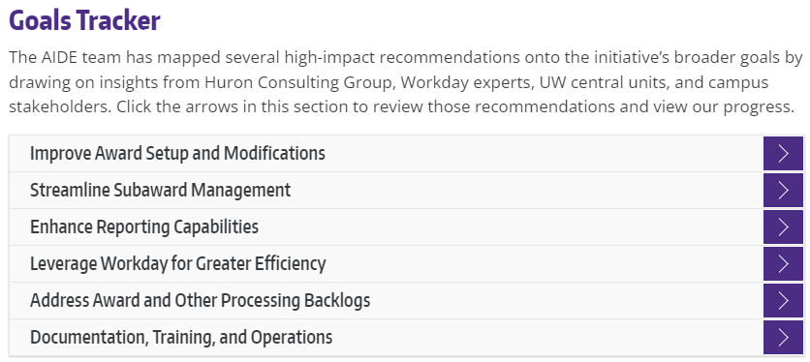
Website enhancements (2 of 2)
Webpage: https://it.uw.edu/initiatives/aide/
Notes:
We’ve also mapped recommendations to AIDE’s broader goals, drawing on input from campus, central units, Huron, and Workday experts. You can now explore these recommendations and their implementation status directly in the Goals Tracker section of the webpage.

Slide 4
Delivered! Streamlining Enhancements
Award Setup Request Validations
Updated Compliance Questions
SAGE-to-Workday Enhancements
Maintenance Fixes & Documentation Updates
SAGE flags errors pre-submission
eGC1 updated for federal compliance
Improved grant tagging, faster processing
Streamlined guidance, smoother user experience
August Pipeline: SAGE MODs-Workday Integrations
Notes:
One of the UW central units, the Office of Research Information Services (ORIS), has recently released improvements aligned with AIDE’s goals
Award Setup Request Validations: New SAGE features now flag common errors before submission, reducing rework and processing delays.
Updated Compliance Questions: In response to upcoming federal requirements, eGC1 now includes updated guidance for biohazards, select agents, SCUBA diving, and hazardous chemicals.
SAGE-to-Workday Enhancements: Integration improvements ensure accurate grant resource tagging and object code mapping for more efficient award processing.
Maintenance Fixes & Documentation Updates: Behind-the-scenes improvements and clearer guidance further reduce friction for campus users.
And in August, we’re expecting the release of SAGE Mods–Workday integrations.

Slide 5
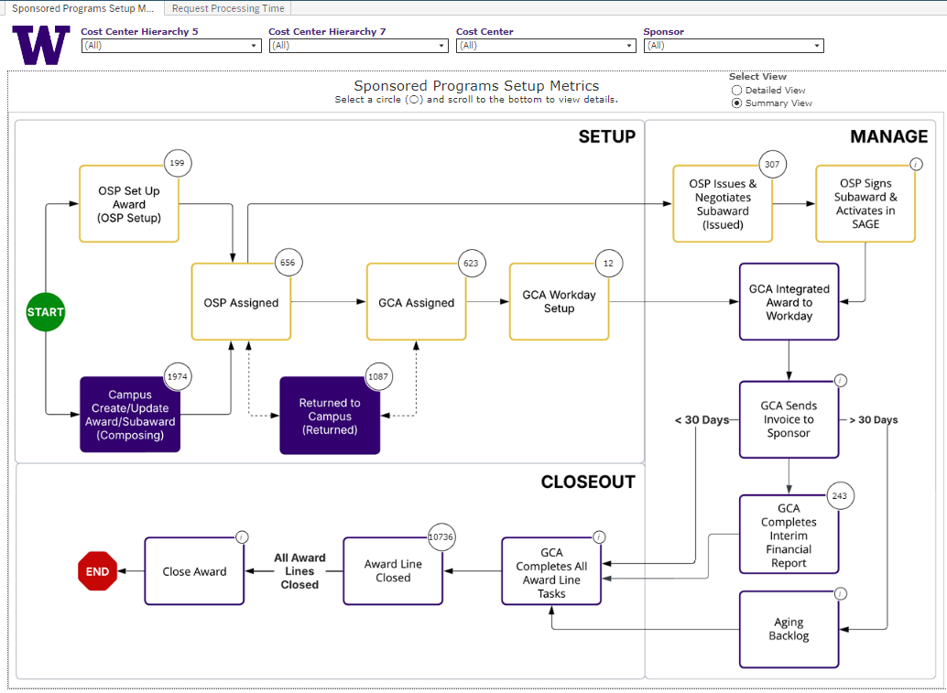
Delivered! Sponsored Programs Metrics Dashboard (1 of 2)
Summary view
Notes:
We’ve launched a new Sponsored Programs Setup Metrics Dashboard, developed with FPB’s DATAGroup. It provides visibility into the full award lifecycle—helping you track progress, anticipate timelines, and plan resources. Search for ‘SponsoredProgramsSetup’ in the BI Portal to access it.
There are two different views – here, a less-detailed summary view.
https://bitools.uw.edu/#/views/SponsoredProgramsSetup/SponsoredProgramsSetupMetrics?:iid=1

Slide 6
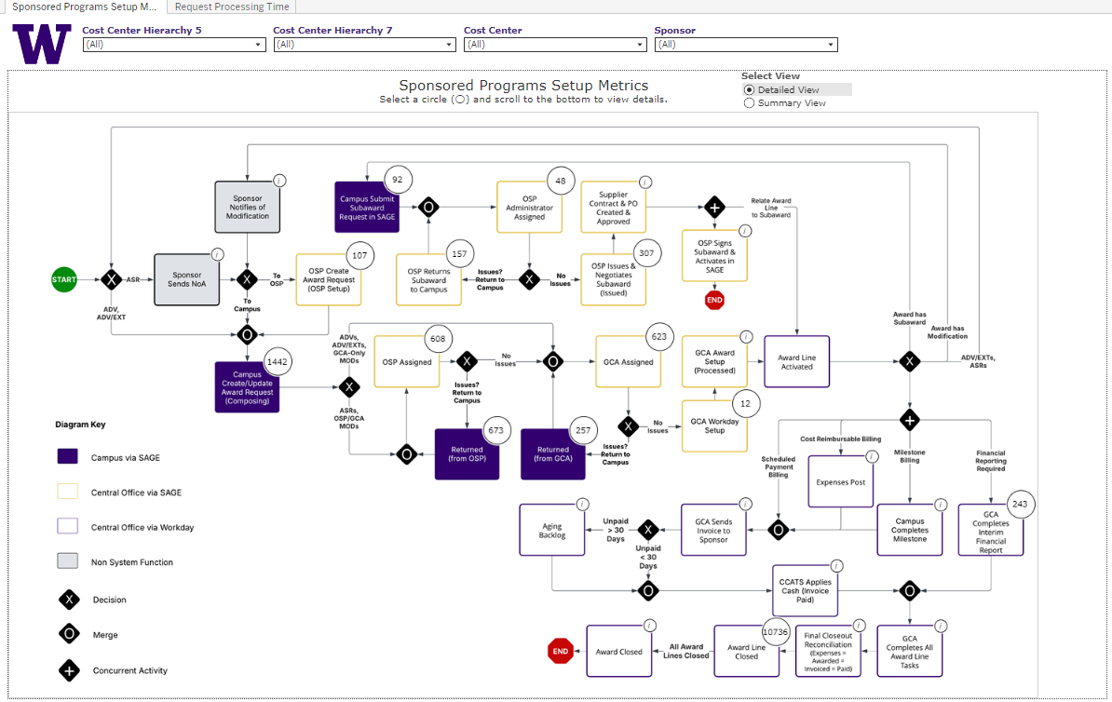
Delivered! Sponsored Programs Metrics Dashboard (2 of 2)
Detailed view
Notes:
There’s also a detailed view that shows the full process flow. This helps pinpoint where an award is in the pipeline.

Slide 7
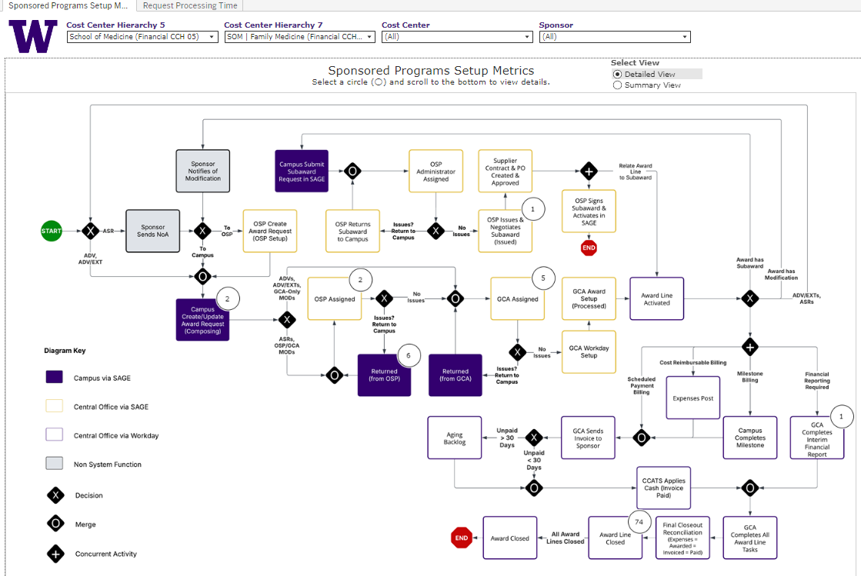
An Updated User Interface
Search for your cost center
Find submission status
For returns, see return comments
Notes:
You can filter by cost center to see where your submissions are. For example, here I’ve filtered for Family Medicine and can see six items returned by OSP. The table includes comments, so you can quickly understand the reason for return.

Slide 8
SMEs for User Testing
SME Participation
Purpose of SME Engagement
35 representatives from 13 schools/colleges/campuses
Selected based on interest, expertise and availability
Representing diverse research administration perspectives
Informs user experience testing and feedback
Provides insight into specific workstreams
Shapes practical, campus-informed solutions
Notes:
We’ve invited each school, college, and campus to identify subject matter experts for user testing. So far, we’ve received 35 names from 13 units—representing a strong cross-section of our research community. These SMEs will help us test usability, flag issues, and shape improvements based on real campus experience. We’ll continue expanding engagement as the initiative progresses.

