Slide 1

SAGE RESOURCES &
SPRING 2025 CLASSES
Kim Halstead
Office of Research Information Services (ORIS)
April 10, 2025

Slide 2

SAGE Spring Classes
Classes are filling up – register now!
  SAGE: Creating and Submitting eGC1s
    Thursday, 5/29, 10 am - 12 pm
  SAGE: Budget
    Tuesday, 4/15, 1 - 3 pm
  SAGE: Creating NIH Proposals in Grant Runner
    Tuesday, 4/29, 1 - 3 pm
  SAGE Awards & Modifications
    Wednesday, 5/14, 1 - 3:30 pm
  Subawards in SAGE
    Thursday, 6/5, 2 - 3:30 pm

Slide 3
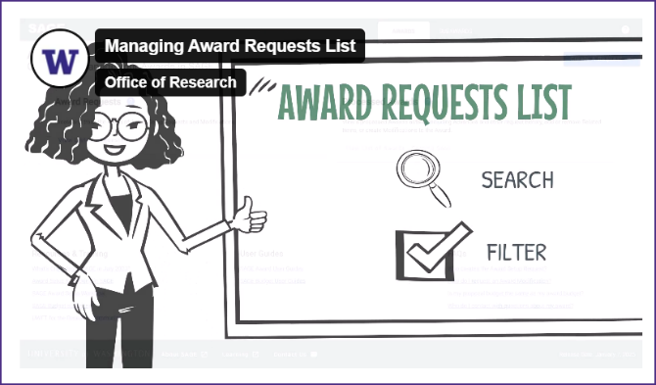
New SAGE Resources (1 of 2)
Managing Your SAGE Award
Requests List (Video)
Notes:
This video is a great resource for learning how to search through and filter your tasklist.

Slide 4
New SAGE Resources (2 of 2)
SAGE Subawards Highlights & Updates (Job Aid Link)
In March, updates were made to the subaward module in SAGE to require associating a subaward request/MOD with both:
  a Workday Finance Grant/Award Line
  an existing ASR or MOD

Slide 5

Updated SAGE Resources
SAGE Award Setup Workflow (Video)

Slide 6
Reminder:
Award Budget Resources
Simplified Award Budgets
  SAGE Award Budget: Quick Tips for Simplifying Your Award Budget
  How to Create a Categorical Totals Budget
  How to Create an Unallocated Totals Budget
Notes:
SAGE award budgets can often be less detailed than proposal budgets. To see if these simplified budgets are right for your award, review our simplified award budget job aid series.
We are also updating our SAGE user guides quite frequently.

Slide 7
Where do I find SAGE
resources? (1 of 3)
All SAGE Budget Resources
All SAGE Awards & Modifications Resources
We update and link to resources on the SAGE landing page, CORE catalog, UW Connect Finance, send out announcements to the SAGE user list, and communicate here at MRAM.

Slide 8
Where do I find SAGE
resources? (2 of 3)
If you’re in the system and see a question mark or hyperlink, they
link out to guidance for that section (job aid, user guides, website guidance).

Slide 9
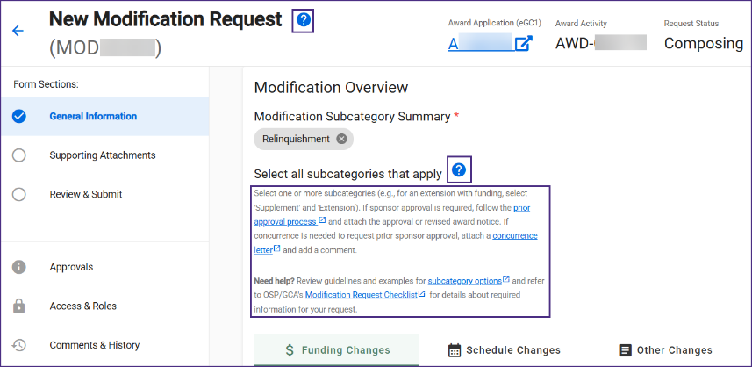
Where do I find SAGE
resources? (3 of 3)

Slide 10
Teams Appointments for SAGE Support
Reminder: Schedule a live consultation with a SAGE Support agent, Tuesday - Thursday.
  SAGE Budget Appointments
  General SAGE Help Appointments
SAGE Contact Information
“How do I adjust the F&A rate to get my award amounts to match my NoA?”
“Help! Why am I getting this eGC1 error?”
“Can you help me simplify my proposal budget for my award budget?”

Slide 11
Questions?

