Slide 1
COMPLIANCE HOT TOPIC:
FEDERAL REGULATIONS UPDATE
MRAM
October 2024
Matt Gardner
Post Award Fiscal Compliance

Slide 2
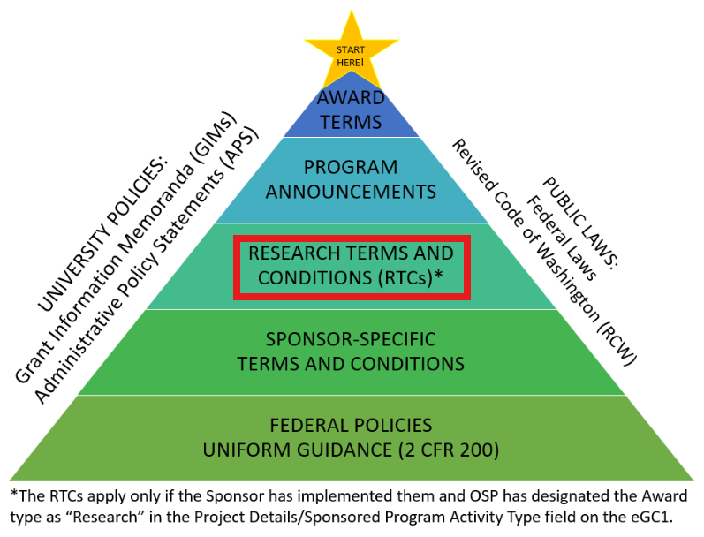
Changes to the Federal Research Terms & Conditions
MRAM – Matt Gardner - PAFC

Slide 3
Changes to the Federal Research Terms & Conditions
Inter-agency interpretation couldn’t be accomplished in limited time prior to issuance of regs
RTCs page will be archived on the NSF website
The links and content will still be available but will not be updated by the Federal agencies in the future
RTCs will not be updated in the future by the federal agencies
This includes the Prior Approval Matrix
MRAM – Matt Gardner - PAFC

Slide 4
Going Forward: Research Terms & Conditions
Applicable for awards issued prior to October 1, 2024
Not applicable for new or modified (continuing or supplemental) awards issued on or after October 1, 2024
NSF awards will reference the PAPPG, GC-1 or 2 CFR 200
Other Federal agencies should reference their agency specific terms and conditions (e.g., NIH Grants Policy Statement)
MRAM – Matt Gardner - PAFC

Slide 5
Research Terms & Conditions:
NSF-specific Guidance
In the case of any inconsistency between the coverage contained in the NSF PAPPG and the Federal Regulations, the Federal Regulations will apply
Where to go for NSF policies?
Grant Terms and Conditions (GC-1)
PAPPG (“Proposal & Award Policies & Procedures Guide”)
2 CFR 200
MRAM – Matt Gardner - PAFC

Slide 6
Research Terms & Conditions:
Prior Approval Matrix
For NSF Awards:
The Prior Approval Matrix will be revised to solely list requirements that are applicable to only NSF awards
For non-NSF Awards:
The Prior Approval Matrix will not be updated going forward
The matrix not applicable for Awards beginning on or after October 1, 2024
MRAM – Matt Gardner - PAFC

Slide 7
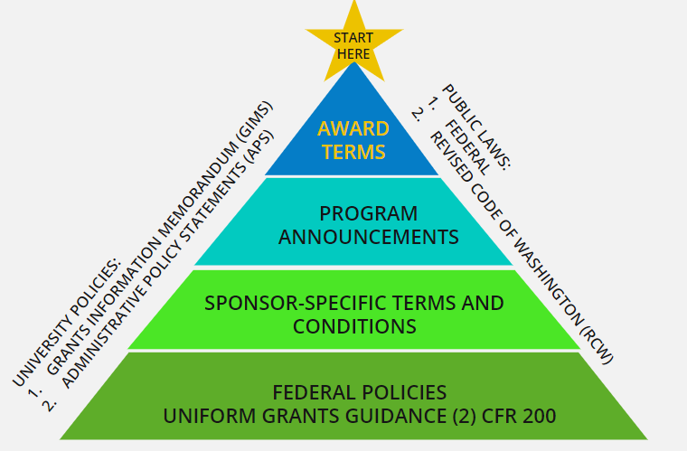
The Federal Regulations Pyramid –
Awards beginning on or after October 1, 2024
MRAM – Matt Gardner - PAFC

Slide 8
Reminders
Review your Notice of Award to determine the applicable policies and terms and conditions
Federal agencies are required to include links in the Notice of Award to applicable terms and conditions
Reach out to PAFC if you have questions concerning which policies, terms and conditions apply
gcafco@uw.edu
MRAM – Matt Gardner - PAFC

Slide 9
Federal Sponsor Policies
Links to Regulations and Sponsor Sites:
https://finance.uw.edu/pafc/regulations/links-regulations-and-sponsor-sites
MRAM – Matt Gardner - PAFC

Slide 10
EFFORT REPORTING / ECC OFFICE HOURS

Slide 11
Upcoming Effort / ECC
“Focused Topic” Office Hour
Thursday, October 17th @ 10:00am – 11:00am
Scheduled topics:
Placing statements “On Hold”
Recertification of Effort and Project Statements
Office Hour info and Zoom links:
https://finance.uw.edu/pafc/effort-reporting/ecc-office-hours
Sessions are recorded and uploaded to the PAFC website
https://finance.uw.edu/pafc/session_recordings
MRAM – Matt Gardner - PAFC

Slide 12
Questions
Post Award Fiscal Compliance (PAFC)
effortreporting@uw.edu (Effort questions)
gcafco@uw.edu (All other compliance questions)
https://finance.uw.edu/pafc/
Open Office Hour every Friday @ 10am
https://finance.uw.edu/pafc/effort-reporting/ecc-office-hours
Matt Gardner
mgard4@uw.edu
David Parks, Effort Compliance Analyst
parksd2@uw.edu
MRAM – Matt Gardner – PAFC

