Slide 1
GCA UPDATE
Juan Lepez
Director, Grant & Contract Accounting
February 13, 2025, MRAM

Slide 2
AGENDA
Budget and Accounting Dates – Definitions and Impacts

Slide 3
BUDGET DATE DEFINITION
The date the transaction is recognized or incurred.
Purpose:
To determine if an expense is allocable to a sponsored program award.
To determine whether the expense will be billable to the sponsor.
To determine the applicable Facilities and Administrative rate (F&A) that the UW has negotiated with the Federal Government’s Department of Health and Human Services.

Slide 4
VIEWING BUDGET DATES IN WORKDAY (1 of 2)
Determine transaction type to know whether date is manually entered or automatically generated. Use job aid: Budget Date in Workday_UW.xlsx

Slide 5
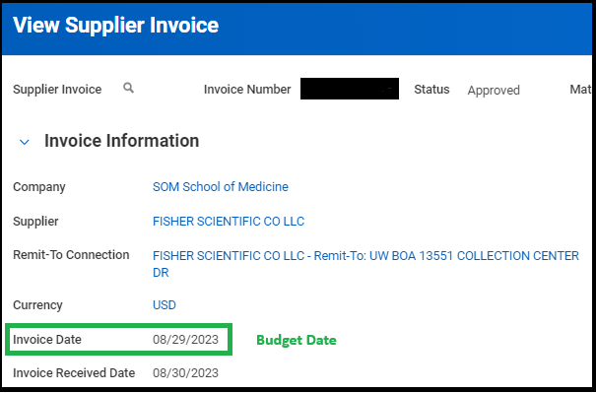
VIEWING BUDGET DATES IN WORKDAY (2 of 2)
Step 1
Step 2

Slide 6
VIEWING SPEND OUTSIDE AWARD LINE DATES
Go to Workday Award 🡪 Award Lines 🡪 Award Line Summary

Slide 7
CORRECTING BUDGET DATE ENTRIES
Determine if transaction type is one that can be corrected by Unit/Shared Environment. These are:
Expense Reports
Procurement Card Transactions
Supplier Invoices (fully paid or partially paid)
Supplier invoice adjustments
Use job aid to make updates: Adjust Accounting – Update Budget Date on Transaction
Transaction type not on list – Send AP ticket to GCA using the “Other” topic.

Slide 8
TRANSACTION REVERSALS AND BUDGET DATE IMPACTS
Example: Transaction's Budget Date for an Expense Report is Outside Award Line Period for a Posted Expense

Slide 9
ACCOUNTING DATE DEFINITION & R1234 IMPACTS
Definition - The date the transaction or adjustment is processed. It controls the accounting period and fiscal year in which the transaction is recorded in the general ledger.
R1234 Impacts
R1234 uses the Accounting Date to determine when and whether a transaction appears in this report
Accounting date is generally editable up until the month closes.

Slide 10
ACCOUNTING DATE IMPACTS ON R1234
Example:

Slide 11
QUESTIONS & RESOURCES
Please send questions to gcahelp@uw.edu
Budget and Accounting Dates on Sponsored Program Awards | Grant & Contract Accounting

