Slide 1
DOGE Requests
MRAM
June 12, 2025
Lori Hobson
Controller’s Office

Slide 2
LOC Draws
Draw Requests
Uploaded as a file
Multiple awards are included in each file
Justification is by Workday Object Class
MRAM – Lori Hobson – Controller’s Office

Slide 3
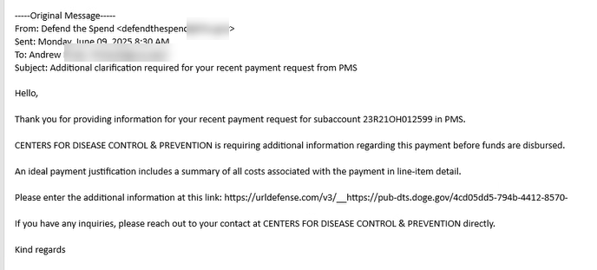
DOGE Requests (1 of 1)
Requests for additional information
Email is received by person submitting the draw
Includes link to form to provide requested information
MRAM – Lori Hobson – Controller’s Office

Slide 4
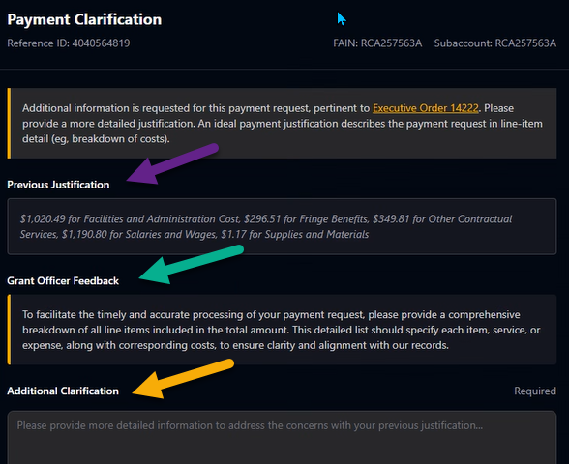
DOGE Requests – Sample Form
MRAM – Lori Hobson – Controller’s Office

Slide 5
DOGE Requests – How you can help
Respond to requests as soon as possible
Provide a detailed response that we can use as written
Address specific transactions included in attachment
Use definitive language
Do not include screenshots
If you receive requests for multiple awards, please reply to each email. Do not combine responses in one email.

Slide 6
DOGE Requests – Sample Responses

Slide 7
DOGE Requests – Questions
Send questions to gcaloc@uw.edu

