Slide 1
FY26 Benefit Load Rate
Proposal Development
MRAM
April 2025
Colleen Bettis
Management Accounting and Analysis

Slide 2
FY26 BLR Rate Overview
Uniform Guidance
  Federal Requirements
  Overview of Calculation
University of Washington Rates
  Current Environment
  FY26 Significant Impacts/Mitigation Efforts
  Next Steps
Questions

Slide 3
Uniform Guidance
eCFR :: 2 CFR 200.431 -- Compensation—fringe benefits.
§ 200.431 Compensation—fringe benefits.
(a) General. Fringe benefits are allowances and services employers provide to their employees as compensation in addition to regular salaries and wages. Fringe benefits include, but are not limited to, the costs of leave, employee insurance, pensions, and unemployment benefits. Except as provided elsewhere in these principles, the costs of fringe benefits are allowable provided that the benefits are reasonable and are required by law, an organization-employee agreement, or an established policy of the recipient or subrecipient.

Slide 4
Uniform Guidance (cont.)
Required to direct charge to Federal Awards
Negotiated annually
Based on actuals from prior closed FY and projections for the upcoming FY
  Alternates odd/even years
    (FY23 actuals used in FY25 calculation)
    (FY24 actuals used in FY26 calculation)

Slide 5
Rate Calculation Components
Actual Benefit Costs (FY24)
Workers Comp, Unemployment, Health Plans, SS, Medicare, Separation Leave, UPASS, PFML, etc..
Projected increases/decreases in benefit costs (FY26)
Over/Under Recovery True Up
(FY24 projected – FY24 actuals)
Actual S&W FY24
Projected FY26 S&W

Slide 6
University of Washington FY26 Rates
Significant Impacts
  High Number of Rate Categories
  Healthcare Costs
    12 – 15% increase proposed
    GAIP significant increases
  Hourly Over Recovery
    Changes in FLSA wage thresholds
    Higher growth in hourly wage base than projected
Compliant Strategies implemented to lessen YOY variance
  Split O/U recoveries over two years
  Averaged Projects when allowable

Slide 7
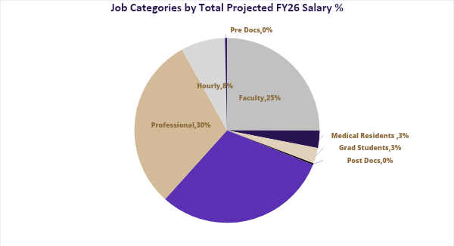
UW Rates – Job Categories

Slide 8
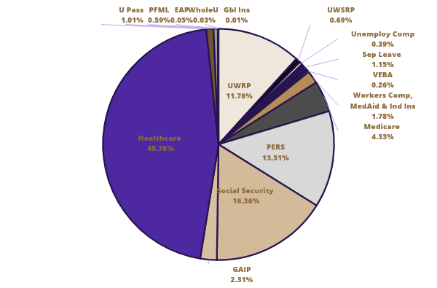
UW FY26 Projected Cost Breakdown (%)

Slide 9
FY26 BLR Preliminary Rates modeling PEBB proposed rates
 | FY24 submitted | FY25 submitted | FY26 preliminary PEBB @$1315 | FY26 preliminary PEBB @$1347
Faculty | 22.6 | 24.9 | 27.5 | 27.7
Medical Residents | 28.5 | 29.3 | 31.2 | 31.7
Grad Students | 18.2 | 18.7 | 29.2 | n/c *GAIP
Post Doc Trainees | 16.3 | 18.7 | 25.4 | 25.8
Classified | 38.1 | 34.4 | 37.5 | 37.9
Pro Staff | 30.0 | 30.3 | 32.0 | 32.4
Hourly | 21.2 | 23.0 | 15.0 | 15.2
Pre Doc Trainees | 25.2 | 22.5 | 29.4 | n/c *GAIP

Slide 10
Next Steps
Analyzing Strategic Options to Mitigate Wide Variances YOY
  Leveraging WD capability
  Discussion with Peer Institutions
  Model Options

Slide 11
Questions?
fahelp@uw.edu

