Slide 1
OR Strategic Plan
Reporting Needs Intake
OFFICE OF RESEARCH
Notes:
Mandy introduces and aligns to AIDE initiative

Slide 2
We want to know about your reporting needs
Which do you use?
What do you wish you had?
BI Portal Reports
BI Portal Dashboards
Research Key Reports
Workday Reports
Redevelopment of legacy reports & dashboards
New reports & analytics
Other needs
Mandy Morneault
Notes:
Mandy -
- Aron will walk through what's available as a reminder
- I will return to promote a survey for needs assessment

Slide 3
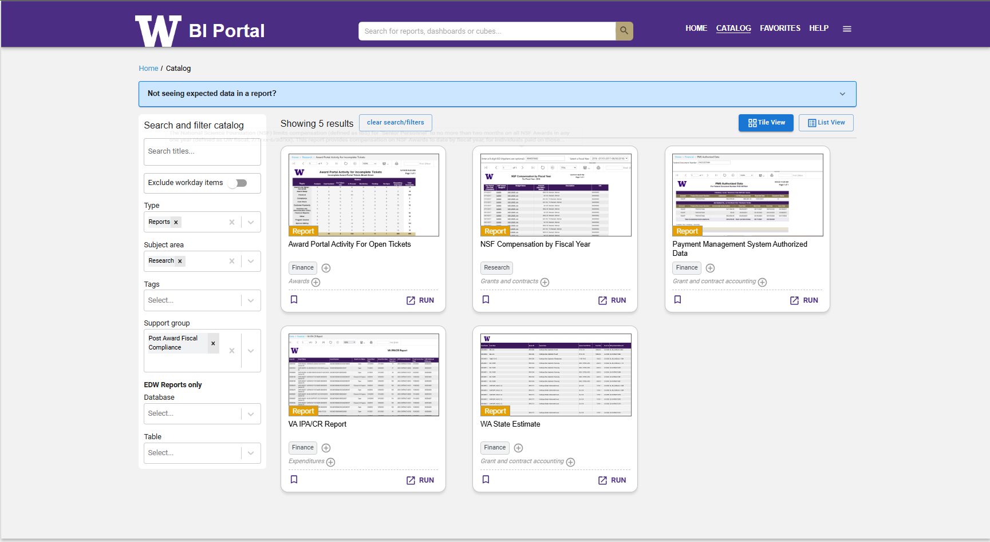
BI Portal Reports
Which do you use?
BI Portal Reports
BI Portal Dashboards
Research Key Reports
Workday Reports
https://biportal.uw.edu/catalog?sa=research
Aron Knapp
Notes:
Aron – review the usability of the BI portal.
Type = Reports
Subject Area = Research

Slide 4
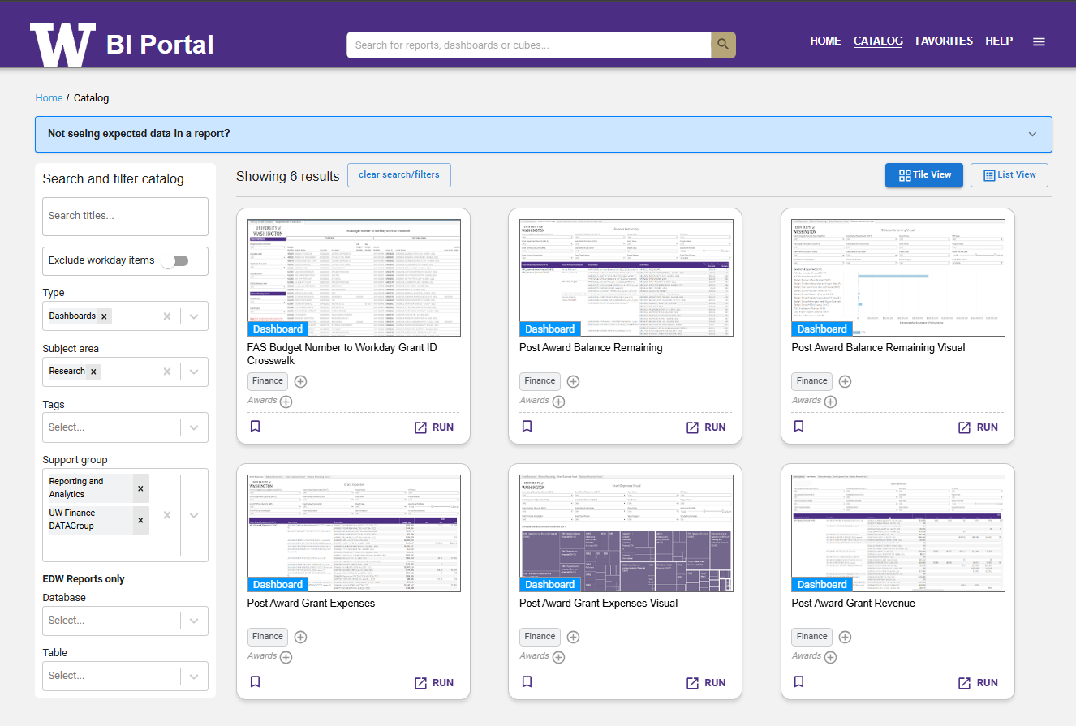
BI Portal Dashboards
Which do you use?
BI Portal Reports
BI Portal Dashboards
Research Key Reports
Workday Reports
https://biportal.uw.edu/catalog?sa=research
Aron Knapp
Notes:
Aron – review Dashboards. and this time show support group

Slide 5
Research Key Reports SharePoint Folder
Which do you use?
BI Portal Reports
BI Portal Dashboards
Research Key Reports
Workday Reports
Unassigned Subaward Requests
Instructions for accessing, downloading and refreshing Excel workbooks in the Key Reports folder
Aron Knapp
Notes:
Aron – Review Reports available at Jim's SharePoint
- unassigned Subawards

Slide 6
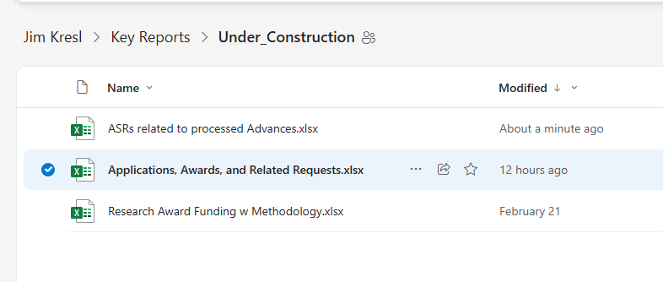
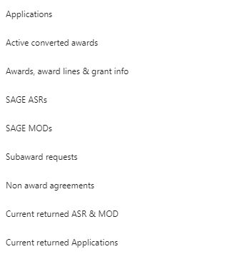
Research Key Reports
Which do you use?
BI Portal Reports
BI Portal Dashboards
Research Key Reports
Workday Reports
Aron Knapp
Notes:
Aron – Review Reports available at Jim's SharePoint
- ASR's related to processed ADVS
- Research Award Funding (w/ Methodology!)
- Applications, Awards and Related Requests

Slide 7
Workday Reports
Which do you use?
BI Portal Reports
BI Portal Dashboards
Research Key Reports
Workday Reports
Mandy Morneault
Notes:
Aron – and here's where I'll turn it back over to Mandy

Slide 8
Tell us
What do you wish you had?
Redevelopment of legacy reports & dashboards
New metrics & reports
Other needs
How do you rank priority for development?
Mandy Morneault
Notes:
Mandy -

Slide 9
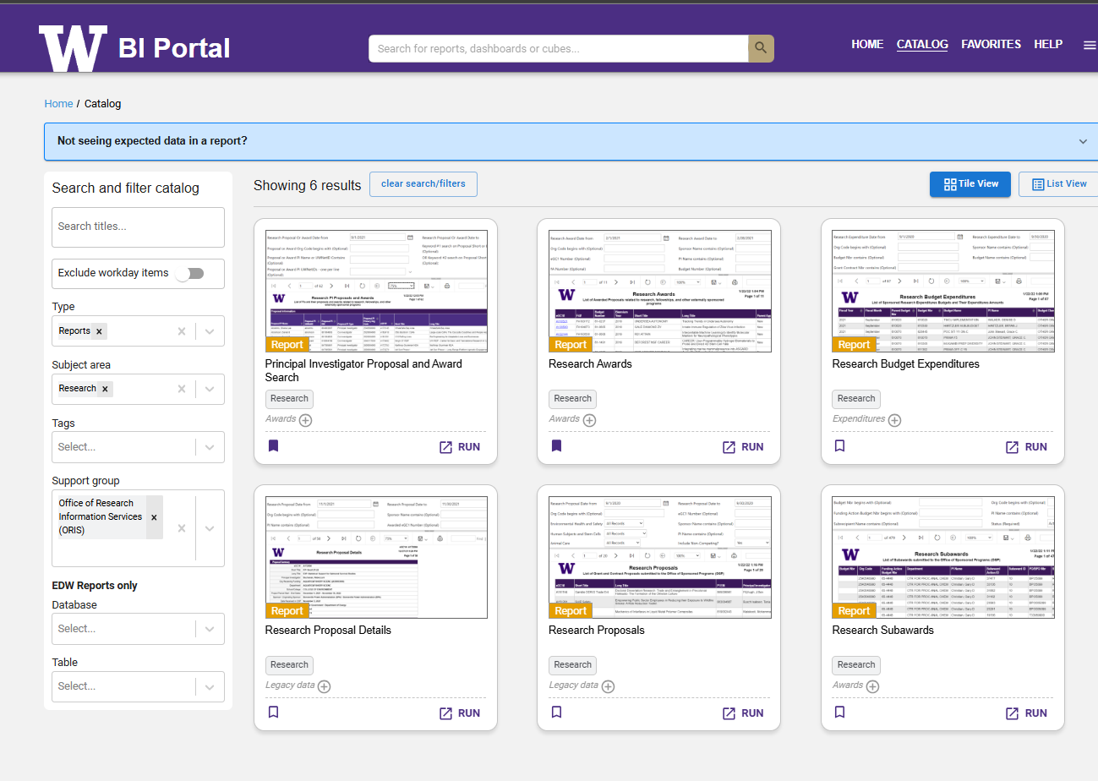
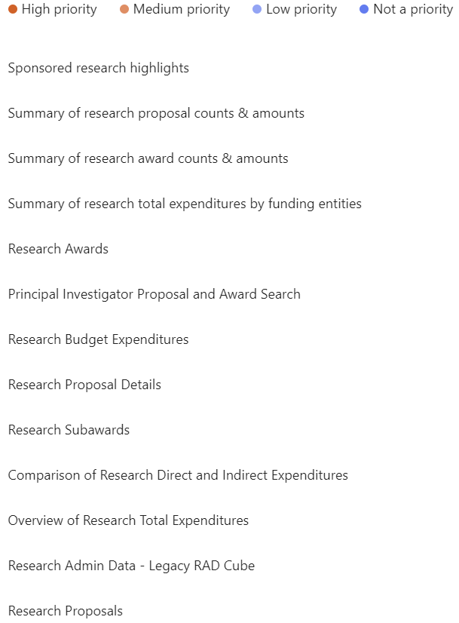
Legacy reporting @ BI Portal
What do you wish you had?
Redevelopment of legacy reports & dashboards
New metrics & reports
Other needs
Mandy Morneault

Slide 10
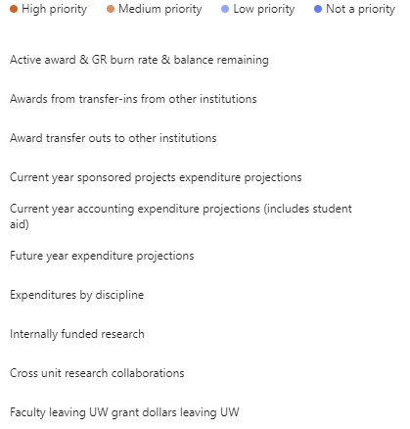
Metrics & reports in development
What do you wish you had?
Redevelopment of legacy reports & dashboards
New metrics & reports
Other needs?
Mandy Morneault

Slide 11
We want to hear from you!
Please send us your reporting usage and needs info by 3/20
https://forms.office.com/Pages/ResponsePage.aspx?id=W9229i_wGkSZoBYqxQYL0nclPm6GAzhPjyaQWAR-VNhUMzZUOE0xRFdWMklUUkZUUlJWSVVZSDFIQi4u
Mandy Morneault

