Slide 1

SAGE UPDATE
Judy Chung & Kim Halstead
Office of Research Information Services (ORIS)
September 11, 2025

Slide 2
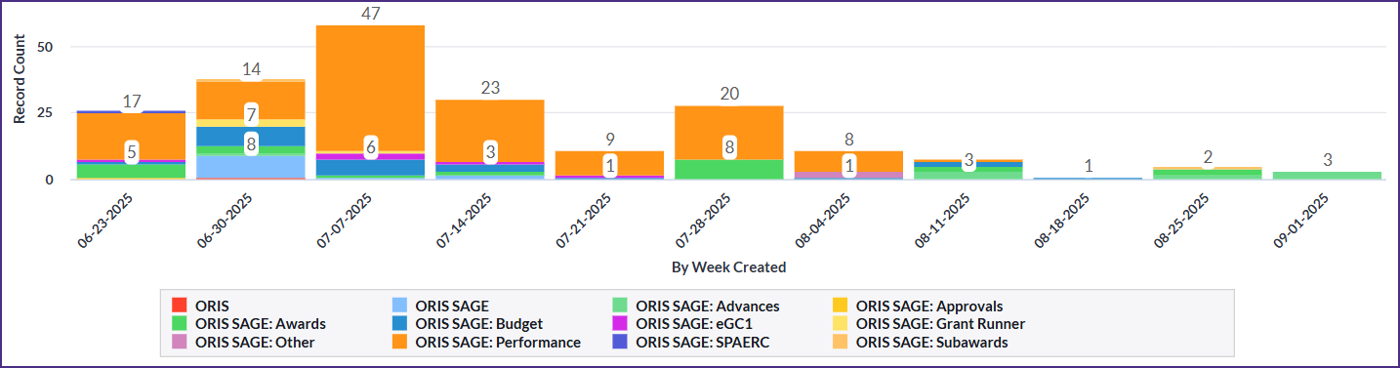
Progress on SAGE Stabilization: Data
SAGE help desk incident reports by week
Continued positive trends for stability
Current issue: ADVs with SFI reviews can get stuck in routing
  Updating them daily as we see them, until issue resolved

Slide 3


Areas of Focus: Overall
Overall System Uptime
Fine-tuned memory and CPU allocations
Addressed errors leading to peak slowness & outages
Expanded monitoring tools
In Progress:
Evaluating slowness observed on Monday ~ 4:30 pm

Slide 4
Areas of Focus: SAGE Budget
SAGE Budget Performance
Resolved worksheet settings saving delays
Increased speed of other cost entry saving
Improved processing times for recalculation of totals
(more to come!)
In Progress:
Improve calculation of totals for faster saving
Testing soon: Prototyping a manual calculation option for budget totals

Slide 5
Areas of Focus: Awards
Awards Section Performance
Reduced status change delays for ASRs & MODs
Reduced general navigation slowness on requests
New! Improved speed of navigation
for MODs with large awards (biggest gains)
for ASRs and ADVs
New! Fixed Award Requests List missing items for new contacts
In Progress (Award-related Issues):
Advances with missing award preparer routing issues
Advances with SFI not updating with review status
Misc remaining errors with routing and status changes

Slide 6
Areas of Focus: Misc Other
Misc Other Performance:
Grant Runner:
Improved navigation & load times when budget is connected
New! Additional performance improvements released 9/9
eGC1:
New! Improve speed of disclosure notifications on eGC1

Slide 7

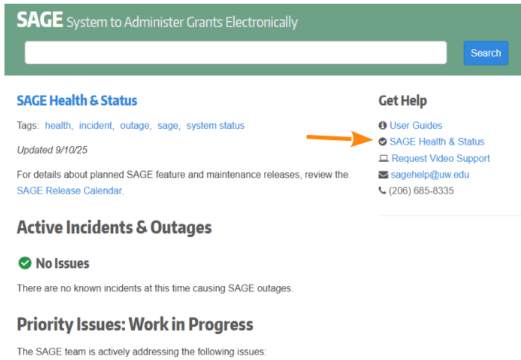
SAGE Health & Status Webpage
SAGE Health & Status
  Currently linked in the sidebar of the SAGE login page
Good place to check first if you’re having issues with SAGE and view work in progress

Slide 8

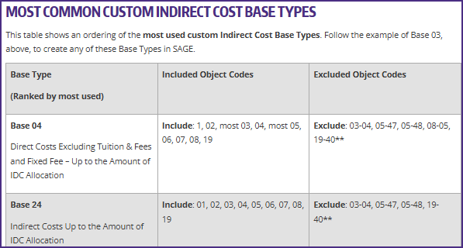
How to Make a Custom Base Type in SAGE Budget
  Added crosswalks for base types and object codes for both preset and custom SAGE base types.
Reminder:
New & Updated Resources (1 of 2)

Slide 9
Reminder:
New & Updated Resources (2 of 2)
(New) SAGE eGC1 Resources Collection:
  Bookmark this collection of eGC1 resources for easy reference.
  Also linked on the SAGE login page sidebar
(Revised) Subawards Quick Guide:
  This reference covers the essential elements of the outgoing subaward process and modifications.

Slide 10

Reminder: Fall SAGE Classes
SAGE: Creating and Submitting eGC1s
  Wednesday, 10/08, 1 – 3 p.m. PT
SAGE: Budget
  Wednesday, 10/15, 2 – 4 p.m.
  Tuesday, 10/28, 1 – 3 p.m.
SAGE: Creating NIH Proposals in Grant Runner
  Wednesday, 10/22, 2:30 – 4:30 p.m.
SAGE: Awards & Modifications
  Wednesday, 11/05, 1 – 3 p.m.

