Slide 1
Foundational RAD Report Updates
MRAM
February 2025
Aron Knapp
Office of Research Information Services (ORIS)

Slide 2
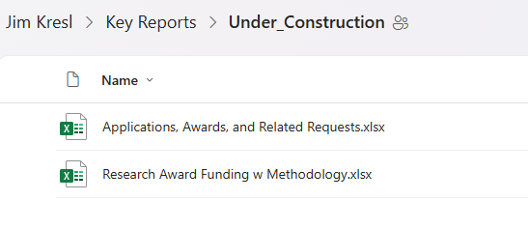
Foundational RAD Reports (1 of 2)
Navigate to the Key Reports folder
Go the to Under construction folder
Open that Applications, Awards, and Related Requests workbook
Instructions for accessing a downloading Key Reports
MRAM – Aron Knapp – Office of Research Information Services

Slide 3
Foundational RAD Reports (2 of 2)
Excel workbook that provides data from the Office of Research’s RAD Datawarehouse, combining Workday and SAGE data for your local analysis.
Includes:
Applications
Active Converted Awards
Awards, Award lines and grant info
Award Setup requests
Award Modification requests
Subawards
Non-Award Agreements
NEW: ASR/MODs in return status

Slide 4
WHAT’S NEW?
Modification subcategories & amounts
Hold & Hold reasons
Latest action comment on all items
New tab just for current ASR/MOD returns
Cost Center Hierarchy 07 on all reports
NIH grouping roll-up
F&A rate, and Amount Subject to F&A on Applications and Awards reports
MRAM – Aron Knapp – Office of Research Information Services

Slide 5
What’s next?
Working with UWIT to get these to the BI Portal
Questions/Ideas? aronk@uw.edu
Need custom data? grantrpt@uw.edu

