Slide 1
Subawards Update
August 14 MRAM
Josy Combs, Subawards Team Manager
Office of Sponsored Programs

Slide 2
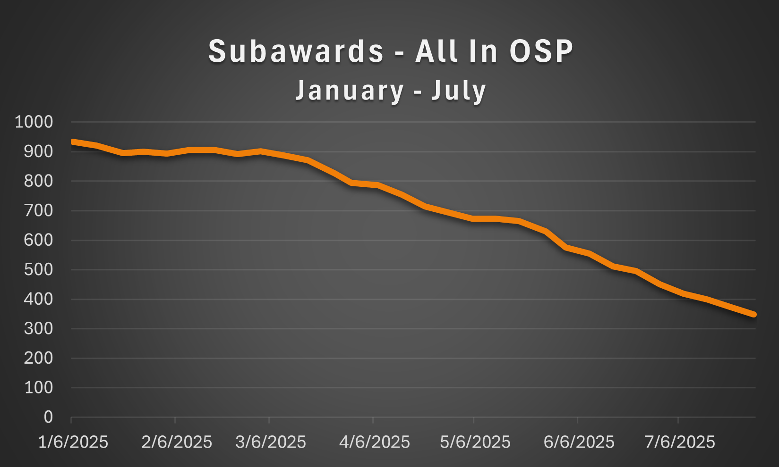
Recent Volumes
OSP Volumes

Slide 3
Subaward Action Reminders
Review all subaward requests before submitting to OSP.
  Budget Period should be one year
  Required documents uploaded and correct
  Include additional details in the Special Instructions box
Have a large volume (10+) of subaward requests under the same award? email ospsubs@uw.edu with details.
Common Errors
Subaward budget is provided as a lump sum within the total project budget. Instead of a detailed budget.
Including a link to SAGE budget rather than attaching the document.
Review First Steps and Next Steps to confirm the subaward request is complete.

Slide 4
New Subaward Escalation Request form
OSP Subawards Team assigns subaward actions (SAs) by the date the SA last arrived in OSP.
Some situations may require you to the request item be escalated for priority assignment.
Reasons to request escalation of an SA, Subrecipient is or has:
Foreign entity in a low to middle income country
Small non-profit organization or a sole proprietorship, domestic or foreign
Other unique circumstances outside the UW’s control that warrant prioritizing
Note, the assurance request form has been disabled.
Escalating Subawards

Slide 5
Before Requesting Escalation
Confirm the subaward request is complete.
SA must have a SAGE state of “In OSP”.
Associated ASR or MOD in SAGE must be fully processed.
Required form fields:
Subaward (SC) #
Subaward Action (SA) #
Subrecipient Name
Associated ASR# or MOD#
Confirm the ASR or MOD is fully processed (Open status in Workday)
UW Award (AWD) #
Workday Grant (GR) #
Cost Center
Reason SA needs to be escalated
OSP will review these requests and make assignments once per week, typically on Tuesdays and may deny or return requests.
Escalating Subawards

Slide 6
Resources
OSP Volumes
Subaward Requests: First Steps and Next Steps
Escalating Subawards

Slide 7
Questions

