Slide 1
Grant Security Hierarchies
UW

Slide 2
Hierarchy Level
All Grants
Level 1
Schools/Colleges
Level 2
Units
Level 3
Level 4
Grant Portfolios

Slide 3
School and Department Visual Flow
CAS | Psychology Grants (Security GRH 03)
Grant managers assigned at level 4
CAS | Psychology Grants Portfolio Awards Gold (Security GRH 04)
CAS | Psychology Grants Portfolio Awards Purple (Security GRH 04)
GR000001
GR000004
GR000002
GR000005
GR000003
GR000006

Slide 4
Grant security is managed via grant hierarchies (1 of 2)
There are over 40,000 active grants in Production in Workday
Assigning grant managers individually to all of these would be difficult
Whenever someone is assigned to grant individually, it removes all assignments inherited via grant hierarchies – this has resulted in multiple tickets and issues for departments

Slide 5
Grant security is managed via grant hierarchies (2 of 2)
We have 300 level 3 grant hierarchies and 600 level 4 grant hierarchies
These allow departments to more easily manage assigning security

Slide 6
Upgrading Workday Principal Investigator Assignments
UW

Slide 7
Current State PI assignments have issues
PIs are assigned by position
Employees change positions all the time
Assistant Professor -> Adjunct Professor, etc.
Creates a compliance and routing issues

Slide 8
Current State

Slide 9
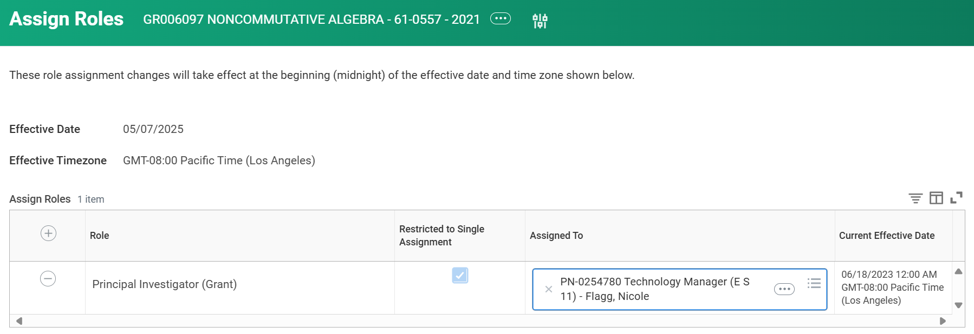
Current State is assigned by position

Slide 10
Future State assigned by Eligible Investigator record
Future State 🡪
Current State 🡪

Slide 11
Eligible Investigator record stays regardless of position changes

