Slide 1
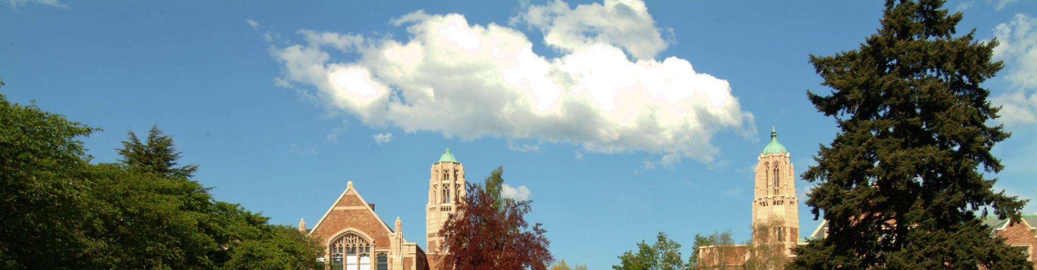
SAGE UPDATE
Judy Chung
Office of Research Information Services (ORIS)
August 14, 2025

Slide 2
Context for SAGE Migration
The SAGE Suite moved to new AWS cloud architecture at end of June.
This involved…
  Upgrading versions of various components
  A learning curve around new technologies
  Managing issues with older code on top of newer infrastructure
A stabilization period after a migration is typical
  Ours has been more impactful and challenging than we anticipated

Slide 3
Progress on SAGE Stabilization: Trends
July:
  3-week period of extreme fluctuation and instability
  Configuration changes & incremental releases made
August:
  Reduction in help desk calls & errors in our logs
  Performance improvements in key areas, but there’s still more to do
  Expanded monitoring tools for early alerts, leading to quicker action

Slide 4
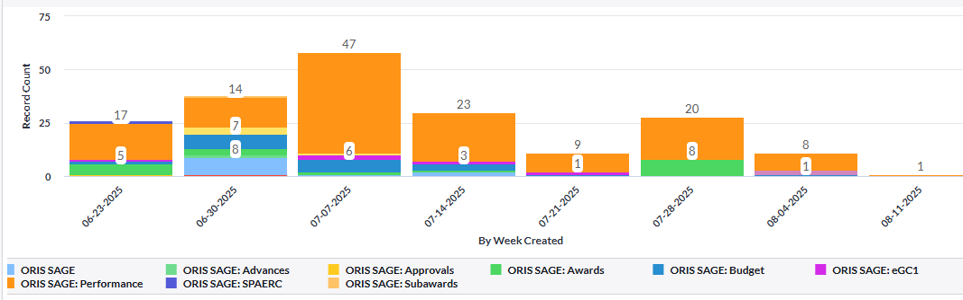
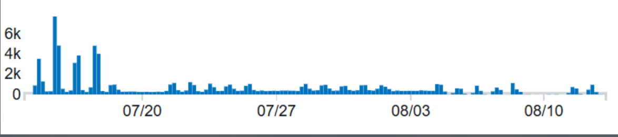
Progress on SAGE Stabilization: Data
SAGE help desk incident reports by week
Error log trends by week

Slide 5


Areas of Focus: Overall
Overall System Uptime
Fine-tuned memory and CPU allocations
Addressed errors leading to peak slowness & outages
Expanded monitoring tools
In Progress:
Continued monitoring & prioritizing of problematic areas and emerging issues with performance and system stability

Slide 6
Areas of Focus: SAGE Budget
SAGE Budget Performance
Resolved worksheet settings saving delays
Increased speed of other cost entry saving
Improved processing times for recalculation of totals
(more to come!)
Grant Runner: Decreased navigation & load times when budget is connected
In Progress:
Additional work on recalculating processing times
  Personnel & other cost entry; F&A changes
More Grant Runner performance improvements

Slide 7
Areas of Focus: Awards
Awards Section Performance
Reduced status change delays for ASRs & MODs
Reduced general navigation slowness on requests
In Progress:
Speeding up load time for large awards
  ADV (renewal) and MODs
Fixing the award list not updating regularly for new personnel entry

Slide 8
Where to Get Updates on SAGE
SAGE Health – webpage coming soon!
  Will share what is known of system issues or outages
Regular MRAM Report Outs
  Will keep in touch on progress and planned work
Email Following Impactful Releases
  MRAM and SAGE mailing list recipients (excludes PIs unless intentionally subscribed)
    Subscribe to SAGE News

Slide 9
How To Keep In Touch with ORIS
We thank you for your partnership and patience as we continue to update, refactor, and fully stabilize the SAGE Suite.
Please do continue to make sagehelp@uw.edu aware of issues, especially if you observe prolonged slow performance for more than 5-10 minutes.
Reporting issues allows us to act more quickly to resolve them!

