Slide 1
UPDATES
MRAM UPDATE
Laurie Stephan
Associate Director for Learning, ORC

Slide 2
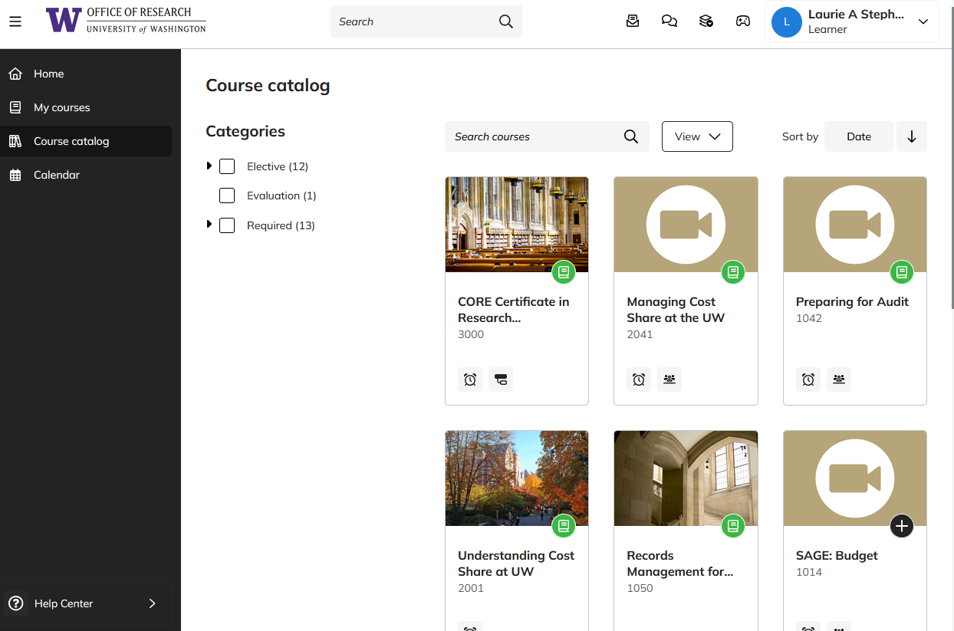
TRACKING CERTIFICATE PROGRESS IN TALENT LMS (1 of 2)
https://certificateresearchadmin-uwashington.talentlms.com/plus/catalog

Slide 3
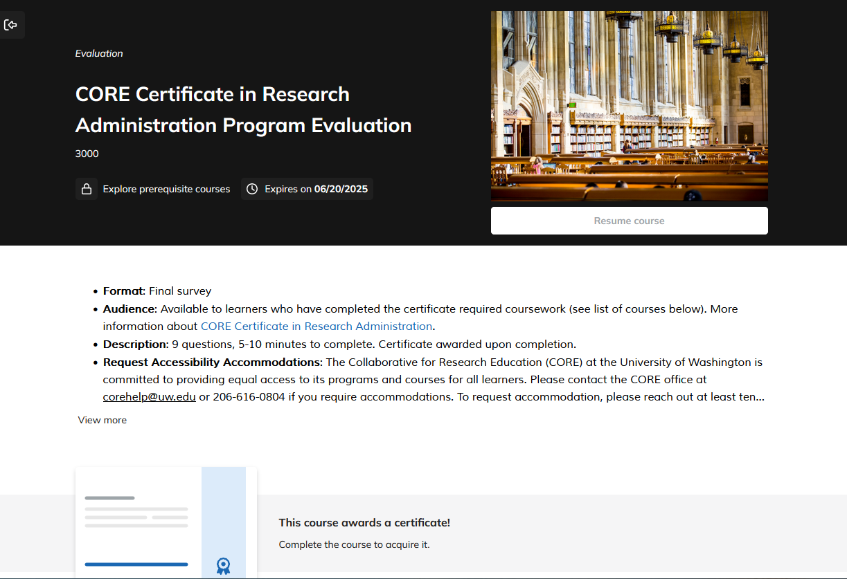
TRACKING CERTIFICATE PROGRESS IN TALENT LMS (2 of 2)
Direct link: https://certificateresearchadmin-uwashington.talentlms.com/plus/catalog/courses/185

Slide 4
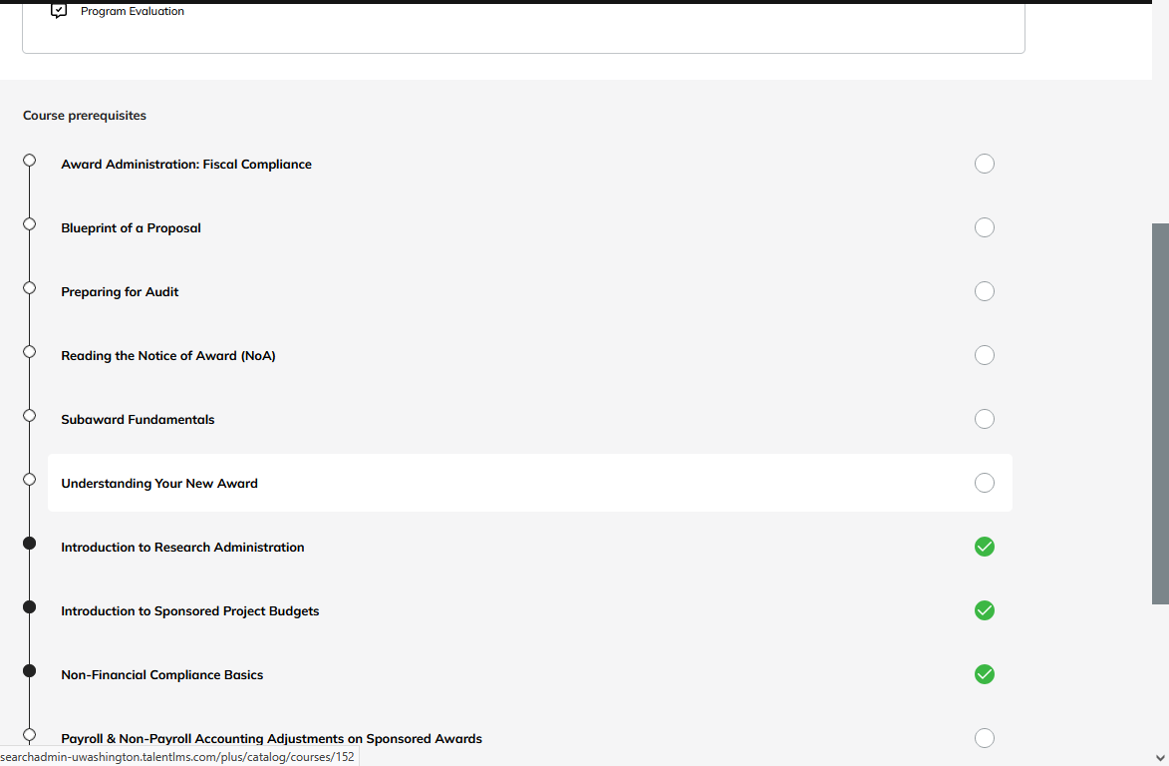
TRACKING CERTIFICATE PROGRESS LMS
Course titles link to courses

Slide 5
2025 SPRING SCHEDULE
Course Registration (https://certificateresearchadmin-uwashington.talentlms.com/plus/catalog)
Course | Date | Time
Blueprint of a Proposal | Mar 27 | 9:30 am-12:00 pm
Managing Cost Share at the UW | Apr 8 | 9:30 am-11:30 am
SAGE: Creating and Submitting eGC1s | Apr 9 | 1:00 pm – 3:00 pm
SAGE: Budget | Apr 15, 23 | 1:00 pm-3:00 pm
SAGE: Creating NIH Proposals in Grant Runner | Apr 29 | 1:00 pm-3:00 pm
Understanding Your New Award | Apr 29 | 9:30 am-11:00 am
Reading the Notice of Award | May 6 | 9:30 am-11:00 am
Award Administration: Fiscal Compliance | May 13 | 9:30 am-12:00 pm
SAGE Awards | May 14, June 11 | 1:00 pm-3:30 pm
New Frontiers of Financial Reporting for Grants Managers | May 15 | 9:30 am -11:30 am
Subaward Fundamentals | May 29 | 1:00 pm-3:30 pm
Compliance Case Studies: FCOI, Export Controls, Research Integrity | June 3 | 9:30 am -11:30 am
Subawards in SAGE | June 5 | 2:00 pm – 3:30 pm
Preparing for Audit | June 10 | 9:30 am-11:30 am
SAGE: Budget | Mar 4 | 1:00 pm-3:00 pm

Slide 6
ON-DEMAND COURSES ALWAYS AVAILABLE
Course Registration (https://certificateresearchadmin-uwashington.talentlms.com/plus/catalog)
1000: Introduction to Research Administration
1002: Introduction to Sponsored Project Budgets
1013: Workshop: Preparing Sponsored Project Budgets
1031: Non-Financial Compliance Basics
1044: Payroll & Non-Payroll Accounting Adjustments on Sponsored Awards
1045: Post Award Food Purchases & Compliance
1046: Timing of Expenditures & Benefit to Award
1050: Records Management for Research Teams: the Basics
2000: Direct Billing of F&A Type Costs
2001: Understanding Cost Share at the UW

