Slide 1
CAMPUS INFORMATION SESSION:
SPONSORED PROGRAM FINANCIAL CLOSEOUT
Grant & Contract Accounting
August 28, 2024
Notes:
Disclaimer: this session is about submitting financial reports to sponsors. We got questions about portfolio reporting for a PI, Workday reports like the R1234 and gift reporting that aren't covered here.

Slide 2
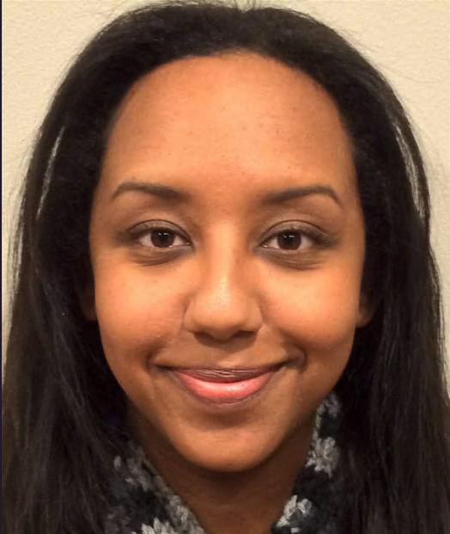
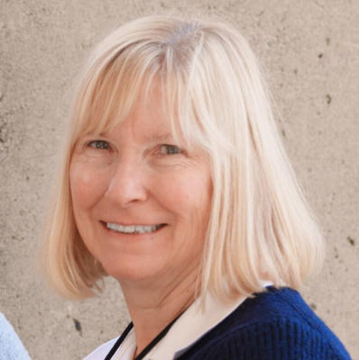
INTRODUCTIONS
Lily Gebrenegus
Session Presenter
Meg Russo
Session Moderator
GCA Information Session- Closing-August 28

Slide 3
HOUSEKEEPING
Sessions are recorded
Please enter questions in the Q&A not Chat
Links from today's session are posted here
SAGE questions can be emailed to sagehelp@uw.edu or brought to SAGE Office Hours
GCA Information Session- Closing-August 28

Slide 4
AGENDA
Closing at Time of Award
GCA's Closing Process
Closing Types
Common Problems and Best Practices
How to Identify a Deficit
Workday Reports and Resources
Q&A
GCA Information Session- Closing-August 28

Slide 5
SESSION NOTES
This session focuses on financial closeout
Backlog of unclosed awards is still high
Parts of the closing process are still being finalized
GCA Information Session- Closing-August 28

Slide 6
CLOSING AT THE TIME OF AWARD
GCA reviews each award document to identify closing requirements (e.g. Disposition of Balance (DOB) and carryover)
You can find the closing requirements on the Award Setup Request or MOD Comments & History
GCA adds closing requirements to Workday as Award Line Special Conditions
GCA processes ASR/MOD and notification is sent to Award Preparers
GCA Information Session- Closing-August 28

Slide 7
CLOSING SPECIAL CONDITIONS
GCA adds special conditions to Workday for:
Disposition of Balance (at end of project)
UW can keep the balance (Fixed Amount)
UW must return the balance (Cost Reimbursable)
Balance Retained Subject to Sponsor Limitations
Carryover (at end of budget period)
Sponsor allows automatic carryover
Carryover requires sponsor approval
Carryover subject to sponsor limitations
GCA Information Session- Closing-August 28

Slide 8
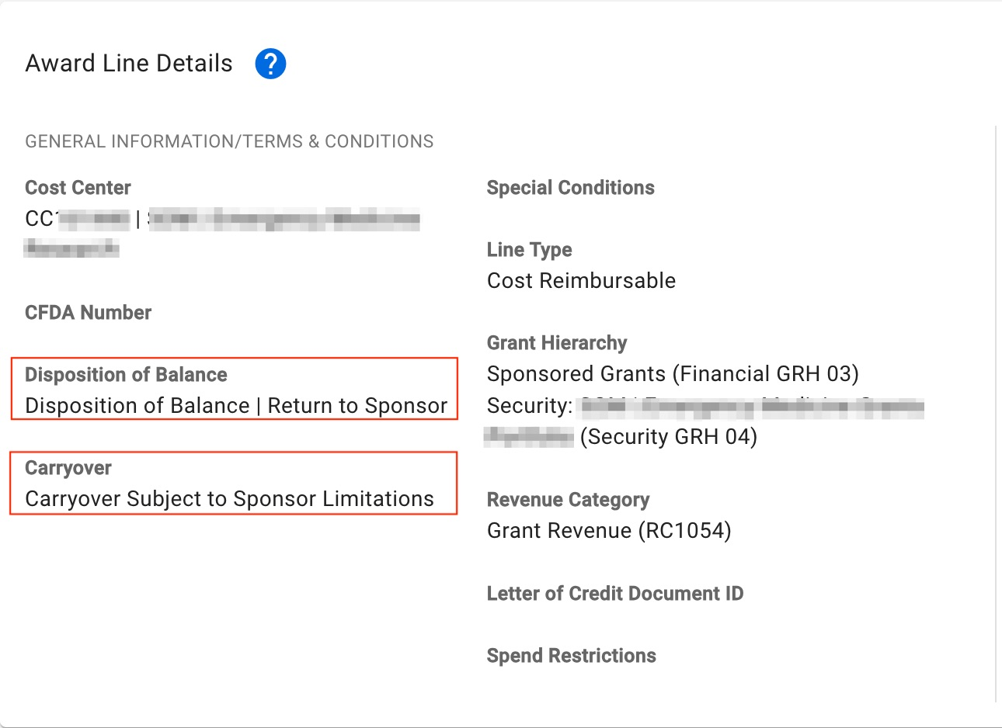
CLOSING SPECIAL CONDITIONS ON THE ASR
GCA Information Session- Closing-August 28

Slide 9
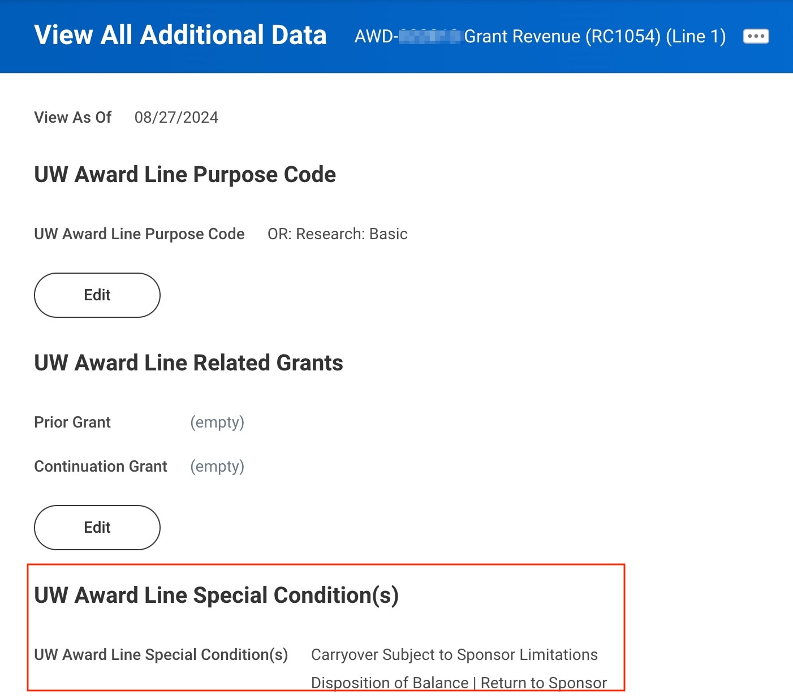
CLOSING SPECIAL CONDITIONS IN WORKDAY
Award Lines>Related Actions>Additional Data>View All
GCA Information Session- Closing-August 28

Slide 10
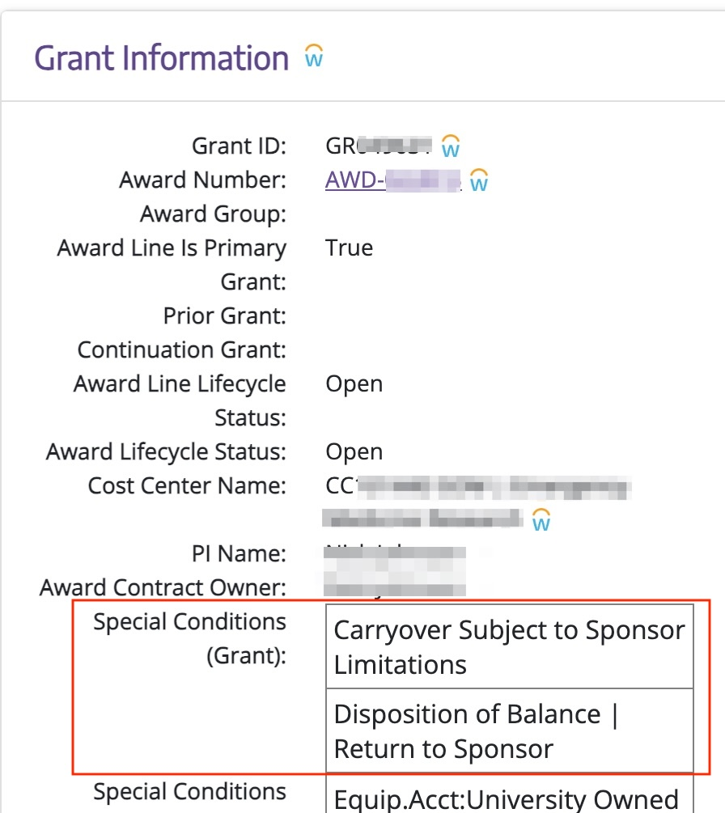
CLOSING SPECIAL CONDITIONS IN AWARD PORTAL
GCA Information Session- Closing-August 28

Slide 11
BEST PRACTICES: AT TIME OF AWARD
Read award document and ASR/MOD Comments & History for closing requirements
Review award in Workday and award tasks to see if GCA assigned a task to you
Review special conditions in Workday/Award Portal
Create a calendar for yourself so you don't miss a deadline or the Final Action Date
Make sure all the right people are listed as Award Portal contacts
Prevents tickets from going unanswered
Grant Managers are automatically added
Managing Campus Contacts in Award Portal
GCA Information Session- Closing-August 28

Slide 12
CLOSING PROCESS GOAL
Goal: Close award lines with 120 days of expiration
All expenditures have posted
All sponsor payments have been received and applied
All encumbrances and pre-encumbrances have been liquidated
F&A expenses have been reconciled
Cash balance has been transferred or refunded
Deficit has been transferred
Cost share has been met
GCA Information Session- Closing-August 28

Slide 13
CLOSING PROCESS
Award Line Lifecycle Status changes to "Closeout in Progress" after Final Action Date passes
GCA waits until 90 days after expiration to begin closing process
Allows time for final payment to be applied
Goal is to close within 120 days of expiration
GCA organizes workload by closing type
GCA reviews each award to determine if outreach to campus is needed
GCA sends Award Portal ticket with the request and deadline
Once we receive a response, or if no outreach is needed, GCA completes closing actions
GCA changes Award Line Lifecycle Status to "Closed"
Once all award lines are "Closed", GCA changes Award Lifecycle Status to "Closed"
GCA Information Session- Closing-August 28

Slide 14
CLOSING TYPE: SPONSOR REFUNDS
Occurs when the sponsor requires the UW to return the balance and there is a positive cash balance
GCA works with several central offices to submit sponsor refunds
GCA is currently processing urgent refunds only
GCA Information Session- Closing-August 28

Slide 15
SPONSOR REFUND EXAMPLE
GCA Information Session- Closing-August 28

Slide 16
CLOSING TYPE: RESIDUAL BALANCE TRANSFERS
Formerly known as "fixed price surplus transfers"
Occurs when the sponsor allows UW to keep the balance and there is a positive cash balance
Requires a worktag to transfer the cash balance to
Residual balance worktag guidance has changed since go-live - more guidance to come
GCA Information Session- Closing-August 28

Slide 17
CLOSING TYPE: CARRYOVER
Occurs with multi-year awards with a positive balance
GCA transfers the unspent balance from one year to the next in Workday
Balance is transferred as available or restricted depending on the terms of the award
Carryover can involve award balance and cash balance ("cash carryover")
Current issue with cash carryover involving sponsor payments applied in legacy system
GCA Information Session- Closing-August 28

Slide 18
CLOSING TYPE: DEFICITS
Occurs when expenses exceed award amount or sponsor payments ("cash deficit")
GCA sends Award Portal ticket when completing final invoice or final financial report
GCA Information Session- Closing-August 28

Slide 19
COMMON CLOSING PROBLEMS
Expenditures are not posted by FAD ("late charges")
One or more sponsor invoice is unpaid
Encumbrances for direct costs are not liquidated
Deficits are not cleared
GCA Information Session- Closing-August 28

Slide 20
LATE CHARGES
Charges that don't post by the Final Action Date are not included in the final invoice/report
GCA can submit a revised final invoice or final financial report if campus gets sponsor approval
Other considerations:
Sponsor reimbursement for late charges
Audit risk, loss of future funding
GCA Information Session- Closing-August 28

Slide 21
BEST PRACTICES: PREVENT LATE CHARGES
Send reminders to subrecipients before their final invoice due date
Be mindful of prime award deadline when negotiating outgoing subaward agreements
Monitor Workday reports to ensure all expenses are posted by Final Action Date
Procurement Services How to Pay
Keep GCA informed of the late charge's status via Award Portal
GCA Information Session- Closing-August 28

Slide 22
UNPAID SPONSOR INVOICES
All sponsor invoices must be paid in full
GCA follows up with sponsor directly when invoices start aging
GCA will involve campus unit if needed
GCA Information Session- Closing-August 28

Slide 23
BEST PRACTICES: UNPAID SPONSOR INVOICES
Monitor invoices and cash received in Workday/Award Portal
Inform GCA via Award Portal if you know why an invoice is not paid
GCA Information Session- Closing-August 28

Slide 24
ENCUMBRANCES
Direct cost encumbrances are campus's responsibility to liquidate
GCA will handle the F&A encumbrance
GCA Information Session- Closing-August 28

Slide 25
BEST PRACTICES: ENCUMBRANCES
Check Workday R1234 report for encumbrances and pre-encumbrances
Request purchase orders be closed timely or before Final Action Date
Fill out Purchase Order – Change or Close Form to close a purchase order
Encumbrance will close automatically
Learn more about encumbrances here
GCA Information Session- Closing-August 28

Slide 26
BEST PRACTICES: DEFICITS
Monitor expenses and cash received throughout life of the award
Determine whether overexpenditure is allowable or unallowable
Allowable? Provide a worktag for a deficit transfer
Unallowable? Prepare accounting adjustment/PAA
Provide a worktag for the deficit when GCA notifies you that the final invoice or final financial report is done
GCA Information Session- Closing-August 28

Slide 27
BEST PRACTICES: GENERAL
Reconcile expenses monthly
Monitor cost share quarterly
Reply to Award Portal tickets by stated deadline
Post all expenses are posted by Final Action Date
Close purchase orders to ensure pre-encumbrances and encumbrances are liquidated
GCA Information Session- Closing-August 28

Slide 28
WORKDAY REPORTS AND RESOURCES
Workday Reports
Grant and Award Line Summary R1202
Grant Budget Vs. Actuals R1234
Resources
GCA Closing Your Award
OSP Closeout
Workday Encumbrance Accounting
GCA Information Session- Closing-August 28

Slide 29
HOW TO IDENTIFY A DEFICIT
By award
Workday R1234
Award Portal
By Grant Security Hierarchy (CC not working)
Workday Grant and Award Line Summary R1202
GCA Information Session- Closing-August 28

Slide 30
PRE-SESSION QUESTIONS
Q: In the instance of a deficit on a budget, after a financial report has been submitted, does the department move the charges or does GCA?
A: It depends if the deficit is caused by unallowable expenses or allowable expenses.
Allowable expenses: GCA prepares the deficit transfer journal.
Unallowable expenses: Campus prepares the accounting adjustment or PAA.
GCA Information Session- Closing-August 28

Slide 31
PRE-SESSION QUESTIONS
Q: As we move into reviewing effort and understand the systems better- We have discovered a lot of issues with SOC (missing grant worktags due to a PAA, put on the wrong worktag, etc). GCA has notified some of our staff that they cannot open up a closed worktag in order to correct. What is the process to correct effort when the SOC worktags are wrong or missing?
A: GCA was not reopening award lines to allow accounting adjustments or PAAs to post to correct incorrect worktags in preparation for Fiscal Year End. We will revisit this with the Controller's Office.
GCA Information Session- Closing-August 28

Slide 32
PRE-SESSION QUESTIONS
Q: Can you address deficit transfers using School of Medicine worktags for a T32 grant in the Academy. Note that the grant is administered in the academy but trainees are in the SoM.
A: We have been advised not to transfer deficits across companies. We will follow-up on this and provide guidance soon.
GCA Information Session- Closing-August 28

Slide 33
LIVE QUESTIONS
Time to answer questions from the audience
Please put your questions into the Q&A
GCA Information Session- Closing-August 28

Slide 34
COMING SOON
Deficit transfers between companies
Closing a subaward award line in Workday
Separate Year Accountability guidance
Where residual balances can be transferred to
GCA Information Session- Closing-August 28

Slide 35
WRAP UP
Session recording, slides, links, Q&A will be posted within 3 business days on the Campus Information Sessions webpage
Please fill out our survey
Link is available in the Chat and the CIS webpage
Deadline: EOD Wednesday, September 4, 2024
Additional questions? Email gcahelp@uw.edu
Next session is Wednesday, September 11 on Subawards (outgoing)
Submit questions ahead of time using this form
GCA Information Session- Closing-August 28

