Slide 1
What should a PI & campus approved eGC1 look like?
Ari Santander & Mike Snow
Proposal and Awards Team Managers
Office of Sponsored Programs

Slide 2
Questions during the demo?
Use the Q&A feature to ask questions.
We will have time following the demo for questions.

Slide 3
Campus & PI: Approvals & Assurances
OSP relies on our principal investigators (PIs) & campus unit approvals of an eGC1 to indicate PIs, Departments, and Schools/Colleges have provided substantive review of the following aspects contained within a proposal.
The PI is responsible for ensuring that the proposal follows all sponsor technical instructions, is complete, accurate, and meets all programmatic, administrative, and compliance requirements. PIs also make assurances when a proposal is submitted on an eGC1 in SAGE.
What does a campus and PI approved eGC1 mean to OSP?
Notes:
MIKE - ACIP3, GIMs, FCR (non-voting)

Slide 4
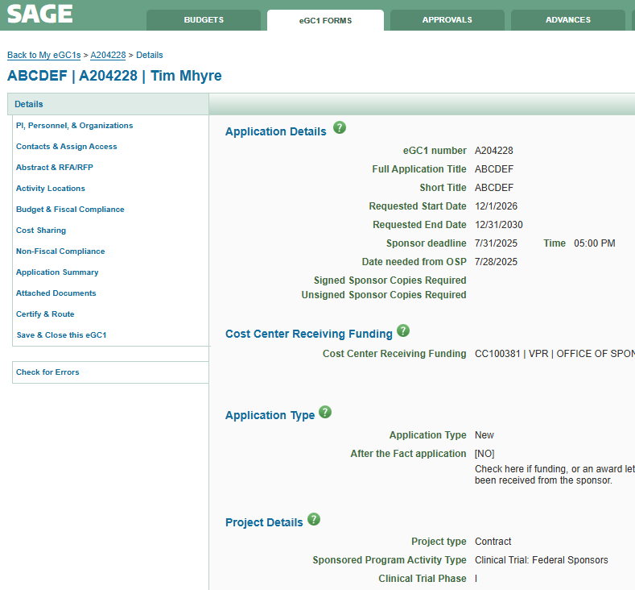
eGC1 Details
Sam Serious
SAGE: eGC1 Details page
Notes:
MIKE - Are the Fields filled out accurately, including Dates, Application type, Project type, SPA type.

Slide 5
eGC1 Details
Project Type and Sponsored Program Activity Type
Project Type
Selecting correct Project Type ~ helps identify the appropriate OSP reviewer, level of review that may be required, and when additional compliance offices may need to be brought in.
On flow-through funding, this is based on originating sponsor funding opportunity.
Sponsored Program Activity Type
Drives the F&A rate for the project and must match the budget.
How do I know what project type to select on an eGC1 and why is it important?
Notes:
MIKE - For flow-through funding, the Project type is based on the Originating sponsor funding opportunity. Please note for Contract or Other Transaction Project types, the eGC1 will need to be in OSP at least 7 business days prior to the sponsor deadline.

Slide 6
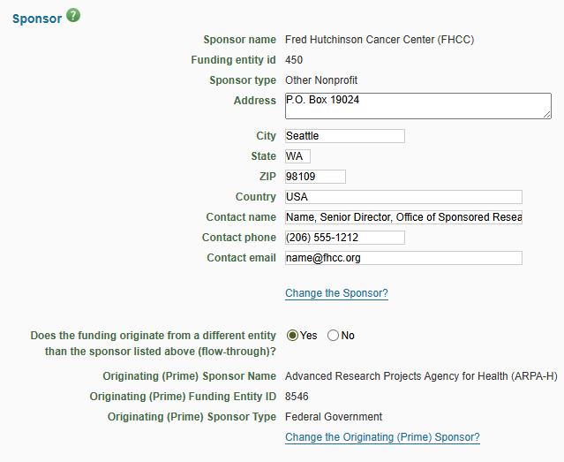
eGC1 Details - Sponsor Contact Info
Is sponsor contact information complete & accurate?
Is originating sponsor identified when applicable?
Notes:
MIKE - Is there adequate sponsor contact information. [Stress that the sponsor contact, esp. for flow-thru should be an AO/BO.] Is this flow-thru funding? If so, is the Originating Sponsor appropriately identified?

Slide 7
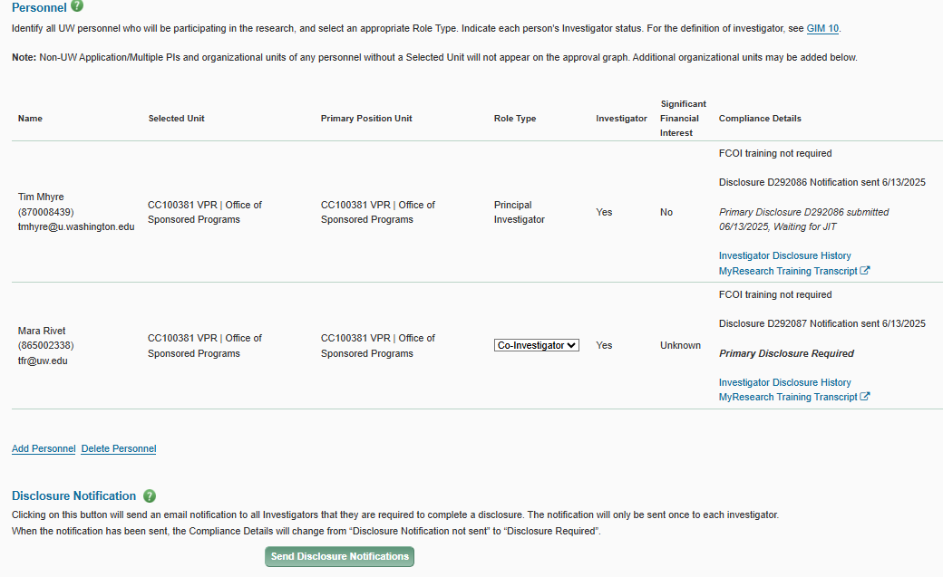
PI, Personnel, & Organizations
Personnel & Disclosures
This is where you identify all personnel & who are investigators that need to disclose.
See GIM 10.
sadsadaasd
as
Sam Serious
(876032145)
san@uw.edu
Teresa Schmidt
(876012347)
schmidt@uw.edu
Research Security Training complete if required?
Notes:
MIKE - Are appropriate PI & Personnel identified (all personnel, not just Investigators)? Have Investigators disclosed FIDS - it’s ok if they haven’t for an RTS NO but to mark an eGC1 RTS Yes, all Investigators must have made their disclosure in FIDS (see GIM 10). This can be updated after the eGC1 is approved and should be updated through the life of the awarded project.
If Research Security Training is required by a sponsor or the funding opportunity, OSP will check the MyResearch Training Transcript to ensure the training has been completed.

Slide 8
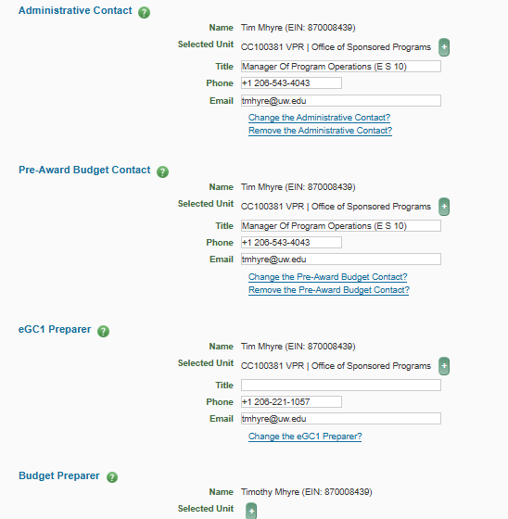
Contacts & Assign Access
Teresa Schmidt (EIN 87012345)
tschmidt@uw.edu
Keep contact info up-to- date and continue to through lifecycle of an award.
Teresa Schmidt (EIN 87012345)
tschmidt@uw.edu
Teresa Schmidt (EIN 87012345)
tschmidt@uw.edu
SAGE User Guide: Administrative and Pre-Award Budget Contacts
Notes:
MIKE - This is important but can be updated after the eGC1 is approved and should be updated through the life of the awarded project. This page allows the eGC1 Preparer to add an Administrative Contact and a Pre-Award Budget Contact, both of whom are optional. In the Access section, the preparer and other owners (contacts and PI) are listed. One person may hold more than one of these roles. Owners have edit access and will receive specific notifications related to the eGC1. When you connect a SAGE budget to an eGC1, then the Budget Preparer is listed in addition to the eGC1 Preparer, and the two items have a shared access page.

Slide 9
Abstract & RFA/RFP
Always include a draft abstract.
Always attach the RFA/RFP
Originating sponsor? Flow-through via a pass-through entity MUST include originating sponsor RFA/RFP.
Notes:
MIKE - Always include a draft abstract. Items in the abstract will inform OSP’s review along with the draft proposal.
Originating sponsor? eGC1s for flow-through via a pass-through entity (where the UW is the subrecipient) MUST have the RFA/RFP attached for the originating sponsor {stress upload under Internal Documents for OSP???}. - this is where most of the technical instructions are coming from on a PTE/Flow through.

Slide 10
Activity Locations
OSP relies on accurate activity location information for F&A rate review.
Notes:
ARI Location information should be accurately identified when routing an eGC1 for OSP review. OSP uses this information when reviewing F&A rates/base during its Institutional Review.
Space planning is an area that OSP doesn’t really review, however, your Unit & School reviewers will need this for their review.

Slide 11
Activity Locations
International Involvement
OSP will confirm UW & sponsor requirements when international involvement is identified.
Export Controls?
Does PI need to be aware if there are additional sponsor forms required?
Notes:
ARI - Space planning is an area that OSP doesn’t really review, however, your Unit & School reviewers will need this for their review.
International involvement is a key area to identify and must be complete for OSP’s review. This may include export controls review, coordination with other central offices, and/or review of the funding opportunity and/or sponsor policies.

Slide 12
Budget & Fiscal Compliance
Fiscal Compliance
OSP reviews F1 & F3.
Notes:
ARI - OSP will review F-1 and F-3, OSP does not review F-2. OSP does not do a compliance check on the costs proposed.
The budget needs to be completed for campus and OSP review. If not using SAGE Budget, please fill in information for Period 1 and Total (all periods) and include any budgetary documentation in the Attached Documents.
Institutional Review of the budget is limited. OSP confirms dates/dollars match on eGC1 and proposal. Ensure F&A rate and base are correct based on GIM 13, eGC1 information, and sponsor requirements. OSP is also responsible for institutional review and signoff (or rejection) of any F&A waivers.

Slide 13
Budget & Fiscal Compliance
Total Costs
OSP will always confirm Total Costs matches the proposal.
If OSP reviews technical instructions, we may recommend budget changes incidental to this review.
Notes:
Ari - If conditions permit, OSP may provide review of technical instructions during which, incidental to this review, may recommend budget changes (e.g., “this cost is not allowed”, “sponsor requires budgeting for a mandatory annual meeting in Washington DC”).

Slide 14
Cost Sharing
Institutional Review ensures:
Proposal & eGC1 accurately reflect sponsor
cost-share requirements
Units Intend to cost-share
Cost-sharing units have approved (via eGC1 approvals)
OSP does not require a Cost Share Addendum at time of proposal
Review GCA’s Cost Share guidance
Send cost sharing questions to Post Award Fiscal Compliance
Notes:
ARI - - Institutional Review ensures:
the proposal and eGC1 accurately reflect sponsor cost-share requirements,
departments intend to cost-share,
and cost-sharing units have approved (via eGC1 approval).
If the eGC1 is IN OSP then campus units approved & there is CS included - we consider this to mean they have approved the CS
If CS is added after campus approvals, OSP will require CS approvals from the appropriate units (e.g., via uploaded emails or other documentation)
OSP does not require a CS Addendum
If included some reviewers find it helpful; see GIM 21.
Encourage campus to follow guidance in Cost Share Review. If time permits PI/campus can follow up with Post Award Fiscal Compliance (gcafco@uw.edu).

Slide 15
Non-Fiscal Compliance
PIs & Units must complete relevant sections for their proposal.
OSP will:
confirm proposal matches eGC1
use info here throughout life of award
Note: Human subjects and animal use approvals are often pending.
Notes:
ARI - Indicate if the project will involve Human Subjects, Animal Use, EH&S, Equipment & Materials, and Data & Technology.
OSP’s Institutional Review is to ensure the information on the eGC1 matches the proposal. For example the UW Abstract mentions recruiting subjects, but the eGC1 is marked No for Human Subjects. (Or, the Sponsored Program Activity Type is marked Clinical Trial: Federal Sponsors, but the HS questions are answered No.) In most cases human subjects and animal use approvals are pending.
OSP uses the information in this section to complete its compliance review during the project’s lifecycle.

Slide 16
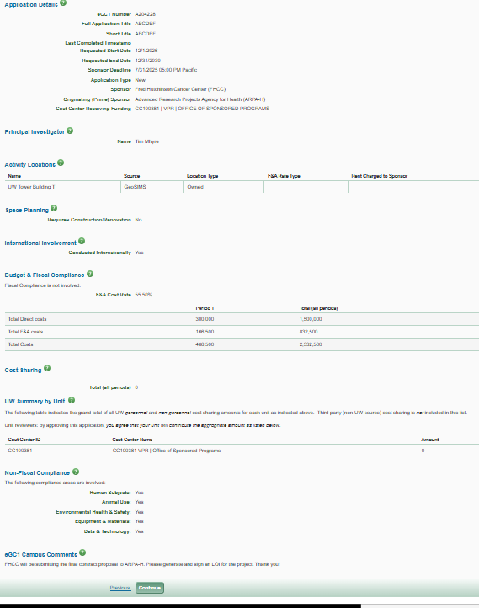
Application Summary
Review and confirm information.
Notes:
ARI - Read Only - pulls information from the other sections. This is a good time to double check that eGC1 information matches the proposal.

Slide 17
Attached Documents
Documents to be Submitted to Sponsor
ONE file of entire application (in correct order) to be submitted to sponsor
Internal Documents for OSP
Copy of sponsor/originating sponsor funding opportunity ~helpful if key info is highlighted
Notes:
ARI - Documents to be Submitted to Sponsor - eGC1 Instructions, “Provide only ONE file with the entire application (in the correct order) that will be submitted to the sponsor; if appropriate, provide a separate file containing only signature pages that require OSP ink signature.”
Internal Documents for OSP - please include a copy of the sponsor (or originating sponsor) funding opportunity (and it’s very helpful if key information has been highlighted, for example key dates, F&A limitations, etc.).

Slide 18
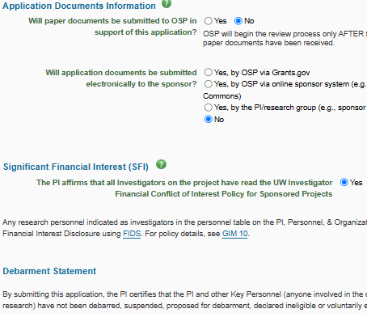
Certify & Route
Application documents, Significant Financial Interest, Debarment Statement
How will application material be submitted
to sponsor?
PI affirms all SFI & Debarment
Notes:
ARI - How will application material be submitted to sponsor?
The PI is responsible for affirming all Investigators have read GIM 10, that PI and Key Personnel have not been debarred, etc., and agrees with the PI Assurance Statement. the PI is making a certification about debarment. If working with new personnel or outside UW and not part of subaward package, it is good for department reviewers to double-check in SAM (and remind that we have SAM instructions online).
"When there is a Non-UW Multiple PI, the eGC1 PI is responsible for securing and retaining assurance statements for non-UW Multiple PIs in their local files."

Slide 19
Certify & Route
Additional Info, Ready to Submit
Include helpful Information for reviewers.
OSP sees this info as part of their review summary in OSP’s eGC1 Campus Comments section.
If Ready to Submit to sponsor, mark this Yes. If not Ready to Submit, mark No.
Should I submit an eGC1 that is marked NO to the Ready to Submit question?
Is my eGC1 Ready to Submit?
Notes:
ARI - The Additional Information section will become the eGC1 Campus Comments section on the eGC1 in SAGE Central (OSP’s view of SAGE).
OSP needs the proposal ID number (e.g., NIH ASSIST or NSF proposal numbers), and any additional comments or instructions for UW reviewers, including OSP.
OSP will review eGC1s In OSP regardless of RTS Status. eGC1 text, “If the application is not ready to be submitted to the sponsor, it can be routed for internal approval with the draft sponsor documents. OSP will not consider the application fully complete unless this question is marked "yes".
Speaker note may want to focus on the content right below the Yes or No selection which emphasizes that an application not ready to be submitted to the sponsor can be routed for internal approval (including OSP’s Institutional Review). This is emphasized in the FAQ “Should I submit an eGC1 that is marked NO to the RTS question”.

Slide 20
Resources
Technical Instructions
How do I know what project type to select on an eGC1 and why is it important?
Proposal Preparation Quick Guide
What does a campus and PI approved eGC1 mean to OSP?
Should I submit an eGC1 that is marked NO to the Ready to Submit question?
Is my eGC1 Ready to Submit?
What resources are available to help me learn how to prepare a proposal at the UW?
SAGE User Guide: eGC1 Overview

Slide 21
Questions?

