Slide 1

What should a PI & campus approved eGC1 look like?
Ari Santander & Mike Snow
Proposal and Awards Team Managers
Office of Sponsored Programs

Slide 2
Questions during the demo?
Use the Q&A feature to ask questions.
We will have time following the demo for questions.

Slide 3
Campus & PI: Approvals & Assurances
OSP relies on our principal investigators (PIs) & campus unit approvals of an eGC1 to indicate PIs, Departments, and Schools/Colleges have provided substantive review of the following aspects contained within a proposal.
The PI is responsible for ensuring that the proposal follows all sponsor technical instructions, is complete, accurate, and meets all programmatic, administrative, and compliance requirements. PIs also make assurances when a proposal is submitted on an eGC1 in SAGE.
What does a campus and PI approved eGC1 mean to OSP?

Slide 4
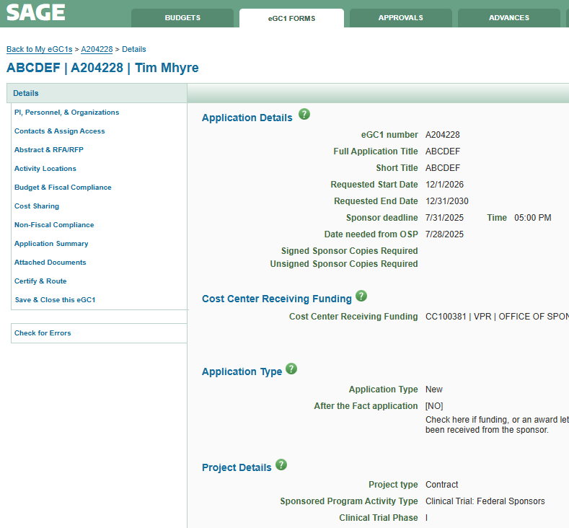
eGC1 Details
Sam Serious
SAGE: eGC1 Details page

Slide 5
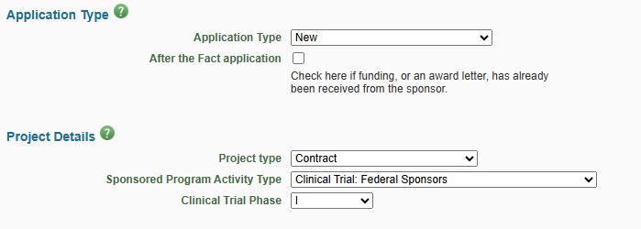
eGC1 Details
Project Type and Sponsored Program Activity Type
Project Type
Selecting correct Project Type ~ helps identify the appropriate OSP reviewer, level of review that may be required, and when additional compliance offices may need to be brought in.
On flow-through funding, this is based on originating sponsor funding opportunity.
Sponsored Program Activity Type
Drives the F&A rate for the project and must match the budget.
How do I know what project type to select on an eGC1 and why is it important?

Slide 6
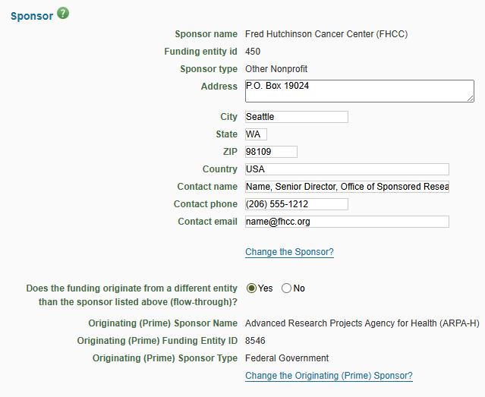
eGC1 Details - Sponsor Contact Info
Is sponsor contact information complete & accurate?
Is originating sponsor identified when applicable?

Slide 7
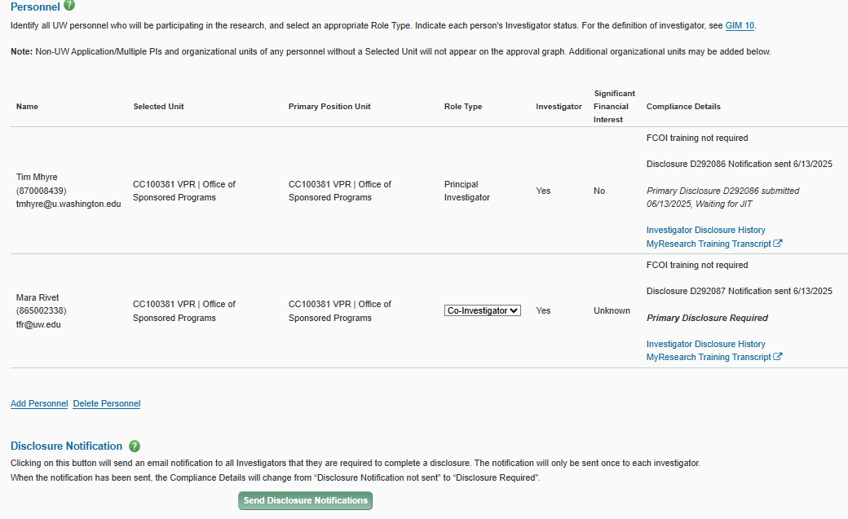
PI, Personnel, & Organizations
Personnel & Disclosures
This is where you identify all personnel & who are investigators that need to disclose.
See GIM 10.
sadsadaasd
as
Sam Serious
(876032145)
san@uw.edu
Teresa Schmidt
(876012347)
schmidt@uw.edu
Research Security Training complete if required?

Slide 8
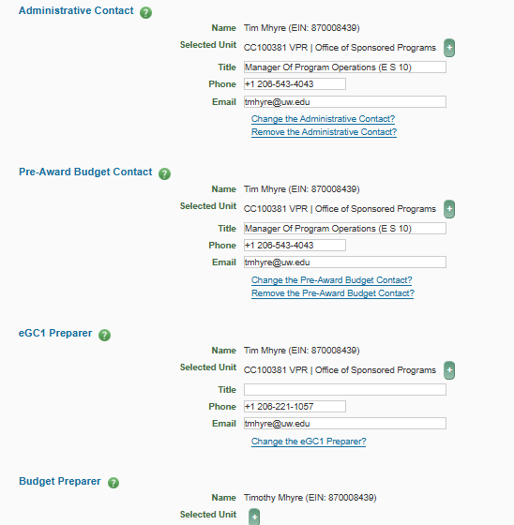
Contacts & Assign Access
Teresa Schmidt (EIN 87012345)
tschmidt@uw.edu
Keep contact info up-to- date and continue to through lifecycle of an award.
Teresa Schmidt (EIN 87012345)
tschmidt@uw.edu
Teresa Schmidt (EIN 87012345)
tschmidt@uw.edu
SAGE User Guide: Administrative and Pre-Award Budget Contacts

Slide 9
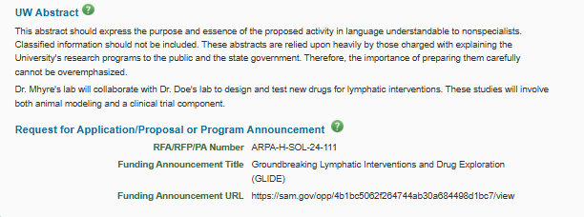
Abstract & RFA/RFP
Always include a draft abstract.
Always attach the RFA/RFP
Originating sponsor? Flow-through via a pass-through entity MUST include originating sponsor RFA/RFP.
Notes:
Originating sponsor? eGC1s for flow-through via a pass-through entity (where the UW is the subrecipient) MUST have the RFA/RFP attached for the originating sponsor {stress upload under Internal Documents for OSP???}. - this is where most of the technical instructions are coming from on a PTE/Flow through.

Slide 10
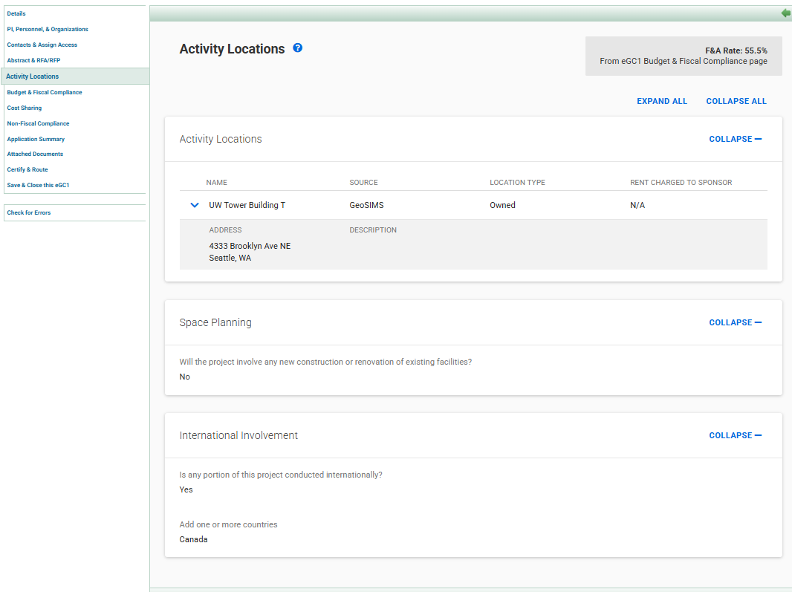
Activity Locations
OSP relies on accurate activity location information for F&A rate review.

Slide 11
Activity Locations
International Involvement
OSP will confirm UW & sponsor requirements when international involvement is identified.
  Export Controls?
  Does PI need to be aware if there are additional sponsor forms required?

Slide 12
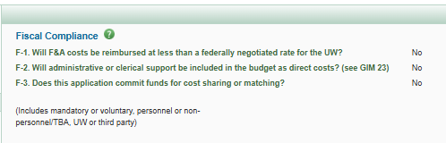
Budget & Fiscal Compliance
Fiscal Compliance
OSP reviews F1 & F3.

Slide 13
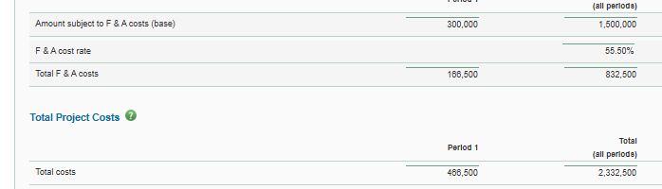
Budget & Fiscal Compliance
Total Costs
OSP will always confirm Total Costs matches the proposal.
If OSP reviews technical instructions, we may recommend budget changes incidental to this review.

Slide 14
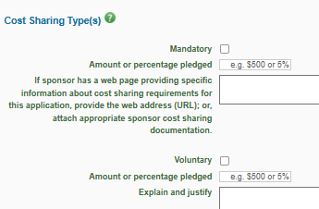
Cost Sharing
Institutional Review ensures:
Proposal & eGC1 accurately reflect sponsor
cost-share requirements
Units Intend to cost-share
Cost-sharing units have approved (via eGC1 approvals)
OSP does not require a Cost Share Addendum at time of proposal
Review GCA’s Cost Share guidance
Send cost sharing questions to Post Award Fiscal Compliance

Slide 15
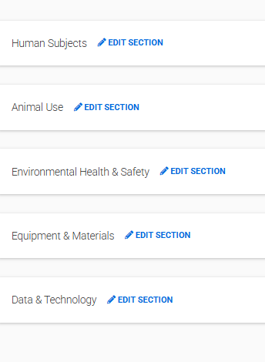
Non-Fiscal Compliance
PIs & Units must complete relevant sections for their proposal.
OSP will:
confirm proposal matches eGC1
use info here throughout life of award
Note: Human subjects and animal use approvals are often pending.

Slide 16
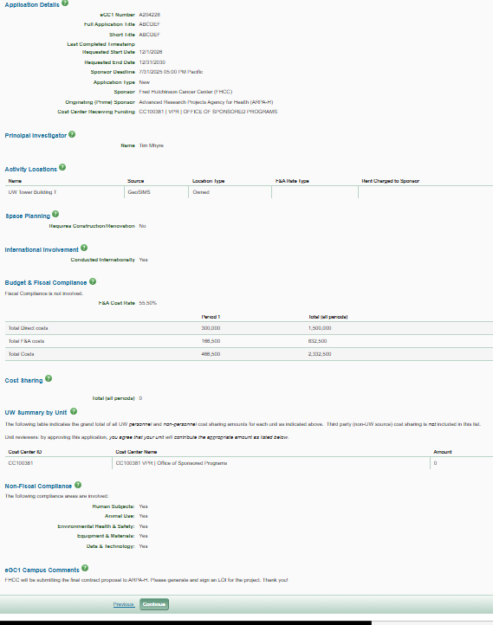
Application Summary
Review and confirm information.

Slide 17
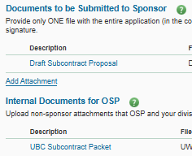
Attached Documents
Documents to be Submitted to Sponsor
ONE file of entire application (in correct order) to be submitted to sponsor
Internal Documents for OSP
Copy of sponsor/originating sponsor funding opportunity ~helpful if key info is highlighted

Slide 18
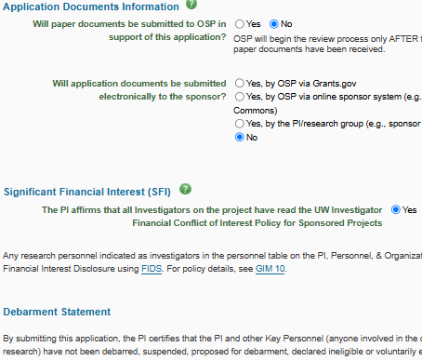
Certify & Route
Application documents, Significant Financial Interest, Debarment Statement
How will application material be submitted
to sponsor?
PI affirms all SFI & Debarment

Slide 19
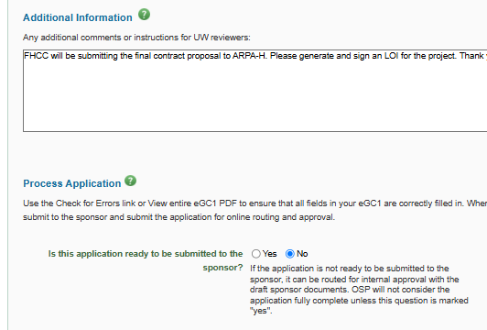
Certify & Route
Additional Info, Ready to Submit
Include helpful Information for reviewers.
OSP sees this info as part of their review summary in OSP’s eGC1 Campus Comments section.
If Ready to Submit to sponsor, mark this Yes. If not Ready to Submit, mark No.
Should I submit an eGC1 that is marked NO to the Ready to Submit question?
Is my eGC1 Ready to Submit?

Slide 20
Resources
Technical Instructions
How do I know what project type to select on an eGC1 and why is it important?
Proposal Preparation Quick Guide
What does a campus and PI approved eGC1 mean to OSP?
Should I submit an eGC1 that is marked NO to the Ready to Submit question?
Is my eGC1 Ready to Submit?
What resources are available to help me learn how to prepare a proposal at the UW?
SAGE User Guide: eGC1 Overview

Slide 21
Questions?

