Slide 1
UPDATES
MRAM UPDATE
Laurie Stephan
Associate Director for Learning, ORC

Slide 2
MIGRATION TO TALENT LMS
Self-serve progress tracking​
Transcripts updated more quickly
Zoom webinar within one workday
On-Demand completions immediately
Certificates issued automatically​​
Calendar
Notifications that make sense

Slide 3
REGISTER FOR COURSES IN THE LMS
LMS Direct Link (https://certificateresearchadmin-uwashington.talentlms.com/plus)

Slide 4
REGISTRATION STEPS
Log in to the LMS with your UW credentials
From the Course Catalog select/click on a course card
Zoom courses represented by the camera icon
Asynchronous/on-demand courses represented by the “play” icon
Live Zoom classes show the date/time for the course and a registration button

Slide 5
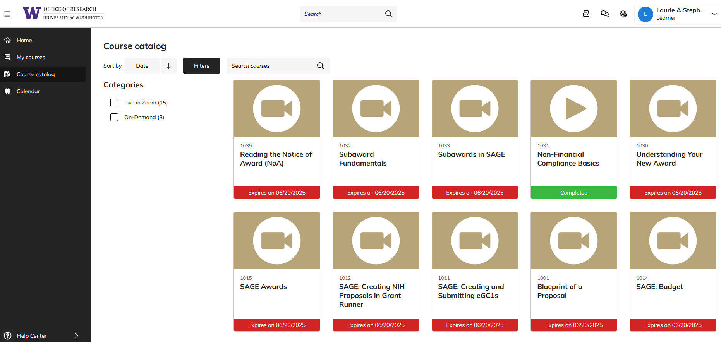
COURSE CATALOG
Select course by clicking on course card

Slide 6
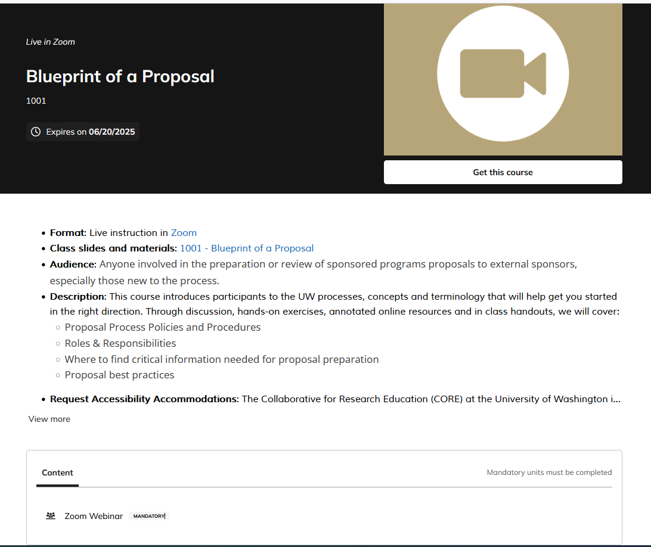
ZOOM COURSE REGISTRATION: 1. Get the Course

Slide 7
ZOOM COURSE REGISTRATION:
2. Reserve your spot in the webinar

Slide 8
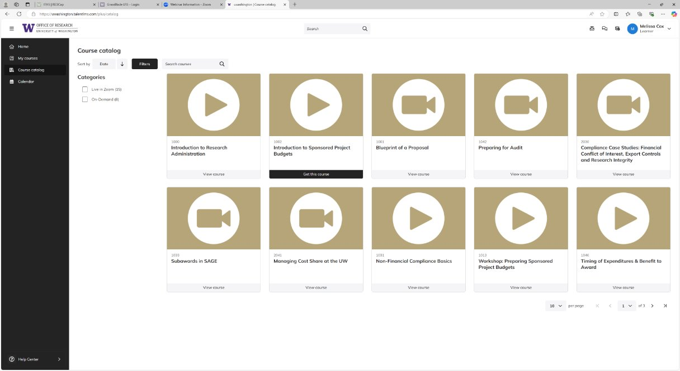
ON-DEMAND COURSE REGISTRATION
From course catalog click on course tile “Get this course”

Slide 9
ON-DEMAND COURSE ACCESS:
Select "Play" or "Start the Course"

Slide 10
ON-DEMAND COURSE COMPLETION:
Complete Course

Slide 11
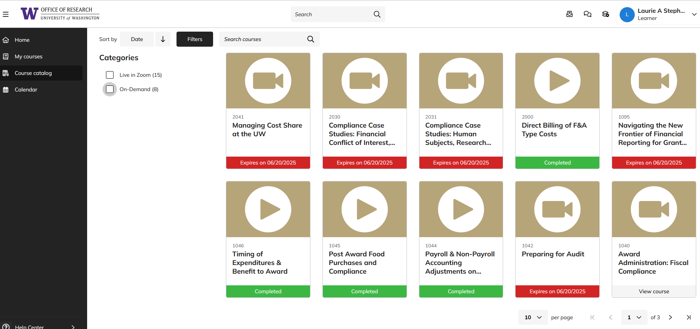
COURSE COMPLETION TRACKING
Complete Course
Historical progress reports imported within one week after your first log-in

Slide 12
CERTIFICATE AWARDED
Upon completion of: ​
​Required Courses and​
Evaluation​
Certificate will be:​
Emailed and​
Available for download in TalentLMS​

Slide 13
UPDATED CERTIFICATE REQUIREMENTS
19.5 hours of foundational leads to certificate
Elective courses do not count toward certificate
Visit Certificate Curriculum Guide for exact information
Courses on hold have been retired
One new course added

Slide 14
2025 WINTER SCHEDULE
Course Registration (https://certificateresearchadmin-uwashington.talentlms.com/plus)
Course | Date | Time
Blueprint of a Proposal | Jan 7 | 9:30 am-12:00 pm
SAGE: Creating and Submitting eGC1s | Jan 14 | 1:00 pm-3:00 pm
SAGE: Creating NIH Proposals in Grant Runner | Jan 21 | 1:00 pm-3:00 pm
Understanding Your New Award | Jan 30 | 9:30 am-11:00 am
Reading the Notice of Award | Feb 2 | 9:30 am-11:00 am
SAGE: Budget | Feb 4 | 1:00 pm-3:00 pm
SAGE Awards | Feb 11 | 1:00 pm-3:30 pm
Award Administration: Fiscal Compliance | Feb 11 | 9:30 am-12:00 pm
Preparing for Audit | Feb 18 | 9:30 am-11:30 am
Navigating the New Frontier of Financial Reporting for Grants Managers | Feb 25 | 9:30 am -11:30 am
SAGE: Budget | Mar 4 | 1:00 pm-3:00 pm
Managing Cost Share at the UW | Mar 4 | 9:30 am-11:30 am
SAGE Awards | Mar 11 | 1:00 pm-3:30 pm

Slide 15
ON-DEMAND COURSES AVAILABLE NOW
1000: Introduction to Research Administration
1002: Introduction to Sponsored Project Budgets
1013: Workshop: Preparing Sponsored Project Budgets
1031: Non-Financial Compliance Basics
1044: Payroll and Non-Payroll Accounting Adjustments on Sponsored Awards
1045: Post Award Food Purchases and Compliance
1046: Timing of Expenditures & Benefit to Award
2000: Direct Billing of F&A Type Costs

