Slide 1
Disclaimer
The GCA Forum will be recorded and retained for the legally approved retention period under Washington State Policy
It is subject to release under the Washington State Public Records Act or Federal Freedom of Information Act (FOIA)
It will be posted publicly on our GCA YouTube channel
Slide decks and recordings for this and past Forums are linked on our GCA Forum web page: https://finance.uw.edu/gca/resources/gca-forum

Slide 2
GCA Winter Forum 2024
February 22, 2024

Slide 3
Welcome!
Please make sure you are muted in order to reduce background noise during the presentation
Please ask us questions using the Q&A feature in Zoom
We want you to be engaged. This meeting is for you

Slide 4
Agenda
General Announcements
Looking for PI presenters
Forum Feedback
Award Portal Updates
Backlogs in ASRs and MODs
Pointers on Advance Requests
Make Sure Your ASR/MOD Is In Good Working Order
Workday Award Lifecycle Statuses
How to Contact GCA: Best Practices

Slide 5
General Announcements
Azalea Vasquez

Slide 6
Looking for PI Presenters
GCA would like to invite a PI to give a 45-minute presentation at our upcoming all-staff meeting!
All-staff meeting - March 5, 2024 (GCA will be closed)
These presentations connect us to the fantastic work done at the UW.
Please email gcahelp@uw.edu with your suggestions!

Slide 7
GCA Fall 2023 Forum Feedback
Feedback from last Forum survey:
We covered too much stuff. Please present fewer topics.
Shortened the length of our presentations
We need to make time for questions. (Chat was very distracting – hard to focus)
Restricted chat to hosts only
Q&A feature should streamline this process
Can we go back to in-person meetings?
No – Everyone affiliated with the UW can attend
Zoom is free (meeting rooms cost money)
Zoom allows us to record our presentation and capture questions

Slide 8
GCA Fall 2023 Forum Feedback
You want monthly forums
It is extremely time consuming to prepare
Our volumes have tripled (no capacity)
Poll: Forum Slides
“Links to slides ahead of time would have helped, for those joining late especially”

Slide 9
Award Portal Updates
Cheryl Haycox

Slide 10
Primary Grant Line Indicator and Legend

Slide 11
More Information on Expenditures!

Slide 12
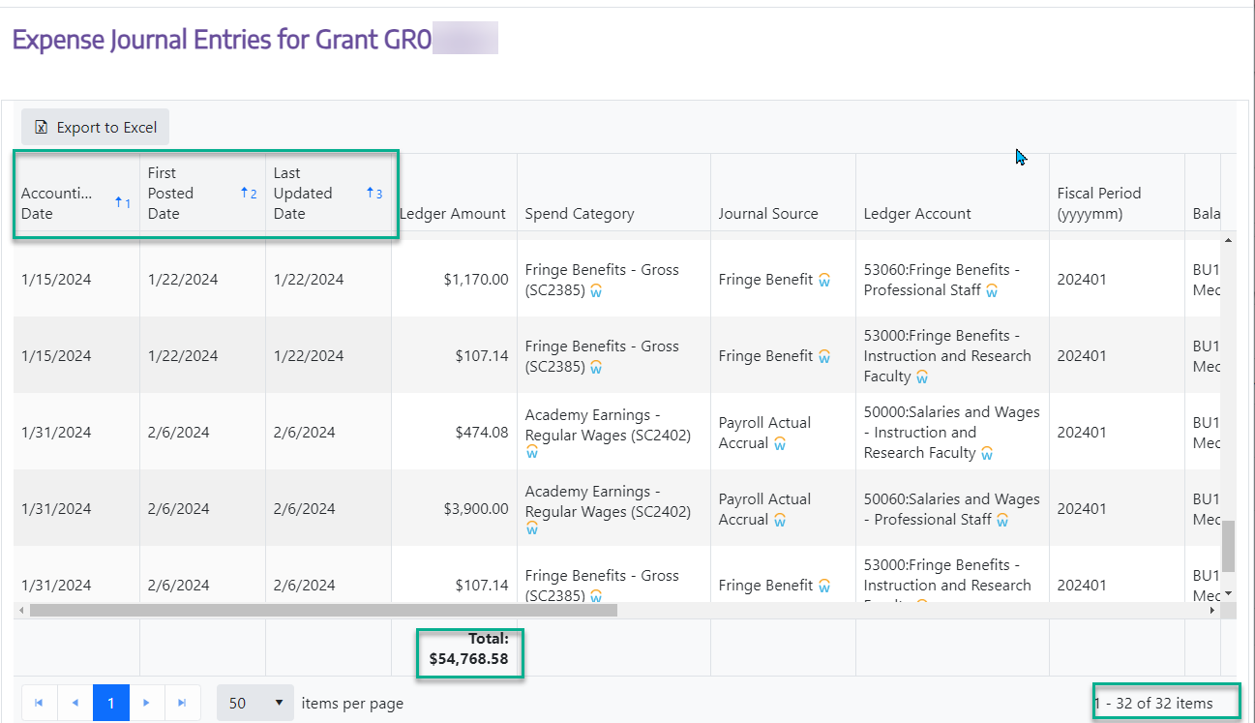

Slide 13
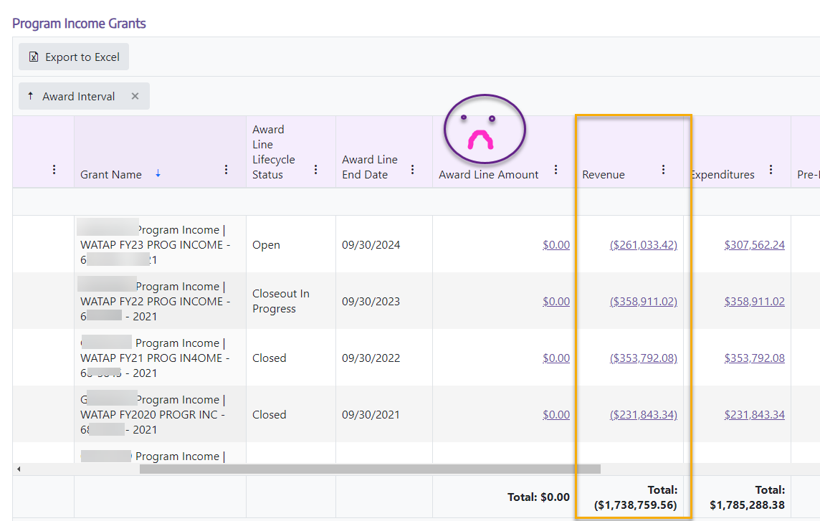
Viewing Program Income in Award Portal

Slide 14
Any Questions?

Slide 15
Backlogs in ASRs and MODs
Cheryl Haycox

Slide 16
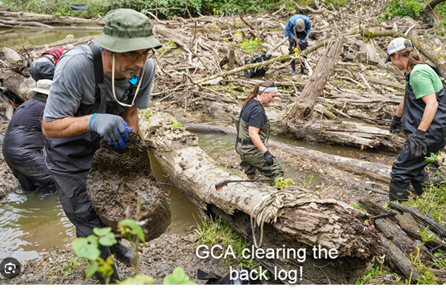
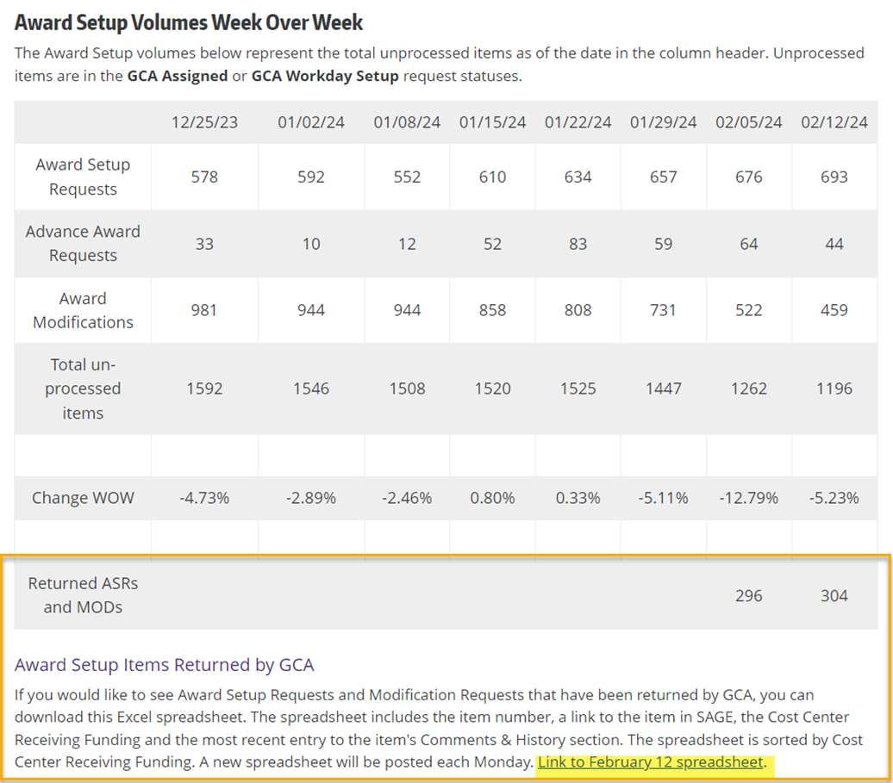
How are we doing?
GCA Workload and Backlog Information

Slide 17
ASRs and MODs-Returned Items
The return rate on both urgent and regular ASRs and MODS remains high.
Main issue is missing/incorrect/mismatched information on the SAGE Budget
Please check SAGE to see if any of your items have been returned-especially your urgent items!
GCA has added a link to a weekly list of returned items for easier searching
We have items that were returned in 2023 that are still in returned status. If they aren’t needed anymore, you can resubmit them to GCA with a comment to DENY the item

Slide 18
Urgent ASRs and MODs
Before asking to have an item expedited, you can avoid delays:
Review to make sure that the SAGE Budgets are in balance and have all required information (and that you’ve updated the grant title)
Check SAGE to see if it’s been returned or processed
For MODS, please include the SAGE Modification Request Checklist to help make sure we can process the item (more later in this presentation!)
For multiple items, please send 1 item every few days so that others have a chance to prioritize their items

Slide 19
Any Questions?

Slide 20
Advance Requests
Cheryl Haycox

Slide 21
Advance Request Strategy
Converting advance award lines from advance to permanent is a low priority
Subaward lines
OSP Subs will not initiate a subaward until the ASR is processed.
Ask for the ASR/MOD to be prioritized
Invoicing
Invoices can not be issued until the ASR is processed
In cases where an invoice will be required soon.
Ask for the ASR to be prioritized
Need to post expenditures
An advance line is beneficial

Slide 22
Advance Requests-Renewal or New?
Types of Requests
New Advance: For an entirely new award with no linkage to a previous sponsored program
Renewal Advance: Will become a new award line in an existing Workday award with a new grant worktag and linked to an existing grant worktag
Extension: Adds more time to an existing advance. Please note that advance award periods may not exceed 12 months in total, 18 months for clinical trials

Slide 23
Advance Request Strategy
What happens if you request an advance line on an existing project, but it is a whole new segment/project?
We cannot link a new award line setup under one award to another award
Create a new award and new award lines
Expenses will need to be transferred from the lines on the project that ended
Lines on the closing project will be cancelled
What happens if you request a NEW advance but it's actually year 2 or 3 of an existing project?
We cannot link a new award line setup under one award to another award
Create a new award line under the existing project
Expenses will need to be transferred to the new grant line
Cancel the award and award lines created in error

Slide 24
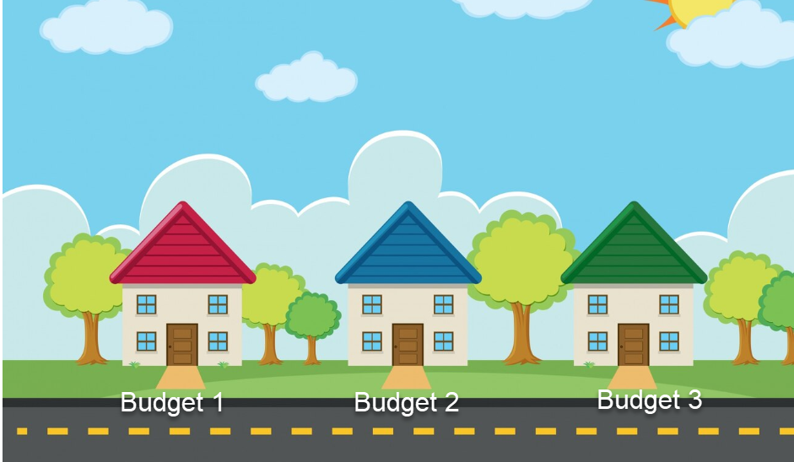
Renewals in the Old System
New budget for each year of a project to keep the expenditures separated for reporting purposes
Visual of a 3 year project

Slide 25
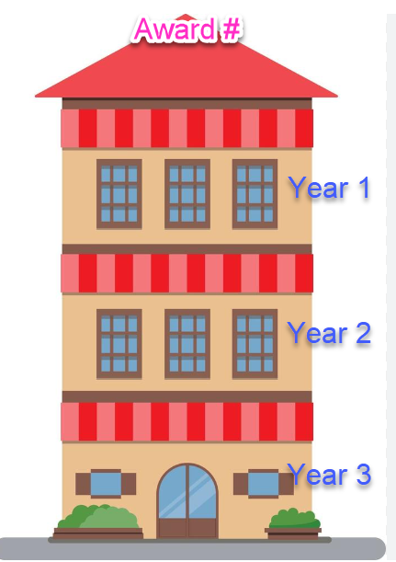
Renewals in the Current System
Same Award number with new award lines for each year
Visual of a 3-year project in Workday
View videos for overview of award structures in Workday

Slide 26
Any Questions?

Slide 27
Make Sure Your ASR/MOD Is In Good Working Order
Patrick Carney

Slide 28
Why It Is Important To Get Items Right
Our setup volumes continue to remain high
Incorrectly routed items create back and forth and duplicate processing
Resubmitted items are prioritized, but they are not currently gotten to immediately, so if your item is not in good order this will further delay your processing time.

Slide 29
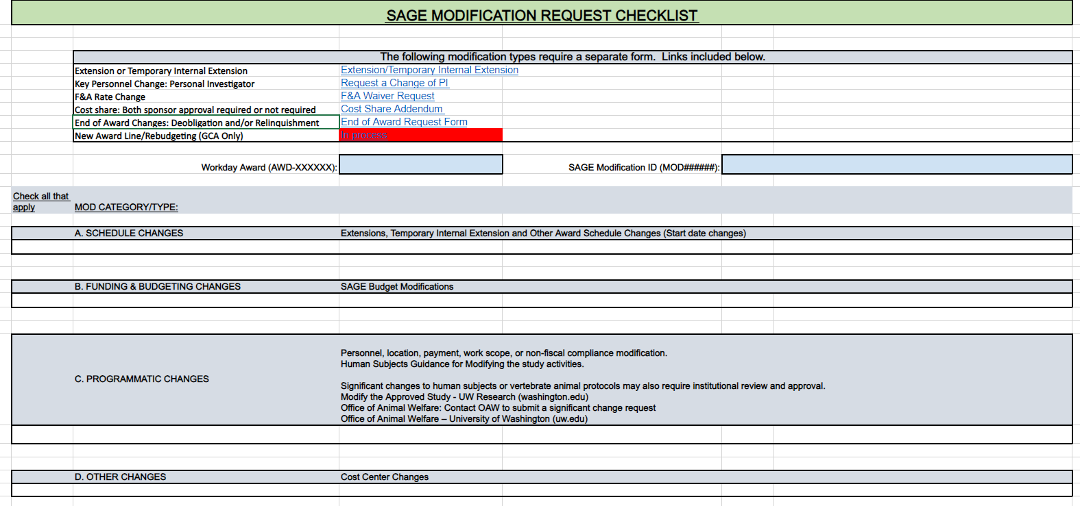
SAGE MOD Checklist
Checklist to help prepare your MODs to be processed on the first go.

Slide 30
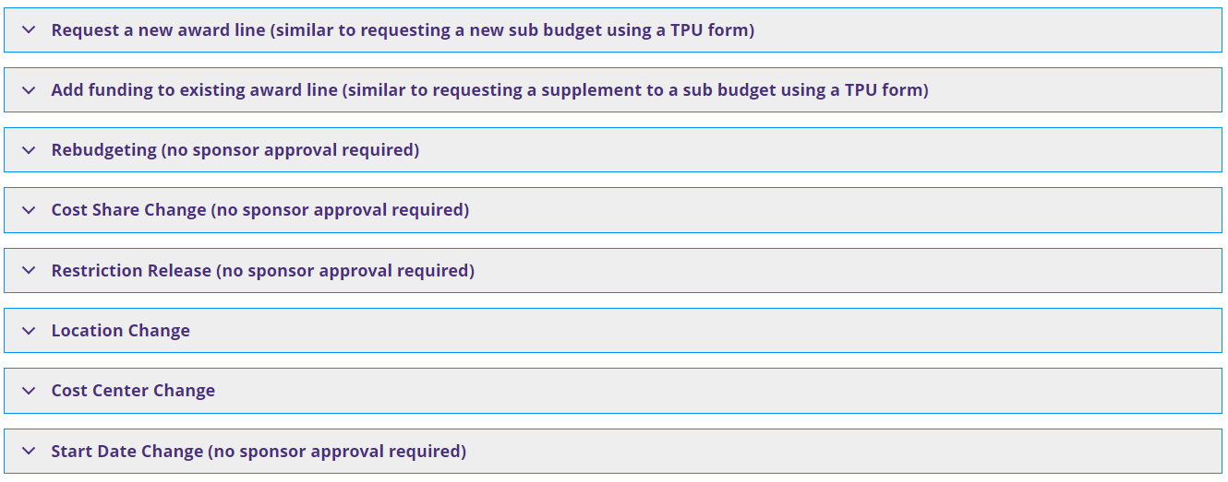
GCA Only MODs
Must NOT require sponsor approval, if the change does require sponsor approval, please use OSP/GCA MODs. If routed incorrectly, the MOD will need denied and a new MOD must be created
Common return reasons include No SAGE Budget snapshot in the comments & history or no SAGE Budget export in the attachments section or missing cost share addendums

Slide 31
OSP/GCA MODs
If a change requires sponsor approval it will need to be routed as an OSP/GCA MOD
Tips for these are as follows
select all categories that reflect the type of change being requested
attach agreements & correspondence with sponsor
add Comments – indicate what you are requesting
include any UW Award Line Worktag(s) (GRXXXXXX) impacted

Slide 32
SAGE Budget Worksheets
SAGE Budget worksheets require all fields to be completed. This includes:
Cost Center
Worksheet Security Grant Hierarchy
PI
Sponsored Program Activity (SPA) Type
Worksheet Periods
Award Lines
Primary Worksheet Name (note Workday Grant Names ARE setup as the name of the SAGE Budget worksheet. Any changes will require a new MOD)
You will need a SAGE Budget for each award line you are requesting with the information completed.
SAGE budget must match your award amount EXACTLY
Details for how to complete your SAGE budget to the award amount can be found here SAGE Budget Help. Additional resources for completing SAGE budgets can be found at the bottom of the link provided.

Slide 33
Resources
SAGE Modification Checklist
Modification instructions
OSP/GCA MODs
Award Setup tips for Success
SAGE Budget Worksheets

Slide 34
Any Questions?

Slide 35
Workday Award Lifecycle Statuses and Award Line Closeout
Jonathan Nagle

Slide 36
Workday Award Lifecycle Status Crosswalk
View on Website
Workday Status Code | Description | Open To Expenses/Transfers | FAS Code
Open | Grant line is within award period. | Yes | 1
Expired | Grant line is outside award period. | Yes | 1
Closeout In Progress | Closeout is in progress. | No | 3
Closed | Grant line is fully closed. | No | 4
Advance Spend | Waiting on award document. | Yes | 1
Temporary Internal Extension | Waiting on award document. | Yes | 1
Restricted From Use | Pending restriction-release award modification. | No | n/a
Pending Subaward | Pending FE subaward from OSP. | No | n/a
Canceled | Grant line is canceled. | No | 4

Slide 37
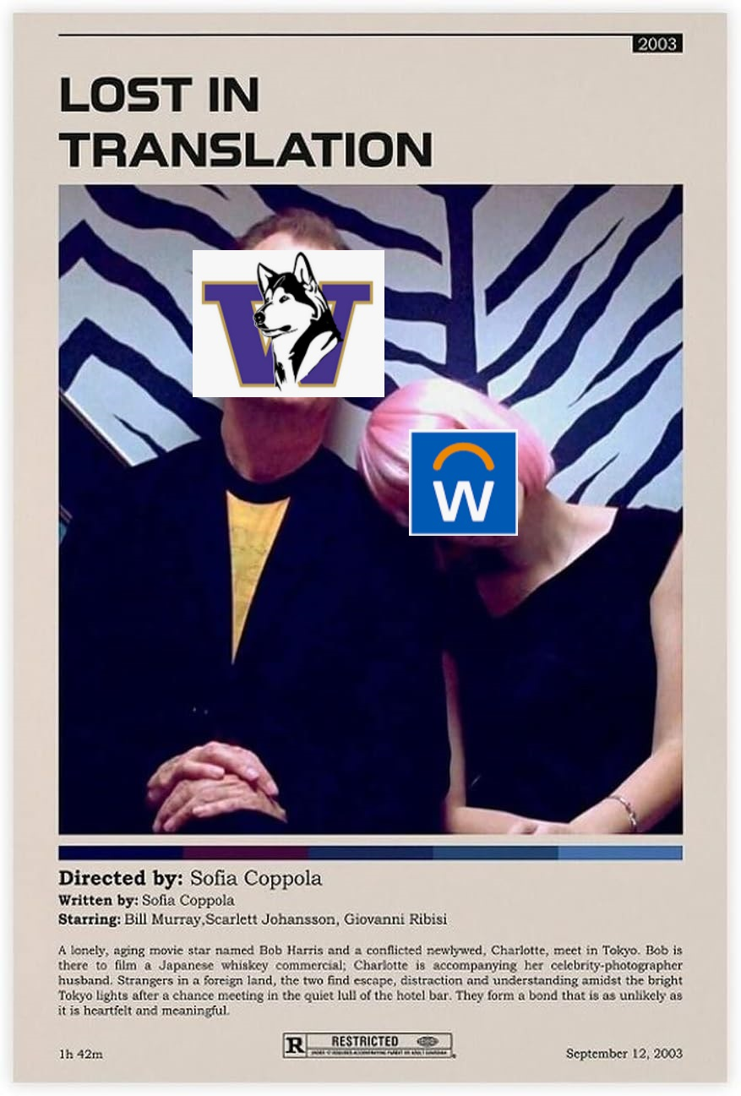
Lost in Translation
Not a 1:1 relationship between the old and new statuses
Expired – expenses/transfers can post! Only restriction is no new salary allocations.
Advanced Spend/Temporary Internal Extension – one or the other, not both.
RIP Status 2 – no equivalent in the new system
Closeout In Progress – nothing* can post. More restrictive than FAS status 3.

Slide 38
Return of the Flip
Award lines will resume automatically changing their lifecycle status after the Final Action Date has passed.
Auto-flip after FAD used to be the norm to allow time to process items and keep UW in compliance.
Loss of internal deadlines had a cost with respect to compliance with sponsor deadlines.
No current ETA, but we anticipate this change going into effect in the next few months. More details to come!

Slide 39
What About Now?
There is no current automatic closeout process.
Campus users can request status change to Closeout In Progress at any time – please submit an Award Portal ticket.
Campus users should keep in mind that CIP is more restrictive than legacy Status 3 and will block transfers and expenditures that previously would have gone through.

Slide 40
Any Questions?

Slide 41
How to contact GCA: Best practices
Susan Wilbanks

Slide 42
Three Options
Award Portal
Email: gcahelp@uw.edu
Phone: 206-616-9995

Slide 43
Award Portal
Use whenever you have an award number in place and want to send communication internal to UW
Do not cc: sponsors or other non-UW stakeholders. They will not be able to access the ticket.
Advantages:
Keeps communication associated with award and readily accessible throughout the life of the award and its retention period afterward.
All department and GCA staff working with the award can view tickets.

Slide 44
Award Portal Tips and Tricks
Do not open multiple tickets about the same issue. This can lead to confusion and duplicate work, especially when the tickets are under separate topics.
Only reopen a ticket if you have a question or new information on that specific issue. Otherwise, start a new ticket.
If you have a related issue on multiple GRs on the same award (e.g. closing or reopening award lines), please send a single ticket under the primary/“parent” award line.

Slide 45
Email
Use whenever you need to include non-UW stakeholders in communication.
Use for general questions, issues involving multiple awards, or when you don’t yet have an award number in place.

Slide 46
Phone
Primarily for urgent questions or issues where a response is needed more quickly than our typical 1-2 business day turnaround for email and Award Portal.

Slide 47
What NOT to do
Send emails to GCA employees’ personal UW addresses.
Contact GCA employees via Teams.
You may request (or we may initiate) a Zoom or Teams meeting to enable a group conversation and/or screen sharing, but the initial contact/scheduling should be via email or Award Portal.
Duplicate requests:
Don’t open a second Award Portal ticket on an ongoing issue. This will lead to confusion and duplicate work, especially if the tickets are under different topics. Instead, update the existing ticket.
Don’t email us on an issue already in Award Portal, or vice versa—this is even more likely to lead to duplicate work!
Exception: If you need to add a non-UW stakeholder to the conversation, it’s OK to move it from Award Portal to email, but please reference the AP ticket number and/or the GCA employee you’ve been communicating with.
On very rare occasions it’s OK to call us about an email or AP ticket if the issue requires immediate attention.

Slide 48
Any Questions?

Slide 49
Future Forum
May via Zoom
https://finance.uw.edu/gca/training-outreach/gca-forum
Survey about today’s forum will be sent out soon!

Slide 50
THANKS FOR ATTENDING

