Slide 1
SAGE and HR/P MODERNIZATION
MRAM
May 2017
Carey Acker, Project Manager
Office of Research Information Services

Slide 2
HR/PAYROLL MODERNIZATION PROGRAM
The HR/Payroll Modernization Program (HRPM) is a major UW initiative to standardize human resources and payroll processes with the implementation of Workday

Slide 3
SAGE HRPM PROJECT GOALS
Make it work!
Update SAGE to utilize new Workday data model and terminology
Make select targeted improvements in key areas
Collaborate closely with HRP-Integrations and HRPM Program staff

Slide 4
COORDINATED RELEASE TIMELINE
June 19
June 27
July 5
July 6
July 7 - 31
HEPPS freeze
Workday Go Live!
NIH Deadline!!
SAGE Go Live!
Stabilization & Support
SAGE personnel & pay data is static/stale

Slide 5
COMMUNICATIONS & TRAINING
User testing May
MRAM presentations May, June, July
Announcements & guidance via website, mailing lists
eLearning & SAGE budget class updates
SAGE system documentation updates

Slide 6
PRIMARY WORKDAY IMPACTS TO SAGE
Throughout SAGE
Person Lookup
eGC1
Approval graph generation based on personnel/jobs & their org codes
Additional reviewers selection
SAGE Budget
Personnel entry
Pay and Benefits

Slide 7
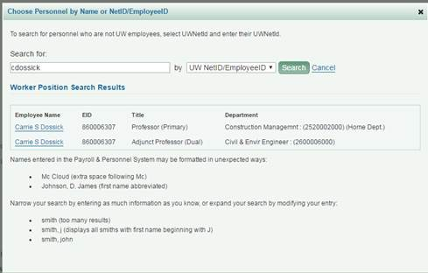
PERSON LOOKUP (throughout SAGE Suite)
Future State
Changes:
Updated data source
No more duplicates
Bonus!
Academic Appointment Type
Primary Department

Slide 8
eGC1- ADDITIONAL REVIEWERS
Bonus!
Compliance question: Additional Organizational Units (FG-9) will now be located on the renamed PI, Personnel, & Organizations page

Slide 9
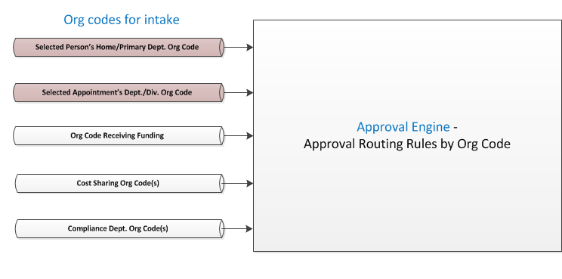
eGC1 - APPROVALS
Changes:
Updated data source with new data model

Slide 10
APPROVALS - Selected Job Org Code
(Primary Org)
(Sup Org)
Changes:
Primary position’s Org Code replaces Home Department Org Code
Primary Org will be part of Approval Graph automatically (current state)
If an academic appointment is selected, and has no related position, the Supervisory Org for the Academic Unit will be added to Approval Graph
Still working with HRPM Program and units where Sup Orgs don’t match current approval orgs

Slide 11
SAGE BUDGET
Changes:
New data source and data concepts
Object Codes less granular for 01, 07, and 08
Earn Types to Earning Codes (not a direct translation)
IBS Earnings Indicator - logic update
Salary Amounts - logic updates
Benefit Exemption Status cannot be identified for Professional staff, so users will be prompted to verify benefit exemptions
Adding TBD or non-Workday personnel
Highlighted today:
Changes:
Personnel source data
Convert/Update Salary
Bonus!
Apply salary and wages to multiple periods on the same screen

Slide 12
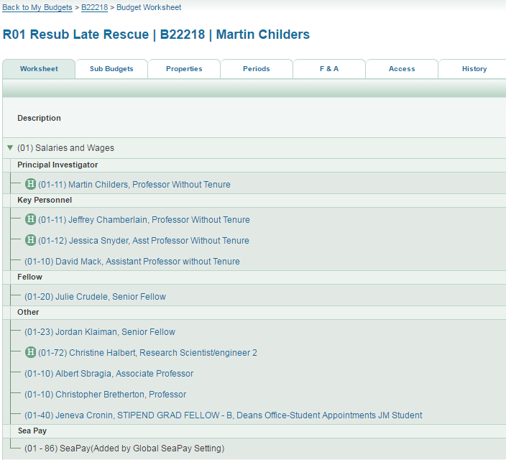
SAGE BUDGET - Personnel Source Data
Changes:
An ‘H’ will display for personnel added using HEPPS data, an indicator displays next to each record
Personnel added/converted using Workday data will not have an ‘H’ displayed

Slide 13
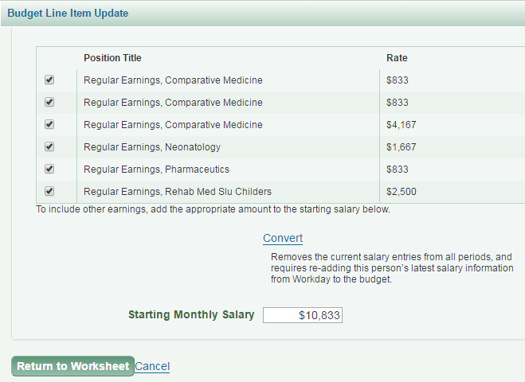
SAGE BUDGET - Convert/Update Salary
HEPPS record
Changes:
Opening HEPPS line items will give you the option to Convert Salary (convert/update salary using Workday data)
Opening Workday line items will give you the option to Update Salary (current state)
WORKDAY record

Slide 14
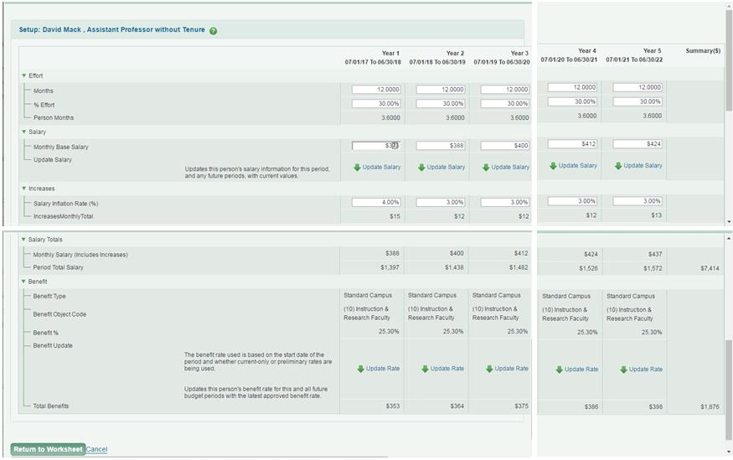
SAGE BUDGET - Apply Salary and Wages to Periods
Bonus!
Apply salary and wages to multiple periods in one place!
Update Salary for personnel records using Workday data (the Update Salary link will not display records with HEPPS data)

Slide 15
THANK YOU!
See you at next MRAM
Keep an eye out for additional communications and training

