Slide 1
 | MRAM Monthly Research Administration Meeting
 | JUNE 8, 2017 UW TOWER AUDITORIUM
 | TOPIC | PRESENTER | EMAIL | MIN
 | Welcome | Ted Mordhorst Research Compliance & Operations | tedm2@uw.edu | 2
 | Federal Demonstration Partnership Clearinghouse Website & Other Quick Notes from OSP | Amanda Snyder Office of Sponsored Programs | acs229@uw.edu | 10
 | SAGE Updates | Carey Acker Office of Research Information Services | ackerc1@uw.edu | 20
 | MAA Update | Michael Anthony Management Accounting & Analysis | mda1213@uw.edu | 20
 | Compliance Corner | Ted Mordhorst Research Compliance & Operations | tedm2@uw.edu | 10
JOIN US FOR OUR NEXT MEETING JULY 13, 2017 UW TOWER AUDITORIUM

Slide 2
Federal Demonstration Partnership (FDP) Website
MRAM
June 2017
Amanda Snyder
Office of Sponsored Programs

Slide 3
FDP Homepage & Web Resources
Fdpclearinghouse.org
Expanded Clearinghouse / Subrecipient Entity Monitoring
Help desk & Feedback : fdpechelp@gmail.com
MRAM - Amanda Snyder- Office of Sponsored Programs
Notes:
As previously reported at MRAM

Slide 4
Quick Updates
MRAM
June 2017
Amanda Snyder
Office of Sponsored Programs

Slide 5
Sponsor News & Updates:
NSF Move
Data center move: 6/30-7/04
Fastlane & Research.gov unavailable 6/30-7/04
Proposals, project reports and cash requests can’t be submitted
Previously saved info & uploaded docs, including in-process proposals and reports, accessible after Data Center move
Physical offices move: 8/24-10/01
Expect delayed response times from NSF
Some Program Officers recommending early submission not NSF wide
Pay attention to sponsor messages

Slide 6
Society of Research Administrators International (SRAI)
Pacific Northwest Chapter Meeting
July 21 in Puyallup WA
Program for basic to intermediate individuals in all aspects of research administration.
Check out their registration scholarships available - June 15 deadline
Contact Jeneil Lagassé (jeneil@uw.edu) for Seattle area carpooling
More information from SRAI re: registration, location, speakers, and schedule.

Slide 7
Sponsor News & Updates:
Grants.gov Workspace
Grants.gov Adobe/PDF forms are going away 12/31/17
Workspace replaces Adobe/PDF forms as a submission option
Stay tuned we’ll provide more info soon

Slide 8
Resources
FDP Website http://sites.nationalacademies.org/PGA/fdp/PGA_055835
NSF Move: https://www.nsf.gov/pubs/issuances/in139.jsp?WT.mc_id=USNSF_109
Grants.gov PFD forms going away: https://blog.grants.gov/2017/03/29/its-going-away-the-legacy-pdf-application-package-will-be-retired/
Grants.gov Workspace resources
Overview: https://www.grants.gov/web/grants/applicants/workspace-overview.html
Workspace User Guide: https://www.grants.gov/help/html/help/index.htm?callingApp=custom#t=Get_Started%2FGet_Started.htm
SRAI PNW Meeting 7/21: http://srainternational.org/meeting/chapter/2017-pacific-northwest-chapter-meeting

Slide 9
SAGE Updates:
Grant Runner plus
SAGE & HR/Payroll Modernization
MRAM
June 2017
Amanda Snyder, Associate Director, Office of Sponsored Programs
Carey Acker, Project Manager, Office of Research Information Services

Slide 10
SAGE Grant Runner Update
What is Grant Runner again?
Allows NIH proposals to be completed and submitted directly from SAGE
Sponsor forms are pre-populated with institutional and eGC1 data, saving time and improving accuracy
Available for select NIH opportunities at this time

Slide 11
2017-18 Grant Runner Goals
Expand to cover more NIH Opportunity Types
Career Development
Fellowships
Training Grants
Update to Forms-E
More pre-population of forms
Deliver high value features (we hear you!)

Slide 12
New Features Just Released - June 6!!
Single PDF
Print or Download all sponsor forms and attachments in a single PDF
Expanded Validations
All NIH validations are now covered in “Check for Errors”

Slide 13
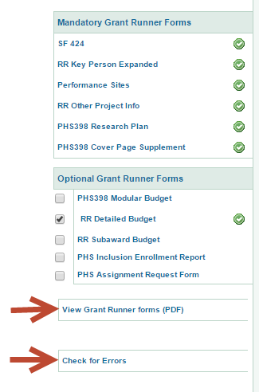
Both Features Accessed from Left Navigation
Check for Errors also available on Certify and Route Page

Slide 14
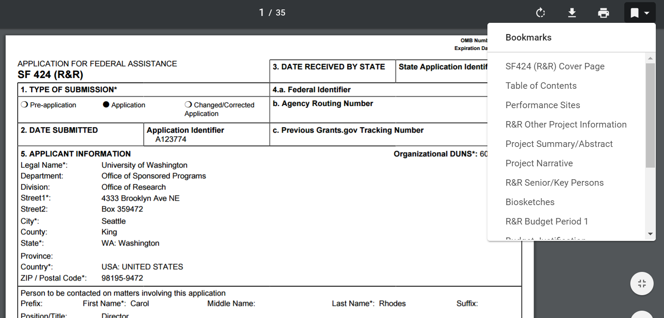
Single PDF Features
Same format that NIH reviewers will see
“Bookmarks” take you quickly to a section
Easy print or download
Notes:
Also generates table of contents, helpful headers and footers

Slide 15
Expanded Validations Highlights
eGC1, Grants.Gov and NIH error checks all included
Allows pro-active application validation (check for errors early and often!)
Errors must be cleared before “completion” of eGC1
NIH Warnings also shown, but won’t prevent eGC1 completion or submission

Slide 16
More coming soon….
Next Release (Summer) :
Forms-E changes
Inclusion of Career Development opportunities
If you haven’t used Grant Runner recently, give it a try and share your feedback!
sagehelp@uw.edu

Slide 17
SAGE Integration with Workday
Timeline Reminder
June 19
June 27
July 5
July 6
July 7 - 31
HEPPS freeze
Workday Go Live!
NIH Deadline!!
SAGE Go Live!
Stabilization & Support
SAGE personnel & pay data is static/stale

Slide 18
Primary Workday Impacts to SAGE
Personnel Chooser
Approval Graph
SAGE Budget

Slide 19
SAGE Personnel Chooser
Enhancement: Search by Employee Identification (EID) number.
Future: In the Personnel Chooser, notice the following results changes:

Slide 20
SAGE Approval Graph
Enhancement: Add organizations via the PI, Personnel, and Organizations page.
Future: Approval Graph may have different results from what had previously displayed. We are still working with HRPM Program and Schools/ Colleges where Supervisory Org Codes don’t match current approval Org Codes.

Slide 21
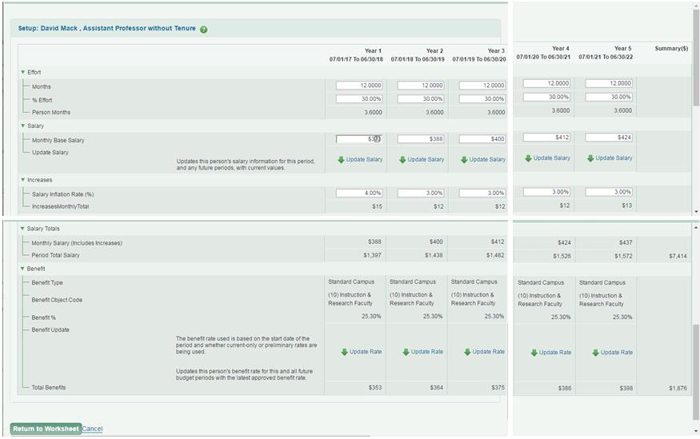
SAGE Budget
Enhancement: Enter data for a given line item across all Budget periods on a single page.

Slide 22
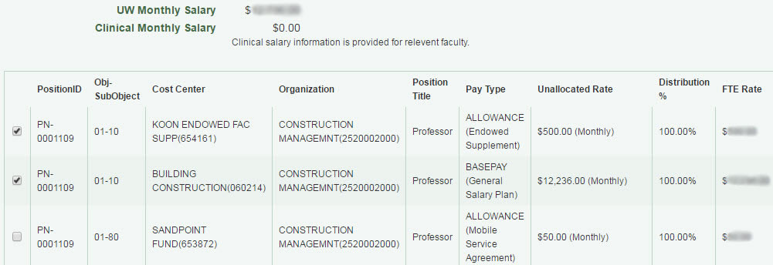
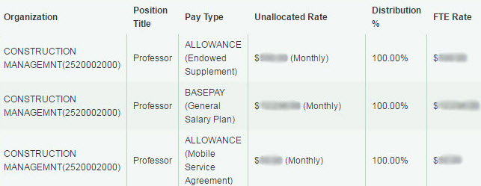
SAGE Budget
Future: Salary information displays differently.
Before:

Slide 23
User Testing & Feedback
Focus group
RAPIT
User testing
SAGE Budget
Approvals

Slide 24
Communications
MRAM presentations:
May, June, July
Research Website:
Announcements, email lists

Slide 25
SAGE Training
eLearning Videos
Workday & SAGE: Changes to Person Chooser
Workday & SAGE: Changes to the Approval Graph
Workday & SAGE: SAGE Budget
Job Aid
Modifying the SAGE Approval Graph
Updates to SAGE Budget class
Next class: September 26

Slide 26
Additional Resources
SAGE system documentation updates
SAGE Help Desk
206.685.8335
oris@uw.edu

Slide 27
Questions?

Slide 28
Management Accounting & Analysis & EIO Updates
MRAM - June 8, 2017
Michael Anthony
MAA/EIO
University of Washington

Slide 29
Reduced Responsibility Faculty
Presently have 13 faculty on RRD; 105 on WOS (Distribution Stop Date => 6/30/2017, Status = Active)
Concern many have not been changed from WOS to RRD
Reminder, faculty need to go on RRD status whenever they lose grant funding and department cannot bridge the loss, and
They intend to seek additional grant funding to enable them to restore their salary to the previous level
Does not affect the faculty member’s appointment status
Changes will occur with the transition to Workday (WOS will not come over from HEPPS to Workday; RRD handled differently
University of Washington Management Accounting & Analysis
Notes:
Net ID – MAA compares the Net ID of the person whose name appears on the FEC with the Net ID of the person certifying the FEC

Slide 30
Workday Impact on WOS – RRD Faculty
Currently - HEPPS identifies Reduced Responsibility faculty through earn type RRD and a distribution line with end date
In Workday -
Reduced Responsibility will be identified via a Job Change –reduction of paid FTE in Workday (with reason code)
As it is a reduction in FTE it does not have an end date
Reports can be run in Workday to identify RRD faculty based on the reason code (critical we have consistent language to do this)
Units will need to track end dates
If RRD faculty still reflected as WOS units need to make the change immediately
University of Washington Management Accounting & Analysis

Slide 31
Salary Cap (Reminder)
For academic schools/colleges eFECS will still use the average of the 2016 and 2017 EL II thresholds.
If department changed distribution effective 1/1/2017 to new salary cap then no cost share adjustments needed
If department did not change distribution to reflect the new salary cap then should check to see if cost share adjustments needed
University of Washington Management Accounting & Analysis
Notes:
Over the salary cap amount does not represent additional effort.

Slide 32
Salary Cap (Reminder)
If department did not change distribution check for materiality
Scenarios for individual with salary of $225,000 and 25% effort to grant:
Active full FEC cycle – Variance is $118.75 ($23.75 / 5% effort)
Active only fall cycle – Variance is $59.68 ($11.88 / 5% effort)
Active only winter cycle – Same as Fall cycle
Change in percent distribution will impact these numbers but change in IBS will not
University of Washington Management Accounting & Analysis
Notes:
Over the salary cap amount does not represent additional effort.

Slide 33
GCCRs & Workday (Reminder)
Issue with the cutover to Workday from HEPPS due to implementation date (June 16, 2017)
April 1 to June 30 GCCRs will only reflect 11 weeks
July 1 to September 30 GCCRs will reflect 13 weeks
Alternative was to have two reports for the April 1 to June 30 time period.
University of Washington Management Accounting & Analysis
Notes:
Over the salary cap amount does not represent additional effort.

Slide 34
Recharge Rates Update
New guidelines document will be posted to MAA website shortly (going through final edits)
Changes mostly clarifications plus 2 year cycle accommodation
MAA will be providing a number of informational updates
University of Washington Management Accounting & Analysis

Slide 35
EIO Update
Retagging project status update
3,000 remaining items (over & under $5,000) that need to be located from original project
Retag new equipment acquisitions received after October 2016 (email went out 5/31/2017 with a report of the items)
Email also went out regarding equipment located out of the area (County/State/Country)
HCA’s engagement has ended (EIO will conclude the project). Send response to Erin Fujiwara not HCA.
University of Washington Management Accounting & Analysis
Notes:
Thanks to everyone who has responded

Slide 36
EIO Update (cont’d.)
Retagging project status update (cont’d.)
Under $5,000 verification only – Provide photo verification of white (old) UW tag on the asset or serial number, plus current location (building /room). If asset is mobile, provide room number of the staff that utilizes the asset.
Over $5,000 to be retagged - Affix new UW tag (dark purple and white) next to the old UW tag (white) and provide photo verification of both UW tags on the asset or the new UW tag and serial number, as well as the current location of the asset. If the asset is mobile, same as above
University of Washington Management Accounting & Analysis

Slide 37
Compliance Corner
MRAM
June, 2017
Ted Mordhorst
Research Accounting and Analysis

Slide 38
Recent Happenings in the World of AUDIT
NSF
$214,177 in equipment, materials, and supplies expenses unreasonably purchased near award expiration
$54,472 in unreasonable travel
$8,744 in unreasonable participant support expenditures
$1,230 in unallocable visa immigration fees
MRAM - Presenter - Department

Slide 39
Recent Happenings in the World of AUDIT
NSF
$214,177 in equipment, materials, and supplies expenses
Proposed amount was reduced and revised budget removed the equipment line item.
In first year, more was spent on equipment than was originally included in the proposal.
Purchase was deemed unreasonable and not prudent.
7 computers purchased on various awards near award end.
Numerous material & supply purchases near or after award end.
Reoccurring finding in many audits
MRAM - Presenter - Department

Slide 40
Recent Happenings in the World of AUDIT
$54,472 in unreasonable travel
The 7 foreign travel trips were not reasonable or prudent for the administration of the award:
The travel expenses were charged to the NSF award two years after the travel occurred.
The award was on its second no-cost extension when the travel was approved by the recipient.
No travel was requested in the NSF award budget, but 14 percent of the award budget was expended on travel.
The funds spent on travel were originally budgeted to fund graduate student researchers.
The travel was not mentioned in the annual reports or the final report.
There was a lack of a clear benefit and necessity to the award for any of these trips.
MRAM - Presenter - Department

Slide 41
Recent Happenings in the World of AUDIT
$8,744 in participant support costs
Employee travel costs – employees are not considered participants
Rebudgeted Participant Support costs for social media and marketing costs without prior approval.
MRAM - Presenter - Department

Slide 42
Recent Happenings in the World of AUDIT
$1,230 in unallocable visa immigration fees.
Visa fees are allowable but must be allocated to benefitting activities.
In the first year after hire, the employee only worked 35 % percent on the NSF award, but 100 percent of the visa fees were charged to the award.
MRAM - Presenter - Department

Slide 43
NSF Draft PAPPG for 2018
Not many significant changes
https://nsf.gov/bfa/dias/policy/papp/pappg18_1/draftpappg_may2017.pdf
Roles and Responsibilities for the Division of Grants and Agreements (DGA) updated
Grants & Agreements Officers (Grants Officers) roles and responsibilities updated.
MRAM - Presenter - Department

Slide 44
NSF Draft PAPPG for 2018
Several changes to pre-award to add clarity but not change the requirements.
Some provisions are being moved to more logical locations in the PAPPG but the content is not changing.
Chapter X: Allowability of Costs, Section 3. Prior Written Approvals. Incorporates the RTC
MRAM - Presenter - Department

Slide 45
NSF Draft PAPPG for 2018
Direct Costs
Where language was a repeat of the Uniform Guidance it is being deleted.
Admin/Clerical salaries
Facilities rental or lease
Relocation costs
Etc.
New NSF Address:
NSF Cost Analysis and Pre-Award Review Branch, 2415 Eisenhower Avenue, Alexandria, Virginia 22314.
MRAM - Presenter - Department

Slide 46
NSF Draft PAPPG for 2018
Most extensive change:
Chapter XI: Other Post Award Requirements and Considerations
Incorporating:
Non-Discrimination Statutes and Regulations
Title VI of the Civil Rights Act of 1964
Section 504 of the Rehabilitation Act of 1973
Title IX of the Education Amendments of 1972
Age Discrimination Act of 1975
Equal Employment Opportunity under E.O. 11246
Limited English Proficiency under E.O. 13166
MRAM - Presenter - Department

Slide 47
NSF Draft PAPPG for 2018
Protection of Living Organisms
Human Subjects
Vertebrate Animals
Language has been added to reflect the new award specific condition on organizational responsibilities.
New language has been added regarding post award responsibilities.
MRAM - Presenter - Department

Slide 48
UPCOMING COURSES IN
RESEARCH ADMINISTRATION
 | June 15 | GCA 203 | Preparing for an Audit
 | Aug 1 | OSP 175 | Introduction to Export Compliance at the UW
 | Aug 2 | MAA 100 | Introduction to Grant and Contract Certification (GCCR)
 | Aug 16 | MAA 101 | Introduction to Faculty Effort Certification
 | Aug 30 | MAA 102 | Electronic Faculty Effort Certification (eFECS) for FEC Coordinators
 | Sep 13 | MAA 205 | Modifying an FEC Using Comments and Adjusting Cost Sharing
 | Sep 14 | OSP 101 | Introduction to Research Administration
 | ONLINE | GCA 201 | Salary and Cost Transfers Online Class
 | ONLINE | RAA 201 | Post Award Food Purchases and Compliance
 | ONLINE | GCA 202 | Direct Billing of F&A Type Costs Online Class
 | ONLINE | RAA 202 | Timing of Expenditures & Benefit to Award
To see a full list of courses and to register, visit: https://uwresearch.gosignmeup.com/public/course/browse
For information on CORE, visit our homepage:
https://www.washington.edu/research/learning/

