Slide 1
SAGE Updates:
SAGE & HR/Payroll Modernization
MRAM
July 2017
Carey Acker, Project Manager, Office of Research Information Services

Slide 2
SAGE HR/P Release Complete 7/6/2017!
SAGE is now using Workday employee, job, and salary data
Key enhancements to make using SAGE easier
Complete details on all release items can be viewed in the July 6, 2017 SAGE Release Notes.

Slide 3
Primary Workday Impacts to SAGE
Personnel Chooser
Approval Graph
SAGE Budget

Slide 4
SAGE Personnel Chooser - Workday Change
“Title (Academic Appointment Type)” replaces Job Class Title
"Primary Position” replaces Home Department

Slide 5
SAGE Personnel Chooser - Enhancement
Primary organizational unit and the selected organizational unit display
No duplicate rows - linked Positions and Academic Appointments are displayed in one row, with more descriptive Academic Appointment Title
Search by Employee ID

Slide 6
SAGE Approval Graph - Workday Change
With the transitions to Positions, Academic Appointments and Primary Organizations, you may see differences in how this information is displayed in the approval graph

Slide 7
SAGE Approval Graph - Enhancement
Can add additional organizations to the approval graph from the “PI, Personnel, & Organizations” page (former compliance question FG-9)
The “View Approval Graph” link will now show on two eGC1 pages -- on “Certify and Route” (as always) and also on “PI, Personnel, & Organizations”

Slide 8
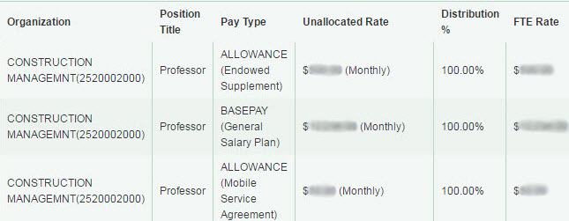
SAGE Budget - Workday Change
Salary information displays in an easy-to-read table format with more detail and new Workday terminology and data
Object Codes are less granular and will display only one digit of the sub-object code (Example: ‘07-06’ is now ‘07-00’, ‘08-02’ is now ‘08-00’)

Slide 9
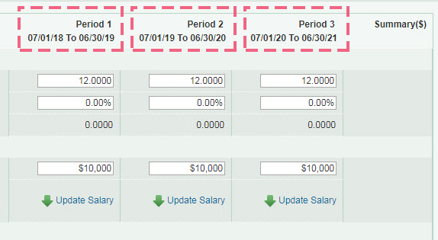
SAGE Budget - Enhancement
Line items can be entered across all Budget periods on a single page
Salary and wages data from HEPPS displays an “H” icon. When editing any of these lines, you can select “Convert Salary” to replace the HEPPS data with the person’s latest salary data from Workday.

Slide 10
Resources
[Video] Workday & SAGE: Changes to Person Chooser
[Video] Workday & SAGE: Changes to the Approval Graph
[Job Aid] Workday & SAGE: SAGE Budget
[Job Aid] Workday & SAGE: Approval Graph Troubleshooting
Go to sage.washington.edu and select “videos” or “job aids” in the right-hand menu

Slide 11
SAGE Training
Updates to SAGE Budget class
Next class: September 26

Slide 12
Additional Resources
SAGE system documentation updates
SAGE Help Desk
206.685.8335
oris@uw.edu

Slide 13
Thank You!
ORIS HR/P project team
ORIS Communications and Training team
UW Workday team
HRP-I team
Campus partners including OSP, GCA, MAA, SoM
Campus members:
Focus group participants
RAPIT
User session participants
SAGE Budget
Approvals

Slide 14
Questions?

