Slide 1
 | MRAM Monthly Research Administration Meeting
 | AUGUST 10, 2017 UW TOWER AUDITORIUM
 | TOPIC | PRESENTER | EMAIL | MIN
 | Welcome | Ted Mordhorst Research Compliance & Operations | tedm2@uw.edu | 02
 | OAW Review of Progress Reports (Non-Competing Renewals) | Michelle Brot and Grant Lyon Office of Animal Welfare | mbrot@uw.edu glyon@uw.edu | 10
 | SAGE Updates | Judy Chung Office of Research Information Services | jachung@uw.edu | 10
 | Zipline | Karen Moe Director & Assist Vice Provost for Research, VPR: ORC: AVP RAI | kemoe@uw.edu | 15
 | Compliance Corner | Ted Mordhorst Research Compliance & Operations | tedm2@uw.edu | 10
JOIN US FOR OUR NEXT MEETING SEPTEMBER 7, 2017 UW TOWER AUDITORIUM

Slide 2


Office of Animal Welfare
OAW Review of Progress Reports (Non-Competing Renewals)
MRAM
August 2017
Michelle Brot, Scientific Reviewer (mbrot@uw.edu)
Grant Lyon, Program Operations Analyst (glyon@uw.edu)
Office of Animal Welfare

Slide 3
OAW Proposal
OAW has eliminated the review of:
Non-competing renewals
Non-competing supplements
Non-competing revisions
Note: OSP will still be confirming that there is IACUC approval for the work, so please attach a copy of the parent award grant/protocol congruence letter to all subsequent non-competing eGC1s.
Notes:
These are not a regulatory requirement and adds administrative burden on our investigators and on the institution. This review was originally put in place to provide additional oversight, but we believe there are better mechanisms for ensuring compliance and we can better serve the researchers putting this time saved to a different use, such as review of submissions.

Slide 4
Review Statistics
OAW review statistics from January 2015 – April 2017
Grants reviewed | Protocol Change Required
Jan 2015-April 2017
Grant type | Full protocol (new or renewal) | Amendment initiated by PI | Amendment initiated by OAW | none | Total | ~ proportion of total hours spent by OAW on congruence review
Eliminated congruence review of:
Non-Competing Renewal | 3 | 5 | 7 | 629 | 644 | 38 %
Non-Competing Supplement |  | 1 | 1 | 39 | 41 | 1 %
Non-Competing Revision |  |  |  | 9 | 9 | <1%
propose to continue congruence review
New Grants * | 32 | 78 | 55 | 225 | 390 | 38%
Resubmission * | 9 | 26 | 15 | 53 | 103 | 12%
Supplement and Extension |  | 6 | 4 | 52 | 62 | 4%
Competing Renewal * | 1 | 7 | 2 | 24 | 34 | 4%
Competing Supplement | 1 | 1 | 1 | 9 | 12 | 1%
Transfer from Another Institution | 5 | 1 | 1 | 5 | 12 | 2%
Other | 1 | 3 |  | 7 | 11 | 1%
Competing Revision |  |  | 1 | 3 | 4 | <1%
Pre-Application |  | 1 |  | 1 | 2 | <1%
Grand Total | 52 | 129 | 87 | 1056 | 1324 | 100%
Notes:
As you can see, we spent ~40% of our grant review time on non-competing renewals, and only 17 of them ever had any sort of issue (within the protocol(s), and 9 of those were being addressed by the PI without OAW’s involvement). This equates to between 1-2% of non-competing grants that did have issues, and we think that we can resolve these

Slide 5
OAW Review going forward
OAW will continue to:
Review all new grants (new, resubmissions, competing renewals, transfers, etc.)
Issue our standard grant/protocol congruence letter.
  If you need a grant/protocol congruence letter for an item that OAW no longer reviews, add ‘Animal Subjects’ as a watcher to the eGC1 and note that a letter is required.
Notes:
Instead of reviewing non-competing grants, as long as the original approval letter is still valid (that is, the protocol(s) cited are still within their approval range), they can be used for subsequent non-competing submissions.

Slide 6
Questions?
If you have any questions or concerns, please do not hesitate to reach out to us, and/or our Director, Sally Thompson-Iritani.
Michelle Brot mbrot@uw.edu
Grant Lyon glyon@uw.edu
Sally Thompson-Iritani sti2@uw.edu

Slide 7
Animal Use Verification
& eGC1
MRAM
August 2017
Carol Rhodes, Director
Office of Sponsored Programs

Slide 8
eGC1 Types
OAW not automatically added as Approver
Competing: Pre-app, New, Competing Renewal, Competing Supplement, Resubmission
As of August 2017
  Noncompeting Renewal: Research Performance Progress Reports (RPPRS), progress report requiring SO sign-off or submission
  Noncompeting Supplement: Additional funding being requested or awarded for ongoing project e.g. administrative supplement
  Noncompeting Revision

Slide 9
When Animal Use Answered Yes
OAW Automatically added as Approver
To these eGC1 Types
Transfer to UW
After-the-Fact Award (no proposal stage)
Supplement/extension

Slide 10
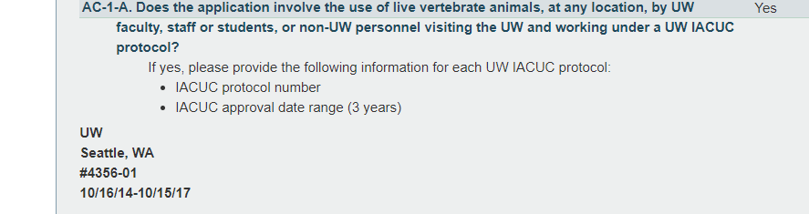
When OAW is Approver
OSP relies on approval & protocol in eGC1.

Slide 11
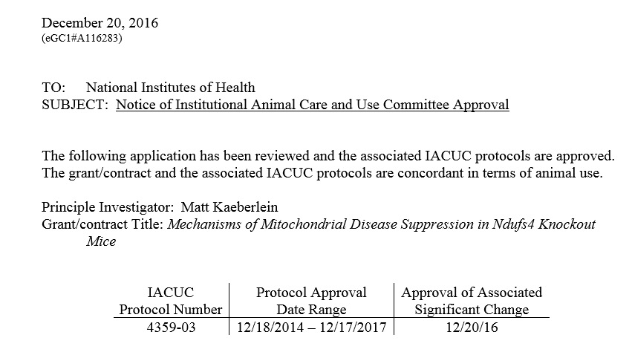
When OAW is NOT Approver
OSP Verification of Animal Protocol Approval
OSP needs congruence letter issued for the project.

Slide 12
Funding & HOLDS
Whenever animal use research will be carried out, an approved protocol must be in place for the work.
OSP will not release funding until verified.
Funding HOLD examples:
Protocol approval date expired on congruence letter
No IACUC approval on record
In all cases, if animal use scope of work changes, it is the PI’s responsibility to provide updated information/materials to OAW.

Slide 13
Related Future Changes...
Updates to GIM 27: Animal Use policy
eGC1:
IACUC approval details pulled into eGC1 from Hoverboard
At JIT or later, campus users will be able to update an eGC1 with current version of compliance information after OSP approval

Slide 14
SAGE Updates: Grant Runner
MRAM
August 2017
Judy Chung, Program Manager
Office of Research Information Services

Slide 15
2017-18 Grant Runner Expansion Project
Mission:
Expand SAGE Grant Runner capabilities to allow more federal opportunities to be supported, saving researcher teams time and effort through:
Reduced duplicate entry
Fewer systems to interact with
Reduced training and support requirements for non-UW Systems

Slide 16
Approach
Deliver more value more frequently (every 2-3 months)
Target NIH forms expansion (first)
Add key features requested to create a more streamlined experience
Expand to more sponsors (future)

Slide 17
What’s New!!
Career Development (K) grants
More NIH required fields on form entry
Reminder: We now show ALL NIH errors and warnings through the “check for errors” feature

Slide 18
Career Development (K) Support
Temporary Issue:
Grant Runner does not yet support applications where the UW PI differs from the application PI.
Temporary Work-around:
Use another submission method OR
  Wait for mid-September SAGE update when that capability will be supported

Slide 19
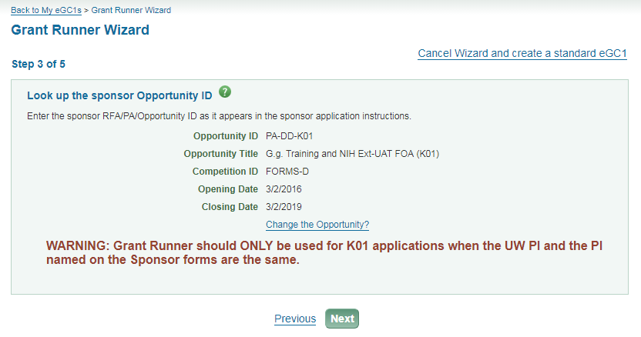
Career Development (K) Support
Temporary Message: (Only until mid-September)

Slide 20
More coming soon….
September Release:
Allow application PI to differ from UW PI (K apps)
Related approval graph changes
October Release:
New Human Subjects and Clinical Trials form
All Forms-E changes available
Fellowship grants
sagehelp@uw.edu

Slide 21
Conclusion
If you haven’t used Grant Runner yet, or for awhile
GIVE IT A TRY
THEN GIVE US FEEDBACK!
sagehelp@uw.edu

Slide 22
Zipline
MRAM
August 2017
Karen Moe, Director
Human Subjects Division

Slide 23

Update
What’s happened, what’s next
The numbers
User experience

Slide 24

Zipline timeline
Date | Event
May 31, 2016 | Implementation for 20% of depts
Aug 12, 2016 | Change 1: Remove dept sign-off
Nov 1, 2016 | Implementation complete: all depts
Jan 6, 2017 | Change 2 Large number of small changes Length of approval period
April 14, 2017 | Change 3 Big policy change re conversions Shared Regulatory Documents
June 23, 2017 | Change 4: FDA question
June 2017 | Status Reports start arriving

Slide 25


Slide 26
Zipline timeline
Date | Event
Jan 2018 | Change 4: External IRB: A major change
May 2018 | Software upgrades Visual appearance (font, colors) External IRB Revised Common Rule?
Oct 2018 | Change 5 ?
2018 | Integration with SAGE

Slide 27

The numbers
Application Type | Approx # submitted
Initial applications | 2300
Modifications | 600
Status Reports | 100
WIRB, CC-IRB | 220

Slide 28
The numbers
Initial Applications | Average turnaround time Calendar days On your desk & ours
Full committee | 49 days
Minimal risk | 24 days
Exempt | 6 days

Slide 29



Slide 30
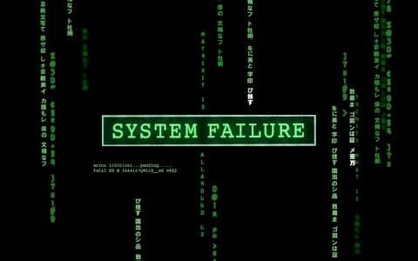
System crashes: none (to date)

Slide 31


Software bugs
Several minor bugs
The big one:
Status Report Reminders

Slide 32

Conversions
Revised policy helped (fewer conversions)
The struggle continues, but the end is near

Slide 33
What happens to your existing application when we make a change to Zipline?
We do our best to supply the missing data.
But occasionally….
When you create a Modification or Status Report, Zipline will ask you to answer any new questions that have been added.

Slide 34
What are we hearing from you and the rest of campus?
Phone calls
Hsdinfo@uw.edu
TAP survey
Lots of very specific questions
Mostly positive
A few very negative

Slide 35
TAP Survey Comment
“So zipline was a pain…but I’m extremely thankful now for it. I use to think the IRB was a huge headache…but in the past 2 years I feel they have improved immensely, especially with explaining and defining things…they are always picking up the phone and/or emailing me responses timely.”

Slide 36

The top 3 questions
Why is my application still in Pre-Submission even though I clicked on the FINISH button?
Why can’t I find my PI’s name on the drop-down list?
How do I add the name of my funder?

Slide 37

We are listening
hsdinfo@uw.edu

Slide 38
Compliance Corner
MRAM
August 2017
Ted Mordhorst, Director
Research Accounting and Analysis

Slide 39
Visa Costs
Uniform Guidance (2 CFR 200.463)
  Found under “Recruitment Costs”
  Short-term, travel visa costs are generally allowable when:
    critical and necessary for the conduct of the project;
    allowable under the applicable cost principles;
    consistent with the non-Federal entity's cost accounting practices and non-Federal entity policy; and
    Meet the definition of “direct cost” as described in the applicable cost principles.
August MRAM – Ted Mordhorst – Research Accounting and Analysis

Slide 40
Visa Costs
Uniform Guidance (2 CFR 200.463)
  Short-term, travel visa costs are generally issued for a specific period and purpose,
  Costs need to be allocated to all sources of funding for the individuals’ salary thru the life of the Visa
August MRAM – Ted Mordhorst – Research Accounting and Analysis

Slide 41
Visa Costs
NIH GPS
  Allowable direct cost as part of recruiting costs for the individual being hired.
  Also allowable when identified in specific FOAs
  or when within the scope of an approved research project.
  If the person is already an employee and the cost in question is a visa renewal then this isn't a recruiting cost so the cost would not be an allowable charge to a grant
August MRAM – Ted Mordhorst – Research Accounting and Analysis

Slide 42
Visa Costs
NIH GPS
  Various VISA related fees when the cost of the visa is determined to be allowable:
    Expedited processing fees are generally unallowable
    Fraud prevention and detection fees are allowable if required
    Department of Homeland Security SEVIS Form I-901 is a required fee and is allowable.
    It should be noted that some countries that normally do not require visas for tourists do require special visas for scientists and engineers engaged in research or studies.
August MRAM – Ted Mordhorst – Research Accounting and Analysis

Slide 43
NRSA Fellowships and Traineeships
Support
  Fellows and Trainees are provided a STIPEND.
  The Stipend is an allowance to cover living costs while the individual is engaged in independent study and/or research
  The stipend is not “Compensation” for work as an employee with the institution or the NIH.
  The STIPEND is intended to allow the individual to devote full time effort to their study or research training project
August MRAM – Ted Mordhorst – Research Accounting and Analysis

Slide 44
NRSA Fellowships and Traineeships
Additional Support
  Two forms of additional support
    Stipend supplementation (Full Time Training/ 40 hrs. per week)
      from non-federal funds
      No additional duties
    Compensation
      Part time employment not related to training prog.
        25% FTE (or in other words)
        10 hrs. per week
      Paid from federal or non-federal sources
August MRAM – Ted Mordhorst – Research Accounting and Analysis

Slide 45
NIH Career Awards = “K” awards
Salary Supplementation on NIH & AHRQ “K” awards:
For effort directly committed to the "K" award
Must be from non-Federal sources
Must not require extra duties or responsibilities
May not interfere with the goals of the "K" award
Additional compensation:
For effort not directly committed to the "K" award
For effort on Federal or non-Federal sources
Aims differ from those of the "K" award.
August MRAM – Ted Mordhorst – Research Accounting and Analysis

Slide 46
Responding to requests for Single Audit
OSP has established an email where you can forward requests from prime sponsors for our Single Audit
A133out@uw.edu
Please forward any requests for our single Audit = A133 audit to this email.
August MRAM – Ted Mordhorst – Research Accounting and Analysis

Slide 47

Financial Fraud and Ethics Hot Line
Report a Violation
A 24-hour, anonymous resource for reporting violations of financial fraud, theft, embezzlement, ethics and waste of university resources.
http://fa.uw.edu/audit/financial-fraud-and-ethics-violation-reporting-process

Slide 48
NCURA Region VI
Congratulations to Amanda Snyder elected as the National Council of University Research Administrators (NCURA) Region VI Chair-elect position!
https://orso.or.wsu.edu/r6ncura/default.aspx
Serve 1 year as Chair-Elect beginning Jan 1
Serve the next year as the Chair for the Region

Slide 49



UPCOMING COURSES IN
RESEARCH ADMINISTRATION
 | Aug 16 | MAA 101 | Introduction to Faculty Effort Certification
 | Aug 30 | MAA 102 | Electronic Faculty Effort Certification (eFECS) for FEC Coordinators
 | Sep 13 | MAA 205 | Modifying an FEC Using Comments and Adjusting Cost Sharing
 | Sep 14 | OSP 101 | Introduction to Research Administration
 | Sep 19 | ORIS 101 | SAGE: Creating and Submitting eGC1s Workday in SAGE Updates
 | Sep 26 | ORIS 103 | SAGE Budget Workday in SAGE Updates
 | Sep 27 | MAA 210 | Modifying an FEC, Change Outside eFECS and Recertifications
 | Oct 3 | ORIS 102 | SAGE: Creating NIH Proposals in Grant Runner
 | COMING SOON |  | Significant updates to SAGE Grant Runner. November class TBA.
Register: https://uwresearch.gosignmeup.com/public/course/browse
About CORE :
https://www.washington.edu/research/training/about-core/

Slide 50
ON DEMAND
LEARNING RESOURCES
 | COMING SOON | RAA 203 | Basic Concepts in Internal Controls for Purchasing
 | Online Class | GCA 201 | Salary and Cost Transfers
 | Online Class | RAA 201 | Post Award Food Purchases and Compliance
 | Online Class | GCA 202 | Direct Billing of F&A Type Costs Online Class
 | Online Class | RAA 202 | Timing of Expenditures & Benefit to Award
 | SAGE/Workday Resources Includes Workday in SAGE updates |  | SAGE Online Learning
 |  |  | SAGE help documentation Learning
Register: https://uwresearch.gosignmeup.com/public/course/browse
About CORE :
https://www.washington.edu/research/training/about-core/

