Slide 1
 | MRAM Monthly Research Administration Meeting
 | SEPTEMBER 7, 2017 UW TOWER AUDITORIUM
 | TOPIC | PRESENTER | EMAIL | MIN
 | Welcome | Ted Mordhorst Research Compliance & Operations | tedm2@uw.edu | 02
 | SAGE Updates | Judy Chung & Carol Rhodes Office of Research Information Services & Office of Sponsored Programs | jachung@uw.edu carhodes@uw.edu | 15
 | NIH Interim RPPRs | Carol Rhodes Office of Sponsored Programs | carhodes@uw.edu | 5
 | NIH Just-in-Time (JIT) Notifications | Carol Rhodes Office of Sponsored Programs | carhodes@uw.edu | 5
 | FOIA Requests | Joe Giffels & Carol Rhodes Office of Research | carhodes@uw.edu | 5-10
 | Budget Extension Request Updates | Kendra Hayward Office of Sponsored Programs | khayward@uw.edu | 10
 | Export Controls | Mark Stomski Export Control Office | stomski@uw.edu | 20
 | Compliance Corner | Andra Sawyer Post Award Financial Compliance | andra2@uw.edu | 5
JOIN US FOR OUR NEXT MEETING | OCTOBER 19, 2017 | UW TOWER AUDITORIUM

Slide 2
SAGE Updates: PI Handling
Release Date: September 12
Judy Chung & Carol Rhodes
Office of Research Information Services &
Office of Sponsored Programs
September MRAM

Slide 3
Multiple PI Designation
The NIH adopted a multiple-PD/PI model in 2006.
Encourages interdisciplinary and other team approaches to biomedical research. All PD/PIs share responsibility and authority for leading and directing the project.
Typically, the PI listed on the eGC1 is the contact PD/PI, responsible for communication between the sponsor and the rest of leadership team.
Use “Multiple PI” designation from selection on eGC1 PI & Personnel page.

Slide 4
SAGE Changes: Multiple PI
Key Changes:
UW “Multiple PIs” will be automatically added to the approval graph
Will receive same approval notification email that the PI receives
Will see “Assurance Statement” as part of their approval screen

Slide 5
New Role Type: Application PI
Use when PI on sponsor forms is different than eGC1 PI, and sponsor “PI” is not eligible to be a UW PI. Examples:
NIH Career Development (K) Award
NIH Fellowship Award
“Application PI” can be selected on PI & Personnel Page. When selected, the API will flow through to Grant Runner SF 424 and Key Persons forms.
UW Application PIs will be added to approval graph and automatically receive same approval notification email that the PI receives.
Application PI will also see the “Assurance Statement” on their approval screen.

Slide 6
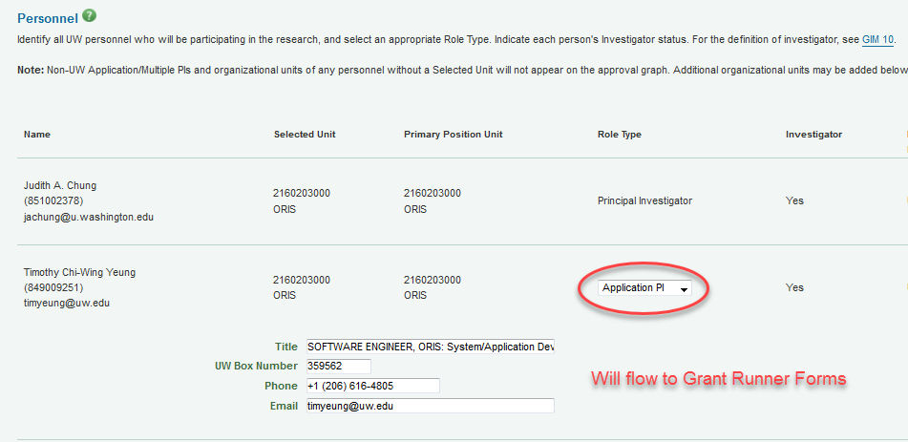
PI, Personnel & Organizations Page Update

Slide 7
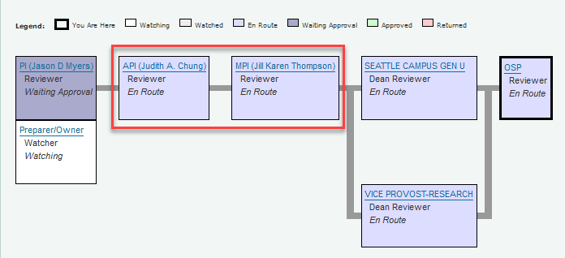
Approval Graph Updates
Application PI & Multiple PI added to Approval Graph

Slide 8
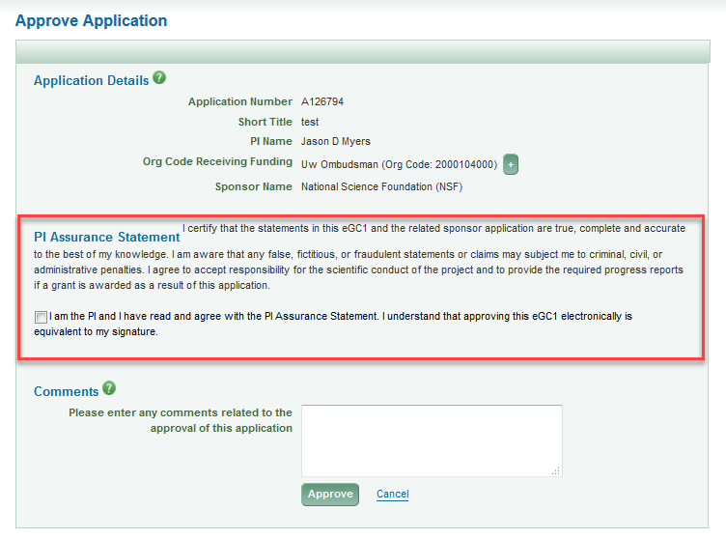
Assurance & Approval

Slide 9
ASTRA Role & SAGE Approval
Ensure all PIs:
have a SAGE ASTRA role: minimum “proposal/preparer”
know to approve eGC1 in SAGE
expect SAGE approval email

Slide 10
Resources
SAGE Documentation:
SAGE ASTRA Roles
Approve an Application

Slide 11
NIH Interim Research Performance Progress Reports (RPPR)
Carol Rhodes
Office of Sponsored Programs
MRAM

Slide 12
NIH RPPR Types
Annual RPPR
Report scientific progress, ID significant changes,
personnel information, and plans for next budget period.
Final RPPR
Part of closeout, submit project outcomes + the info submitted on annual RPPR.
Excludes budget & plan for next budget period.
Includes Project Outcomes section to gather info for general public.
Interim RPPR
Submitting a renewal (Type 2) application.
Data on Interim RPPR = Final RPPR

Slide 13
NIH RPPR Process
Annual
Prepare RPPR in eRA Commons and route to SO.
Route an eGC1 with RPPR attached.
Final
Prepare RPPR in eRA Commons and submit.
Notify closeout@uw.edu with a copy of RPPR attached confirming submission.
No eGC1 required
Interim RPPR
Same process as Final RPPR.
CORRECTION 9.28.17
An earlier version of these slides indicated campus had to route the RPPR to SO and
Notify closeout@uw.edu that it is ready for submission in eRA Commons
These instructions have been corrected.

Slide 14
Considerations
Has the PI applied for a competing renewal?
Submit Interim RPPR within 90 days (GIM 39) of project end date.
If renewal funded:
Interim serves as annual RPPR for final year of previous competitive segment.
Interim RPPR must be submitted, even if it is due after the start date of renewal.
When Interim RPPR is missing or the Outcomes section is
incomplete, NIH can delay future funding until received.
Not funded?
Interim RPPR becomes the Final RPPR for the project.

Slide 15
FAQs Straight from NIH (1 of 2)
What is the difference between Accomplishments (Section B2) and Project Outcomes (Section I) in Interim & Final RPPRs?
Accomplishments = technical accomplishments in relation to project aims since last RPPR was submitted, written for scientific audience
Outcomes = concise summary of outcomes/findings for entire project, written for general public
What if renewal is awarded & we don’t submit an Interim RPPR?
  NIH will likely hold future funding until I-RPPR is submitted.
More FAQs: https://grants.nih.gov/grants/rppr/faqs.htm

Slide 16
FAQs Straight from NIH (2 of 2)
How do I complete Section D1 (Individuals who have worked on Project) for a Final or Interim RPPR?
  Include individuals/staff who worked on the project during the last budget period minus any approved no-cost extensions.
What if the eRA Commons shows a Final RPPR for my grant and a renewal is later funded?
  Final RPPR converts to an Interim RPPR. No need to re-enter.
More FAQs: https://grants.nih.gov/grants/rppr/faqs.htm

Slide 17
Resources
Manage Award: Reporting
www.washington.edu/research/myresearch-lifecycle/manage/reporting/#progress-reporting
Closeout: Reporting
www.washington.edu/research/myresearch-lifecycle/closeout/reporting/#technical
GIM 39: Closeout of Sponsored Programs
www.washington.edu/research/policies/gim-39-closeout-of-sponsored-programs/
NIH RPPR Instruction Guide
grants.nih.gov/grants/rppr/rppr_instruction_guide.pdf

Slide 18
NIH Just-In-Time (JIT) Notifications
Carol Rhodes
Office of Sponsored Programs
September MRAM

Slide 19
JIT Process & Changes
NIH sends JIT notifications automatically to PI with grant application receiving impact scores of 40 or less. It is not a guarantee of funding and often not acted upon by PI.
Specific JIT requests from a GMS are actionable and often have a very short turnaround within which to respond.
Response to JIT needs to be via OSP.

Slide 20
NIH Just-in-Time (JIT) Requests
JIT Type | Received | Process
Automated JIT notification from NIH | By PI, with copy sent to OSP | If PI uploads JIT information in eRA Commons, contact osp@uw.edu with eGC1# and note JIT material ready. PAN created and assigned to OSP Grant Specialist.
Specific JIT request from Grants Management Specialist | By PI and OSP | OSP creates a PAN and notifies PI/dept. to provide the JIT material to your OSP Grant Specialist.

Slide 21
Resources
NIH JIT Notification and Submission Process
grants.nih.gov/grants/guide/notice-files/NOT-OD-12-101.html
eRA Commons
public.era.nih.gov/commons/public/login.
Who is my OSP Grants Specialist?
Use Contact Us, search topic: “JIT” and your department
www.washington.edu/research/contact-us/

Slide 22
FOIA Requests
Joe Giffels & Carol Rhodes
Office of Sponsored Programs
September MRAM

Slide 23
What is the Freedom of Information Act (FOIA)
Provides ability for requestor to access information from the federal government.
FOIA requests are received by the federal agency, not by UW or the PI.
The agency will contact an applicant organization or grantee if an application or award is subject to the request.
Notes:
CR

Slide 24
Information Made Public
Washington State Public Records Act
U.S. Freedom of Information Act
Notes:
JG

Slide 25
Typical FOIA Notification from an Agency Sponsor
Re: Grant # 123ABC
Dear Dr. ____,
Please be advised that the Office of Justice Programs (OJP), Office of the General Counsel, received a Freedom of Information Act request for a copy of the attached funded grant application.
We are writing to obtain your assistance in determining whether any of the information in this grant application falls within one or more of the Freedom of Information Act (FOIA or Act) exemptions. Please note that in order for us to withhold material from release under the Act, and specifically using a particular exemption(s), you must demonstrate clearly and specifically, and in a manner that is nonconclusory, why the information should be withheld. Please specify all grounds for withholding any of the information within this funded grant application. In addition, please place in brackets the information you believe should be withheld.
Please notify this office in writing within five (5) working days from receipt of this letter if you object to the release of any portions of this proposal.
If you have any questions, please feel free to contact me by telephone at
(202) 111-1111 or by e-mail at FOIA officer@usdoj.gov.
Notes:
CR

Slide 26
What Now?
After reviewing exemptions, identify any information in your application or award that you wish to redact.
Highlight (but do not redact) those sections or information.
Send to FOIA officer with request and explanation regarding why you believe withholding that information falls in a FOIA exemption category.
Whether it is redacted is up to agency responding.
Notes:
CR

Slide 27
FOIA Exemptions (1 of 2)
Exemption 1:
Classified to protect national security.
Exemption 2:
Related solely to the internal personnel rules and practices of an agency.
Exemption 3:
Prohibited from disclosure by another federal law.
Exemption 4:
Trade secrets or commercial or financial information that is confidential or privileged.
Exemption 5:
Privileged communications within or between agencies, including those protected by the Attorney-Client Privilege
Notes:
CR

Slide 28
FOIA Exemptions (2 of 2)
Exemption 6:
If disclosed, would invade another individual's personal privacy.
Exemption 7:
Information compiled for law enforcement purposes.
Exemption 8:
Concerning the supervision of financial institutions.
Exemption 9:
Geological information on wells.
Notes:
CR

Slide 29
Need Help?
Response to agency does not need to go through Institutional Official, unless specifically required by agency.
If assistance needed for response, contact osp@uw.edu
OSP can provide:
Assistance communicating with FOIA officer to ask questions or get an extension
Help drafting request to agency to redact information
Relevant eGC1 information so copies of your proposal/award can be retrieved from SAGE by PI
OSP cannot provide:
Review of information in application or award to determine what should be redacted
Highlighting assistance/making pdfs
Legal advice
Notes:
CR

Slide 30
Tips
A notification from an agency that there is a FOIA request is not unusual.
Proposals, in and of themselves, are not confidential or proprietary.
The most common response to a FOIA officer is
“I have no redactions to request”.
Notes:
CR

Slide 31
Two Different Processes
Some Things in Common
UW must comply with all records requests
Limited redaction is allowed
Assistance is available
Consider what is put into the record in the first place
Notes:
JG

Slide 32
Resources
Freedom of Information Act:
www.foia.gov/
Help with FOIA request:
osp@uw.edu

Slide 33
Budget Extension Form Updates
Kendra Hayward
Office of Sponsored Programs
MRAM

Slide 34
New Budget Extension Form
& Updated Guidance Publication on 9/20/17
9/19 after 5pm:
Budget Extension request form replacement
Document attachment & updated questions
One form to handle all your no cost extension (NCE) & temporary budget extension requests at the same time
NIH 2nd NCE request
Updated temporary budget vs. advance budget guidance

Slide 35
New NIH 2nd NCE Request
New NIH Prior Approval Module allows OSP to submit 2nd NCE requests within eRA Commons directly.
New form guides requestor to attach 3 NIH required PDFs:
Programmatic Justification Document
Budget Document
Progress Report
Same info NIH has always requested - new format
This new NIH process enables tracking of requests directly within eRA Commons upon submission.

Slide 36
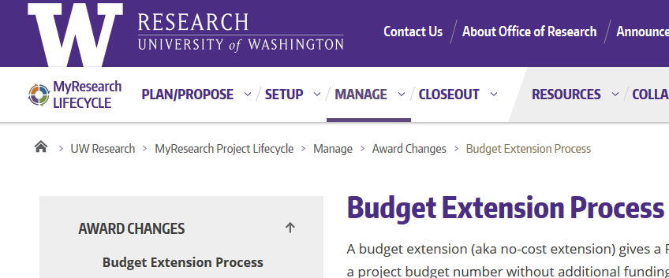
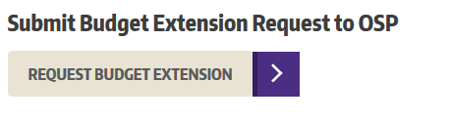
Finding the Form
https://www.washington.edu/research/myresearch-lifecycle/manage/award-changes/budget-extensions/
Notes:
Current form will redirect but only for a few months
Update your bookmarks!

Slide 37
Thank you testers!
A huge thanks to all our staff & campus testers!
Questions?
email osp@uw.edu

Slide 38
Don’t Forget
Research Administrators Day
Monday, September 25!

Slide 39
Export Controls and Sponsored Research
Mark Stomski
Export Control Office
September MRAM

Slide 40

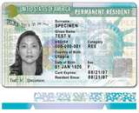



What is an Export?
“’Export’ means an actual shipment or transmission of items … out of the United States, or release of technology or software, … to a foreign national in the United States”
        Export Administration Regulations (EAR)
Not Foreign Nationals
Slide 40

Slide 41
Why Export Controls at a University?
Exports do not have to be shipments of goods
  Providing goods, technology, or software to a foreign national in the United States is still considered to be an export – a.k.a. “deemed export”
  E-mailing technical data or a software program
Foreign nationals coming to the United States for education and research (increasing numbers from more countries)
Technology has enabled education to become increasingly global and “hands-on”
Export Controls does not cover FISMA, Personal Identifiable Information, or Confidential Unclassified Information
Slide 41

Slide 42
Exporting Basics
Categorization (What?)
  Determines Jurisdiction (State, Commerce, NRC, etc.)
  Almost everything has a control number
Destination (Where?)
  Sanctioned countries may have additional prohibitions on financial or travel transactions
End-User (Who?)
  Debarred Parties Screening
End Use (Why?)
  Certain End Uses are prohibited (e.g., nuclear proliferation)
Slide 42

Slide 43

Why?
Prohibited End Uses
Certain nuclear activities
Rocket Systems and UAVs (drones)
Chemical and Biological Weapons
Others but very specific – luckily not the type of activities UW performs
Slide 43

Slide 44
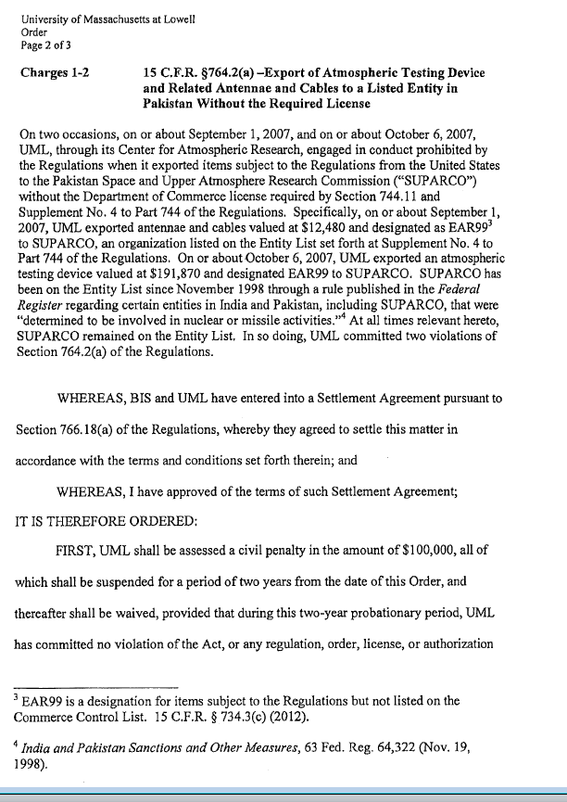
Who?
KNOW YOUR RECIPIENT!
Debarred Parties, include universities, hospitals, research institutes, etc.
  Beihang University
  Sichuan University
  Ben Gurion University
  Space and Upper Atmosphere Research Commission (SUPARCO)
Slide 44

Slide 45
Debarred Parties
When dealing with an unknown entity, we can screen all of these, and many more, for you
Denied Persons List (Commerce)
Entity List (Commerce)
Specially Designated National List (Treasury)
Debarred List (State)
Nonproliferation Sanctions (State)

Slide 46


What is generally not subject to export controls?
Public Domain Information
  Information that is generally accessible to the public through: periodicals, books, print, or electronic media.
  Includes information that is readily available at libraries, in patents, or through an “open” conference.
Academic Catalog Courses
Slide 46

Slide 47
What is excluded from Export Controls?
Fundamental Research Results
  Basic and applied research in science or engineering; and
  Intention is to publish the research results and there are no restrictions or approvals required on the publishing of the research results; and
  No restrictions on the access to the research results (including foreign national restrictions or approvals)
Slide 47

Slide 48
How do I know if UW’s research is covered under the fundamental research exclusion?
Contracts
  Read clause carefully. UW may notify the sponsor of any publications or foreign nationals working on a research project but it must be clear that it is not an approval process (or it appears to be an approval process.) Generally, any clause which requires PRIOR notification of a foreign national on a project is not acceptable.
  DFARS 252.204-7000 is an obvious example of a publication restriction
Slide 48

Slide 49
Sample Clauses
Unacceptable
DFARS 252.204-7000
(a) The Contractor shall not release to anyone outside the Contractor's organization any unclassified information, regardless of medium (e.g., film, tape, document), pertaining to any part of this contract or any program related to this contract, unless—
(1) The Contracting Officer has given prior written approval; or
(2) The information is otherwise in the public domain before the date of release.
(b) Requests for approval shall identify the specific information to be released, the medium to be used, and the purpose for the release. The Contractor shall submit its request to the Contracting Officer at least 45 days before the proposed date for release.
(c) The Contractor agrees to include a similar requirement in each subcontract under this contract. Subcontractors shall submit requests for authorization to release through the prime contractor to the Contracting Officer.
Acceptable
To comply with DFARS 252.204-7000, Disclosure of Information, the contractor shall be free to publish, permit to be published, or distribute for public consumption, any information, oral or written, concerning the results of conclusions made pursuant to performance of the contract; provided, however, that it shall provide copies of any such publication or notification of release of information to the Contracting Administrator 15 days prior to release.
Slide 49

Slide 50
Hidden Contractual Restriction
On publication
Slide 50

Slide 51

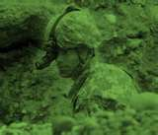


What is controlled?
International Traffic in Arms Regulations ITAR -
  State Department
  Anything specifically designed or modified for military or space application
    DARPA, AFRL, ONR, ARO technology and/or goods
    Includes mock-ups and models
    Does not include general system descriptions
  License required for all countries (limited exceptions)
Slide 51
Notes:
Guns, Arms, and Ammunition (story about Australian DoD)
Rockets (microrocket)
Explosives (Hallinga)
List of Propellants, Oxidizers, Additives, and Precursors (provide lists)
Military equipment (Bass’ Helmet story)
2nd & 3rd generation night vision equipment (Cummer)
List of Toxilogical Agents (provide list)

Slide 52
Defense Service
The only export that can be done with public domain information, courses, or fundamental research results
Furnishing assistance (including training) on defense articles to foreign persons
  Includes design, development, engineering, manufacture, production, assembly, testing, repair, maintenance, modification, operation, demilitarization, destruction, processing or use of defense articles
Training of foreign units/forces, including through the use of educational or informational publications
What does this mean?
Any activity with a foreign government’s military or space programs should be brought to the Office of Research’s attention
Slide 52

Slide 53
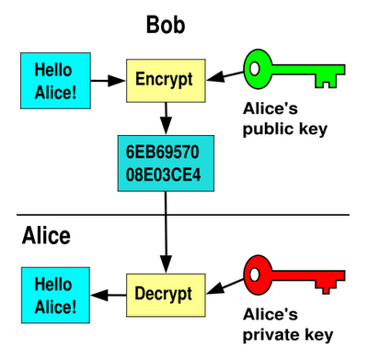




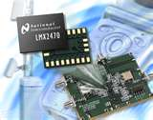
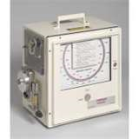
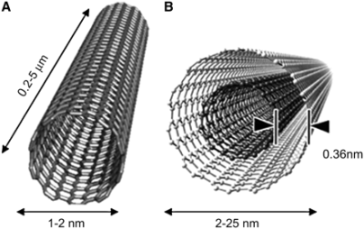
Examples of Export Controlled
Goods And Technology
Department of Commerce
  Export Administration Regulations (EAR)
Slide 53

Slide 54
Export Administration Regulations (EAR)
Categories
0. Nuclear Materials, Facilities and Equipment
1. Chemicals, Microorganisms, Toxins
2. Material Processing
3. Electronics
4. Computers
5. Telecommunications and Information Security
6. Sensors and Lasers
7. Navigation and Avionics
8. Marine
9. Propulsion Systems, Space Vehicles, and other
Product Groups (Subcategories)
Equipment, Assemblies and Components
Test, Inspection, and Production Equipment
Materials
Software
Technology
Slide 54

Slide 55
When might an export license be needed?
Slide 55

Slide 56
When the Fundamental Research Exclusion Doesn’t Apply
Confidential or Proprietary data being shared with a foreign national
Foreign national use of ITAR items
Research results that are withheld from publication due to national security or ethical issues
Shipments of physical items
Encryption software
Providing a “Defense Service”
Foreign nationals who are working on a controlled project (e.g., sensitive APL project)
Slide 56

Slide 57
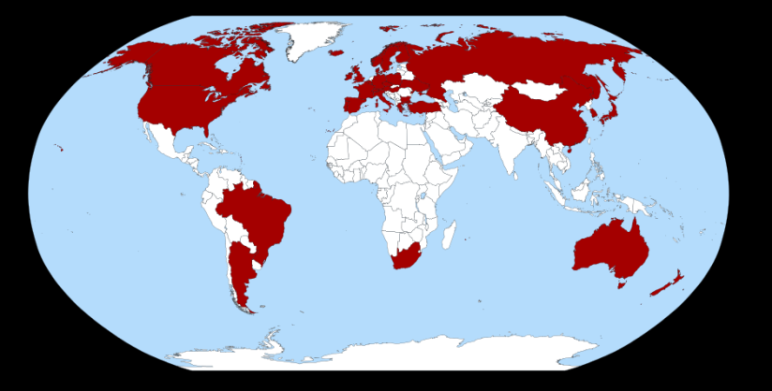
Where?
Export Controls vary based on the country
  Canada
  NATO
  Countries/Regions that are US-friendly and stable
  Countries suspected of nuclear weapon/missile development
  Sanctioned countries
Missile Technology Export Control Regime Membership Map
Slide 57

Slide 58
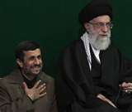

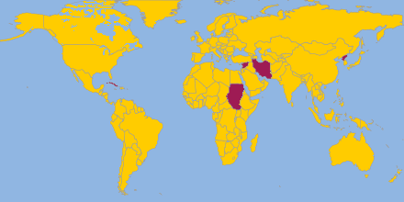



Sanctions and Embargos
Office of Foreign Assets Controls (OFAC)
CUBA
IRAN
NORTH KOREA
SUDAN
SYRIA
Belarus
Cote d’Ivoire (Ivory Coast)
Congo
Liberia
Lebanon
Libya
Somalia
Zimbabwe
Slide 58

Slide 59

The Sanctioned Countries
Often prohibited:
  Exports/Imports of any kind
  Collaboration on research projects or publications
  Financial transactions
  “Participation” in conferences
  Technical data
Public domain information may be shared without restrictions
Slide 59

Slide 60
Anti-Boycott
It is illegal for a US person or a person in the US to accept terms which support an international boycott in which the US does not participate – (Israel)
The law also requires US persons to report any such language to the US government
May be found on any type of document (contract, P.O., Letter of Credit, Waybill, certification, etc.) – Do not sign and contact export controls
Slide 60

Slide 61
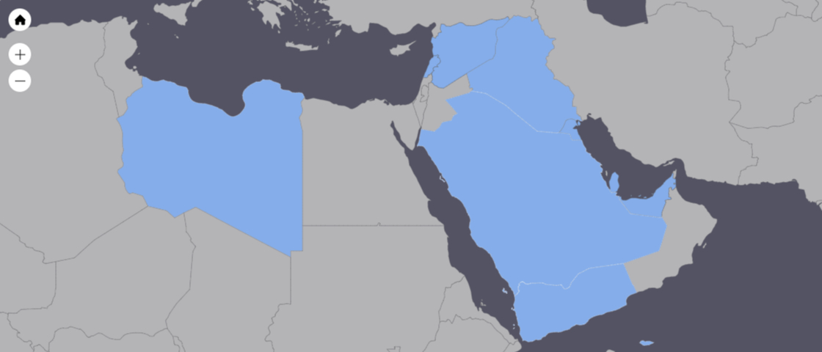
Anti-Boycott Countries
Countries currently* cooperating with Arab Boycott of Israel:
  Iraq
  Kuwait
  Lebanon
  Libya
  Qatar
  Saudi Arabia
  Syria
  United Arab Emirates
  Yemen, Republic of
* As of 2017
Slide 61

Slide 62
Other Export Licensing Regimes
Department of Energy – Nuclear Regulatory Commission
  Regulate the import and export of radioactive materials and certain research activities with radioactive materials
Fish and Wildlife Service – CITES
  Regulates the trade of animals (primates, marine mammals, migratory birds, etc.) as well as specimens of endangered species
Department of Health and Human Services – Food and Drug Administration
  Regulates export of certain drugs, devices, and biological products
Department of Commerce –
  Patent and Trademark Office - regulates the international filings of patents and trademarks
  Bureau of Census – collects data on all exports
Slide 62

Slide 63
Incoming Foreign Nationals
UW has a system of reviewing any foreign nationals coming to UW under a sponsored visa
If UW is not sponsoring an H1-B Visa but the foreign national is coming to UW, ask:
  Will we be exposing export controlled equipment/technology to the foreign national?
  Will we provide them something to take out of the country?
  Could they be considered a foreign government official?
  Where are they from (both citizenship and residency?)
  Should they be screened against debarred lists?
  Is the purpose of their visit allowable?

Slide 64
Key Points
Fundamental Research Exclusion
  No publication of foreign national approvals or restrictions
  Physical shipments of goods overseas and proprietary data is never considered to be fundamental research
Screen unknown foreign entities
Military and Space research requires extra thought
Sanctioned country interaction should be thoroughly reviewed
Ask the question – resources are available

Slide 65

Real Cases
Dr. J. Reese Roth of the University of Tennessee – Knoxville was convicted of export control violations
He shared DARPA research with a Chinese national and went on a lecture tour in China
He was sentenced to 4 years in prison followed by 2 years of supervised release
Began serving sentence in February 2012
“I could hardly believe it,” Roth said. “This whole imbroglio has such heavy police state overtures.”

Slide 66

Real Cases
In March 2004, Dr. Tom Butler of Texas Tech University was sentenced to 2 years imprisonment, 3 years supervised release, and a $50,000 fine
Sent vials of bubonic plague bacteria to Tanzania
Claimed the vials were either lost or stolen
September 2010 - “Officials shut down most of the airport (Miami) overnight, roused hotel guests from their beds and detained Thomas Butler, 70, until Friday morning, when he was released without charges, the official said.”

Slide 67
Questions?
Mark Stomski: 206-616-8741
stomski@uw.edu
Slide 67

Slide 68
Compliance Corner
MRAM
September 2017
Andra Sawyer
Research Accounting and Analysis

Slide 69
Data Analytics Program
Q2 (April – June) 2017 Reports released August 22
Contact College/School Administrator for access to the Office 365 report repository

Slide 70
Data Analytics: July 2015 – June 2017
90 Equipment purchases in last 90
days of an Award: 392 for $4.3m
Food purchases: 11,566 for $2.8m
Cost Transfers > 120 days: 12,458 for $16.2m
Cost Transfers > 120 days from
Federal Awards: 5,376 for $6.1m

Slide 71
PSA
Updated GCA Help Phone Hours:
8:00am – 4:30pm
GCA Help: 206-616-9995

Slide 72
Post Award Fiscal Compliance (PAFC) Updates
Welcome Matt Gardner!
Website: finance.uw.edu/pafc
E-mail: gcafco@uw.edu

Slide 73



UPCOMING COURSES IN
RESEARCH ADMINISTRATION
 | Sep 13 | MAA 205 | Modifying an FEC Using Comments and Adjusting Cost Sharing
 | Sep 14 | OSP 101 | Introduction to Research Administration
 | Sep 19 | ORIS 101 | SAGE: Creating and Submitting eGC1s Workday in SAGE Updates
 | Sep 26 | ORIS 103 | SAGE Budget Workday in SAGE Updates
 | Sep 27 | MAA 210 | Modifying an FEC, Change Outside eFECS and Recertifications
 | Oct 4 | MAA 215 | Faculty Effort and Cost Share: Calculate it Right!
 | Oct 10 | GCA 100 | Post-Award Financial Administration: Processes, Offices and Best Practices
 | Oct 18 | MAA 220 | Managing Faculty Effort
 | Nov 29 | ORIS 102 | SAGE: Creating NIH Proposals in Grant Runner Updates + NIH Forms E
Register: https://uwresearch.gosignmeup.com/public/course/browse
About CORE :
https://www.washington.edu/research/training/about-core/

Slide 74
ON DEMAND
LEARNING RESOURCES
 | COMING SOON | RAA 203 | Basic Concepts in Internal Controls for Purchasing
 | Online Class | GCA 201 | Salary and Cost Transfers
 | Online Class | RAA 201 | Post Award Food Purchases and Compliance
 | Online Class | GCA 202 | Direct Billing of F&A Type Costs Online Class
 | Online Class | RAA 202 | Timing of Expenditures & Benefit to Award
 | SAGE/Workday Resources Includes Workday in SAGE updates |  | SAGE Online Learning
 |  |  | SAGE help documentation Learning
Register: https://uwresearch.gosignmeup.com/public/course/browse
About CORE :
https://www.washington.edu/research/training/about-core/

