Slide 1
SAGE Updates: PI Handling
Release Date: September 12
Judy Chung & Carol Rhodes
Office of Research Information Services &
Office of Sponsored Programs
MRAM

Slide 2
Multiple PI Designation
The NIH adopted a multiple-PD/PI model in 2006.
Encourages interdisciplinary and other team approaches to biomedical research. All PD/PIs share responsibility and authority for leading and directing the project.
Typically, the PI listed on the eGC1 is the contact PD/PI, responsible for communication between the sponsor and the rest of leadership team.
Use “Multiple PI” designation from selection on eGC1 PI & Personnel page.
Notes:
Also may see the term Co-investigator or Co-I- They are NOT a multiple PI, while they may make significant contributions Co-Investigators are not considered responsible for the project and should not have Multiple PI Distinction. NSF: Uses the term Co-PI.
If other PI(s) are at other institutions, do not list them on the eGC1 PI&Personnel page. Their assurance is captured through subrecipient documentation (e.g. letter of intent from other institution for a Multiple PI opportunity containing a Multiple PI plan is taken as that institution’s due diligence it has captured its PI’s necessary assurances).

Slide 3
SAGE Changes: Multiple PI
Key Changes:
UW “Multiple PIs” will be automatically added to the approval graph
Will receive same approval notification email that the PI receives
Will see “Assurance Statement” as part of their approval screen

Slide 4
New Role Type: Application PI
Use when PI on sponsor forms is different than eGC1 PI, and sponsor “PI” is not eligible to be a UW PI. Examples:
NIH Career Development (K) Award
NIH Fellowship Award
“Application PI” can be selected on PI & Personnel Page. When selected, the API will flow through to Grant Runner SF 424 and Key Persons forms.
UW Application PIs will be added to approval graph and automatically receive same approval notification email that the PI receives.
Application PI will also see the “Assurance Statement” on their approval screen.

Slide 5
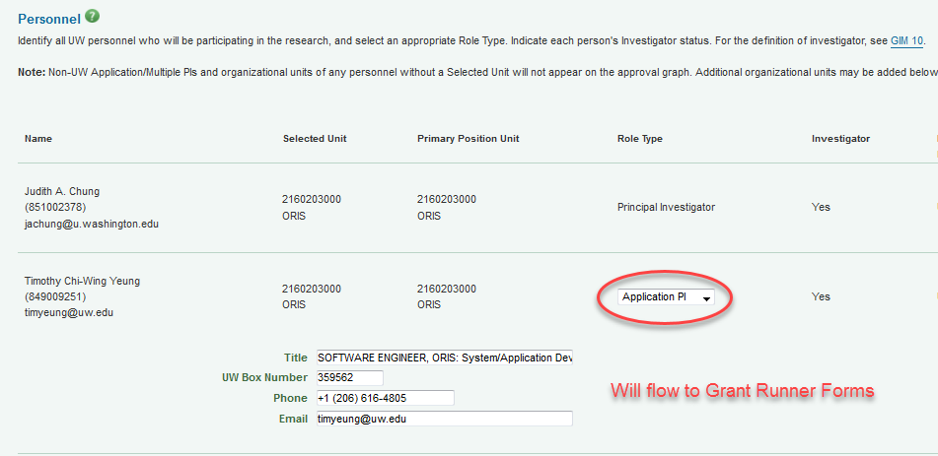
PI, Personnel & Organizations Page Update

Slide 6
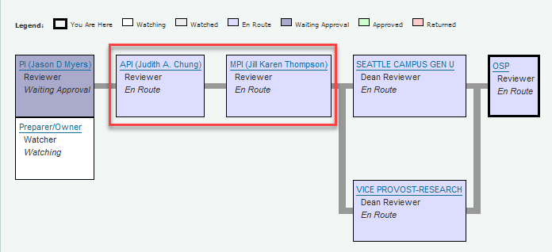
Approval Graph Updates
Application PI & Multiple PI added to Approval Graph

Slide 7
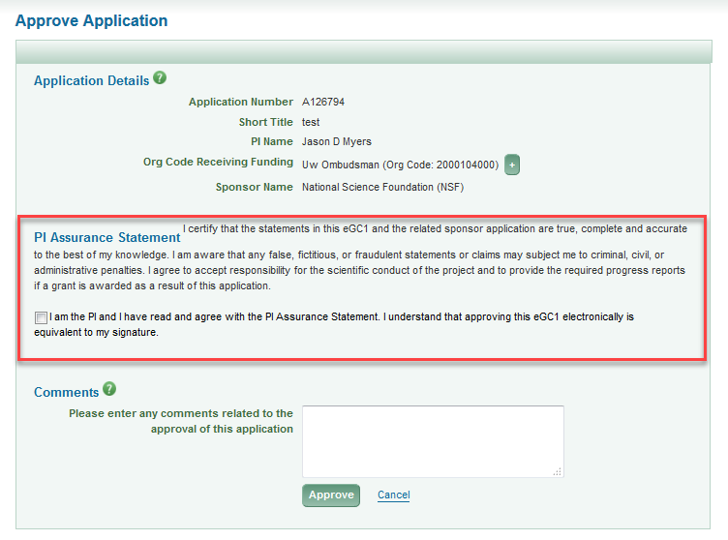
Assurance & Approval

Slide 8
ASTRA Role & SAGE Approval
Ensure all PIs:
have a SAGE ASTRA role: minimum “proposal/preparer”
know to approve eGC1 in SAGE
expect SAGE approval email

Slide 9
Resources
SAGE Documentation:
SAGE ASTRA Roles
Approve an Application
Notes:
FAQs coming soon

