Slide 1
 | MRAM Monthly Research Administration Meeting
 | OCTOBER 19, 2017 9:00 AM UW TOWER AUDITORIUM
 | TOPIC | PRESENTER | EMAIL | MIN
 | Welcome | Ted Mordhorst Research Compliance & Operations | tedm2@uw.edu | 2
 | National Biosafety Month | Zara Llewellyn Environmental Health & Safety | zaral@uw.edu | 10
 | Grants.gov - Workspace Introduction | Amanda Snyder Office of Sponsored Programs | acs229@uw.edu | 10
 | SAGE: Review Oct. 17 Release & Updates | Chris Carlson Office of Research Information Services | carlsc@uw.edu | 15
 | NIH: Forms - E | Amanda Snyder Office of Sponsored Programs | acs229@uw.edu | 5
 | FEC Decision Tree | Michael Anthony Management Accounting & Analysis | mda1213@uw.edu | 5
 | Certificates of Confidentiality | Carol Rhodes Office of Sponsored Programs | carhodes@uw.edu | 2
 | New Subrecipient: Form improvements & Process | Cathy Cottle Office of Sponsored Programs | cottlec@uw.edu | 5
 | Compliance Corner | Andra Sawyer Post Award Fiscal Compliance | andra2@uw.edu | 10
JOIN US FOR OUR NEXT MEETING: NOVEMBER 16, 2017 at the UW TOWER AUDITORIUM

Slide 2
Great Shake Out 10.19.17 at 10:19 AM Earthquake Drill - That’s Today!
All floors of the Tower will receive a live announcement with drill instructions.

Slide 3
OCTOBER IS NATIONAL BIOSAFETY MONTH
MRAM
October 2017
Zara Llewellyn, PhD.
Biological Safety Manager
206-221-2676, zaral@uw.edu
Environmental Health & Safety Department

Slide 4
WHAT IS BIOSAFETY?
The containment of potentially harmful biological agents
Requires use of safe practices, training, facilities, and equipment for managing biohazardous materials
Provides protection of people, animals, and the environment

Slide 5
UW BIOLOGICAL SAFETY PROGRAM
1,813 of 4,100 total (44%) of lab spaces are biohazard labs
539 of 970 total (56%) lab Principal Investigators (PI) are registered with Institutional Biosafety Committee (IBC)
681 projects are registered with the IBC
387 IBC applications reviewed in 2016
40% of IBC applications involve animals
5.6 Biological Safety Officers
IBC/Research Coordinator

Slide 6
OCTOBER IS NATIONAL BIOSAFETY MONTH
Led by the National Institutes of Health (NIH)
Office of Science Policy
Started in 2014 as a result of biosafety lapses at government laboratories

Slide 7
NATIONAL BIOSAFETY MONTH
Time to focus attention to biosafety policies, practices, and procedures
We encourage labs to raise biosafety awareness, discuss safety, and seek ways to strengthen biosafety in their labs
Last year we focused on biological inventories

Slide 8
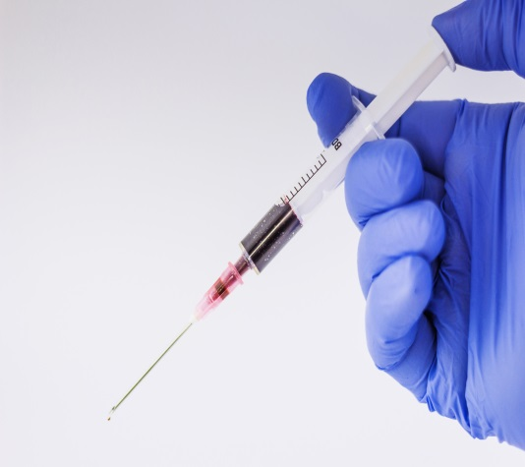
2017 UW BIOSAFETY MONTH
SHARPS SAFETY
Sharps Safety
Raise awareness about working safely with needles and other sharp items
Prevent needlesticks, injuries, and accidents
Exposure Response Procedures
Clarify and simplify response procedures
Raise awareness about the Exposure Response Poster

Slide 9
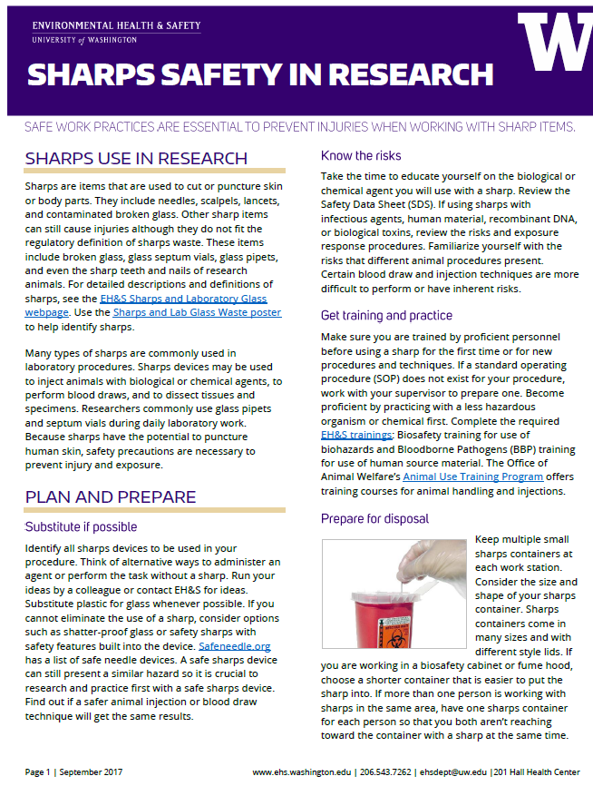
SHARPS SAFETY IN RESEARCH
http://www.ehs.washington.edu/manuals/focus/sharps_safety.pdf

Slide 10
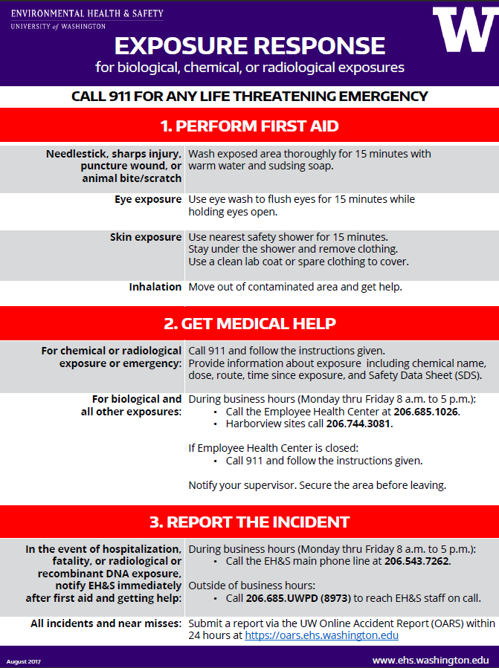
NEW EXPOSURE
RESPONSE POSTER
https://www.ehs.washington.edu/manuals/posters/exposureresponseposter.pdf

Slide 11
HELP US GET THE MESSAGE OUT
National Biosafety Month
Sharps safety in research
New exposure response poster

Slide 12
RESOURCES
EH&S web: www.ehs.washington.edu
Biological safety: https://www.ehs.washington.edu/rbsbiosafe/index.shtm
UW Biological Safety Stewardship: http://www.ehs.washington.edu/rbsbiosafe/steward.shtm
Sharps Safety in Research: http://www.ehs.washington.edu/manuals/focus/sharps_safety.pdf
Exposure Response Poster: https://www.ehs.washington.edu/manuals/posters/exposureresponseposter.pdf
Institutional Biosafety Committee: https://www.ehs.washington.edu/rbsresplan/ibc.shtm
NIH Biosafety Month:
https://osp.od.nih.gov/2017/09/13/national-biosafety-month-new-fall-classic/
EH&S Biosafety:
206.221.7770 or ehsbio@uw.edu

Slide 13
Grants.gov Workspace
October 2017 MRAM
Amanda Snyder
Office of Sponsored Programs

Slide 14
Workspace Background
Objective:
Enhance Grants.gov Apply functionality with shared, online environment to collaboratively complete & submit grant applications
Benefits:
Multiple users concurrently complete forms
Reuse/copy existing forms
Validation upon upload of forms reduces rejections
Seamless Integration between online webforms & offline PDF forms
Collaborate with external collaborators
Changes to FOA immediately reflected
Data retained for 3 years

Slide 15
What’s Happening
As of January 1, 2018 Grants.gov Adobe Forms application packages will be replaced with the Grants.gov Workspace solution.
Federal agencies who do not have their own proposal submission systems and who currently use the Adobe forms package will be using Workspace.

Slide 16
What You Need to Know
Grants.gov will continue to accept Adobe forms for a brief transition period if they were downloaded before January 1, 2018.
OSP will not accept Adobe application packages on eGC1s arriving “IN OSP” after February 28, 2018.

Slide 17
What You Need to Do
Preparing proposals to federal agencies (other than NIH or NSF) and still using Adobe Forms package through 12.31.17?
Become familiar with other submission options now.

Slide 18
Federal Proposal Submission Options
Method | Considerations
Workspace | Adobe Forms Packages replacement
SAGE Grant Runner | Submit Specific NIH Opportunities in the UWs System to System Solution (S2S), Grant Runner. Reduces duplicate entry & routes with eGC1
Sponsor Specific System | NIH ASSIST, NSF Fastlane, NASA NSPIRES etc...

Slide 19
NIH & NSF Submissions?
Submit NIH proposals via Grant Runner or ASSIST.
Check to see if your specific NIH opportunity can be submitted via Grant Runner.
Enhancements and expanded opportunities within Grant Runner are under way. Stay tuned for more information.
NSF proposals MUST continue to be submitted in Fastlane.

Slide 20
Using Workspace
We recommend these 7 Grants.gov User Guide articles.
Individuals must register in Grants.gov to use Workspace.
eGC1 preparers need to include the Workspace ID# and upload 2 Workspace application PDF files to the eGC1:
Workspace generated PDF showing form fields completed
One PDF of all attachments.The PDF downloaded from Workspace does not currently include attachments - but it will!

Slide 21
Workspace Resources
Grants.gov UW registration instructions
7 Grants.gov User Guide articles
Workspace Online User Guide
Grants.gov Applicant Training
Grants.gov YouTube Channel
OSP Announcement:
Grants.gov Adobe Application Packages Are Going Away!
Grants.gov Helpdesk Support Center:
support@grants.gov or 1-800-518-4726

Slide 22
What’s next from Grants.gov?
11.20.17
User access management streamlining
Can create acc’t w/out org approval & register w/ org later
Updates to subscription mgmt (info & updates on FOAs)
Enhancements to copy functionality
Grant Opportunity search by Application Package IDs
Later (around March 2018)
Allow orgs to create custom roles, more flexibility on expanded AOR role assignment, modify some eBiz POC privileges
Add attachments to Application/Form view
Enhance error messages
Enhance copy functionality further

Slide 23
Questions

Slide 24
SAGE Compliance Improvements R1 MRAM Overview 10.19.17
System to Administer Grants Electronically
(SAGE)

Slide 25
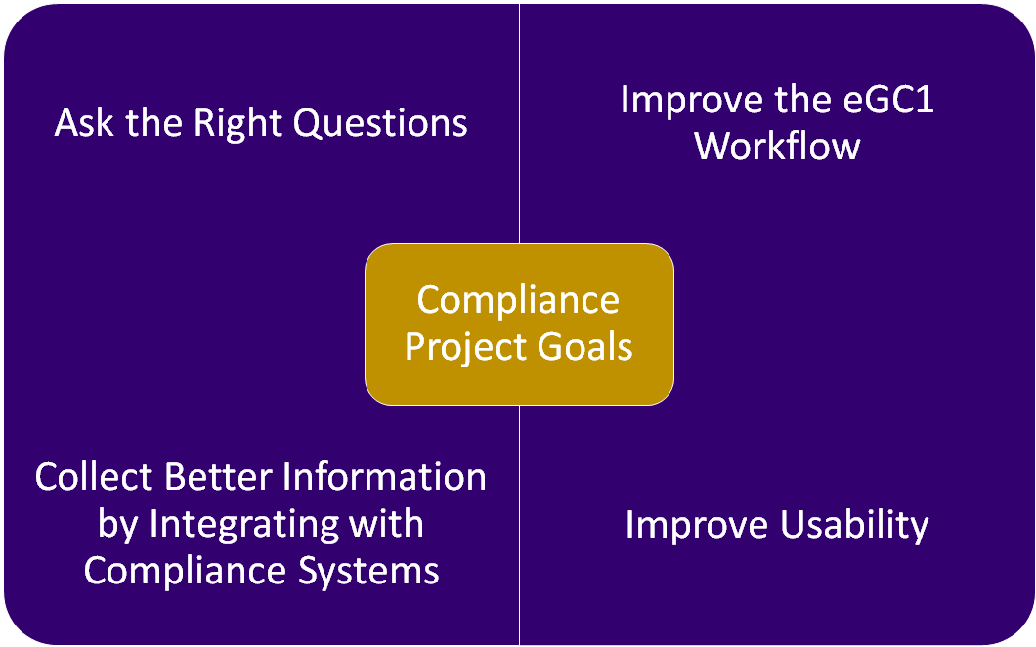

Slide 26
Two Phased Feature Delivery
Release 1 (Released on 10/17!!) | Release 2 (Win2018)
Goal: Ask the Right Questions
Eliminate unnecessary questions Reword fiscal and admin questions to better clarify purpose/intent | Revise Compliance page questions
Goal: Improve Workflow
Move fiscal & administrative questions off Compliance page Add new Activity Locations page with space planning & international involvement
Goal: Integrate with other Systems
Use GeoSIMS for location lookups | Use Hoverboard and Zipline lookups for protocol status, start and end dates
Goal: Improve Usability
Updated design on Activity Locations Feedback will inform future rollout across all of SAGE | New Compliance page design Provide PIs direct access to Compliance page via URL

Slide 27
Release 1 Feature Overview
Compliance pages get slimmer….
Question | Change
FG-1 Cost Share | Relocated to Budget & Fiscal Compliance page
FG-2 Conducted off campus | Removed (Replaced by Activity Locations)
FG-3 F&A at less than federally negotiated rate | Relocated to Budget & Fiscal Compliance page
FG-4 New, rental or renovation | Relocated to Activity Locations page
FG-5 Compensation for overtime | Removed
FG-6 Deliverables | Removed
FG-7 Administrative support | Relocated to Budget and Fiscal Compliance page
FG-8 Interdisciplinary facilities | Relocated to the PI, Personnel & Organizations page
FG-9 Review by other organization | Relocated to the PI, Personnel & Organizations page
NG-1 Advancement assistance | Removed
NG-3 Originating sponsor | Relocated to the Details page

Slide 28
Release 1 Feature Overview
Budget & Fiscal Compliance page

Slide 29
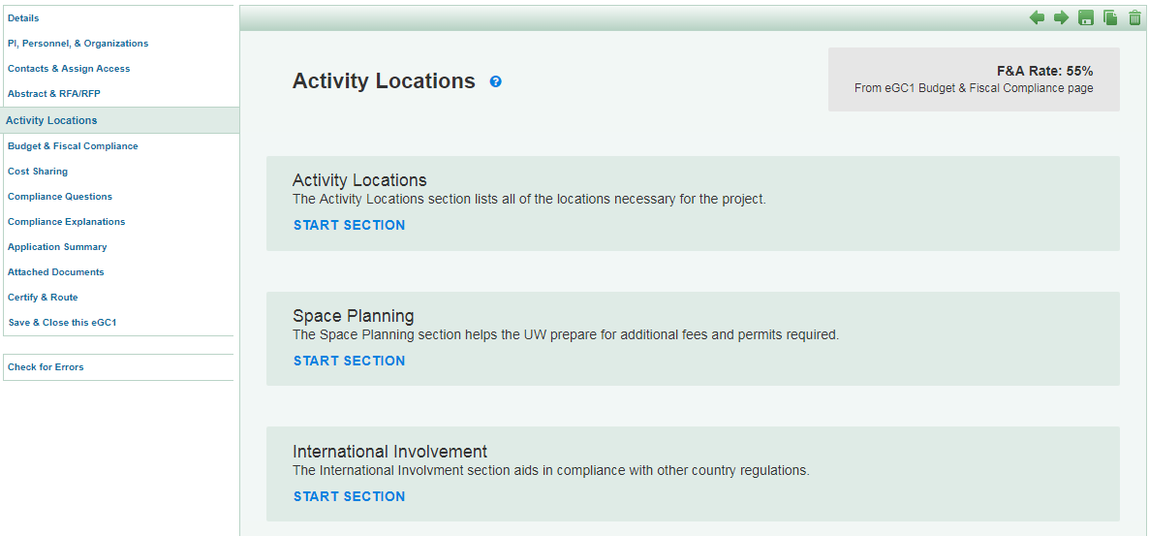
Release 1 Feature Overview
New Activity Locations page (New Design)

Slide 30
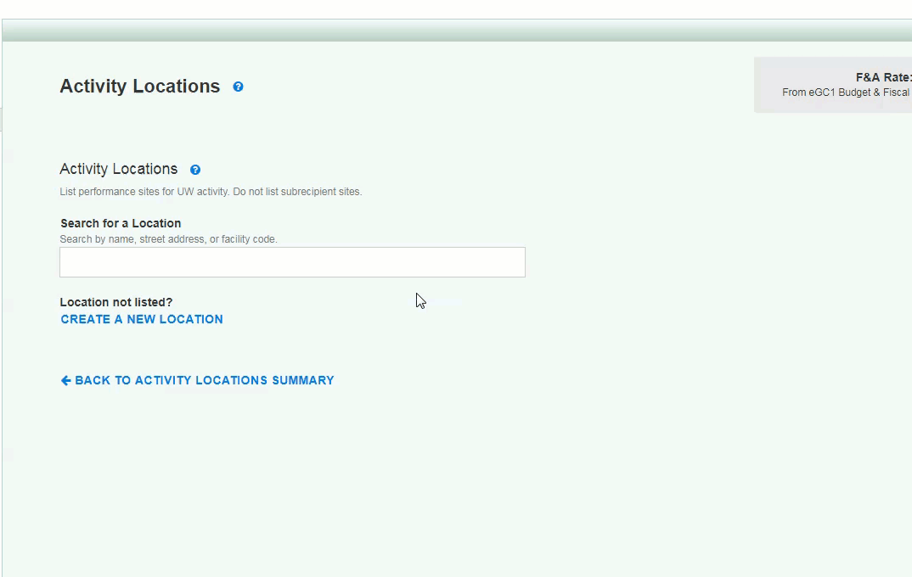
Release 1 Feature Overview
New Activity Locations page (Adding Locations)
Notes:
touch on new design and address/owned&leased coming as available in GeoSIMS

Slide 31
Release 1 Benefits

Slide 32
Resources and Feedback
Useful resources
SAGE Help Documentation
GIM 13: Facilities & Administrative (F&A) Rates
Stay tuned for updates to GIM 13: Locations section
Determining the Correct F&A Rates
Have questions or suggestions?
Contact sagehelp@uw.edu

Slide 33
SAGE Budget Update -- Pending
Resources and Training Opportunities
Coming October 26:
Fixes to cascading behavior
New setting to turn salary cascading ON/OFF (defaults to ON)
Fixes to APL rates
Decimal handling updates

Slide 34
Grant Runner Update -- Pending
Resources and Training Opportunities
Coming in Late November…
FORMS-E changes
Human Subjects & Clinical Trials Form

Slide 35
NIH Forms E:
Human Subjects &
Clinical Trials
October MRAM
Amanda Snyder
Office of Sponsored Programs

Slide 36
NIH Forms E: Changes Coming
Mostly changes to human subjects and clinical trials data collection
Consolidates Clinical Trials & Human Subjects info into single form
NEW PHS / CT Form Mandatory in MOST Application Packages
NOT-OD-17-062

Slide 37
FORMS - E Timing
Instructions available 9.25.17
FORMS-E packages available 10.25.17
MUST be used for due dates on or after 1.25.18
CANNOT be used for earlier due dates
Some FOAs will be posted before 10.25 without packages
e.g., PAR-17-301
All active non-clinical trial FOAs with due dates on/after Jan. 25 - FORMS-E will be added between 10.25 - 11.25
Check online version of FOA within 8 weeks of due date to confirm it’s appropriate for the opportunity.

Slide 38
NIH Forms E Changes & Impacted Forms
Agency Specific PHS forms
PHS 398: Career Dev. Award Supp., Cover Page, Modular Budget, Research Plan, Research Training Program Plan, Training Budget & Subaward
Additional Indirect Costs
Assignment Request Form
Fellowship Supp. Form
Inclusion Enrollment Report - No longer used rolled into new form
Federal-wide forms
Other Project Info - Added 2 Exemptions (7 & 8), anticipating future use
Budget added- Total Cost & Fee Calculation

Slide 39
Exceptions for Inclusion of New
Human Subjects/Clinical Trial Form
Form not included in package
Training
Shared Instrumentation – S10
Construction – C06/UC6, G20
Resource Awards – X01
Form optional
Admin Supp Type 3 – research, career dev, fellowship, institutional training (K12 and D43)
Type 6 & Type 7 - research, career dev, fellowship

Slide 40
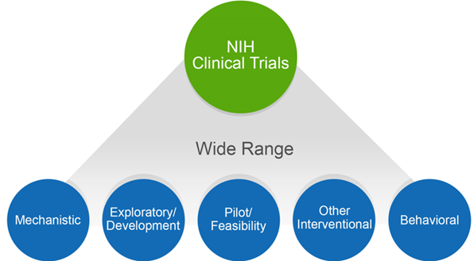
NIH Might Consider Your
Human Subjects Research a Clinical Trial
Does your study…
Involve one or more human subjects?
Prospectively assign human subject(s) to intervention(s)?
Evaluate the effect of intervention(s) on the human subject(s)?
Have a health-related biomedical or behavioral outcome?
If YES to ALL these questions, NIH considers your study a clinical trial.
Unsure how to answer?
Use the NIH Clinical Trial Decision Tree!

Slide 41
Why This Is Important
If NIH considers the study a clinical trial (CT) the PI needs to:
Respond to a clinical trial-specific FOA
Include detailed study level info in new Human Subjects & CT information form in application
Address additional review criteria specific for clinical trials
Register and report the clinical trial in ClinicalTrials.gov

Slide 42
Clinical Trial Designation in
Funding Opportunity Announcements (FOA)
All FOAs will be designated as one of the following in Section II:
Clinical Trial Required
Clinical Trial Not Allowed
Clinical Trial Optional
No Independent Clinical Trials: *only for Career Development (K) & Fellowship (F)

Slide 43
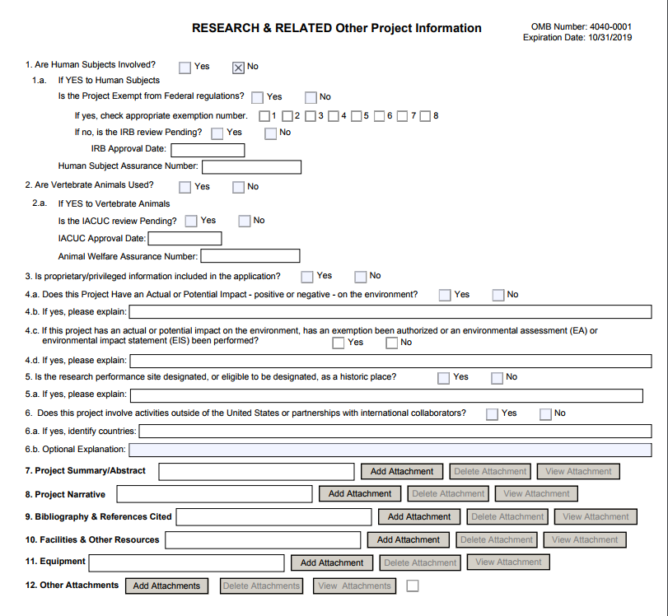
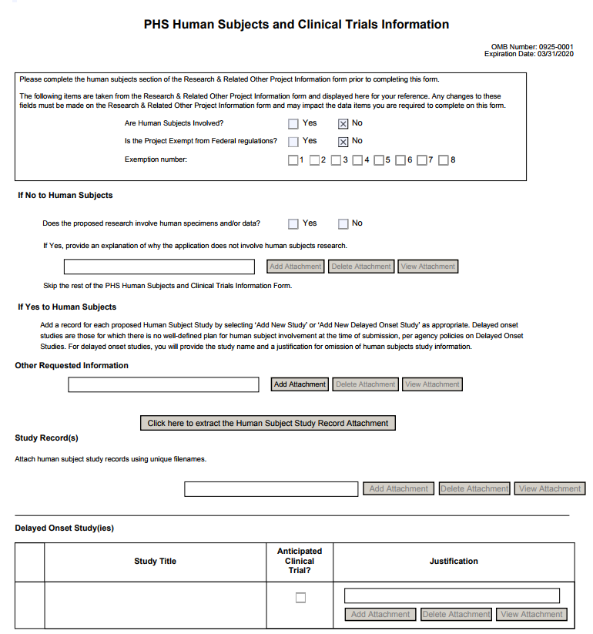
PHS HS & CT Form
When HS=NO

Slide 44
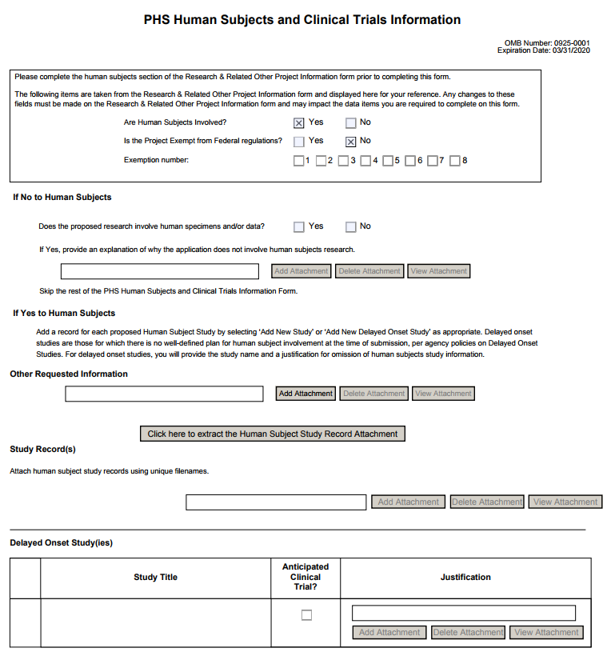
PHS HS & CT
Form
WHEN HS=YES
…must include at least one full or delayed onset study record
Full Study Record
Delayed Onset Study

Slide 45
Pay Attention
Choose announcement specific for your package due date.
During transition, some FOAs will have BOTH FORMS-D to FORMS-E packages available.
Choose the FOA appropriate for your proposal type.
FOAs that allow CT using FORMS-E will be reissued. New FOAs will specify CT allowability in FOA title.

Slide 46
NIH Resources
FORMS-E
Annotated Form Sets
High-level Summary of Form Changes in FORMS-E Application Packages
Preview of FORMS-E Grant Application Form Changes
NIH Clinical Trials:
Definition of a CT
CT Decision Tree
CT Training
Case Studies
Take a 10 min. tour of new Human Subjects /CT form
NOT-OD-17-043

Slide 47
Stay tuned...
SAGE Grant Runner updates coming in November will support these changes.
Reminders & more details to come...

Slide 48
Management Accounting & Analysis Update
MRAM - October 19, 2017
Michael Anthony
University of Washington

Slide 49
Effort Certification
MAA developing ‘decision tree’ to assist faculty in the completion of their FEC reports
Seeking department input on the types of questions FEC coordinators, administrators, etc. receive from faculty when completing these reports
University of Washington Management Accounting & Analysis
Notes:
Net ID – MAA compares the Net ID of the person whose name appears on the FEC with the Net ID of the person certifying the FEC

Slide 50
Effort Certification
Examples:
Why is there cost sharing reflected on my FEC? (faculty member paid over the salary cap)
Why is my grant being charged 30% REG pay when my effort is 15%? (faculty IBS includes ADS not being charged to grant)
Why does my FEC reflect 5% effort to my grant when I’m working 10% on the grant? (grant not active for full FEC cycle)
My FTE is 75% so why does the FEC reflect 100% (FEC must reflect how an individual’s total (100%) salary/effort is distributed
University of Washington Management Accounting & Analysis
Notes:
Net ID – MAA compares the Net ID of the person whose name appears on the FEC with the Net ID of the person certifying the FEC

Slide 51
Effort Certification
Draft due 10/31/2017
Need your input by 10/25/2017
email me (mda1213) or Stepanka Sirotek (sr8) with your input by 10/25/2017
THANK YOU!
University of Washington Management Accounting & Analysis
Notes:
Net ID – MAA compares the Net ID of the person whose name appears on the FEC with the Net ID of the person certifying the FEC

Slide 52
NIH:
Certificate of Confidentiality
October 2017 MRAM
Carol Rhodes
Office of Sponsored Programs

Slide 53
NIH: Certificate of Confidentiality - Purpose
A Certificate of Confidentiality (CoC) protects the privacy of individuals whose information is used as part of a project. It prevents the disclosure of the name of an individual or any information, document, or biospecimen that contains identifiable, sensitive information.
Specifically, a COC prevents disclosure when:
As part of a Federal, State, local civil, criminal, administrative, legislative or other proceeding
To any other person not connected with the research
For studies in which informed consent is sought (i.e. protocol in place requiring informed consent), investigators must inform research participants of the protections and limits to protections provided by a Certificate issued by this Policy.

Slide 54
NIH Updated CoC Policy
CoCs are now issued automatically to awards funded wholly or in part by the NIH that collect or use identifiable, sensitive information.
Applies to all ongoing or new research funded by NIH as of December 2016.

Slide 55
UW CoC Approach
Projects funded by NIH from December 2016 or later:
Treat all info about individuals as protected by a CoC and subject to CoC limitations.
When a PI is asked to disclose or needs to share this info:
PI applies NOT-OD-17-109 guidance
Use UW CoC decision tree being released on OR site
PI keeps a record of decision tree analysis in local project file:
Do not share if determination = sharing is not allowed.
Share only if determination = allowed. Must also inform recipient that info. is subject to CoC & recipient must do same analysis to further disclose.
Use recommended DUA language from OR site.
Centrally: Terms of the CoC limitation included in subaward.

Slide 56
Resources
21st Century Cures Act
NIH:
NOT-OD-17-109
CoC webpage
Human Subjects Division
Guidance
SOP: CoC Apply/Extend/Modify
Decision Tree - Coming Soon

Slide 57
Questions?

Slide 58
New
Subrecipient Entity
October 2017 MRAM
Cathy Cottle
Office of Sponsored Programs

Slide 59
NEW SUBRECPIENTS - PROCESS CHANGE
NEW:
OSP needs a completed New Subrecipient Certification Form before entity can be activated in SAGE.
Department can provide completed form; or provide New Sub contact and ask ospsubs@uw.edu to collect it.
REVISED:
New Subrecipient Certification Form

Slide 60
NEW SUBRECPIENTS - PROCESS CHANGE
WHY?
SAGE Subaward Admin Tool now collects new unique identifiers and data elements.
Examples: EIN, organization type, legal entity, location
New Subrecipient Entity form revised to capture unique identifiers & conform to current regulations

Slide 61
NEW SUBRECPIENTS - PROCESS CHANGE
RESULTS:
Early metrics show: new approach reduces time elapsed between issuing and executing a subaward by three to five days.
OSP will be able to sort data and run systematic reports.

Slide 62
Questions?

Slide 63
Compliance Corner
MRAM
October 2017
Andra Sawyer & Matt Gardner
RAA/Post Award Fiscal Compliance (PAFC)

Slide 64
RTC UPDATE
Three additional agencies implemented Research Terms & Conditions (RTCs)
USDA / NIFA
Department of Commerce (NOAA)
NASA
Link to updated Prior Approval Matrix
http://finance.uw.edu/pafc/research-terms-and-conditions-rtcs
NSF released updates to Agency Specific Requirements
“Technical Corrections” only; no impact to Campus
Notes:
For agencies that have implemented them, the RTCs clarify and/or modify provisions under the UG.
Three additional agencies have implemented the RTCs and provided guidance for specific deviations from the standard RTCs: USDA/NIFA, Dept. of Commerce (NOAA), and NASA.
Check the PAFC website for an updated Prior Approval Matrix
NSF updated the ASRs to the RTCs – Technical corrections only due to redundancy or omissions from the last update.

Slide 65
LESSONS FROM TED

Slide 66
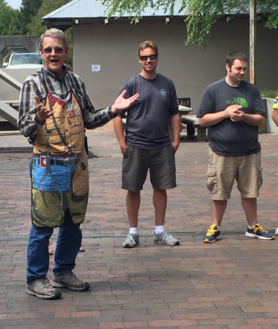
LEAD BY EXAMPLE

Slide 67
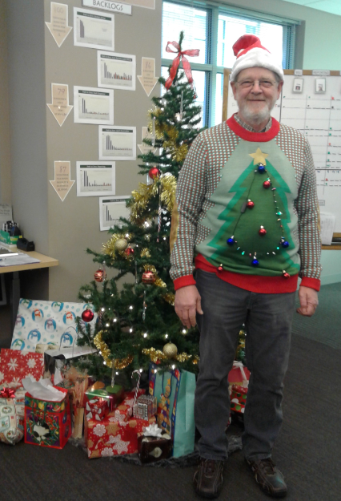
ENCOURAGE INNOVATION

Slide 68
BE A TEAM PLAYER

Slide 69
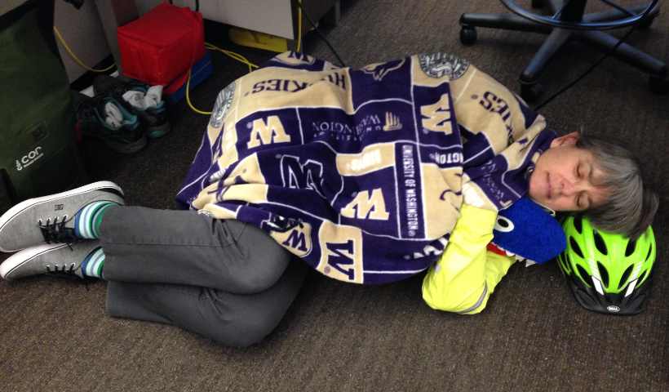
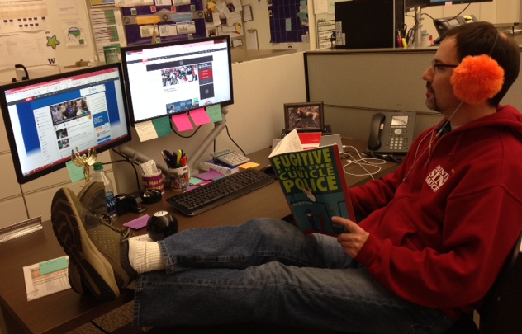
HIRE THE RIGHT PEOPLE

Slide 70
BUILD LEGACY SYSTEMS

Slide 71
DELEGATE

Slide 72
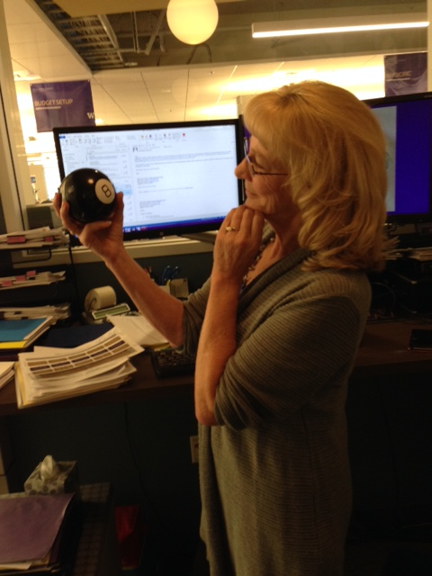
ENSURE YOU LEAVE GOOD RESOURCES BEHIND

Slide 73
IF YOU ARE IN CHARGE OF COMPLIANCE, ALWAYS BE COMPLIANT

Slide 74
UPCOMING COURSES IN
RESEARCH ADMINISTRATION
 | Oct 25 | RAA 100 | Grant and Contract Fiscal Administration: Compliance
 | Oct 25 | MAA 100 | Introduction to Grant and Contract Certification (GCCR)
 | Nov 1 | MAA 101 | Introduction to Faculty Effort Certification
 | Nov 1 | OSP 145 | Subaward Fundamentals
 | Nov 7 | GCA 203 | Preparing for an Audit
 | Nov 8 | MAA 102 | Electronic Faculty Effort Certification (eFECS) for FEC Coordinators
 | Nov 28 | OR Special Topics | Subawards in SAGE
 | Nov 29 | ORIS 102 | SAGE: Creating NIH Proposals in Grant Runner
Register: https://uwresearch.gosignmeup.com/public/course/browse
About CORE: https://www.washington.edu/research/training/about-core/

Slide 75
ON DEMAND
LEARNING RESOURCES
 | COMING SOON | RAA 203 | Basic Concepts in Internal Controls for Purchasing
 | Online Class | GCA 201 | Salary and Cost Transfers
 | Online Class | RAA 201 | Post Award Food Purchases and Compliance
 | Online Class | GCA 202 | Direct Billing of F&A Type Costs Online Class
 | Online Class | RAA 202 | Timing of Expenditures & Benefit to Award
 | SAGE/Workday Resources Includes Workday in SAGE updates |  | SAGE Online Learning
 |  |  | SAGE help documentation Learning
Register: https://uwresearch.gosignmeup.com/public/course/browse
About CORE: https://www.washington.edu/research/training/about-core/
THANK YOU TED!!!!

