Slide 1
NIH Forms E:
Human Subjects &
Clinical Trials
October MRAM
Amanda Snyder
Office of Sponsored Programs

Slide 2
NIH Forms E: Changes Coming
Mostly changes to human subjects and clinical trials data collection
Consolidates Clinical Trials & Human Subjects info into single form
NEW PHS / CT Form Mandatory in MOST Application Packages
NOT-OD-17-062

Slide 3
FORMS - E Timing
Instructions available 9.25.17
FORMS-E packages available 10.25.17
MUST be used for due dates on or after 1.25.18
CANNOT be used for earlier due dates
Some FOAs will be posted before 10.25 without packages
e.g., PAR-17-301
All active non-clinical trial FOAs with due dates on/after Jan. 25 - FORMS-E will be added between 10.25 - 11.25
Check online version of FOA within 8 weeks of due date to confirm it’s appropriate for the opportunity.

Slide 4
NIH Forms E Changes & Impacted Forms
Agency Specific PHS forms
PHS 398: Career Dev. Award Supp., Cover Page, Modular Budget, Research Plan, Research Training Program Plan, Training Budget & Subaward
Additional Indirect Costs
Assignment Request Form
Fellowship Supp. Form
Inclusion Enrollment Report - No longer used rolled into new form
Federal-wide forms
Other Project Info - Added 2 Exemptions (7 & 8), anticipating future use
Budget added- Total Cost & Fee Calculation

Slide 5
Exceptions for Inclusion of New
Human Subjects/Clinical Trial Form
Form not included in package
Training
Shared Instrumentation – S10
Construction – C06/UC6, G20
Resource Awards – X01
Form optional
Admin Supp Type 3 – research, career dev, fellowship, institutional training (K12 and D43)
Type 6 & Type 7 - research, career dev, fellowship

Slide 6
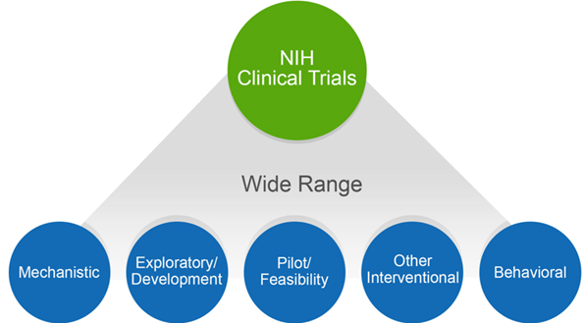
NIH Might Consider Your
Human Subjects Research a Clinical Trial
Does your study…
Involve one or more human subjects?
Prospectively assign human subject(s) to intervention(s)?
Evaluate the effect of intervention(s) on the human subject(s)?
Have a health-related biomedical or behavioral outcome?
If YES to ALL these questions, NIH considers your study a clinical trial.
Unsure how to answer?
Use the NIH Clinical Trial Decision Tree!

Slide 7
Why This Is Important
If NIH considers the study a clinical trial (CT) the PI needs to:
Respond to a clinical trial-specific FOA
Include detailed study level info in new Human Subjects & CT information form in application
Address additional review criteria specific for clinical trials
Register and report the clinical trial in ClinicalTrials.gov

Slide 8
Clinical Trial Designation in
Funding Opportunity Announcements (FOA)
All FOAs will be designated as one of the following in Section II:
Clinical Trial Required
Clinical Trial Not Allowed
Clinical Trial Optional
No Independent Clinical Trials: *only for Career Development (K) & Fellowship (F)

Slide 9
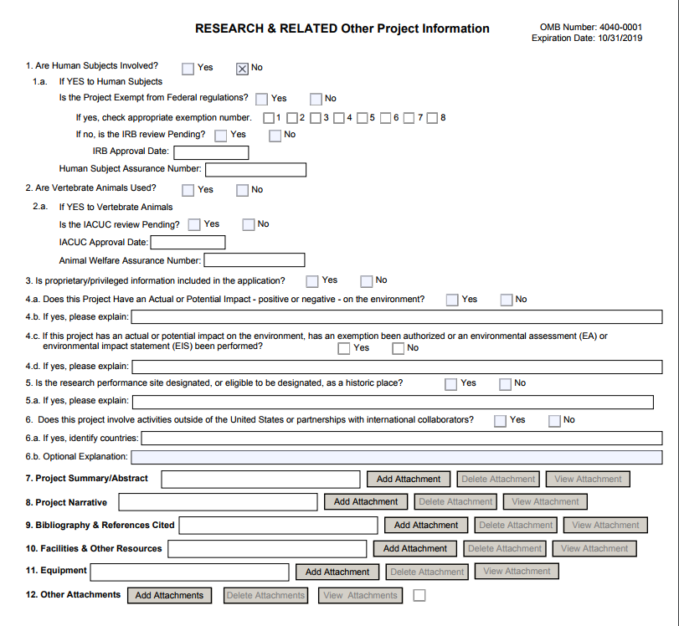
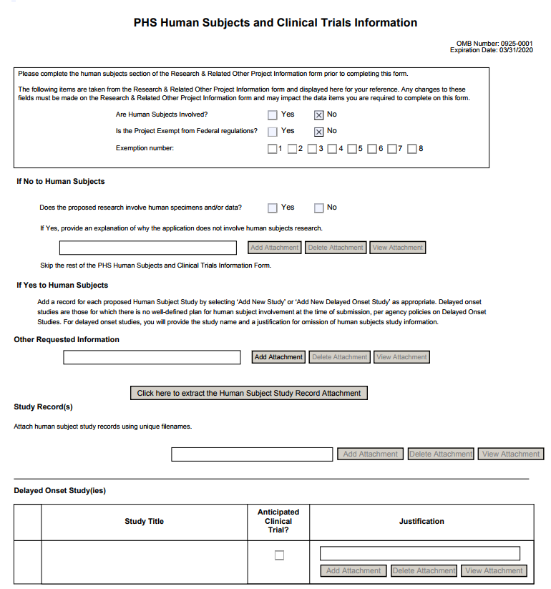
PHS HS & CT Form
When HS=NO

Slide 10
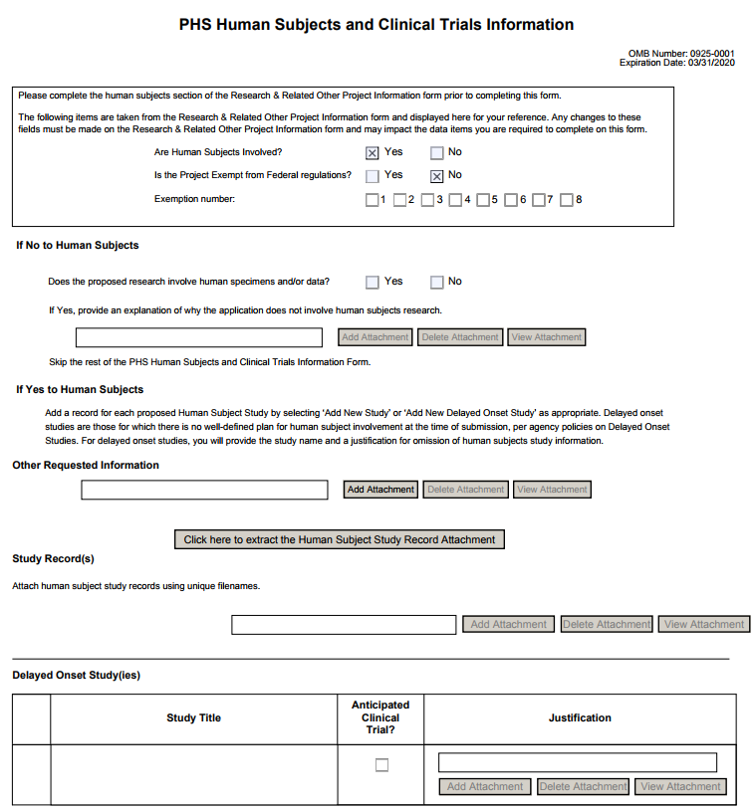
PHS HS & CT
Form
WHEN HS=YES
…must include at least one full or delayed onset study record
Full Study Record
Delayed Onset Study

Slide 11
Pay Attention
Choose announcement specific for your package due date.
During transition, some FOAs will have BOTH FORMS-D to FORMS-E packages available.
Choose the FOA appropriate for your proposal type.
FOAs that allow CT using FORMS-E will be reissued. New FOAs will specify CT allowability in FOA title.

Slide 12
NIH Resources
FORMS-E
Annotated Form Sets
High-level Summary of Form Changes in FORMS-E Application Packages
Preview of FORMS-E Grant Application Form Changes
NIH Clinical Trials:
Definition of a CT
CT Decision Tree
CT Training
Case Studies
Take a 10 min. tour of new Human Subjects /CT form
NOT-OD-17-043

Slide 13
Stay tuned...
SAGE Grant Runner updates coming in November will support these changes.
Reminders & more details to come...

