Slide 1
Compliance Corner
MRAM
October 2017
Andra Sawyer & Matt Gardner
RAA/Post Award Fiscal Compliance (PAFC)

Slide 2
RTC UPDATE
Three additional agencies implemented Research Terms & Conditions (RTCs)
USDA / NIFA
Department of Commerce (NOAA)
NASA
Link to updated Prior Approval Matrix
http://finance.uw.edu/pafc/research-terms-and-conditions-rtcs
NSF released updates to Agency Specific Requirements
“Technical Corrections” only; no impact to Campus
Notes:
For agencies that have implemented them, the RTCs clarify and/or modify provisions under the UG.
Three additional agencies have implemented the RTCs and provided guidance for specific deviations from the standard RTCs: USDA/NIFA, Dept. of Commerce (NOAA), and NASA.
Check the PAFC website for an updated Prior Approval Matrix
NSF updated the ASRs to the RTCs – Technical corrections only due to redundancy or omissions from the last update.

Slide 3
LESSONS FROM TED

Slide 4
LEAD BY EXAMPLE

Slide 5
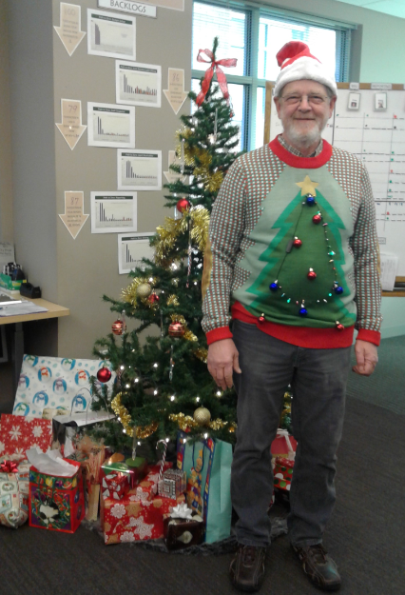
ENCOURAGE INNOVATION

Slide 6
BE A TEAM PLAYER

Slide 7
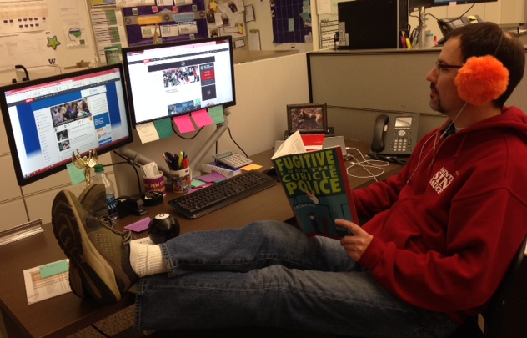
HIRE THE RIGHT PEOPLE

Slide 8
BUILD LEGACY SYSTEMS

Slide 9
DELEGATE

Slide 10
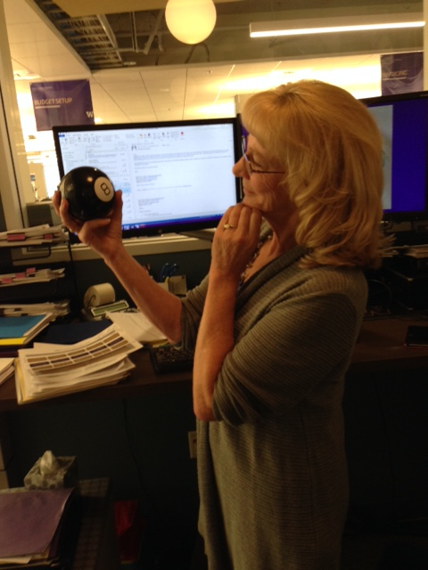
ENSURE YOU LEAVE GOOD RESOURCES BEHIND

Slide 11
IF YOU ARE IN CHARGE OF COMPLIANCE, ALWAYS BE COMPLIANT

Slide 12
UPCOMING COURSES IN
RESEARCH ADMINISTRATION
 | Oct 25 | RAA 100 | Grant and Contract Fiscal Administration: Compliance
 | Oct 25 | MAA 100 | Introduction to Grant and Contract Certification (GCCR)
 | Nov 1 | MAA 101 | Introduction to Faculty Effort Certification
 | Nov 1 | OSP 145 | Subaward Fundamentals
 | Nov 7 | GCA 203 | Preparing for an Audit
 | Nov 8 | MAA 102 | Electronic Faculty Effort Certification (eFECS) for FEC Coordinators
 | Nov 28 | OR Special Topics | Subawards in SAGE
 | Nov 29 | ORIS 102 | SAGE: Creating NIH Proposals in Grant Runner
Register: https://uwresearch.gosignmeup.com/public/course/browse
About CORE: https://www.washington.edu/research/training/about-core/

Slide 13
ON DEMAND
LEARNING RESOURCES
 | COMING SOON | RAA 203 | Basic Concepts in Internal Controls for Purchasing
 | Online Class | GCA 201 | Salary and Cost Transfers
 | Online Class | RAA 201 | Post Award Food Purchases and Compliance
 | Online Class | GCA 202 | Direct Billing of F&A Type Costs Online Class
 | Online Class | RAA 202 | Timing of Expenditures & Benefit to Award
 | SAGE/Workday Resources Includes Workday in SAGE updates |  | SAGE Online Learning
 |  |  | SAGE help documentation Learning
Register: https://uwresearch.gosignmeup.com/public/course/browse
About CORE: https://www.washington.edu/research/training/about-core/
THANK YOU TED!!!!

