Slide 1
MRAM | Monthly Research Administration Meeting
DECEMBER 14, 2017 9:00 – 10:00 AM UW TOWER AUDITORIUM
TOPIC | PRESENTER | EMAIL | MIN
Welcome | Carol Rhodes Office of Sponsored Programs | carhodes@uw.edu | 2
Federal Budget Info | Carol Rhodes Office of Sponsored Programs | carhodes@uw.edu | 2
European Union funding and time tracking | Carol Rhodes Office of Sponsored Programs | carhodes@uw.edu | 5
OSP Organizational Changes | Carol Rhodes Office of Sponsored Programs | carhodes@uw.edu | 2
Federal Sponsor Proposal Submission Changes: Are you Ready? | Amanda Snyder Office of Sponsored Programs | acs229@uw.edu | 10
SAGE: Grant Runner Updates | Judy Chung Office of Research Information Services | jachung@uw.edu | 15
Institutional Allowance | Matt Gardner Post Award Fiscal Compliance | mgard4@uw.edu | 5
Compliance Corner | Andra Sawyer Post Award Financial Compliance | andra2@uw.edu | 10
NEXT MEETING JANUARY 11, 2018 UW TOWER AUDITORIUM

Slide 2
European Union
Time Tracking
December 2017 MRAM
Carol Rhodes
Office of Sponsored Programs

Slide 3
Guidance Follow Up
EU Time tracking form

Slide 4
Questions

Slide 5
OSP Organizational Changes
December MRAM
Carol Rhodes
Office of Sponsored Programs

Slide 6
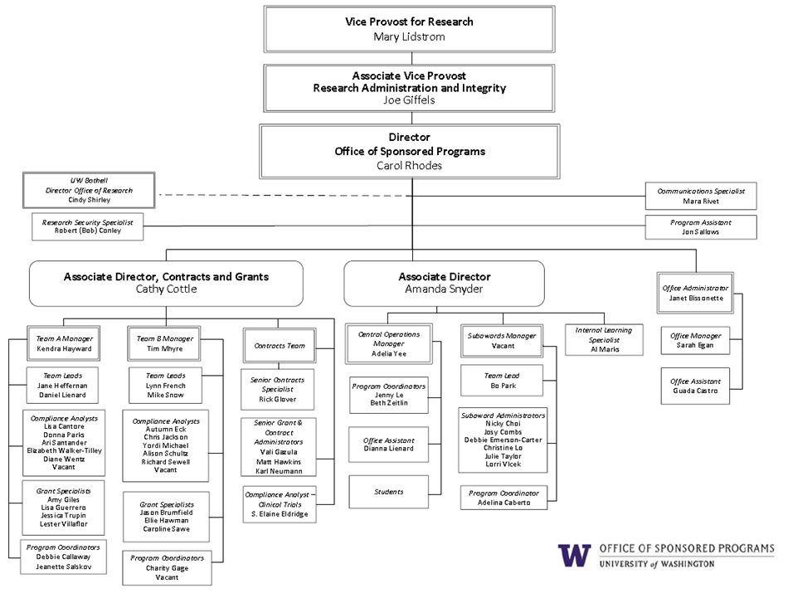
Notes:
OSP Organizational Chart

Slide 7
Questions

Slide 8
Are you ready for Federal Proposal Submission Changes?
December 2017 MRAM
Amanda Snyder
Office of Sponsored Programs

Slide 9
What’s Happening
Grants.gov:
Adobe Application Packages Are Going Away!
NIH - due dates on or after 1.25.18:
FORMS E & new Human Subjects Clinical Trial Form
Clinical Trial Specific Funding Opportunities Announcements (FOAs)
Single IRB Policy

Slide 10
Grants.gov Federal Submission Options
After January 1st
Method | Considerations
Workspace | Adobe Forms Packages replacement
Sponsor System | NIH ASSIST, NSF Fastlane, NASA NSPIRES etc...
SAGE Grant Runner | Submit Specific NIH Opportunities in the UWs System to System Solution (S2S), Grant Runner. Reduces duplicate entry & routes with eGC1
OSP will not accept Grants.gov Adobe application packages on eGC1s arriving “IN OSP” after February 28, 2018.
Review more guidance from the October MRAM
Notes:
Grants.gov has a small window they will continue to accept adobe forms packages that were downloaded before January 1st.

Slide 11
Workspace Resources
Grants.gov UW registration instructions
Workspace Online User Guide
Grants.gov Applicant Training
Grants.gov YouTube Channel
Grants.gov Helpdesk Support Center:
support@grants.gov or 1-800-518-4726

Slide 12
NIH - Select the Right Form
Use FORMS-D for applications... | Use FORMS E for applications...
Due dates on or before 1.24.18 Submitted under NIH Late Policy 2-week window of consideration for due dates on or before 01.24.18 Submitted by 02.07.18 under NIH Continuous Submission Policy for 1.7.18 AIDS due date | Due dates on or after 1.25.18 including: Those submitted early for due dates on or after 01.25.18 All application types (New, Resubmission, Renewal, Revision)
Competition ID on the form will indicate what version &
NIH Validations in ASSIST and GrantRunner will help.
Notes:
Late Policy = Extenuating Circumstances, rarely applies; Continuous Submission = PIs who are especially active Peer Reviewers

Slide 13
REMEMBER
If NIH Considers your research a clinical trial:
Review NIH Definition of a Clinical Trial
Respond to a Clinical Trial-specific FOA
FORMS E - additional required fields & new Human Subjects Clinical Trials Form
Multi-research sites must Include plan for a Single IRB
Review:
NIH Clinical Trial Stewardship MRAM presentation
Open Mike Blog: Pick the Right FOA!

Slide 14
NIH FORMS E & Clinical Trial Resources
FORMS-E
Annotated Form Sets
Do I Have the Right Form Version For My Application?
Application Forms, Form Updates, Choosing Correct Forms FAQs
NIH Clinical Trials:
NIH Policy on FOAs for Clinical Trials with target posting dates
Definition of a CT
CT Decision Tree
Case Studies
HSD Single IRB Resources
What sIRB information should be included in grant applications?
Single IRB
Complete list of resources

Slide 15
Questions

Slide 16
SAGE Updates
MRAM
December 2017
Amanda Snyder, Associate Director, OSP
Judy Chung, Program Manager, ORIS

Slide 17
SAGE: Coming Next Week!
On December 21, 2017:
Grant Runner:
FORMS-E updates
New Human Subjects and Clinical Trials form
Other SAGE:
Non-Award Agreement changes
Subaward updates

Slide 18
2017-18 Grant Runner Expansion Project
Mission:
Expand SAGE Grant Runner capabilities to support more federal opportunities, saving users time and effort through:
Fewer systems to interact with
Reduced duplicate entry
Reduced training and support requirements for non-UW Systems

Slide 19
Grant Runner FORMS-E Updates
Opportunity search:
Forms-E will be selectable after next week’s release
Notes:
Will see multiple versions for certain opportunities
Pick the correct opportunity version, based on due date

Slide 20
Human Subjects and Clinical Trials Form
New HSCT form shown in left navigation
Inclusion Enrollment no longer a separate form; embedded in HSCT
Fields from Research Plan and Career Development Supplemental transferred to new HSCT form

Slide 21
Human Subjects & CT Form Features
Features:
Download a blank fillable pdf study form
Import study data from the fillable PDF
Partial form import is OK; edit remainder in SAGE
Notes:
Teams may find it helpful to have the PI complete the study form using the PDF;
The form import is for individual studies only, not the entire HSCT form which can contain multiple studies. One study at a time gets imported.

Slide 22
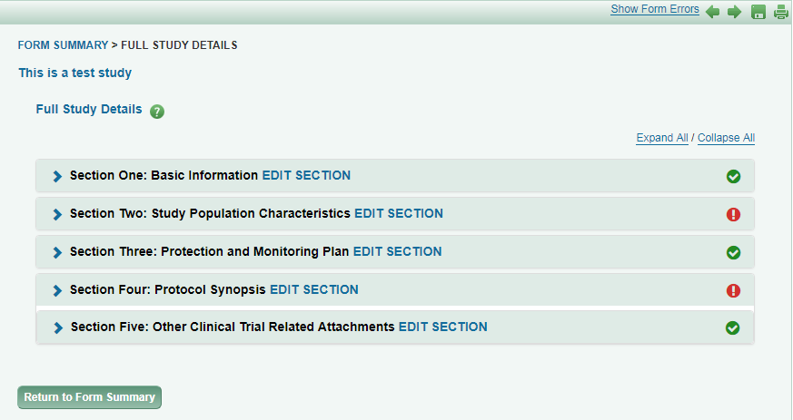
Form Features (continued):
Easy navigation and section status markers
“Expand All” for full form viewing
Notes:
Navigation includes: breadcrumbs at top, expandable sections
Sections are large, so can choose expand or not

Slide 23
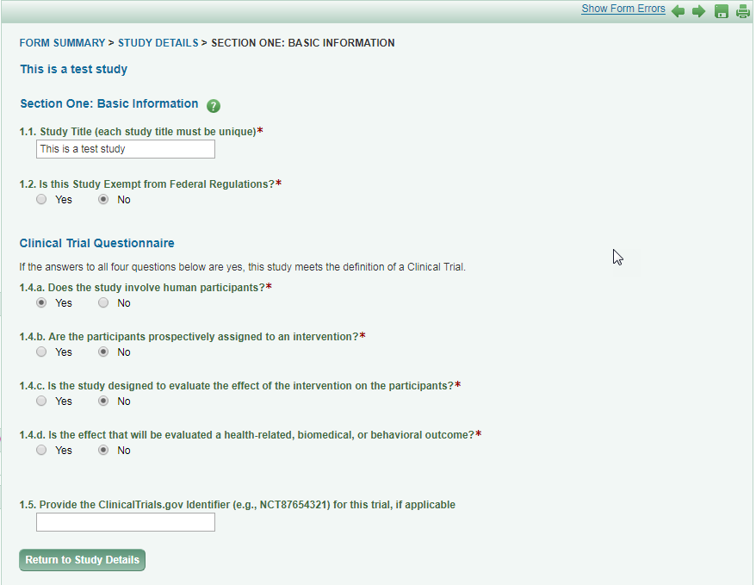
Edit Section by Section
Notes:
Easier to manage one section at a time
Will provide error checking section-by-section as well

Slide 24
Form Features (continued):
As with other Grant Runner forms, HSCT includes:
Print/preview PDF
individual form or full package, in NIH format
Error Checking
Individual form level -- Grants.gov errors only
Full package -- eGC1, Grants.gov and NIH errors

Slide 25
NIH Opportunities Currently Supported in Grant Runner
NIH Single Project, 5 year budget for:
Basic Research
Career Development
Endowment Programs
Shared Instrumentation
Director Awards
Targeted Research
Pre-Applications
Resource Awards
List by Activity Code

Slide 26
Non-Award Agreement Changes
Agreement related to research that does not include external funding but does obligate UW resources or make other legal obligations of UW, requiring institutional sign-off.
Examples include:
Data Use Agreements (DUA)
Confidentiality Agreements (CDA),
Master Agreements,
Material Transfer Agreements (MTA)
Unfunded research agreements

Slide 27
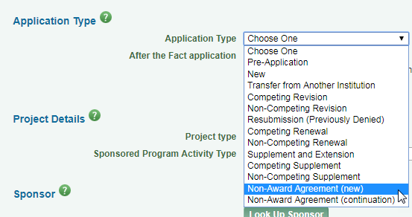
eGC1 Requirements for NAAs
eGC1s are required for an NAA.
2 new Application Types created for NAAs
Upon selection:
When is an eGC1 required? https://www.washington.edu/research/faq/need-use-egc1/
Notes:
May need explanation on when to use continuation.

Slide 28
eGC1 Requirements for NAAs (cont.)
Other changes to the eGC1 for NAAs:
“After the Fact” will always be YES
Help text that Sponsor = Other Party to the agreement
Budget locked down, fiscal questions default to “no”
Loosening of required field restrictions
Notes:
Loosening of field restrictions: sponsor deadline fields, abstracts & RFA/RFP fields

Slide 29
NAAs on eGC1: What has not changed
What is still required for NAAs:
FIDS Disclosures
Compliance question responses (non-fiscal)
Standard approval routing
Notes:
FIDS disclosures will fire when the eGC1 is in approved status AND a child admin action is created.

Slide 30
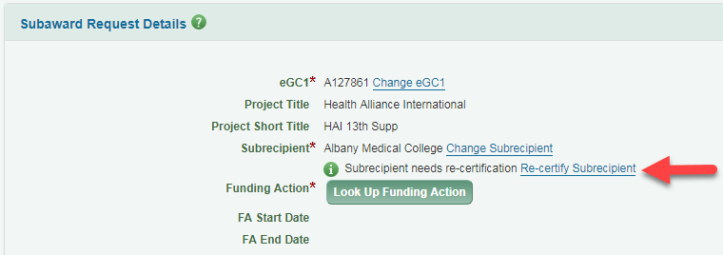
Subaward Changes
New prompt on screen when subrecipient certification is expired
It will not hold up submission
Meant to give an early heads up to take action
Send recertification form to subrecipient for completion, OR
OSP will send as part of their process

Slide 31
Locations Survey Link
Give us your feedback on the new design used in Locations page
Will help inform SAGE-wide design direction

Slide 32
Next Up in SAGE….
Winter 2018 Targets
Grant Runner:
Import from Clinical Trials.gov to pre-populate HSCT
SAGE Budget sync with RR Detailed Budget
Fellowship grants
Compliance (non-fiscal):
Question revisions
New look and feel (like locations)

Slide 33
Institutional Allowance Budgets
MRAM
December, 2017
Matt Gardner
Post Award Fiscal Compliance

Slide 34
Current IA Treatment
Currently, IA funds are transferred to a 67-budget upon receipt of the Fellowship (80-budget) using transfer coding (9481/9480).
We have noticed in some instances that 67-budget funds remain unexpended for years after the original fellowship budget closed.
MRAM – Matt Gardner – Post Award Fiscal Compliance

Slide 35
Simplification Proposal
In an effort to simplify this process, we propose establishing sub budgets moving forward.
These new sub budgets will carry the same end date as their related parent (80-budget).
MRAM – Matt Gardner – Post Award Fiscal Compliance

Slide 36
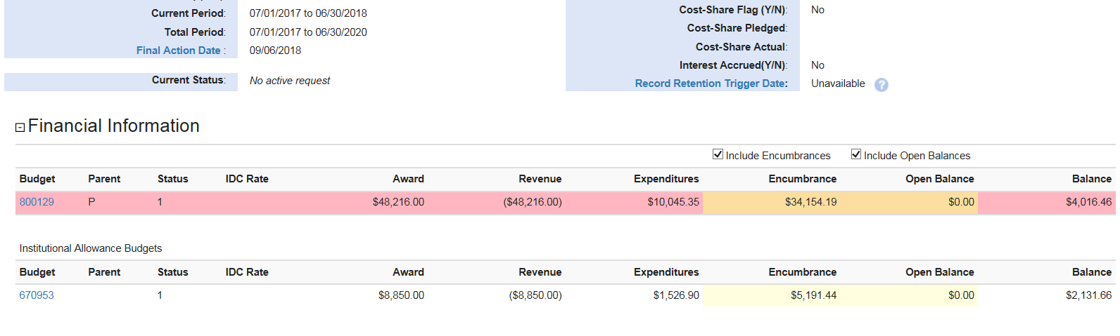
IA Visual “Before”
IA 67-budget related, but not a sub budget. Can carry a different end date then linked 80-budget.
MRAM – Matt Gardner – Post Award Fiscal Compliance

Slide 37
IA Visual “After”
IA will function as a standard sub budget, with the benefit of a view that clearly displays the award as one unit (rather than spread across two or more distinct standalone budgets).
MRAM – Matt Gardner – Post Award Fiscal Compliance

Slide 38
Questions?
gcahelp@uw.edu
206-616-9995

Slide 39
Compliance Corner
MRAM – December 2017
Andra Sawyer
Post Award Fiscal Compliance (PAFC)
gcafco@uw.edu

Slide 40
Training Grants – NIH Fellowships – Graduate Student Appointments (GSAs)
PAFC Website – Award Management:
http://finance.uw.edu/pafc/award-management

Slide 41
Training Grants-Fellowships-GSAs
Definitions
Components (Salary? Stipend? Tuition? Fringe Cash?)
Object Codes
Effort Requirements
Re-budgeting
Limitations

Slide 42
Travel on Federal Awards
Revised PAFC’s Website – Spending:
http://finance.uw.edu/pafc/travel

Slide 43
Travel on Federal Awards
It gets audited. All of the time.
Per diem follows UW policies (see UW Travel webpage)
Airfare purchases must follow federal policies (Yes = Fly America Act, No = business class)
Stay reasonably within budgeted Travel line item
Sponsor approval is not technically required but if not in the proposal:
notify sponsor
document justification/need/benefit
include benefit of travel in subsequent sponsor reports

Slide 44
UPCOMING COURSES
2018 METRICS
 | Jan 17 | MAA 100 | Introduction to Grant and Contract Certification
 | Jan 24 | OSP 101 | Introduction to Research Administration
 | Jan 30 | OSP 175 | Introduction to Export Compliance at the UW
 | Jan 31 | MAA 101 | Introduction to Faculty Effort Certification
2017 CORE Program Metrics:
57 Classes with 560 Attendees!
200 Online CORE/PAFC Participants!
Register: https://uwresearch.gosignmeup.com/public/course/browse
CORE home: https://www.washington.edu/research/training/about-core/
THANK YOU to all our participants! See you in 2018!

